Slide 1
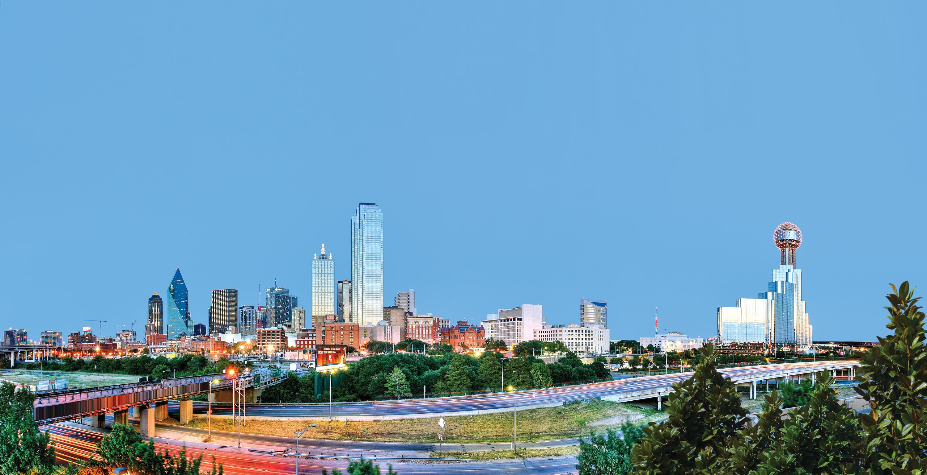
WELCOME
Diocese of Dallas Mid-Year Meeting
August 6th, 2022
St. Michael The Archangel Catholic Community
KofCDallas.org

Slide 2
Diocese of Dallas Mid-Year Meeting August 6, 2022
AGENDA
9:00 –Call To Order –Mike Courtney Opening Prayer –Fr. Joseph Mehan, DDC Chaplain Pledge of Allegiance –SK Ken Franch
9:05 Welcome –Mike Courtney Diocesan Deputy Diocese of Dallas
9:15 American Wheelchair Mission –Bill Weber –Program Chairman TX
9:25 Bob Stras Annual Basketball Tournament –Jake Fleischer
9:35 Tom Clark –Pro-Life
9:45 State Presentation –Bill Tillotson –Star Council Director
Break –TBD
11:25 KofC Insurance -John Regan
11:40 Emergency Response Harry Storey
11:50 Fourth Degree –DM SK Ken Franch
12:00 RSVP –John Little
12:10 Committee 1000 –Mike Green
12:20 Membership –Pat Conway
12:30 Spanish Initiative –ED Diaz, Nick Flores, Eddie Castillo
12:45 DDC Jake Fleischer
1:00 Wrap Up –Mike Courtney

Slide 3
Opening Prayer
Fr. Joseph Mehan, DDC Chaplain

Slide 4
Pledge of Allegiance
SK Ken Franch, District Master

Slide 5
WELCOME
SK Mike Courtney, Diocesan Deputy
Diocese of Dallas

Slide 6
American Wheelchair Mission
Bill Weber, Texas Wheelchair Chairman
The Knights of Columbus work in partnership with the American Wheelchair Mission to provide wheelchairs to an estimated over 100 million people worldwide that need one, but cannot afford it. The Texas Ladies' Project will focus on the American Wheelchair Mission.
VIDEO: Knights of Columbus Answering Prayers

Slide 7
American Wheelchair Mission Program Highlights
Wheelchairs allow children to go to school for the first time, adults to go to work, and the elderly to get out of bed.
A life changing gift of mobility that answers prayers and delivers hope, dignity, freedom and independence.
It is estimated that each wheelchair delivered changes and improves an average of 10 lives.
Retailing at $500, each wheelchair is delivered at an average cost of $150.
100% of a donation goes towards the purchase and delivery of a wheelchair, as a Knights of Columbus grant covers overhead costs.
A $150 donation allows you to request a personalized Certificate of Thanks, which includes a picture of a wheelchair recipient.
A $500 donation allows you to request a framed 34” x 23” Our Lady of Guadalupe lithograph, blessed at her Basilica in Mexico City.
A Council donation of $1,500 for 10 wheelchairs counts 2 points towards earning the Columbian Award.
Wheelchair Sundays are an effective way to raise funds for this program and are also a good way to recruit new members.
Helping at a Wheelchair Sunday counts as an event towards earning your Pro Life ACE Wings.

Slide 8
American Wheelchair Mission - Thank You!
Thank you and God bless you to the 21 Councils that have donated a total of $24,654 for 164 wheelchairs this fraternal year.
The goal for this fraternal year is to increase the donations from each Diocese by holding more Wheelchair Sundays and by every Texas Council participating in the Wheelchair Program by donating at least $150 for one wheelchair.
If you have any questions about the Wheelchair Program, need help with a Wheelchair Sunday, or need wheelchairs, please contact Texas Wheelchair Chairman Bill Weber in Plano at yankeesweb@tx.rr.com/214-405-8023 or Assistant Wheelchair Chairman Brian Nelson in San Antonio at abn091951@gmail.com/210-275-7921.

Slide 9
Bob Stras Annual Basketball Tournament
Jake Fleischer, President
Dallas Diocese Chapter

Slide 10
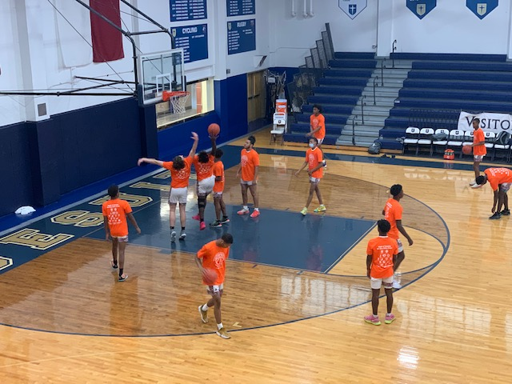
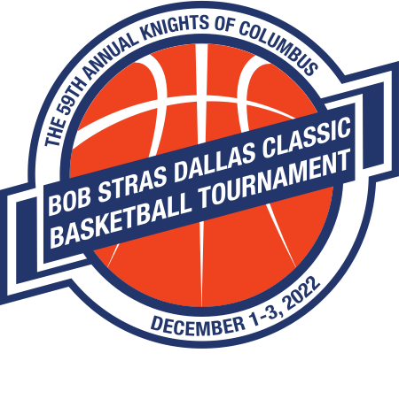
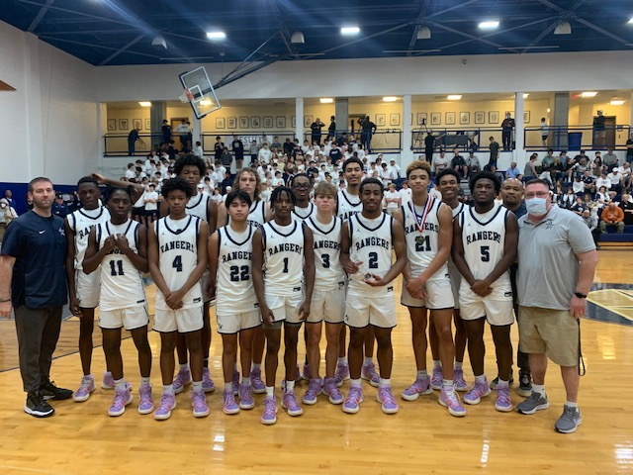
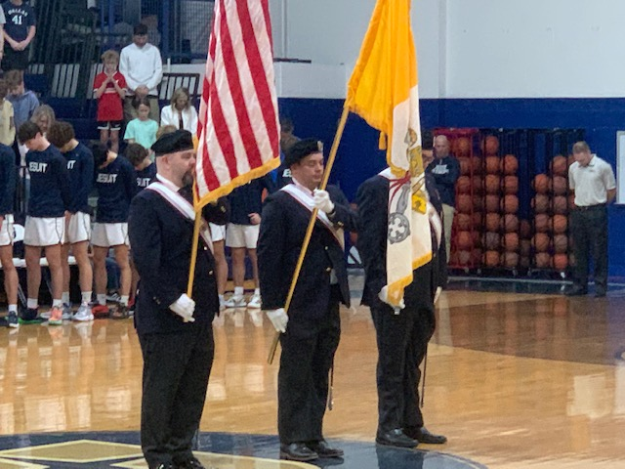
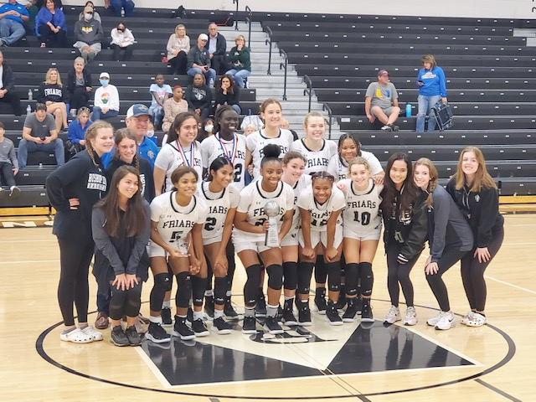
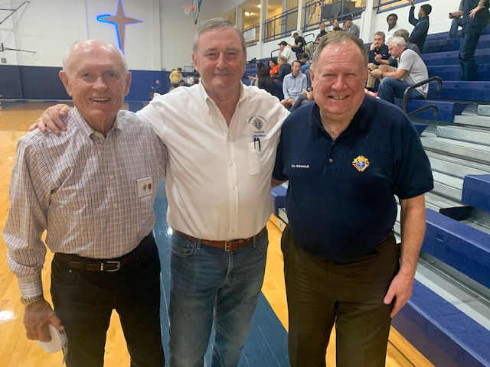
The 59th Annual Knights of Columbus Bob Stras Dallas Classic High School Basketball Tournament

Slide 11
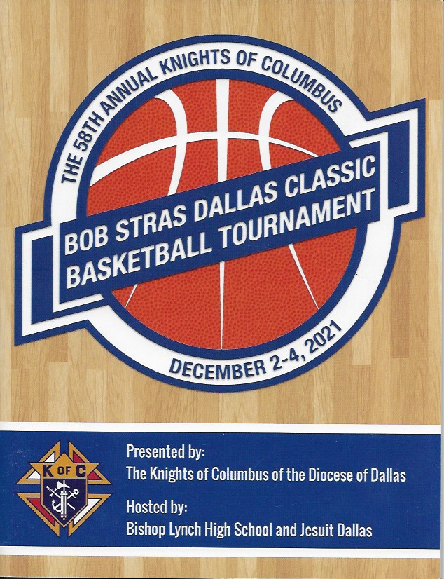
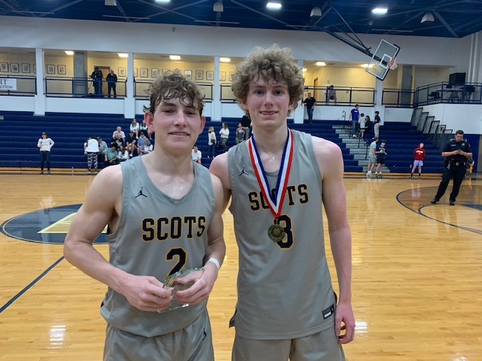
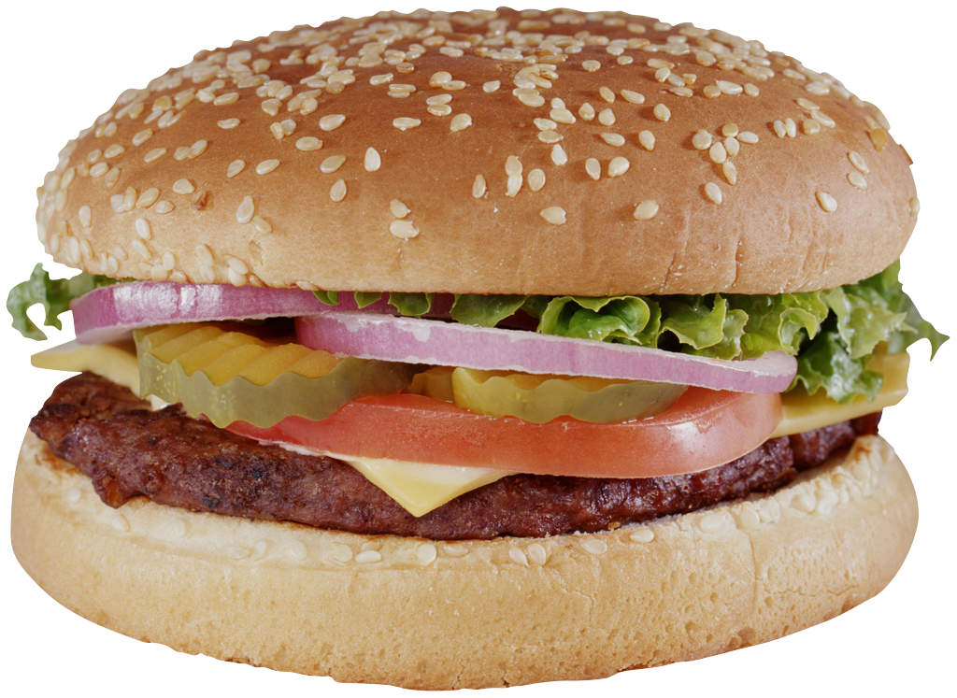
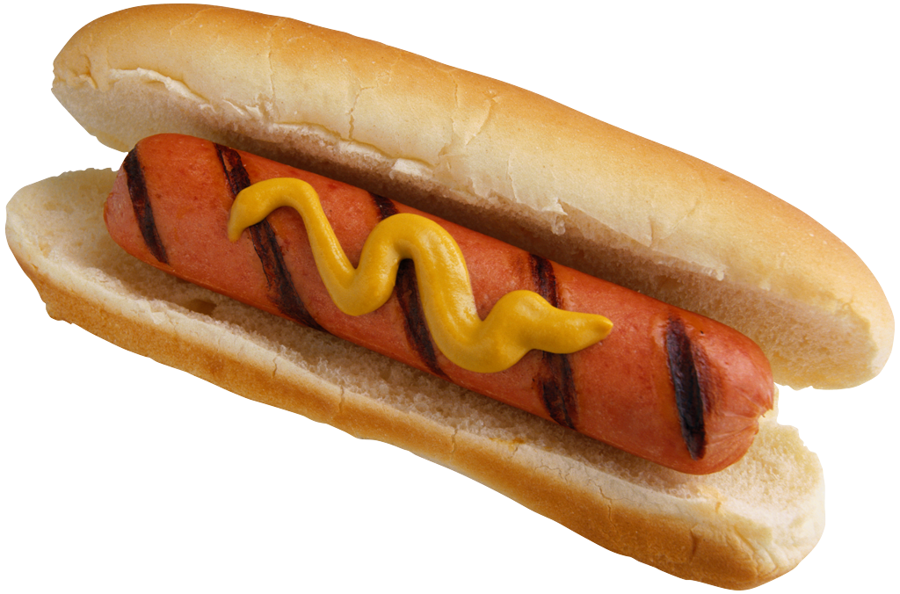
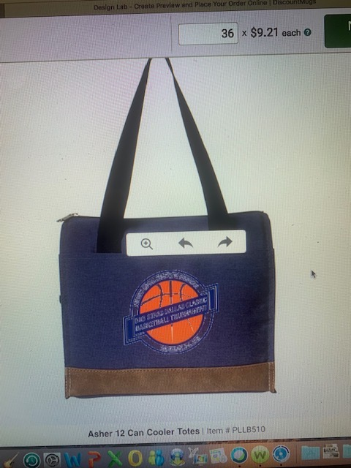
What Do the Knights of The Dallas Diocese Do For The 16 High School Teams Who Compete at Jesuit & BL ?
We print and distribute a high quality 48 page program with rosters and more!
We provide all team and individual trophies and awards.
We provide 320 high quality Commemorative Knights of Columbus Tee Shirts (20 per Team) for all players and managers.
Funds for Referees, Security and other operating expenses.
Food for the players and coaches after to games
Commemorative coaches gift for all head coaches.
And much more ...
Personalized Luggage Tags
Color Corps
Posters and Banners
Volunteer Knights

Slide 12
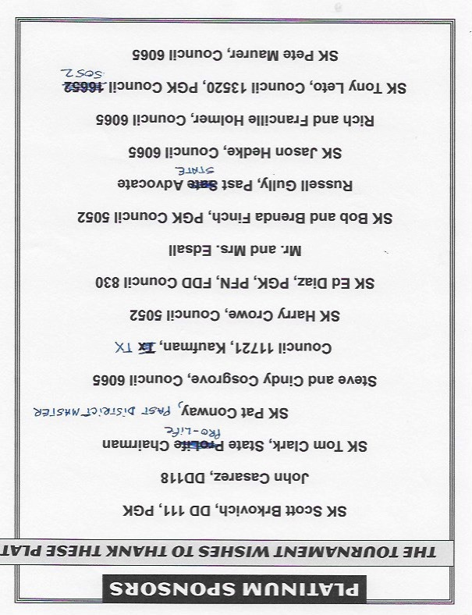
How Does the Dallas Diocese Chapter Do All This?
100% of the Cost of the Tournament is Provided Through the Generosity of Councils, Assemblies, Individual Knights, Affiliated Organizations and a Few Corporate Sponsors
Council and Assembly Ads
Affiliated Business Ads
Individual Knights Sponsorships
Corporate and
Foundation Ads

Slide 13
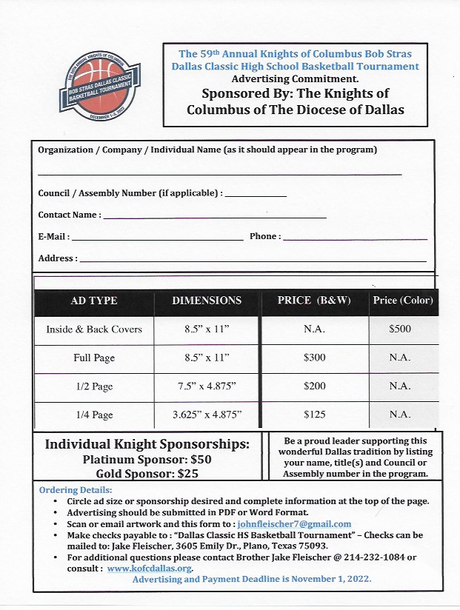
What Do I Need To Do???
Please Make a Commitment for Your Council and Yourself!

Slide 14
LIFE
Tom Clark

Slide 15
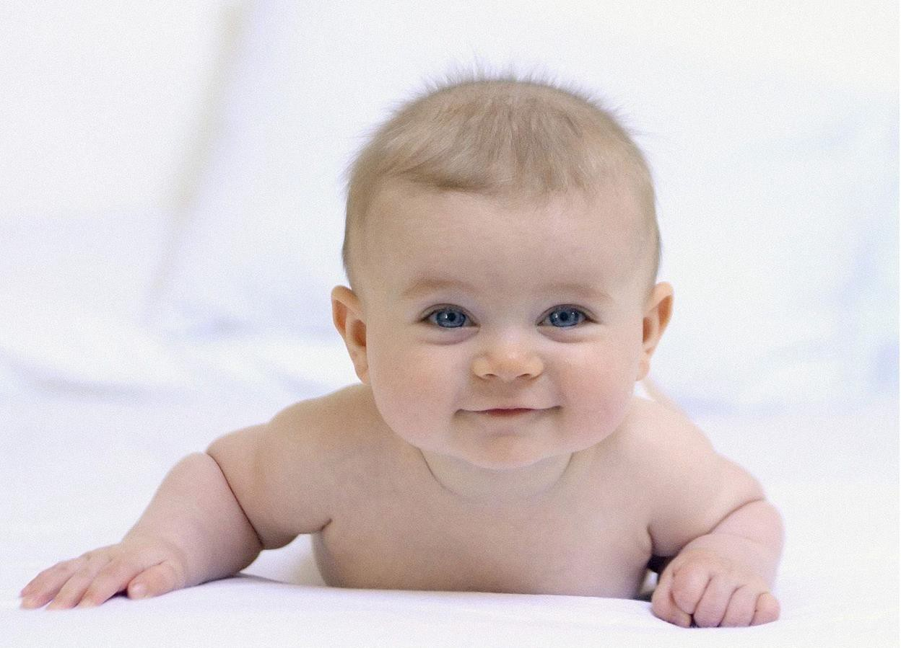
KNIGHTS OF COLUMBUS Texas State Council
Pro-Life – What happens after the fall of Roe?
2022 Texas State Convention

Slide 16
KNIGHTS OF COLUMBUS Texas State Council
Pro-Life
Together we can prevent this…
2022 Texas State Convention

Slide 17
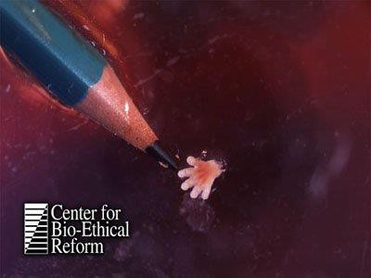
KNIGHTS OF COLUMBUS Texas State Council
Pro-Life
Together we can prevent this…
2022 Texas State Convention

Slide 18
Pro-Life
KNIGHTS OF COLUMBUS Texas State Council
Together we can help God’s creation know
all the joys of LIFE!!!
2022 Texas State Convention

Slide 19
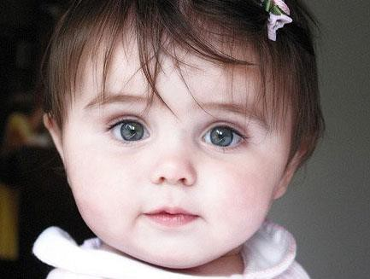
KNIGHTS OF COLUMBUS Texas State Council
Pro-Life - The Choice is up to you!
2022 Texas State Convention

Slide 20
Pro-Life
KNIGHTS OF COLUMBUS Texas State Council
ACE Wings
How to get them and why you should
The Ultrasound Initiative
What to do now that Roe is gone
Some Pro-Life ideas you can incorporate into your council/parish
2022 Texas State Convention

Slide 21
Pro-Life The ACE Wings
KNIGHTS OF COLUMBUS Texas State Council
Pro Life without Apology, without Compromise, without Exception
Form to apply is online - https://www.tkofc.org/starguide/programming/pro-life-ace- wings
Need 5 Public Pro Life events to qualify – Private prayer, Private Mass intentions do not count
Only some events can be repeated – please consult the new form to identify which can/cannot.
2022 Texas State Convention

Slide 22
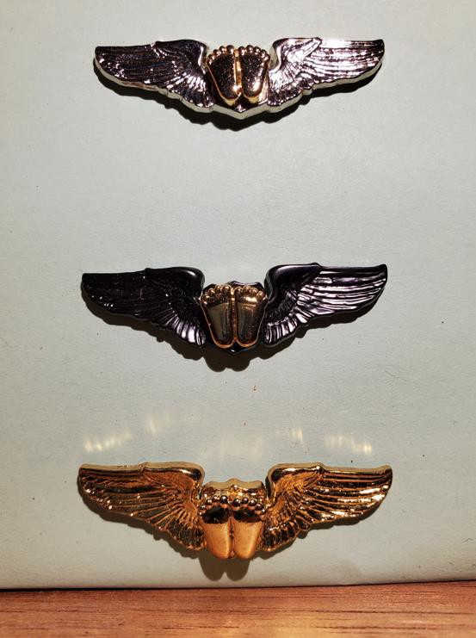
Texas State Council
KNIGHTS OF COLUMBUS
2022 Texas State Convention

Slide 23
Pro-Life The ACE Wings
KNIGHTS OF COLUMBUS Texas State Council
Silver ACE Wings – The Knight begins the journey to earn them. Need 5 events to earn the right to wear them.
Special Forces ACE Wings – The Council recognizes the knight who has earned the Silver and continues to be a force for good in Pro Life
Gold ACE Wings – The Diocesan Deputy can award up to 2 Knights (and their Ladies), per fraternal year, the Gold ACE Wings for exemplary Pro Life work. Let your DD know if someone is doing great Pro Life work.
2022 Texas State Convention

Slide 24
Pro-Life The ACE Wings
KNIGHTS OF COLUMBUS Texas State Council
It takes a real man, a brave Knight, to earn and wear the ACE Wings!
Please treat them with the same respect you would any blessed object – ACE wings are sent to you blessed. A guide for wearing the ACE Wings will be distributed to the state in the near future. Please distribute it to the Diocese.
2022 Texas State Convention

Slide 25
Texas State Council
KNIGHTS OF COLUMBUS
2022 Texas State Convention

Slide 26
KNIGHTS OF COLUMBUS Texas State Council
Pro-Life The ACE Wings
Questions?
2022 Texas State Convention

Slide 27
Pro-Life
The Ultrasound Initiative
KNIGHTS OF COLUMBUS Texas State Council
Texas has placed its 100th machine – Congratulations Texas!!!
Biggest question/problem we often have are:
Council not notifying the State Ultrasound Chairman that they would like to assist
Or a Council simply does not know how to get started
on a initiative.
2022 Texas State Convention

Slide 28
Pro-Life
The Ultrasound Initiative
KNIGHTS OF COLUMBUS Texas State Council
How to get started
Find a Pregnancy Resource Center in your area that is in need of a machine. Can be a PRC that has received a machine previously, but should have been at least 4
to 5 years prior.
Notify the State Ultrasound Chairman and he will walk
you through the process.
2022 Texas State Convention

Slide 29
Pro-Life
The Ultrasound Initiative
KNIGHTS OF COLUMBUS Texas State Council
***The Process***
1. Once a PRC is identified - Get a Diocesan Evaluation form filled out and signed by the Director of the Diocesan Right to Life Office. Each Diocese should have someone in this capacity. This person reports to the local Bishop.
The form needed is form 10715 – Can be downloaded from Supremes' website or the State Ultrasound Chairman can send one to you.
2022 Texas State Convention

Slide 30
Pro-Life
The Ultrasound Initiative
KNIGHTS OF COLUMBUS Texas State Council
***The Process***
Once signed the 10715 will be sent to Supreme for its
consideration. No fundraising can take place until after Supreme approves the 10715.
Fundraising begins. The PRC should have already picked out the model they are wanting to use. Supreme has preferred pricing with Phillips, Mindray, Samsung,
Siemens, Sonoscape and Esote – Please have the PRC
consider these manufacturers for the best pricing.
2022 Texas State Convention

Slide 31
Pro-Life
The Ultrasound Initiative
KNIGHTS OF COLUMBUS Texas State Council
***The Process***
The Council(s) will need to raise half of the cost of the
machine. Once the council(s) have completed this a 10716 form will need to be filled out and sent to the State Ultrasound Chairman. He will check it and he will then send it to the State Deputy for his signature.
Once the State Deputy has signed off on the 10716 the State Ultrasound Chairman will send it, along with the
quote and other documents to Supreme.
2022 Texas State Convention

Slide 32
Pro-Life
The Ultrasound Initiative
KNIGHTS OF COLUMBUS Texas State Council
***The Process***
Supreme will place the 10716 into the next Director’s agenda for consideration. This is usually around every 4 to 6 weeks, so depending upon the timing of submission
there could be a significant delay in getting approval.
Once Supreme approves the machine a letter is sent to
notifying the State Deputy, State Life Chairman, State Ultrasound Chairman, and the Council POC on the 10716.
2022 Texas State Convention

Slide 33
Pro-Life
The Ultrasound Initiative
KNIGHTS OF COLUMBUS Texas State Council
***The Process***
8. Funds raised by the local council should then be released to the PRC, and Supremes' check will also be going to the PRC – it is up to the PRC to make the actual
purchase.
Please note – Supreme only pays for the machine and the items that come with it. Additional probes or options will not be paid for, nor will Supreme pay for training.
2022 Texas State Convention

Slide 34
KNIGHTS OF COLUMBUS Texas State Council
Pro-Life
The Ultrasound Initiative
Questions?
2022 Texas State Convention

Slide 35
Pro-Life
What to do after Roe Falls
KNIGHTS OF COLUMBUS Texas State Council
***Issue***
Once Roe falls the State of Texas is set up to where no
abortions can be performed within our borders.
This is not the end of our work – it is the beginning.
We will still need to support our PRC, Maternity Homes
and Pro-Life Ministries – more than ever.
Our greatest mission now begins – to heal a nation!
2022 Texas State Convention

Slide 36
Pro-Life
What to do after Roe Falls
KNIGHTS OF COLUMBUS Texas State Council
***What to do***
Set up a Life Resource Center at each Parish that has a
KofC presence
A Life Resource Center (LRC) is not for ultrasound and pregnancy tests, these are places for underserved moms to get diapers for their children, clothing, maternity clothes, and other necessities needed to raise a child.
2022 Texas State Convention

Slide 37
Pro-Life
What to do after Roe Falls
KNIGHTS OF COLUMBUS Texas State Council
***What to do***
These go hand in hand with St. Vincent DePaul Societies and Food Pantries. If you have one in your Parish then this is a natural extension.
By inviting moms into our parishes for help they are likely to come face to face with Christ Himself through us and the other volunteers that assist. They might even join the parish – this is a true outreach that could affect generations.
2022 Texas State Convention

Slide 38
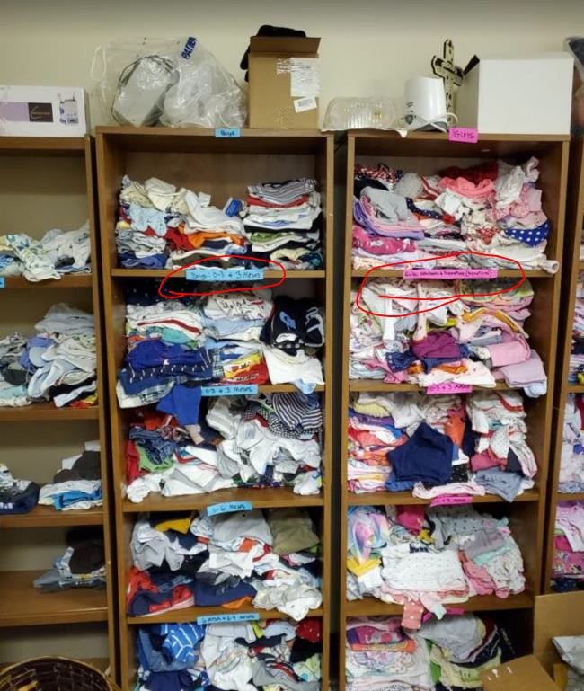
Texas State Council
KNIGHTS OF COLUMBUS
2022 Texas State Convention

Slide 39
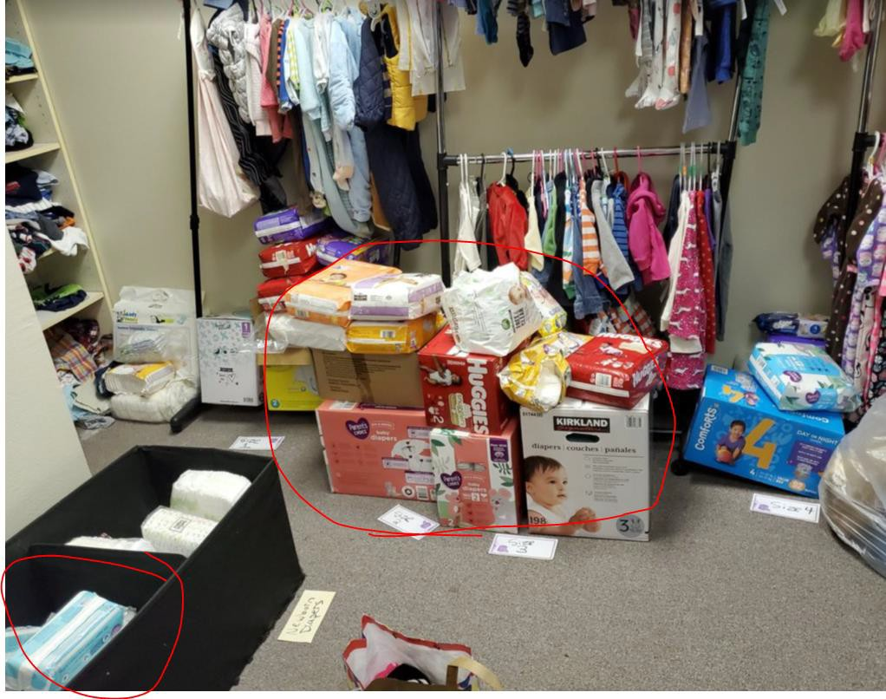
Texas State Council
KNIGHTS OF COLUMBUS
2022 Texas State Convention

Slide 40
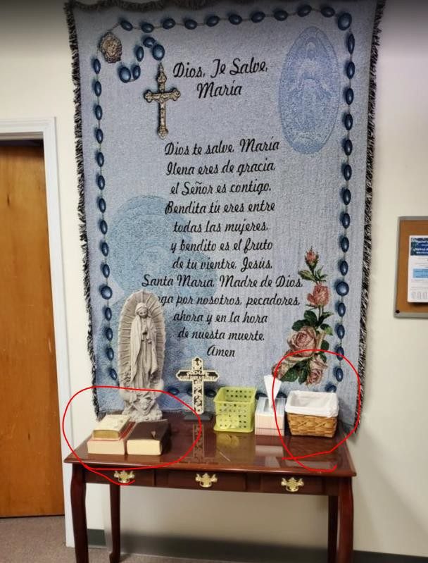
Texas State Council
KNIGHTS OF COLUMBUS
2022 Texas State Convention

Slide 41
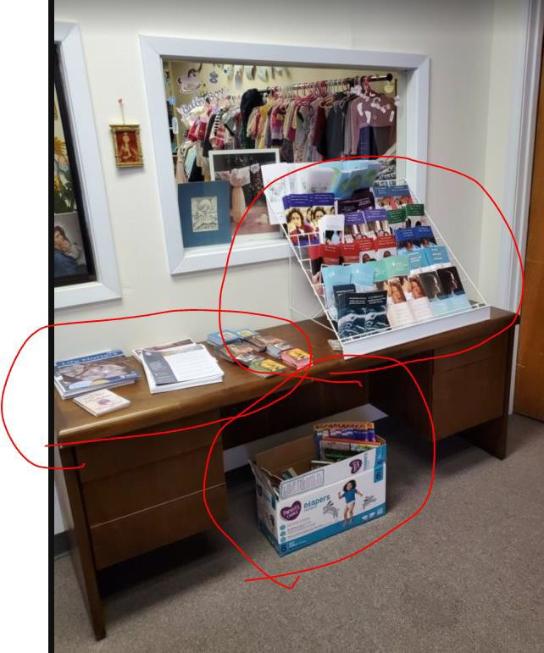
Texas State Council
KNIGHTS OF COLUMBUS
2022 Texas State Convention

Slide 42
Pro-Life
What to do after Roe Falls
KNIGHTS OF COLUMBUS Texas State Council
A document is available to help you consider making an LRC a reality in your Parish. Send me an email today and I will send you a copy.
This is a corporal act of mercy.
Our Lord will guide you… if it is meant to be He will break down any walls that are in front of you – all you have to do is say yes!
2022 Texas State Convention

Slide 43
Pro-Life
What to do after Roe Falls
KNIGHTS OF COLUMBUS Texas State Council
What is at stake?
Other states will continue to provide abortions – women from Texas will likely travel to those others states.
There are people that will work to turn Texas to a Pro- Choice state like California – we must increase our message to those who do not attend church and to those that are not Pro-Life.
We cannot stop, we cannot become complacent!
2022 Texas State Convention

Slide 44
KNIGHTS OF COLUMBUS Texas State Council
Pro-Life
What to do after Roe Falls
Questions?
2022 Texas State Convention

Slide 45
Pro-Life Faith in Action
KNIGHTS OF COLUMBUS Texas State Council
March for Life – Washington DC
Special Olympics
Christian Refugee Relief
Silver Rose
Mass for People with Special Needs
Pregnancy Center Support
Novena for Life
Ultrasound Initiative
2022 Texas State Convention

Slide 46
Pro-Life ASAP
KNIGHTS OF COLUMBUS Texas State Council
Aid and Support After Pregnancy (ASAP), a new initiative from Supreme. Knights of Columbus Councils work to support pregnant women, mothers, and their babies by serving pregnancy resource centers and maternity homes.
Through ASAP, for every $500 a council or assembly donates to a qualifying non-profit pregnancy resource center or maternity home, the Supreme Council will issue a
$100 grant to the same qualifying organization. This is up to $2000.
2022 Texas State Convention

Slide 47
Pro-Life Local Events
KNIGHTS OF COLUMBUS Texas State Council
Pro-Life Mass with the Bishop (Both of them) – Monday August 22, 2022 – Cathedral Guadalupe – 7:00PM
Texans for Life Coalition Annual Dinner – Saturday September 17, 2022 – Westin DFW Hotel – Dinner starts at 7PM – www.texlife.org
2022 Texas State Convention

Slide 48
Pro-Life Local Events
KNIGHTS OF COLUMBUS Texas State Council
Hike for Life 2022 – Several Dates and
Locations
McKinney – Saturday October 1st
Garland – Saturday October 8th
Dallas Flag Pole Hill – Saturday October 15th
Dallas Bachman Lake – Saturday October 22nd
2022 Texas State Convention

Slide 49
Pro-Life Local Events
KNIGHTS OF COLUMBUS Texas State Council
Here are the checks we presented last year – YOU
made this happen!!
White Rose Pregnancy Center - $30,000
Birth Choice Pregnancy Center - $30,000
Mater Filius Maternity Home - $10,000
Bella House Maternity Home - $10,000
In My Shoes Maternity Home - $10,000
Guadalupe Maternity Shelter - $10,000
Catholic Pro-Life Community - $10,000
Option Line (24 hour Pregnancy Hotline) - $1,000
Guadalupe Radio Network - $1,000
2022 Texas State Convention

Slide 50
Pro-Life Local Events
KNIGHTS OF COLUMBUS Texas State Council
40 Days for Life
Prayerfully consider adopting a day at your Parish and have a 1 to 24 hour Adoration for Life.
The Fall “40 Days for Life” is Sept 28 to Nov 6
Next page – Monument to the unborn – the pictures are
from St. Michael’s in Garland – cost was around $500
2022 Texas State Convention

Slide 51
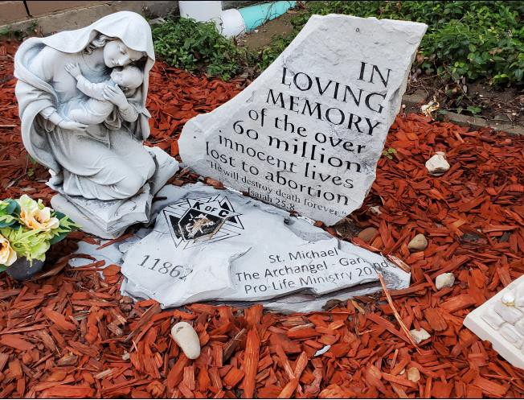
KNIGHTS OF COLUMBUS Texas State Council
Pro-Life
2022 Texas State Convention

Slide 52
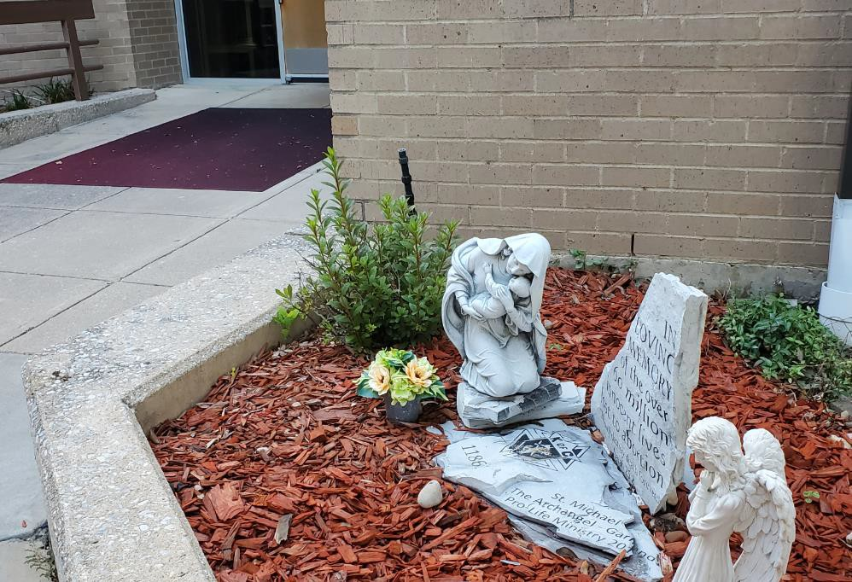
Texas State Council
KNIGHTS OF COLUMBUS
2022 Texas State Convention

Slide 54
Membership

Slide 55
Membership
TEXAS HAS GONE BACK-TO-BACK
INTO THE CIRCLE OF HONOR
with BACK-TO-BACK
PINNACLE AWARD
WAY TO GO TEXAS!!!!
Notes:
Briefly celebrate!
Now down to business!

Slide 56
Membership
“Christ Be Our Light”
‘Then God said, “Let there be light”; and there was light. ⁴ And God saw that the light was good; and God separated the light from the darkness. ⁵ God called the light Day, and the darkness he called Night. And there was evening and there was morning, the first day.’ (Gen 1.3-5)
As Knights of Columbus, we are called to step into the breach and lead others to the light of Christ.

Slide 57
Membership
2022-2023 Membership Intake Goals
- Diocesan of Dallas Goal = 546
-- Monthly and Quarterly Goals
Notes:
Each Diocese has been assigned a monthly Membership intake goal. – Provided by WSD and Membership Director
- we will continue with the weekly update communications
Each District has an assigned Membership intake goal. Can be found in Officer’s Online
Each Council is assigned a Membership intake goal. Can be found in Officer’s Online

Slide 58
Membership
How do we get there?
- Active Council Programs
- Online Membership – actively incorporated
- Social Media – champion who you are
- Church Bulletins
Notes:
Put your Faith into Action
Tell your story – use every resource available – Facebook, Instagram, Twitter, Church Bulletin
Engage with Parish Ministries – RE, OCIA (formally RCIA), CYO, etc.
Social Media resources within Officer’s Online

Slide 59
Membership
Recruitment
- Membership (Church) Drives
- Online Membership
Notes:
We need every Council conducting Membership Drives.
Goal for this fraternal year is to have every council conduct at least one Membership Drive during the fraternal year.
Ensure the council leaders have been trained in how to plan and execute an effective Membership drive.
Ensure the event is conducted when it will attract a significant number of prospective members.
Have key Knights of Columbus leaders (field agent, district deputy, etc.) engaged in the planning and execution of the Membership drive.

Slide 60
Membership
Membership Retention
- Retention starts at the moment of invitation
- Stay engaged with Membership
- Ask for assistance

Slide 61
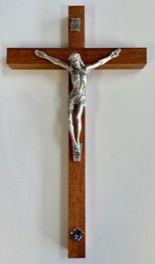
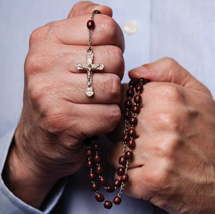
Membership
Ceremonials
- Exemplification of Charity, Unity and Fraternity
- Plan and schedule them
- Form 450 no longer required
Notes:
Plan and schedule – one a month – without fail
Report scheduled ECUFs to District Deputy, Field agent, Diocesan Deputy, and Ceremonials Chairman, in a timely manner.
This will ensure the ceremonial can be shared as widely as possible.

Slide 62
Membership
Online Membership - FREE
- New Promo Code BlessedMcGivney
- Make it a seamless and timely process
- Plan ahead
- Conversion into Council
Notes:
BlessedMcGivney will remain an active Promo Code until further notice for free online Membership.

Slide 63
Membership
Power of ONE!
- One Member, per Council, per Month
- One Star Council, per District
- One Exemplification of CUF, per Council, per Month
Notes:
We need fraternal leaders at all levels to embrace the Power of ONE!

Slide 64
Membership
Notes:
We have provided key pieces to the puzzle of Membership … What are your questions?

Slide 65
State Charities

Slide 66
State Charities
Reed A Fontenot, III
State Charities Director

Slide 67
Charity fundraising goals:
2022-2023 TSC Charity Goal = $820,000 (impacted by affiliate program)
Increase Charitable Volunteer Hours Documentation
(reported on Form 1728 due January 31, 2023)
TSC Charity PIN displayed by every Texas fraternal leader
- just $20 for individual contributions!

Slide 68
Charity fundraising goals:
100% Council Participation
Increase number of councils earning Quick Start – pay 100% by 12/31/22
The rest of our councils should earn Honor Roll – pay 100% by 6/30/23

Slide 69
State Charities
Each active member of a council is assessed $10 for State Charities on July 1
Statements to go to councils end of July
70% of these funds come back to your Bishop for his charity of choice
Once you reach 100% of your charity goal, 100% of any additional funds collected goes to the Bishop
Please urge your councils to BUDGET for State Charities now!

Slide 70
Bishop Charity of choice
Bishop Edward J. Burns | Dallas | Persons with Disabilities and Deaf Ministries
Bishop Mark J. Seitz | El Paso | Vocations
Bishop Michael F. Olson | Fort Worth | Deaf Ministry and Seminarian Support
Daniel Cardinal DiNardo | Galveston/Houston | Archdiocesan Catholic Schools
Bishop James A. Tamayo | Laredo | Evangelization/Outreach Charity & Seminarian Support

Slide 71
State Charities American Wheelchair Mission
The 1st Lady’s Project!
Goal is to exceed $800,000 in contributions this year
Increase council and individual member contributions
Each wheelchair costs $150 – all councils should budget for at least one chair
Increase Wheelchair Sunday Drives

Slide 72
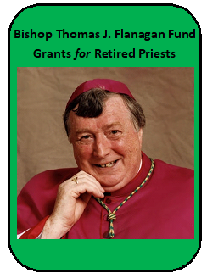
State Charities Bishop Thomas J. Flanagan Fund Goals
Fund established to provide Grants to our Retired Priests
Increase participation with TX DMV License Plate opportunity
- just $30 more per year for a “K of C” license plate!
Double the number of Texas K of C license plates issued
- currently ~1,000. We should easily get to over 2,000 this year!
This will increase Retired Priest fund distributions to each of the Diocese

Slide 73
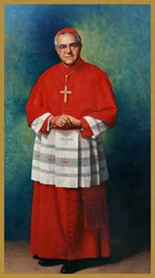
State Charities Cardinal Medeiros Fellows
Who should you consider as a potential recipient of a $1,000 fellowship?
In the last 2 years ALL Bishops in Texas were awarded!
Districts - Retiring District Deputy, Retiring Diocesan Deputy
Councils - Council Chaplains, Retiring Parish Priests
Assemblies - Former Masters, Faithful Friars

Slide 74
State Charities Catholic Educational Grants
Interest from the Cardinal Medeiros Program funds all these grants! This trust began in 1993.
Increase program awareness to increase number of submissions received – due March 1, 2023

Slide 75
State Charities Special Olympics
Continue strong partnership with Special Olympics Texas.
Increase council and individual Membership participation in events
Increase submission of Partnership Profile Report (Form 10784) – by paying State Charities you should report 2.5% of your contribution. Funds come back to Texas! An average of $9,000 but we could use more!

Slide 76
State Charities Emergency Response
Regional Emergency Response Coordinators:
Larry Pellerito – Central - Austin, Galveston/Houston, Victoria
(281) 224-3728 or kcpellerito@gmail.com
Ronnie Kwiat – Northeast – Beaumont, Dallas, Fort Worth, Tyler
(619) 368-5996 or rpkwiat48@gmail.com
Joe Alvarez – South – San Antonio, Laredo, Corpus Christi, Brownsville
(361) 229-1021 or joew.alvarez@me.com
Michael Samp – West – Amarillo, Lubbock, El Paso, San Angelo
(432) 352-4259 or thelungpro@gmail.com

Slide 77
State Charities Emergency Response
What Every Council Should Do To Prepare
Know who is your Diocesan ERC and save his contact information. He is the first person to call when disaster strikes.
Select a Council Emergency Response Coordinator & arrange training with the Diocesan ERC.
Read information at www.KofC.org/Prepare
Budget $500 for disaster relief & make your State Charities contribution.

Slide 78
4th Degree

Slide 79
Programs

Slide 80
Texas State Programs
State Programs Team
Director – Carlos X. Martinez
Chairmen
Ken Oradiegwu – Faith in Action
Tom Clark – Pro-Life
Tom Krueger – Vocations, Pilgrim Icon, Silver Rose
Andrew Clark – Pregnancy Resource
David Colton – Veterans Affairs
Jesse Aguilar - State Free Throw
Richard “Ricky” Meyer – State Golf Tournament
G.F.”Skipper” Arsenault – State Bowling Tournament
Steve Simons – State Softball Tournament

Slide 81
The Circle of Success
Membership
Council Growth
PROGRAMS
Star Councils
Education, Training, Communications
Charities

Slide 82
Texas State Programs
Faith In Action Includes the Following –
Faith
Family
Community
Life
Columbian Award requires
Faith – 4 activities
Family – 4 Activities
Community – 4 activities
Life – 4 activities

Slide 83
Texas State Programs - Faith
1) RSVP – Seminarians and Religious Support 2) Into the Breach – Videos used to deepen members’ spirituality and formation to combat the crisis of religious faith in our world.
3) Spiritual Reflection – Pray Fraternally.
4) Adoration – Holy Hours and Eucharistic Processions.
5) National Eucharistic Revival – This is a journey to knowing and establishing a relationship with Jesus Christ.

Slide 84
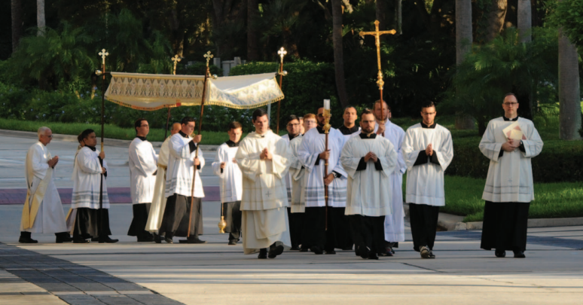
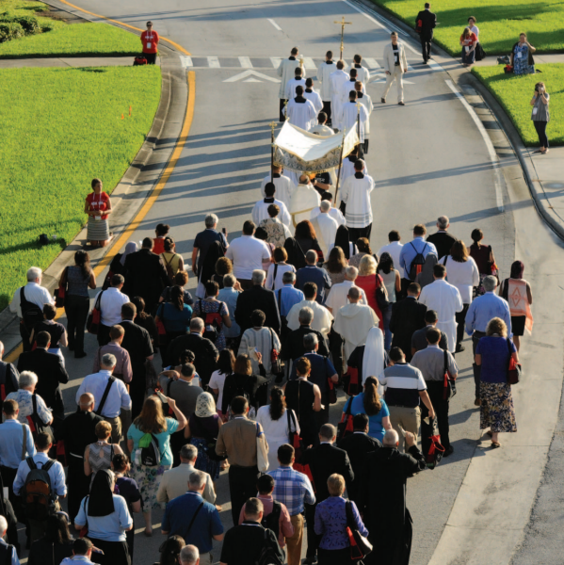
Texas State Programs
70% do not believe in the Body, Soul, and Divinity presence in the Holy Eucharist
The Knights will lead the Eucharistic Revival movement

Slide 85
Family
1) Food for Families – Food Drives for families. 2) Family of the month/year – Councils Recognizing deserving Family of the Month and Family of the Year. 3) Family Fully Alive – The “Family Fully Alive” booklet can be used as a devotional guide to help families place God and the Catholic faith at the center of their lives.
4) Family Prayer Night – Council members, their families and the parish community coming together for prayer and fellowship.

Slide 86
Community
1) Coats for Kids – Purchase coats for children in need during the cold winter months. 2) Global Wheelchair Mission – The gift of mobility, helping change the lives of people with disabilities worldwide. 3) Habitat for Humanity – Councils can donate a minimum of $1,000 or 200 service hours to Habitat for Humanity projects. 4) Helping Hands – Providing dignity, hope and love to all neighbors in need.

Slide 87
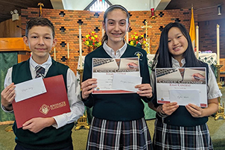
Texas State Programs - Essay
TOPIC - An essay of 500- 750 words, explain how young Catholics can evangelize our faith to families and friends who have turned away from religion and encourage them to return to the Church and embrace the sacraments?
Order Kits from Supreme Now
Follow Fraternal Planner schedule
Judging by Council, District, Diocese
Diocesan Winners forwarded to State Jan. 2023

Slide 88
Life
1) March for Life – State March for Life – Austin Jan. 2023 2) Special Olympics – Working with Special Olympics affiliates, funding, sponsoring or volunteering for these events in home community. 3) Ultrasound Program – Major Influence for Life, women view their unborn children. 4) Pregnancy Center Support – Adopt a pregnancy center and provide material, labor and spiritual support throughout the year.

Slide 89
Pro-Life ACE Wings Pro-Life without Apology, Compromise or Exception
It takes a real man, a Brave Knight, to earn and wear the ACE Wings!
Silver ACE Wings – 5 Public Pro-Life Events in 1 year – Each event must be different
Special Forces ACE Wings – Once a Knight earns the Silver ACE Wings his Council can elect to present him (and Spouse) the SFAW
Gold – Diocesan Deputy may present 2 Knights from the Diocese the Gold ACE Wings per year.

Slide 90
Texas State Programs Pro-Life in Texas
Life Resource Centers in each Parish
Supplies needed information on where to get help.
Can also supply Diapers, clothing for baby and other needed items
See the Life Resource Guide for more details

Slide 91
Texas State Programs Pro-Life in Texas
Sonogram Machines
We have six $4000 Grants available Contact State Life Chairman Tom Clark or State Ultrasound Chairman Andrew Clark to find out how to obtain a grant.

Slide 92
Texas State Programs
Aid and Support After Pregnancy (ASAP)
Support pregnant women, mothers and their babies
Financial support and material assistance. Every $500 Council donates, Supreme will match with $100

Slide 93
Vocations
RSVP assistance also involves prayer and moral support:
Visit each sponsored seminarian or postulant
Brother Knights and their families pray for the seminarian or postulant
Continuous communication throughout the year – e.g. birthday, Christmas and Easter Greetings
Share with them Council newsletter or other communications

Slide 94
Vocations
Resources:
#1942 Vocations Handbook
#2863 RSVP Refund Application
#4688 RSVP Tri-Fold
#10743 Vertical Poster
#2959 “Keep the Faith Alive”
Vocations DVD’s: The vocation to the Priesthood – The Vocation to Marriage – The Vocation to Religious Life for Women

Slide 95
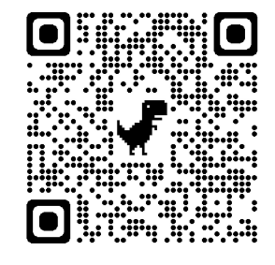
Vocations
Report your program on the #10784
This is in addition to your submission of the #2863 RSVP Refund Application
Notes:
Two forms are required to obtain double credit.
Simple and easy to do but we are not getting these. Any Council member can fill this out so it can be completed at the event while the details are fresh on the mind.
When you enter your Membership number and last name you receive an email invitation to complete the form 10784. This invitation is good for 48 hours.
Simple process that can me completed by the chairman for the event or any member of the Council.
Log the event in the Fraternal Planning guide to reference for the Columbian Award Application (SP7) in April or May for end of year reporting. Due date is June 30 but avoid the last minute rush if you have earned the Columbian Award.

Slide 96
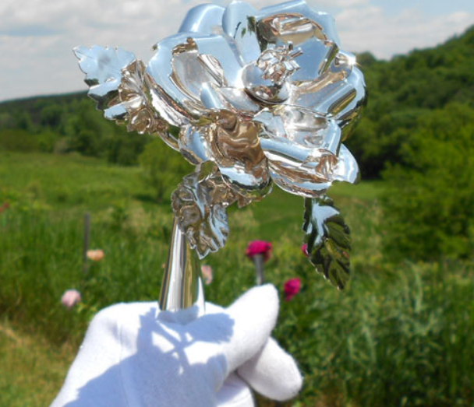
Texas State Programs – Silver Rose
#10625 Guide Sheet
#4841 Service Booklet
#9754 Our Lady of Guadalupe Prayer Card
#10722 News Release
#10219 Vertical Poster
#10723 Horizontal Poster
#10270 Schedule
#4752 The Woman Who Changed the Face of a Hemisphere Booklet
#10575 The Secrets of Her Image Poster
Share the message of Our Lady of Guadalupe

Slide 97
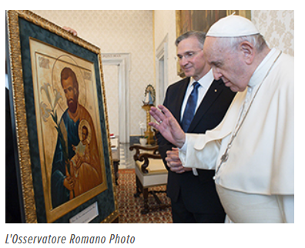
Texas State Programs - Pilgrim Icon
Program Resources:
#10682 Guide sheet
#5050 Prayer Service Booklet
#11221 St. Joseph Icon Prayer
#10738 Horizontal Poster
#10739 Vertical Poster
#11266 News Release
#11265 Schedule
Notes:
We currently have the best resources I have seen available. If a member has not run a program like this, they can be a pro if they just follow the guidelines. 12 steps to excellent success.
Some of these resources must be ordered through Officers Online. I encourage Councils to order their own booklets as we progress the prayer cards will disappear as intended and while not intended the service booklets will also diminish. When you get the Icon the booklets and prayer cards are to back up your supply only. Experience tells us to not expect to have the booklets and prayer cards supplied with the Icon. Best Resources and a great template for all programs if you utilize the #10682 Guide sheet
With this tool anyone that has not run a program can be effective. Also a great tool for the experienced. As we grow comfortable running an event some start on auto pilot and neglect some of the elements that made prior events outstanding. Encourage all to utilize this Guide sheet at minimum as a checklist

Slide 98
Texas State Programs Veterans Affairs
Veterans Value Add
Leadership,
Management,
Teamwork,
Accountability
Responsibility
Recruitment Positive
Veteran member mentorship

Slide 99
Texas State Programs
Shield a Badge Program
Pray for your local officer for his/her Safety, Good Judgement, and Safe Return Home.

Slide 100
Texas State Programs - Athletics
State "Johnny Lopez" Golf Tournament
Ricky Meyer – Chairman
C: 979-732-7301 H: 979-732-6371
email: ricky.meyer33@sbcglobal.net
September 16,17,18, 2022 – Two Courses
Deadline to enter August 1, 2022
Scott Schreiner Golf Course
1Country Club Dr. Kerrville, TX 78028
830-257-4982
Buckhorn Golf Course
36 Ranch Road 473, Comfort, TX. 78013
830-995-5351
State Free Throw
Jesse Aguilar – Chairman
State Free Throw Championship
March 4, 2023
San Antonio
State Bowling Tournament
Skipper Arsenault – Chairman
April 2023 – Location TBD
State "Daryl Entrop“ Softball Tournament
Steve Simons – Chairman
June 2023 – Location TBD

Slide 101
Council Growth

Slide 102
Council Growth
David Zeigler, Director
903-926-0776 or zigsr@att.net

Slide 103
Council Growth
The Team:
New Council Development (NCD) - Rick Guzman, Chairman - skrickguzman6021@gmail.com
Round Tables - Dan Aguilar, Chairman - daguilar1@satx.rr.com
Reactivations and Mergers - Greg Dutchover, Chairman- gdutchover@musiccitymall.net
Jason Kelley, Coordinator - jkell318@icloud.com
Giovani Hyppolite, Coordinator - hyppolite.giovani@gmail.com
Council Retention - Michael Barnett, Chairman - mbarnett360@yahoo.com
Hispanic Council Development –
Miquel Torres, North Chairman - mike.torres1681@icloud.com
Carlos Rene Ramirez, South Chairman - carlosrenermz@gmail.com
College Council Development - Archie Wright II, Chairman - allw1989@yahoo.com

Slide 104
Council Growth
Council Retention
Supreme Per Capita – total $6.50/member
($4.50 per capita & Catholic Advertisement & $2.00 Culture of Life)
Assessed twice a year: ($3.25/member each)
July 1 Roster – Due by October 10
January 1 Roster – Due by April 10
Council Statements will only be available on Officers online, Go To:
www.kofc.org> sign in>Enter Council number>Click on Reports tab>Click on Financial Statement
Texas State Council Per Capita – total $8.00/member
Assessed once a year in July (sent with State Charities Statement)
Due by March 1 or earlier for certain State Awards

Slide 105
Council Growth
Roundtables
Roundtables help both the parish & supporting Council
Should have regular meeting prior to the Council meeting
The Coordinator is to be a member of the adjacent Parish/Mission & of the supporting Council & attend both the Roundtable meeting & Council Meetings to report back & forth the needs of the Parish/Mission & Council
Parish Round Table Coordinator (Form #2629) DUE: September 30 https://www.kofc.org/un/en/forms/council/roundtable_coordinators2629_p.pdf
Report of the Roundtable is on same form - due as needed
Submit to Supreme, State Roundtable Chairman, Diocesan Deputy, & District Deputy

Slide 106
Council Growth

Slide 107
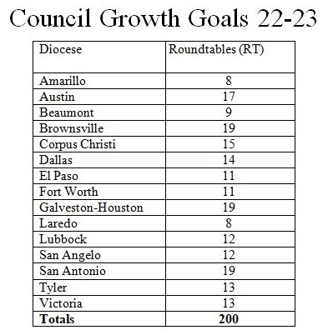

Slide 108
Insurance and Fraternal Benefits

Slide 109
Star Council

Slide 110
Star Council Team
Bill Tillotson - Director
Joe Naderer - Full time Safe Environment
Clint Mendonca - Tyler, Beaumont, Victoria, Corpus Christi
Don Piwonka - Amarillo, Lubbock, San Angelo, El Paso
Brian Kozel - Galveston/Houston
Pat Ortiz - Austin, Brownsville
Hector Gutierrez - San Antonio, Laredo
Mark Von Rosenberg - Dallas, Fort Worth

Slide 111
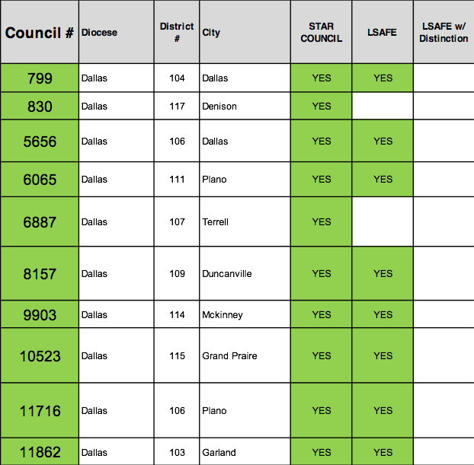
Dallas 15 Star Councils!! 10 LSAFE 1 LSAFE w/ Distinction 2 Star Districts!!

Slide 112
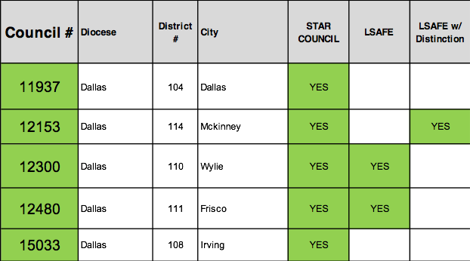
Dallas 15 Star Councils!! 10 LSAFE 1 LSAFE w/ Distinction 2 Star Districts!!
Star Districts
District Deputy 107 Robert Repka
District Deputy 111 Michael Steffens

Slide 113
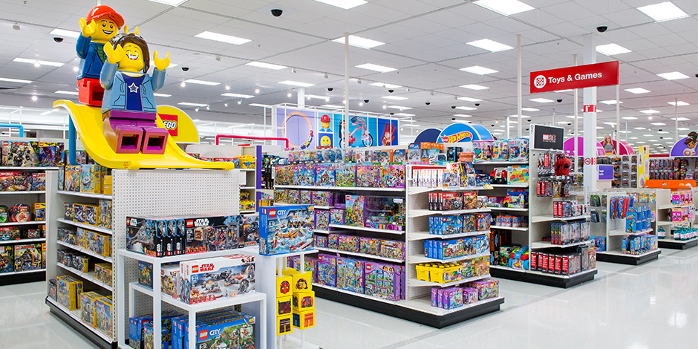
Star Council Why Are Awards Important?
We’re not in it for the awards!
We don’t care about seeing our names on plaques!

Slide 114
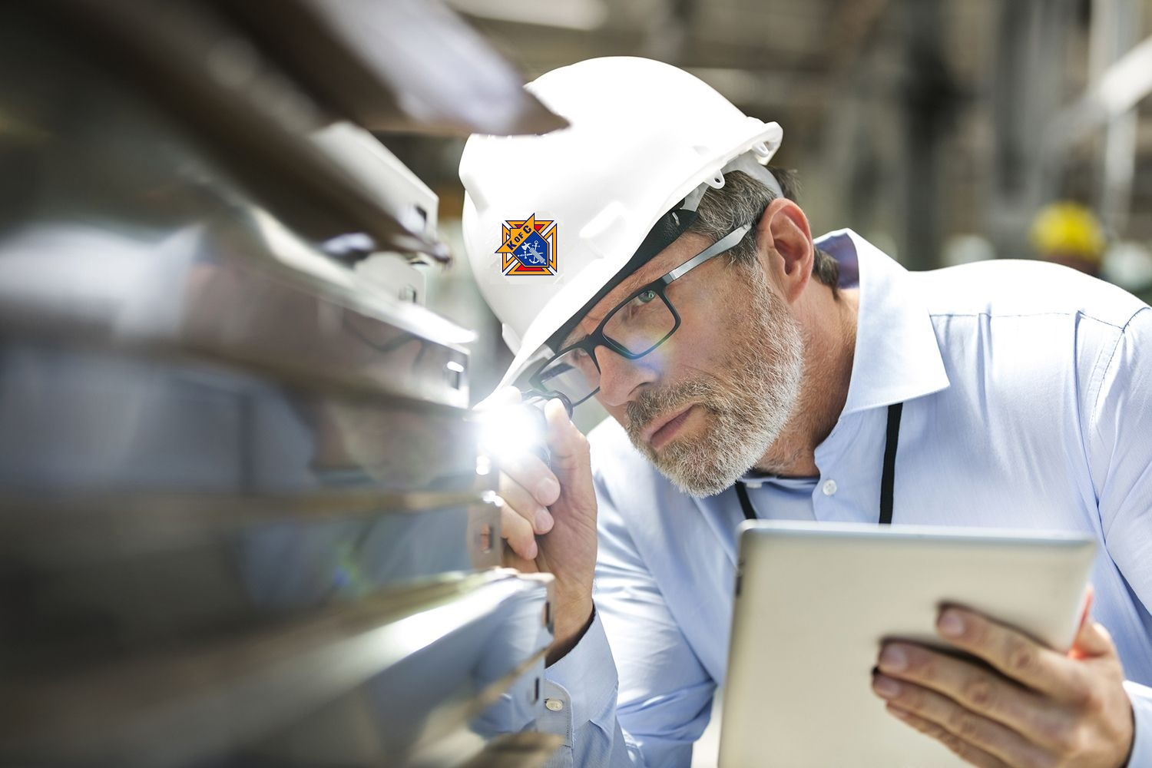
Star Council Why Are Awards Important?
Quality Control
The behaviors most commonly seen in successful councils

Slide 115
Star Council Star Council Award Requirements
Earn the Father McGivney Award for Membership growth by June 30, 2023. Membership goals are set at 6% gross growth with a minimum of 5 and maximum of 15.
Earn the Founders’ Award for insurance growth by June 30, 2023 by hosting at least two Fraternal Benefits events.
Earn the Columbian Award for Faith in Action programs by June 30, 2023 by conducting four programs in each of the four Faith in Action categories of Faith, Family, Community, and Life.

Slide 116
Star Council Star Council Award Requirements (Cont.)
Complete and send required forms (365, 1728, SP-7) to Supreme and the Texas State Office.
Be in good standing with Supreme (i.e., current on Per Caps).
Safe Environment – The Grand Knight and Program, Community and Family Directors must be Safe Environment compliant.

Slide 117
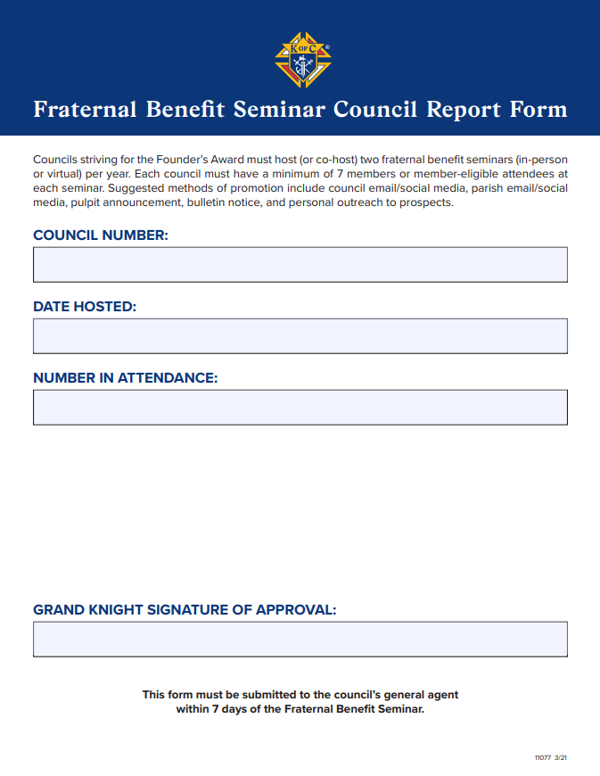
Star Council Fraternal Benefit Nights
Must have at least 7 members or Membership eligible people at the event
Form 11077 must be submitted to GA within 7 days of event
Must be submitted to Supreme by General Agent

Slide 118
Star Council Safe Environment Requirements
The following positions must be current in the Safe Environment Training through Praesidium: Grand Knight, Community, Family and Program Directors (and Squires Counselors, if applicable).
The following must also consent to a background check: Family and Community Directors (and Squires Counselors, if applicable).
E-mails are sent (one for training, another for background check, if required) after submittal of Forms 185 and 365.
If the Knight has no online access, booklet training can be requested from Office of Youth Protection.

Slide 119
Star Council Safe Environment Requirements (Cont.)
Grand Knight and Directors are required to complete training and background check approval within 30 days.
Failure to do so will result in Director being removed from position by Supreme.
Make it clear to men you appoint they are expected to fulfill this requirement!
Since training is valid for 3 years, past directors are an excellent choice.

Slide 120
Star Council Lone Star Award for Excellence Requirements
Meet the Star Council Award criteria
Submit Form 185 by July 1, 2022
Pay State Per Capita by March 1, 2023
Meet State Charity Goal by June 30, 2023
Seat at least one delegate at the State Convention in Dallas May 5-7, 2023
Submit Form 1295 Semi-Annual Audit by August 15, 2022 & February 15, 2023

Slide 121
Star Council Lone Star Award for Excellence with Distinction Requirements
Meet the Star Council Award criteria
Submit Form 185 by July 1, 2022
Pay State Per Capita by December 31, 2022
Meet State Charity Goal by December 31, 2022
Seat at least two delegates at the State Convention in Dallas May 5-7, 2023
Submit Form 1295 Semi-Annual Audit by August 15, 2022 & February 15, 2023
File Special Olympics Activities using From 10784 by January 31, 2023
Submit at least one entry for a State Service Program Award or Family of the Year or Chap. Of the Year or Educational Grant by March 1, 2023

Slide 122
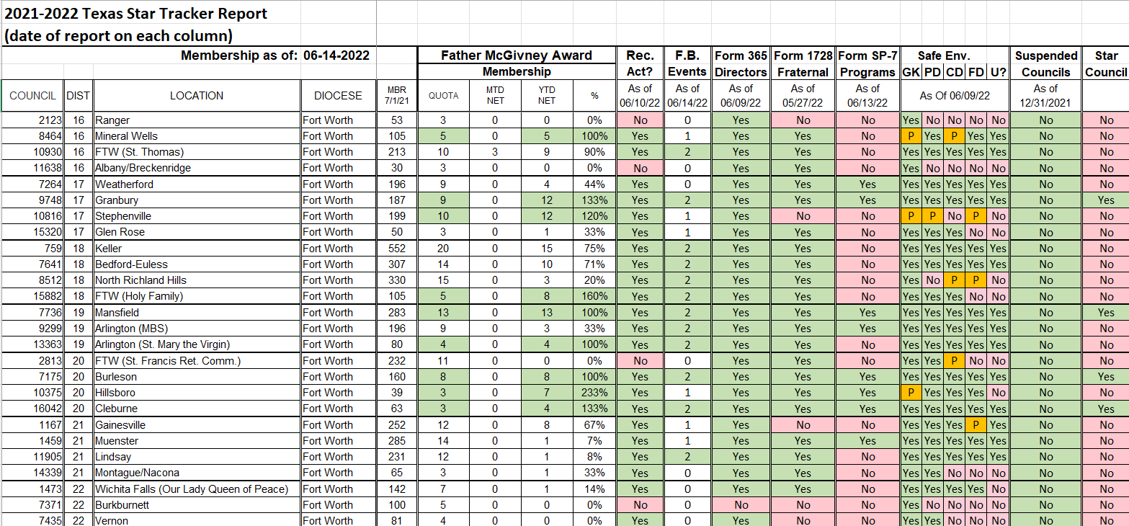
Star Council Star Tracker – Star Council Award
Gee, that sure is a lot of stuff. How can I keep track?

Slide 123
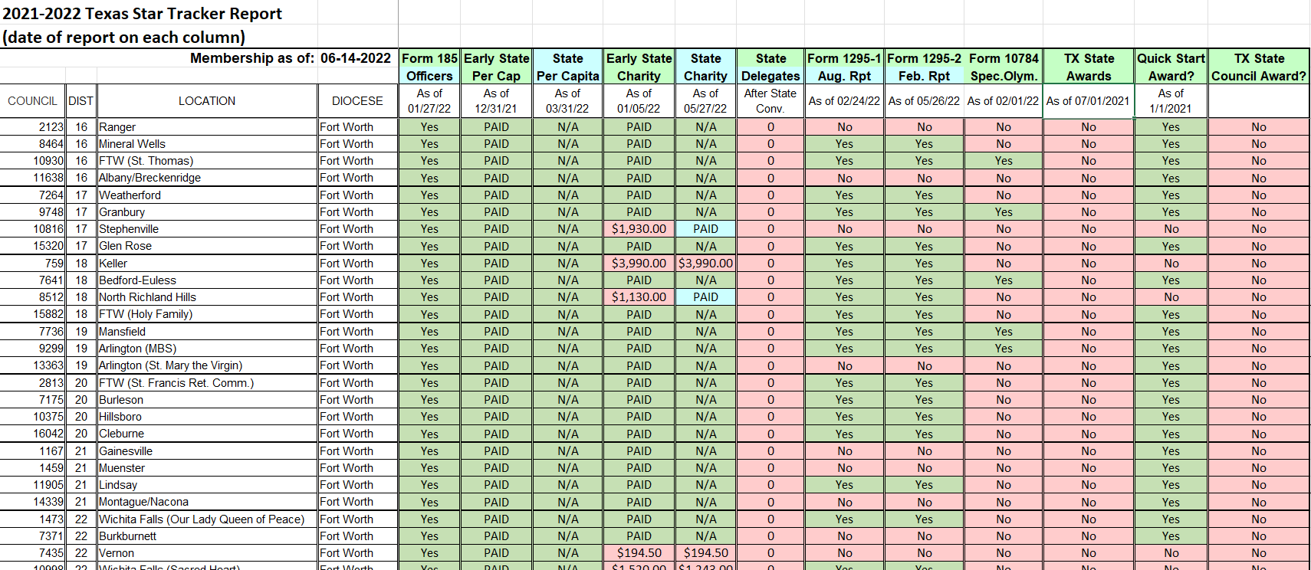
Star Council Star Tracker – LSAFE Awards

Slide 124
Star Council Star Tracker – Online Location
Star Tracker will be e-mailed out twice a month via Constant Contact
Star Tracker, along with other Star council resources, can be downloaded from:
https://www.tkofc.org/downloads/star-council

Slide 125
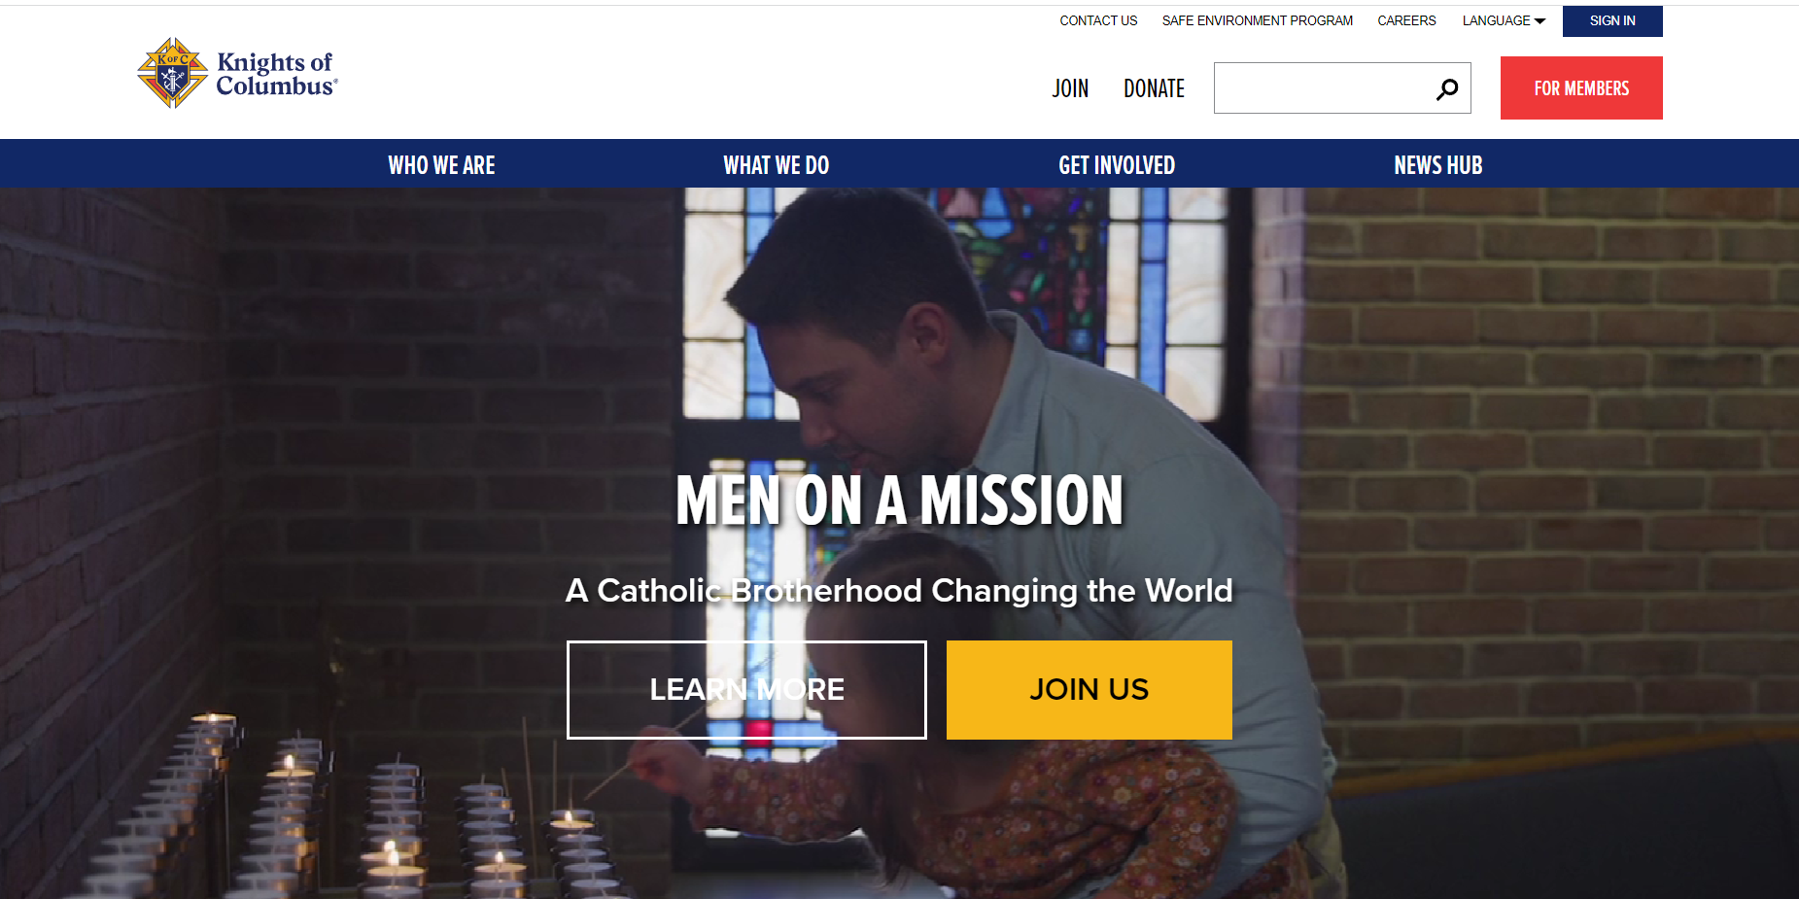
Star Council Resources – Officers Online
Didn’t get the e-mail? Get login info from Supreme Council Customer Service Department at 1-800-380-9995

Slide 126
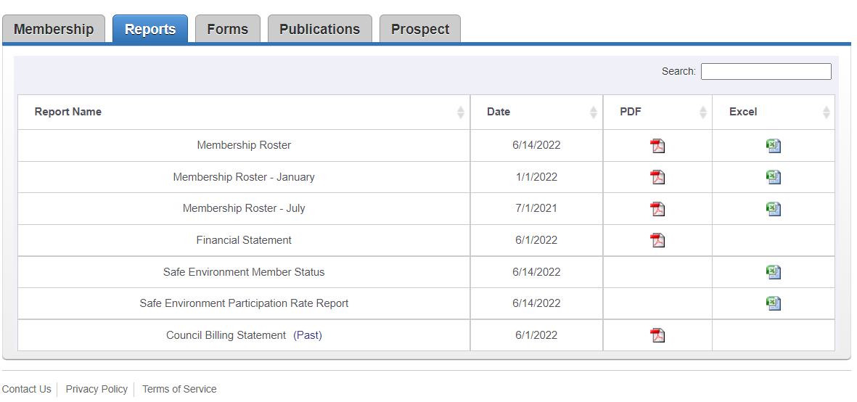
Star Council Resources – Officers Online

Slide 127
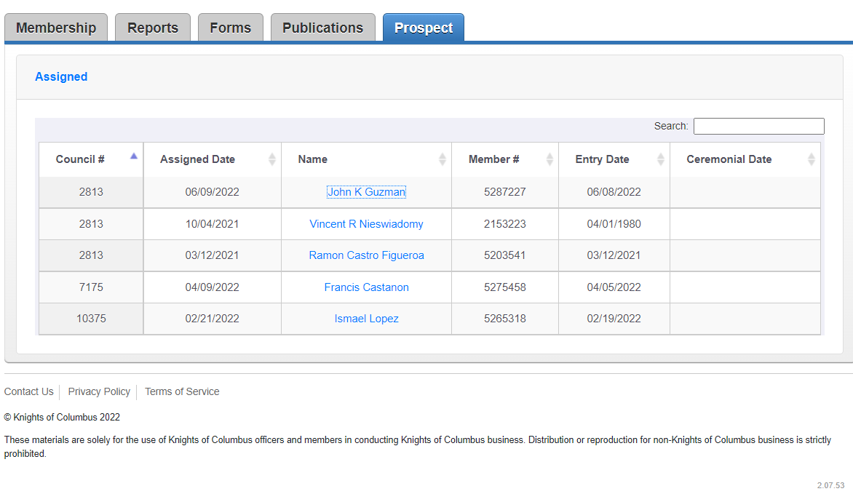
Star Council Resources – Officers Online

Slide 128
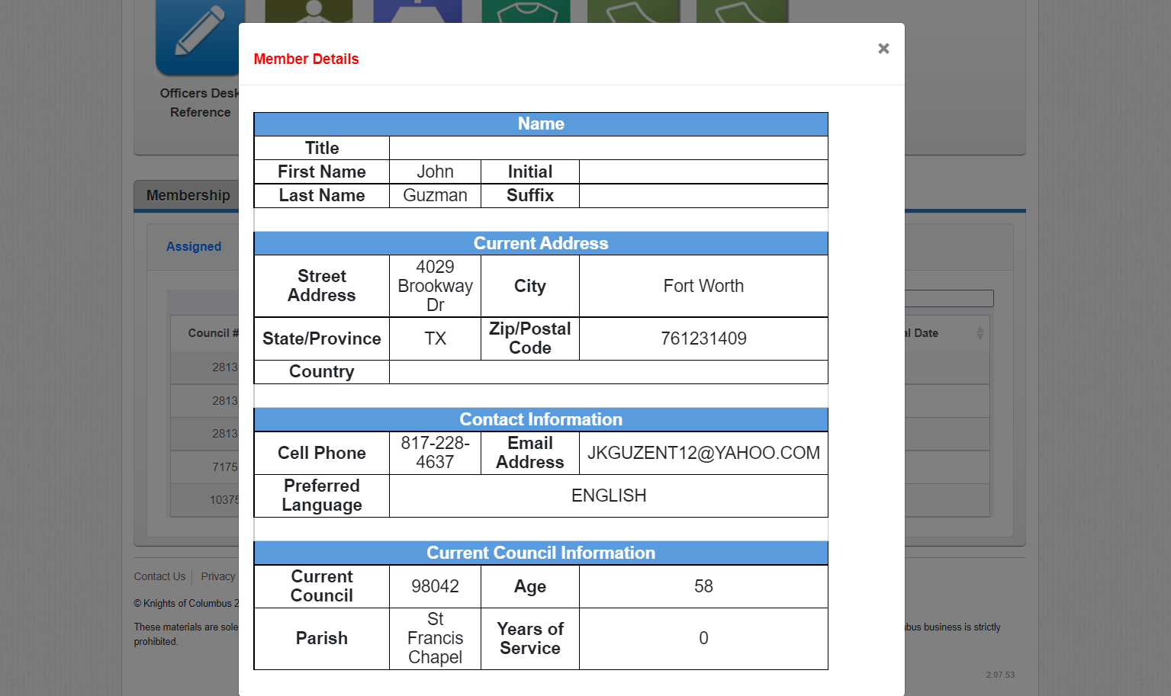
Star Council Resources – Officers Online

Slide 129
Star Council Goals
Diocese | Active Councils | Star Council Goal
Amarillo | 23 | 6
Austin | 90 | 22
Beaumont | 28 | 7
Brownsville | 40 | 10
Corpus Christi | 42 | 10
Dallas | 59 | 14
El Paso | 32 | 7
Fort Worth | 64 | 16
Gal-Houston | 124 | 30
Laredo | 10 | 2
Lubbock | 26 | 6
San Angelo | 32 | 7
San Antonio | 101 | 24
Tyler | 31 | 7
Victoria | 32 | 7
TOTAL | 734 | 175

Slide 130
Star Council Strategies for Success
Accuracy is preferred
Timeliness is mandatory

Slide 131
Education, Training, and Communication

Slide 132
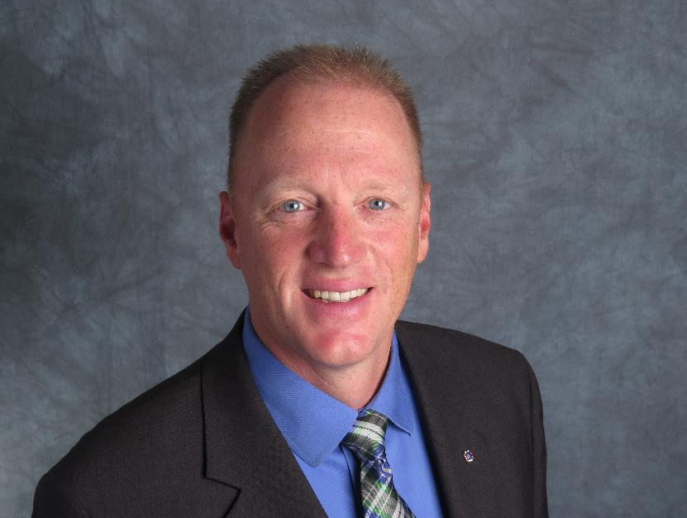
Education/Training/Communication
Ed Tydings, ETC Director
Edwardtydings@gmail.com
512-565-9749

Slide 133
Education/Training/Communication
The ETC Team
Presentations – Greg Brown
Social Media – Josh Jones
Webmaster & Photographer – Mark Johnson
Scorekeeper – Greg Wilson

Slide 134
Education/Training/Communication
The Financial Secretary Training Team
Chairman and El Paso / San Angelo – David Solis
Austin / San Antonio – Pete Donahoe
Dallas / Ft. Worth / Tyler – Victor Garza
Galveston-Houston / Beaumont / Victoria – Mike Dunn
Corpus Christi / Brownsville / Laredo – Michael Murphy
Amarillo / Lubbock - TBD

Slide 135
Education/Training/Communication
Our mission is to provide
Who
What
Where
Why
When
for the state, diocesan, district, and council leadership teams

Slide 136
Education/Training/Communication
Who are we?
We are the leadership for the Texas Knights of Columbus
We are all volunteers, but we also volunteered to be leaders
We have a responsibility to prepare ourselves for our various roles

Slide 137
Education/Training/Communication
What are we?
We are the team that will help provide education and training to our fraternal leaders
We are the team that will help communicate our goals and our accomplishments

Slide 138
Education/Training/Communication
What else do we do?
Diocesan and District Deputy of the Year
The Finish Line
The Texas Knight and the Website
Constant Contact
The Star Guide

Slide 139
Education/Training/Communication
Where?

Slide 140
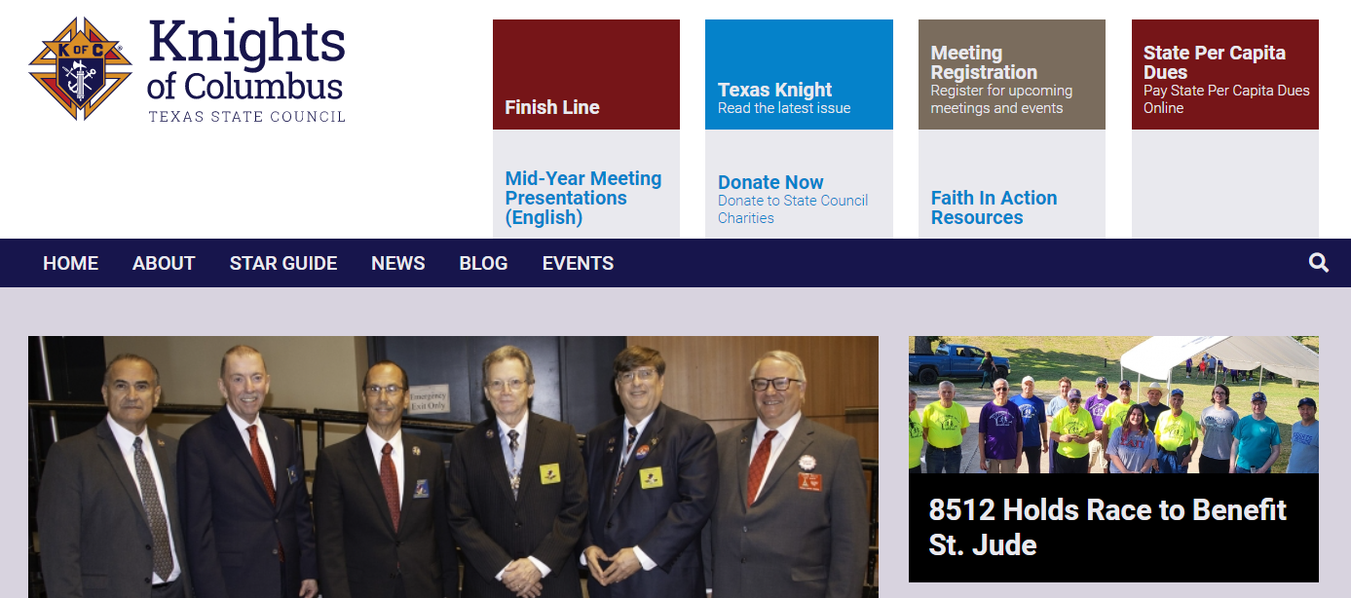
Education/Training/Communication
Where?
The Texas state council website www.tkofc.org

Slide 141
Education/Training/Communication
Where?
SOCIAL MEDIA
Provide Catholic content for council lecturers
Social Media coordinators for all dioceses and districts
Make sure they are trained
Share your stories!!

Slide 142
Education/Training/Communication
Where can we share it?
Texas State Council Website – www.tkofc.org
Texas State Council Facebook page – www.facebook.com/txkofc
Texas State Council Twitter page – https://twitter.com/txkofc
Texas State Council Instagram page – https://instagram.com/txkofc
Texas State Council YouTube – www.youtube.com – search “Texas Knights of Columbus”

Slide 143
Education/Training/Communication
Why do we do it?
Catholic marriages are down
Children are not receiving the sacraments
Families are leaving the church
Children whose fathers attend Mass are more likely to remain in the faith

Slide 144
Education/Training/Communication
Why do we do it?
We are losing almost 200 men EVERY day
If we don’t attract men into the Order, the Order will cease to be relevant
The Order offers every man the opportunity to be a better father, husband, son, grandfather

Slide 145
Education/Training/Communication
When do we promote ourselves?
Every day on social media
Every quarter in the Texas Knight, articles due August 1, November 1, February 1, and May 1
As often as you can on www.tkofc.org
Leading up to Membership drives
Leading up to major events (fish fries, family picnics)

Slide 146
Education/Training/Communication
Texas Knight Reporter Award
For outstanding reporting of local Knights of Columbus Events
to the Texas Knight.
Applications and links should be sent to the communications team at communications@tkofc.org or it can be snail mailed.
Due by March 1.
1st Place award to be a 10” Wi-Fi tablet with front & rear Camera and case. 2nd & 3rd Place awards to receive a TSC Shirt with name &
“Texas Knight Reporter” as a title.

Slide 147
Education/Training/Communication
Council Communication Award
For those Councils for excellence in digital media communications
Post all activity on the on the Texas State Council Facebook page. The Council should use the hashtag #TX(your Council #). An Example is #TX1422.
A Council Social Media Coordinator must be appointed for the Council to qualify for this award.
Applications and links should be emailed to the communications team at communications@tkofc.org .
Due by March 1.
1st Place award to be a 10” Wi-Fi tablet with front & rear Camera and case
2nd & 3rd Place awards to receive a TSC Shirt with name &
“TSC Council Communicator” as a title.

Slide 148
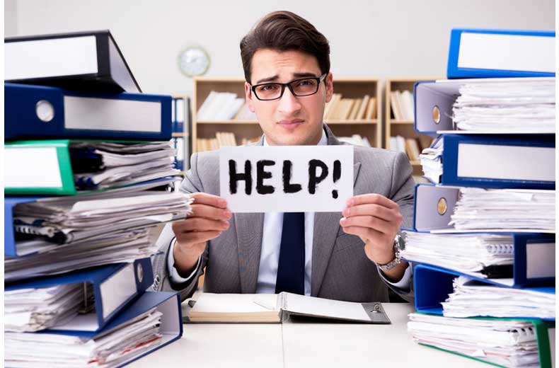
Education/Training/Communication
Financial Secretary Training
Schedule at least 2 training sessions per diocese each year
Both live and virtual training options

Slide 149
Education/Training/Communication
Form Submissions
Submit all forms electronically
Copy all Supreme forms to forms@tkofc.org
For forms requiring State Deputy signature, sdsignature@tkofc.org

Slide 150
Have a great Fraternal Year!

Slide 151
Knights of Columbus Insurance
John Regan, General Agent

Slide 152
Knights of Columbus Insurance
FBN FORM UPDATE
Attached is one of the 2 new forms for FBN reporting.
They must be signed by the grand knight and emailed directly to me, you can copy anyone else you like but the forms must be sent to me.
At the end of the month I am required to fill out a separate form that John Regan needs to sign and send it up along with your submissions.
I will be sending the July 2022 submissions on Monday August 8th so please have all submissions in before 4pm that day.
Please forward to anyone who needs to know that I forgot to copy.
Also please note I received outdated forms for councils 15174, 1502, and 12711 for events held on 7/30/22 that need to be transferred to the updated form.

Slide 153
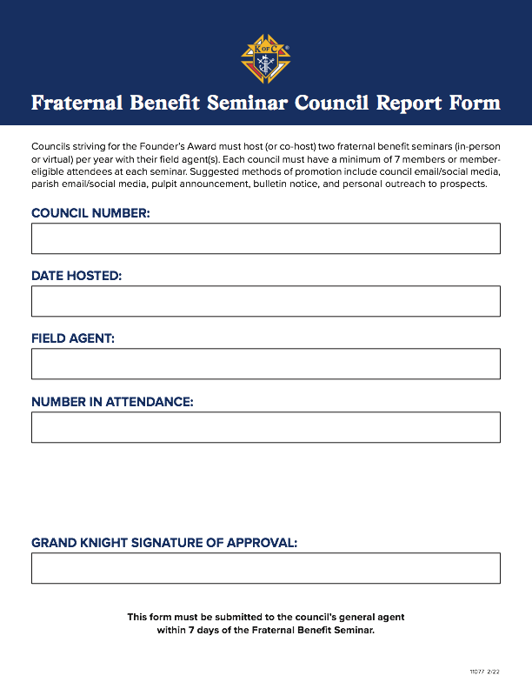
Knights of Columbus Insurance

Slide 154
Emergency Response
Harry S. Storey
Texas State Emergency Response Chairman
(214) 557-2923
hss@storeycorp.net

Slide 155
Emergency Response
Rod Downs, Dallas ERC
Dallas Diocesan Emergency Response Coordinator
(469) 829-5929
4panamarod@gmail.com

Slide 156
Emergency Response
Saint Vincent de Paul Yellow House
South Dallas/Lancaster
Lisa Hill, Executive Director
lisa@svdpdallas.org
Seeking help with needed repairs for the house.
1120 Randlett Street, Lancaster, TX 75146

Slide 157
Emergency Response

Slide 158
Emergency Response

Slide 159
Emergency Response

Slide 160
Emergency Response

Slide 161
Emergency Response
WEST SIDE
2 lengths of lower board siding 28 feet long
2 windows need trim replacement 3 four inch boards 8 feet long
SOUTH SIDE FRONT OF BUILDING
2 lengths of lower board siding 10 feet long
3 lengths of lower board siding 12 feet long
4 Post 8 feet long to support porch roof line
4 windows need trim replacement 4 four inch boards 8 feet long
NORTH SIDE
2 lengths of lower board siding 16 feet long
5 lengths of lower board siding 16 feet long
4 windows need trim replacement 7 four inch boards 8 feet long
EAST SIDE
2 lengths of lower board siding 28 feet long
2 windows need trim replacement 3 four inch boards 8 feet long
10 Corner boards for building surround 8 feet long 4 inches wide

Slide 162
Fourth Degree
SK Ken Franch, District Master

Slide 163
BJPL 3rd Texas District…by the numbers
From the Supreme Secretary’s Supreme Convention report:
June 30, 2022: added 11,888 SK’s in 142 exemplifications
Total intake of 12,608; total decrease of 12,453 (9,480 deaths); net gain = 155; 370,159
133 Districts with 3,603 Assemblies
Our Lady of Guadalupe Province:
Includes all Texas and Oklahoma; 7 Districts, 6 in Texas, 1 in Oklahoma; 22,260 SK’s
BJPL 3rd Texas District:
Dioceses: Dallas, Fort Worth , Tyler; 38 Assemblies, 14 D, 13 FtW, 11 T; 4,543 SK’s
36 out of 38 have CC (up from ~22 two years ago)
Likely 3 Star Assemblies (would have been 7 more if…)
13 Civic Award winners (should be…)
7 Exemplifications: 3 in-person, 2 virtual with AK, 2 Spanish virtual

Slide 164
BJPL 3rd Texas District…looking forward
Grow the order, we grow the Fourth Degree
FAdmirals, Assembly representatives…attend the CUF exemplifications:
State Deputy Fruge agrees rep should speak at CUF…request permission from GK, DD… keep presentation to ~5 minutes, be available to speak with them after…bring Form 4’s, material on the Fourth, tri-fold/registration form for upcoming exemps
Two fall exemplifications:
Sept 17, 2022, in Aledo, TX (Fort Worth Diocese), and Oct 15, 2022, in Frisco, TX (Dallas Diocese). Information has been emailed to the FN’s, FA’s, and FComp’s.
Information is also on the District website…kofcntxpatriotic.org; also great resources for our officers, SK’s, and veterans

Slide 165
BJPL 3rd Texas District…going forward!
For Assemblies, recommending the following for this fraternal year:
Grow your Assembly membership…help grow the order and more opportunities for new Fourth Degree members will become available;
Conduct patriotic events with your councils, churches, and community…plan each quarter: 1 member meeting (officer meetings continue monthly), 1 social activity (spouses, families…), and 1 patriotic event, and;
Grow and train your Color Corps…Worthy Dallas Diocese District Marshal Jim Hale and myself would be honored to assist in training.
Lastly…

Slide 166
Bishop SK Edward J. Burns
…CONGRATULATIONS to Bishop Burns for becoming a Sir Knight on July 27, 2022!
…CONGRATULATIONS to Bishop Burns for becoming a Sir Knight on July 27, 2022!

Slide 167
Refund Supported Vocations Program (RSVP)
SK John Little, Program Director

Slide 168
Refund Supported Vocations Program (RSVP)
PREMISE
Councils, Assemblies and Squire Circles “adopt” or “sponsor” one or more seminarians or postulants and provide financial assistance and moral support.
FINANCIAL SUPPORT
Councils and Assemblies write checks, payable to their adopted seminarians or postulants, for $500 per sponsorship. Squire Circles can write checks in $100 increments.
REFUND
Councils, Assemblies and Circles complete and file Form 2863 with Supreme. Councils and Assemblies receive a $100 refund for each $500 donated. Circles receive a $20 refund for each $100 donated. NOTE: The form requires copies, front and back, of the cancelled check(s), and must be submitted by June 30 of the fraternal year.
LIMITS
A Council, Assembly or Circle can donate up to $2,000.00 to a single individual and receive a refund of $400.00. Donations above that amount will not receive refunds.

Slide 169
Refund Supported Vocations Program (RSVP)
Who is eligible?
In short, any seminarian in formation for the priesthood. Any man or woman who is a novice or postulant in a religious order or community. Supreme also offers the ability to sponsor military chaplains.
Who is Not?
Ordained priests or other religious seeking assistance for continuing education.
Religious brothers who are not in formation for the priesthood. Candidates for the permanent diaconate.

Slide 170
Refund Supported Vocations Program (RSVP)
Selecting a Seminarian
Each year (typically late August/early September) we circulate a list of the Diocesan seminarians for that fraternal/academic year. The list includes information concerning prior sponsors for seminarians, and also includes other seminarians, prior military chaplain sponsorships, and postulants.
Councils, Assemblies and Circles are encouraged to renew/continue sponsorships from year to year.
Generally, Councils, Assemblies and Circles are free to select the seminarians they would like to sponsor, with one large caveat.
The Diocese has asked that we work to spread sponsorships around, with a Diocesan goal of at least two (2) sponsorships for each Diocesan seminarian. As the fraternal year progresses, Councils, Assemblies and Circles will get steered toward seminarians who have not yet gotten two sponsorships.

Slide 171
Refund Supported Vocations Program (RSVP)
Timing
Pledging support doesn’t help a seminarian – cutting the check does. We have a new goal this fraternal year to get each Diocesan seminarian at least one check by September 30, 2020.
Reporting
In order to track the program, and meet our Diocesan goal, it is imperative that Councils, Assemblies and Circles keep the Diocesan RSVP Chair informed of sponsorship decisions, check issuance, and Form 2863 submissions:
John Little
john@angrydog.com
214.394.8658 (mobile)

Slide 172
Refund Supported Vocations Program (RSVP)
How to Pay
Sponsorship checks are to be made payable to the seminarian or postulant.
For Dallas Diocesan seminarians (including those at Redemptoris Mater), checks are mailed to the Diocesan Vocations Director:
Fr. Zachary Webb
Dallas Diocesan Vocation Office 3725 Blackburn
Dallas, Texas 75219
If your Council/Assembly/Circle is in a position to deliver a check directly to a seminarian you MUST send a copy to Father Webb’s office.¹
For all other seminarians or postulants, checks should be mailed to the seminarian or postulant directly.

Slide 173
Refund Supported Vocations Program (RSVP)
Moral Support
In addition to funding sponsorships, Councils, Assemblies and Circles
are encouraged to provide moral support to their “adopted” seminarians and postulants (and there is a space on the Form 2863 to detail that support). Some options include:
Praying for vocations and your seminarians, at meetings; establishing a vocations chalice program
Sending cards/notes for birthdays, Christmas, Easter Sending your seminarian your Council newsletter
Invite your seminarian to Council activities/events
Introduce your seminarian to your parish youth group/ministry, your parish school, or scout troops
Offer congratulations and support on your seminarians ordination to the diaconate and the priesthood.
This requirement is critical. Each year, we have one or more Councils pledge support in August that don’t write checks until the spring. Fr. Webb’s office, and our Diocesan RSVP chair, both attempt to track when checks are written and to whom they are written.

Slide 174
Committee of 1000
Mike Green, Program Director

Slide 175
Membership
SK Pat Conway

Slide 176
Spanish Initiative
Ed Diaz
Nick Flores
Eddie Castillo

Slide 177
Dallas Diocese Chapter
Jake Fleischer, President

Slide 178
Diocese of Dallas Major Meeting Calendar for 2022/23
August 6th - Dallas Diocese Fraternal Year Kickoff
(Today)
Sept.29th – DDC Update and Progress Check
Four Meetings a Year to Learn, Share and Grow!
January – Dallas Diocese Mid-Year Update
March 30th – DDC Update and Progress Check

Slide 179
Dallas Diocese Chapter (DDC)
kofcdallas.org

Slide 180
Important Dates for Knights of the Dallas Diocese
Sept.29th
DDC Update and Progress Meeting
Feb. 10, 2023
Dallas Diocese Clergy Appreciation Dinner
EVERYDAY
Exemplifications and Membership!
May 5th -7th, 2023
Texas State Convention in Dallas

Slide 181
2021/22 Fraternal Year
Dallas Diocese Chapter
Awards of Excellence

Slide 182
2021/22 Fraternal Year
Dallas Diocese Chapter
Awards of Excellence
“It ain’t braggin’ if you really done it!”
Dizzy Dean

Slide 183
2021/22 Fraternal Year
Dallas Diocese Chapter
Awards of Excellence
2021/22 Panel of Judges
SK Pat Conway – Immediate Former District Master, Texas State Council Master of the Sword and Assistant Diocesan Deputy for Membership.
SK Ed Diaz – PGK, PFN, FDD and Assistant Diocesan Deputy
SK Ed Stankunas – PGK, PFN, FDD and Assistant Diocesan Deputy

Slide 184
2021/22 Fraternal Year
Dallas Diocese Chapter
Awards of Excellence
Congratulations To:
Father Joseph Mehan, Jr.
St. Michael the Archangel Catholic Community
Garland, Texas
Dallas Diocese Chapter “Chaplain of the Year” !

Slide 185
2021/22 Fraternal Year
Dallas Diocese Chapter
Awards of Excellence
Congratulations To:
SK Oscar Sanchez
St. Mark the Evangelist Catholic Community
Plano, Texas
Dallas Diocese Chapter “Knight of the Year” !

Slide 186
2021/22 Fraternal Year
Dallas Diocese Chapter
Awards of Excellence
Congratulations To:
Council 11716
Prince of Peace Catholic Community
Plano, Texas
Dallas Diocese Chapter “Council of the Year” !

Slide 187
Thank you.
SK Mike Courtney, Diocesan Deputy
Diocese of Dallas

