Slide 2
MEMBERSHIP
New Member Intake Goals
All Councils Active
Ceremonials
Membership Drives
Online Membership
Recruitment

Slide 3
MEMBERSHIP
New Member Intake Goals
Division I = 3368
Austin = 612
Dallas = 572
Fort Worth = 484
Galveston-Houston = 1013
San Antonio = 687
Notes:
Membership Growth – 6% (Min of 5; Max of 15)

Slide 4
MEMBERSHIP
New Member Intake Goals
Division II = 1024
Beaumont = 177
Brownsville = 214
Corpus Christi = 227
San Angelo = 200
Victoria = 206
Notes:
Membership Growth – 6% (Min of 5; Max of 15)

Slide 5
MEMBERSHIP
New Member Intake Goals
Division III = 633
Amarillo = 98
El Paso = 152
Laredo = 125
Lubbock = 109
Tyler = 149
Notes:
Membership Growth – 6% (Min of 5; Max of 15)

Slide 6
MEMBERSHIP
Prospect
+18-year-old Catholic man
Member
Online
Leader
Officer
Council
Affiliate
Director
All Councils Active
- Recruitment active
- Adding new vitality to the Council
- Bringing new energy into the fold
Goal: Incredible Experience at Every Stage
Notes:
We have no one to recruit – RE, RCIA, CYO, Rosary Guild, Morning Prayer Group,

Slide 7
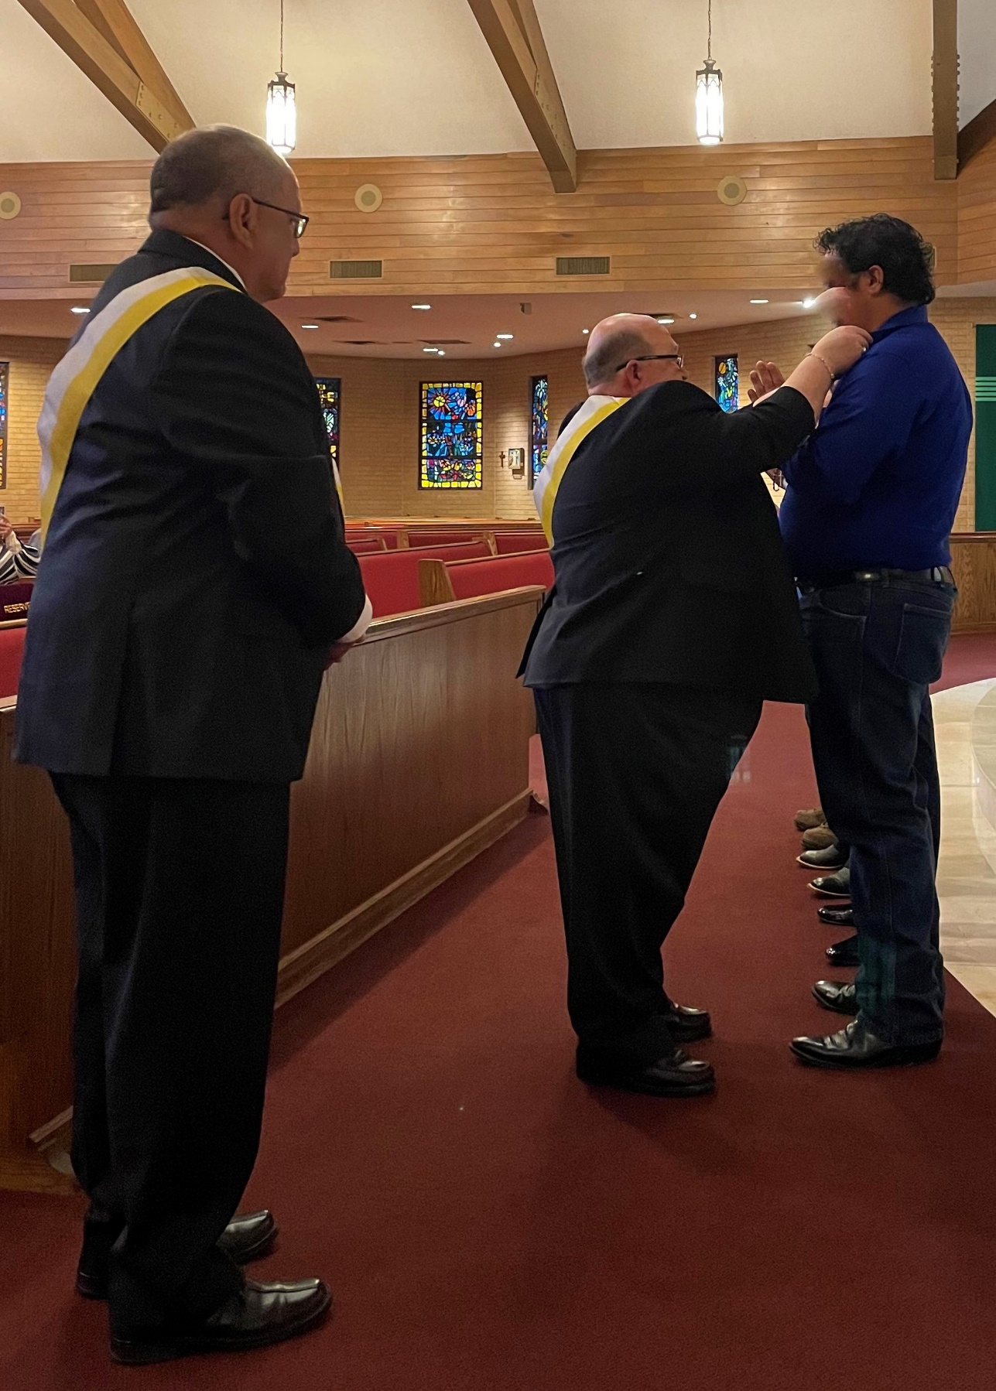
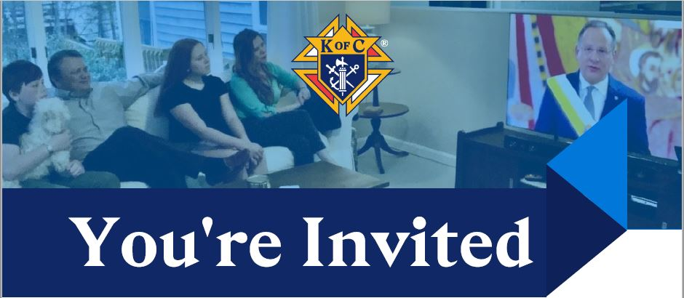
MEMBERSHIP
Ceremonials
- Live
- Video
- On-Demand
Notes:
Live – assemble a Team, practice, present the CUF to live candidates
Video – download from the Supreme website under the Ceremonials link – new videos available in Spanish and French
On-Demand – invite candidates to watch on their schedule

Slide 8
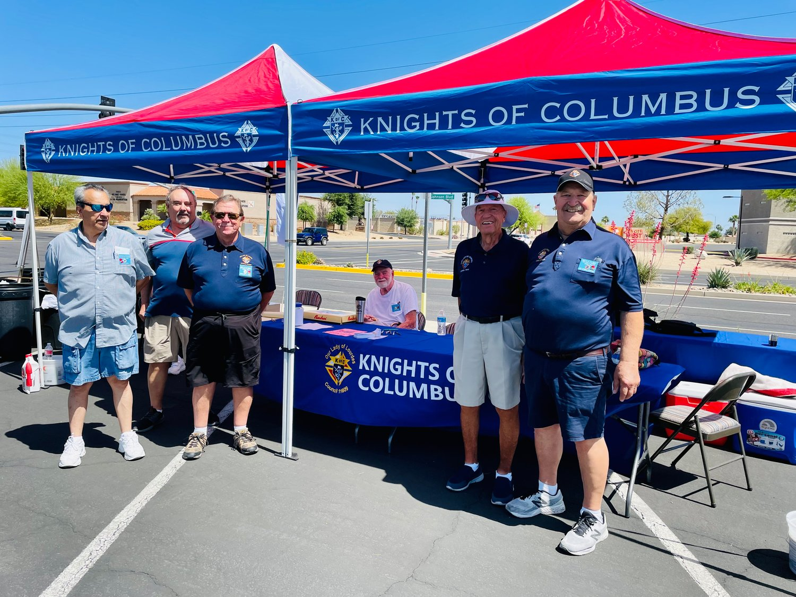
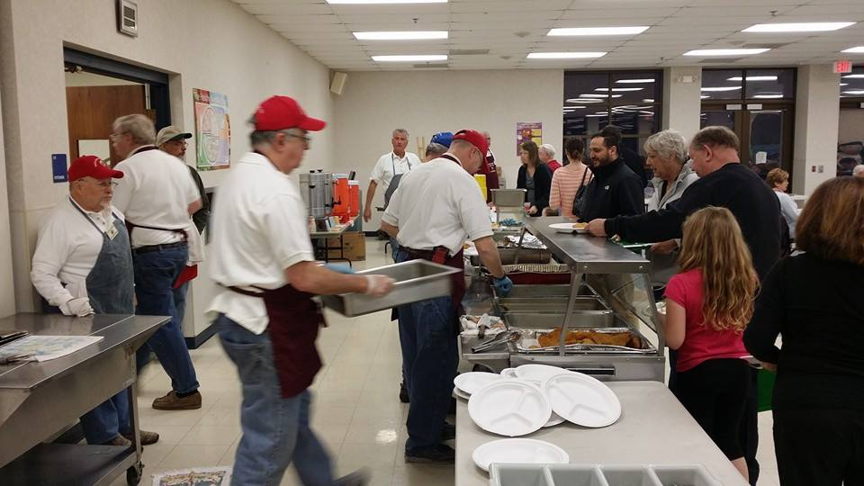
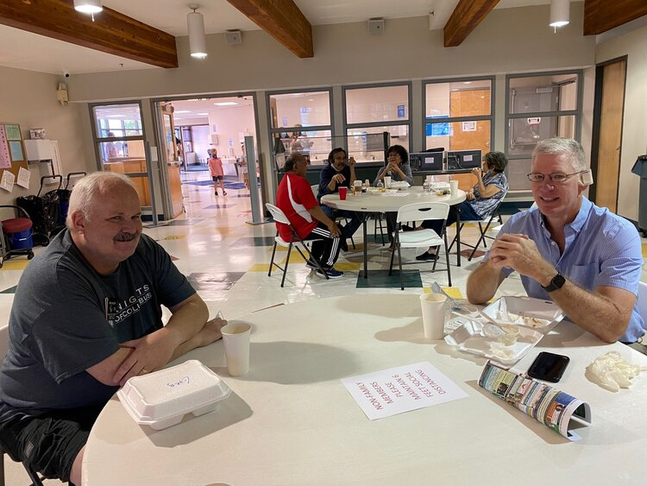
MEMBERSHIP
Membership Drives
- Organized
- Event connected
- Impromptu
Notes:
Organized – Delta Church Drive – model to follow – training available
Event Connected – plate sale, fish fry, BBQ
Impromptu – unplanned opportunity to share what we are about – after Mass, after a Prayer Group Meeting, etc.

Slide 9
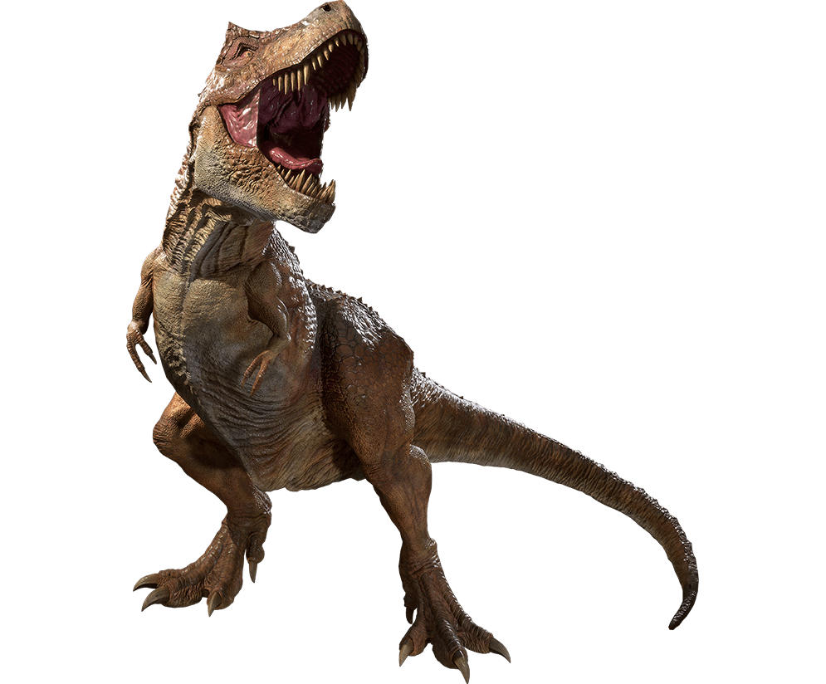
MEMBERSHIP
Notes:
What is this? A dinosaur.

Slide 10
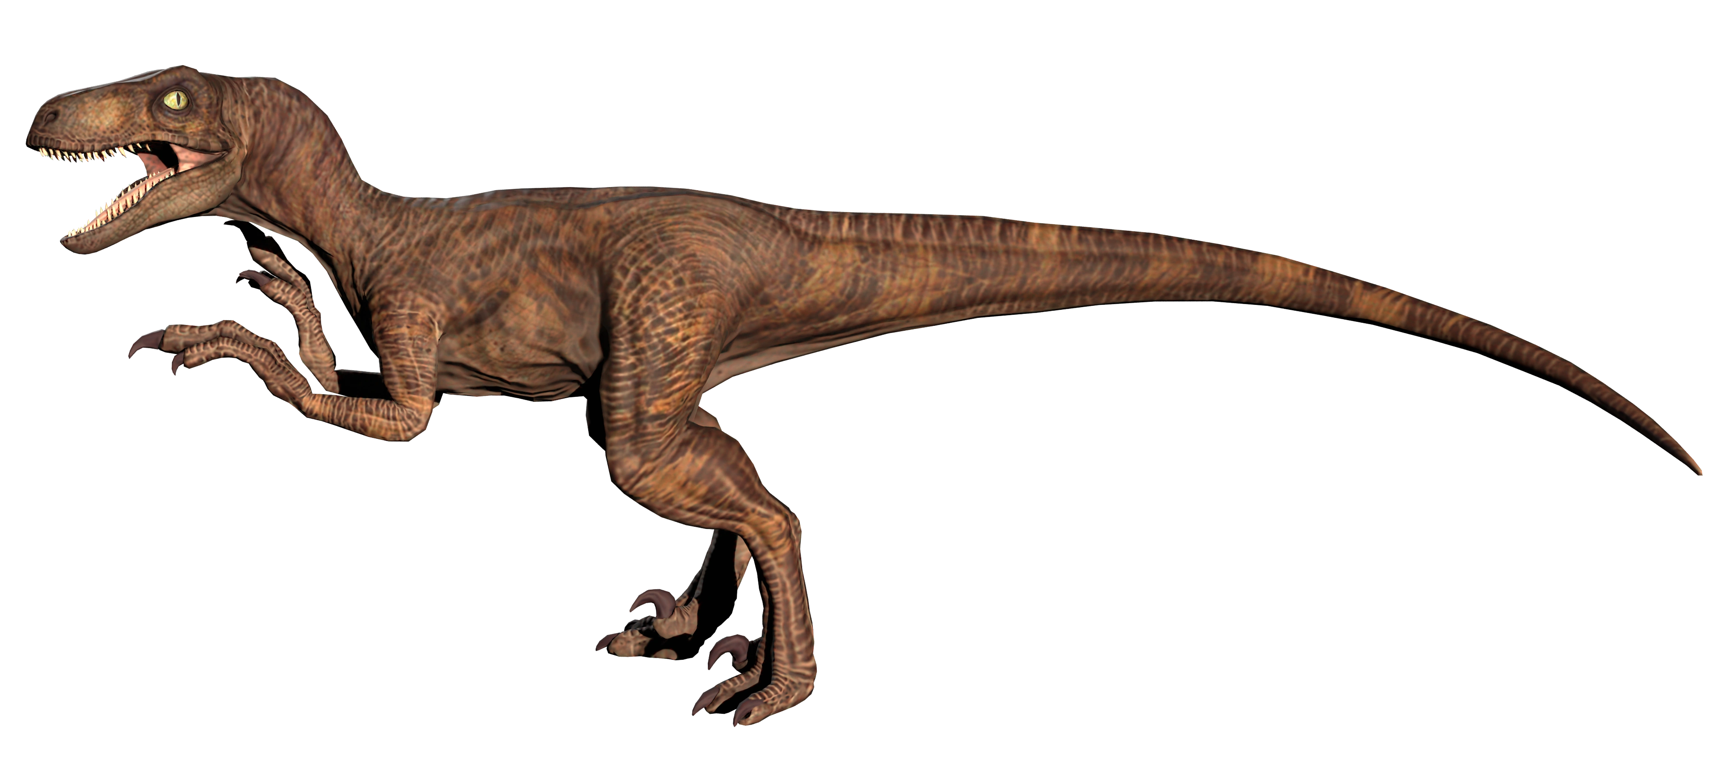
MEMBERSHIP
Notes:
What is this? A dinosaur.

Slide 11
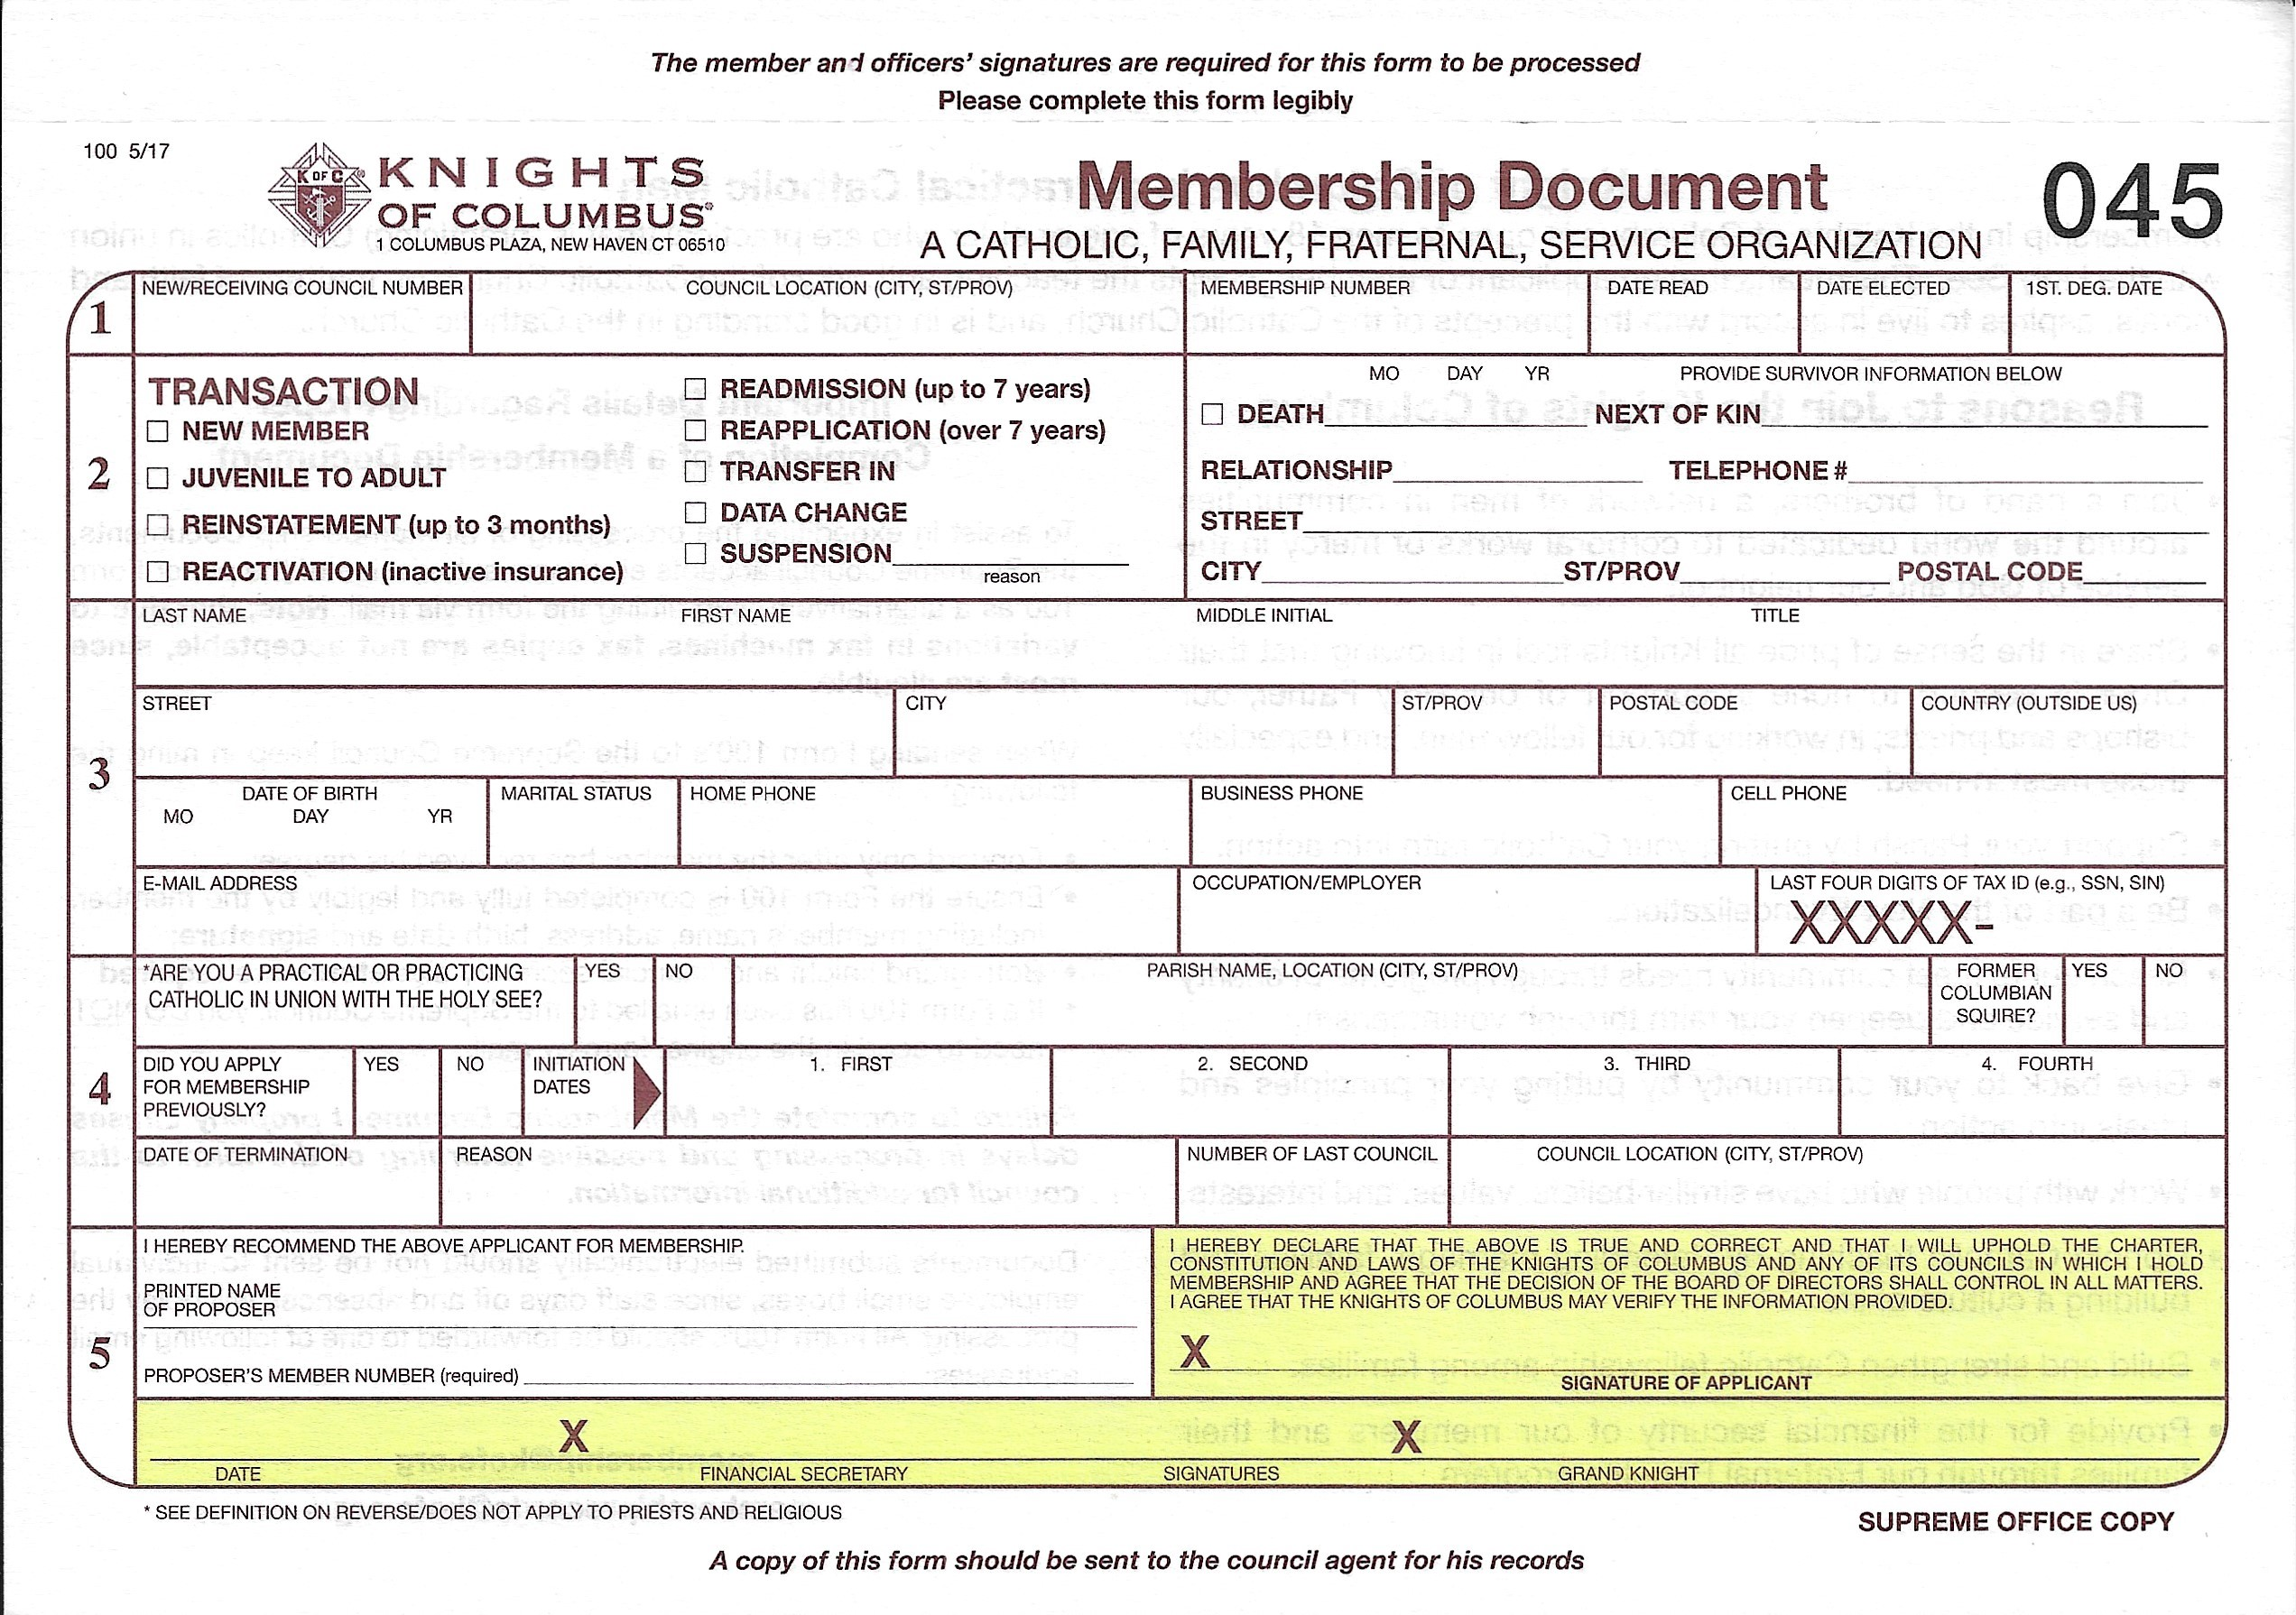
MEMBERSHIP
Notes:
Also, a dinosaur.
Put the Form 100 in the Grand Knight’s file cabinet – save them for another time.

Slide 12
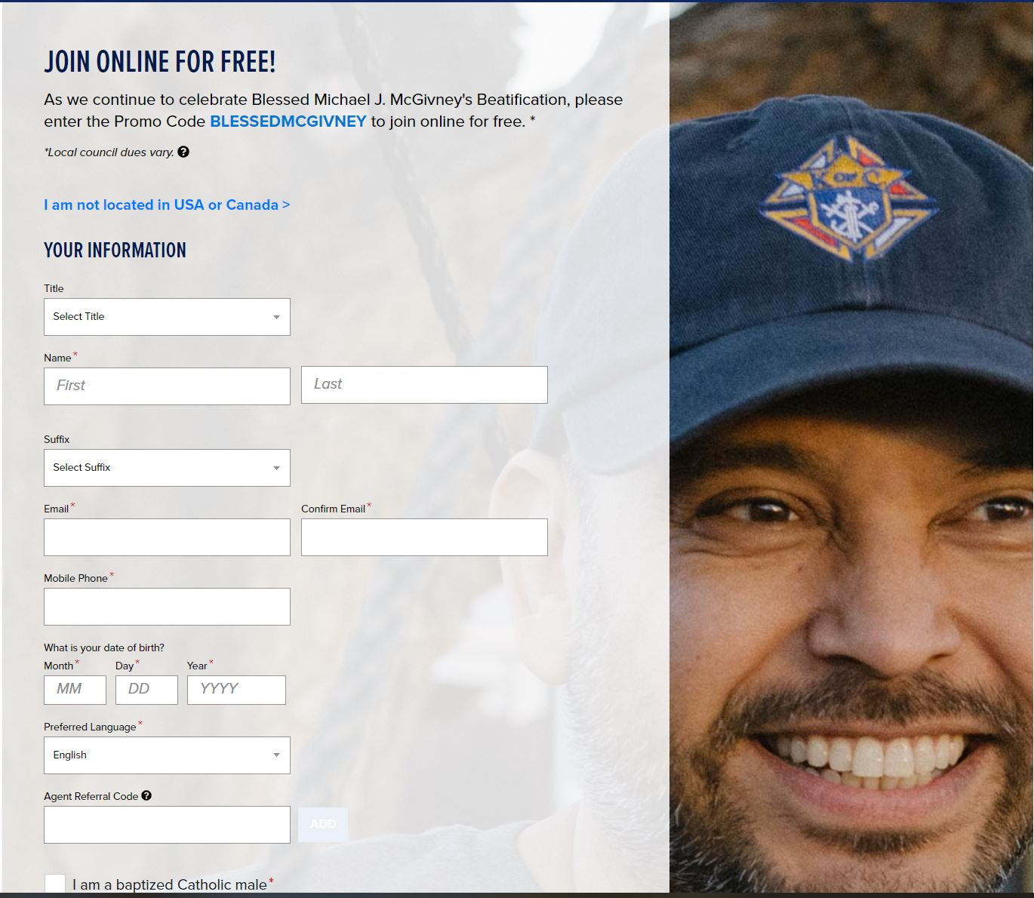
MEMBERSHIP
Online Membership
- KofC.org/join
- the best and easiest way
- conversions are key to growth
-- rate of 56% in Texas
Notes:
- Men are initially emailed 3 times to confirm membership
-- Instantly, 24 hours, 48 hours
-- Simply click button: “CONFIRM MEMBERSHIP”
- Unconfirmed men remain prospects and are emailed weekly
A member right away – access to benefits and resources
Learn more about the KofC firsthand through online activity

Slide 13
MEMBERSHIP
Prospect: Online Join Process
1. Completes Online Join Application
2. Confirms Membership
3. Becomes Online Member; Enrolled in Onboarding
4. Managed via Prospect Tab
5. Contacted by State or Local Council
6. Attends Exemplification (if desired)
7. Transfers to Local Council (if desired)

Slide 14
MEMBERSHIP
Managing the Prospect Tab
Approval/Rejection at Council level
Grand Knight
Financial Secretary
Read Only Access
District Deputy
Officer’s Online
Prospect Tab
Work with your Online Membership Chairman
Notes:
Stay in contact with members on the Council Prospect Tab
- Invite them to Council activities and events
Members rejected by a Council are returned to Council 98042

Slide 15
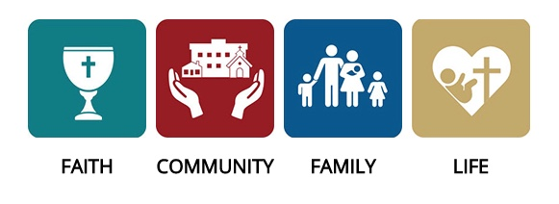
MEMBERSHIP
Recruitment
Prospect
+18-year-old Catholic man
Member
Online
Leader
Officer
Council
Affiliate
Director
Notes:
Where do I recruit? Everywhere
When do I recruit? All the time
Who should be recruiting? Every practical Catholic Man 18 YOA and over

Slide 16
MEMBERSHIP
The “Whys”
We help bring men back to the church
If not the Knights, then “who”?
Local communities need help now more than ever
What better way to do that than by participating in our Faith in Action and programs
The organization that provides fraternity and spiritual support to strengthen families and local communities – and help build back support for our Church, Bishops, and Priests
Help men become better Catholics, fathers, husbands
Tell your personal story
Why did you become a Knight?
How have you benefited from your membership?

Slide 17
MEMBERSHIP
Two Membership Awards to present in Fort Worth

Slide 18
MEMBERSHIP
Notes:
We have provided key pieces to the puzzle of Membership Growth … What are your questions?

Slide 19
Star Council Mission Statement
Supreme and State Awards are meant to encourage behaviors most seen in successful councils in all councils.
Our mission as a committee is the motivate councils to exhibit those behaviors through fraternal service to our councils, district deputies and diocesan deputies.
We thus will help fulfill Fr. McGivney’s vision of strong councils helping Catholic men walk in the footsteps of Christ.

Slide 20
Star Council Team
Bill Tillotson - Director
Clint Mendonca - Tyler, Beaumont, Victoria, Corpus Christi
Don Piwonka - Amarillo, Lubbock, San Angelo, El Paso
Brian Kozel - Galveston/Houston
Pat Ortiz - Austin, Brownsville
Hector Gutierrez - San Antonio, Laredo
Freddy Rodriguez - Dallas, Fort Worth

Slide 21
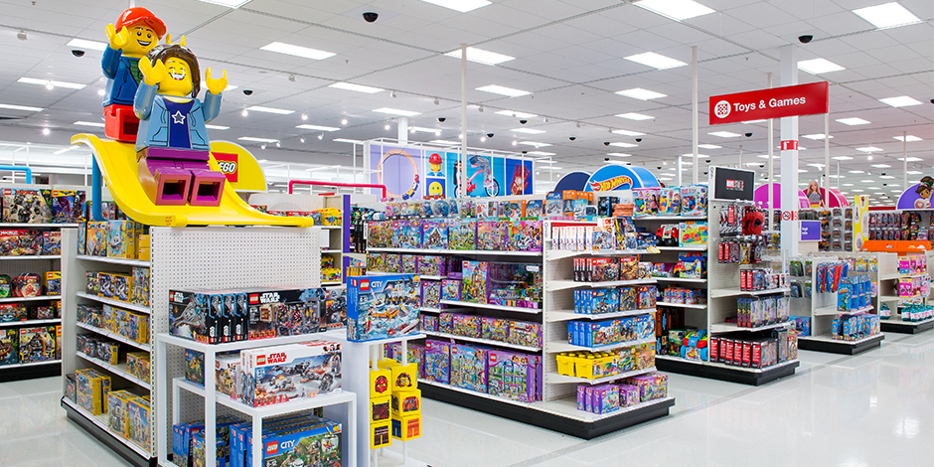
Star Council Why Are Awards Important?
We’re not in it for the awards!
We don’t care about seeing our names on plaques!

Slide 22
Star Council Why Are Awards Important?
Quality Control
The behaviors most commonly seen in successful councils

Slide 23
Star Council Star Council Award Requirements
Earn the Father McGivney Award for membership growth by June 30, 2024. Membership goals are set at 6% growth with a minimum of 5 and maximum of 15.
Earn the Founders’ Award for insurance growth by June 30, 2024 by hosting at least two Fraternal Benefits Events.
Earn the Columbian Award for Faith in Action programs by June 30, 2024 by conducting four programs in each of the four Faith in Action categories of Faith, Family, Community, and Life.

Slide 24
Star Council Star Council Award Requirements (Cont.)
Complete and send required forms (365, 1728, SP-7) to Supreme and the Texas State Office.
Be in good standing with Supreme (i.e., current on Per Caps).
Safe Environment – The Grand Knight and Program, Community and Family Directors must be Safe Environment compliant.

Slide 25
Star Council Fraternal Benefit Events
2 Fraternal Benefit Events Minimum
Total Number of members and membership eligible people required between all FBEs - 10 for councils with 99 or fewer members; 14 for councils with 100 or more members
Online submission required by Grand Knight
https://survey.alchemer.com/s3/7322809/Fraternal-Benefits-Event-Council-Report-v2
Goes direct to Supreme Council
Copy to General Agent with option to dispute

Slide 26
Star Council Safe Environment Requirements
The following positions must be current in the Safe Environment Training through Praesidium Academy: Grand Knight, Community, Family and Program Directors (and Squires Counselors, if applicable).
The following must also consent to a background check: Family and Community Directors (and Squires Counselors, if applicable).
E-mails are sent (one for training, another for background check, if required) after submittal of Forms 185 and 365.
If Knights has no online access, booklet training can be requested from Office of Youth Protection.

Slide 27
Star Council Safe Environment Requirements (Cont.)
Grand Knight and Directors are required to complete training and background check approval within 30 days.
Failure to do so will result in Director being removed from position by Supreme.
Make it clear to men you appoint they are expected to fulfill this requirement!
Since training is valid for 3 years, past directors are an excellent choice.

Slide 28
Star Council Lone Star Award for Excellence Requirements
Meet the Star Council Award criteria
Submit Form 185 by July 1, 2023
Pay State Per Capita by March 1, 2024
Meet State Charity Goal by June 30, 2024
Seat at least one delegate at the State Convention in Houston in April 2024
Submit Form 1295 Semi-Annual Audit by August 15, 2023 & February 15, 2024

Slide 29
Star Council Lone Star Award for Excellence with Distinction Requirements
Meet the Star Council Award criteria
Submit Form 185 by July 1, 2023
Pay State Per Capita by December 31, 2023
Meet State Charity Goal by December 31, 2023
Seat at least two delegates at the State Convention in Houston in April 2024
Submit Form 1295 Semi-Annual Audit by August 15, 2023 & February 15, 2024
File Special Olympics Activities using Form 10784 by January 31, 2024
Submit at least one entry for a State Service Program Award or Family of the Year or Bl. Fr. McGivney Award or Educational Grant by March 1, 2024

Slide 30
Star Council Star Tracker
Shows progress towards all these awards
Sent out via Constant Contact twice a month to DDs – once a month to GKs and FSs
More frequent as end of FY approaches
Sent as both Excel and PDF (learn how to use Excel)
All source data in Excel file
Changes for 2023-2024 – Council Lookup function, Star District progress, letter grade for council progress

Slide 31
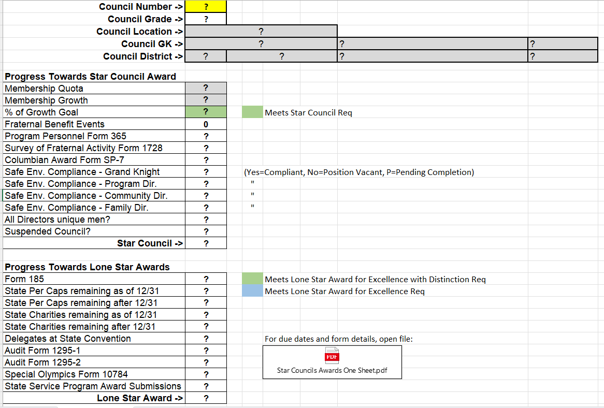
Star Council Star Tracker – Council Lookup Tab

Slide 32
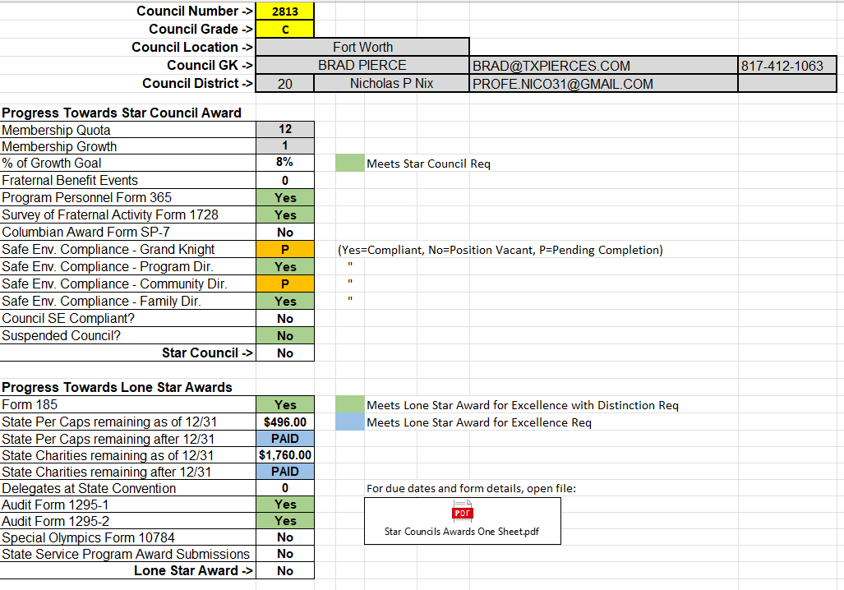
Star Council Star Tracker – Council Lookup Tab

Slide 33
Star Council Star Tracker – BY DISTRICT tab

Slide 34
Star Council Star Tracker – BY DISTRICT tab

Slide 35
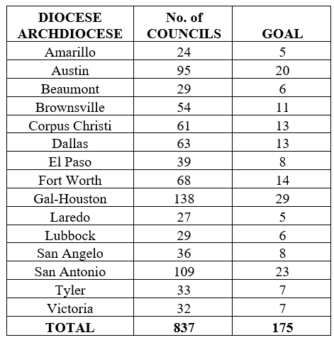
Star Council Goals

Slide 36
Star Council Strategies for Success
Use the Star Council program as a guide for the year
Have council planning meetings in July and January to plan required programs; membership drives, etc
Create plan to achieve 50% of the Star Council goals before Christmas
Adjust plans in January to achieve the other half
Watch for details on filling out SP-7 in the spring

Slide 37
Star Council Strategies for Success
Accuracy is nice, but…
Timeliness is mandatory

Slide 38
Star Council Conclusion
Awards encourage specific behaviors common to successful councils
Some award requirements have changed – make sure your councils know what needs to be done when
There are multiple resources available to help
Every council can be Star Council

Slide 39
Star Council

Slide 40
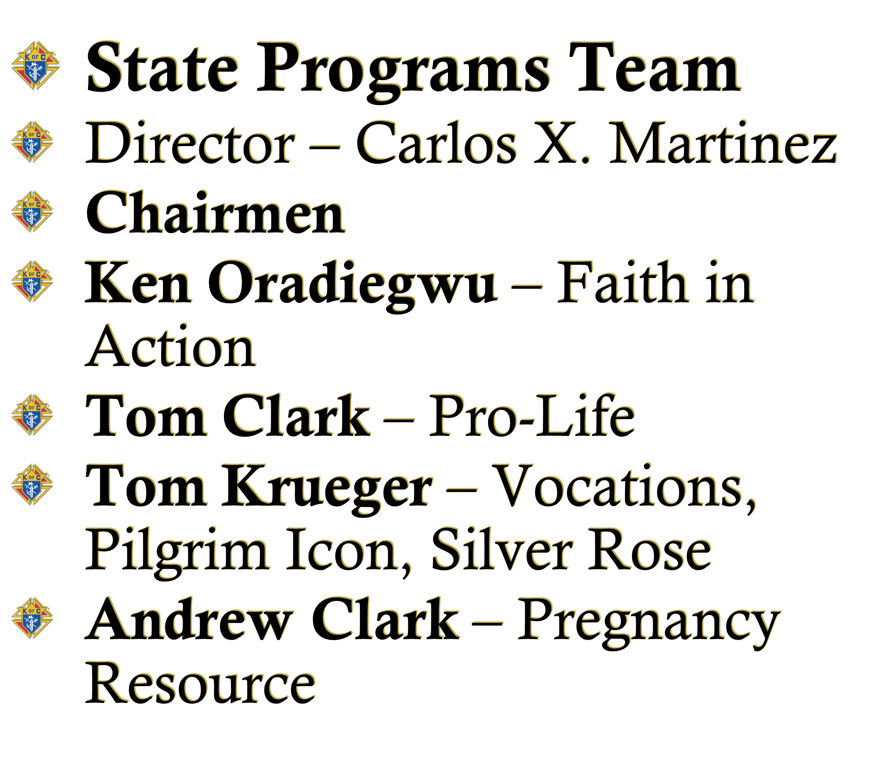
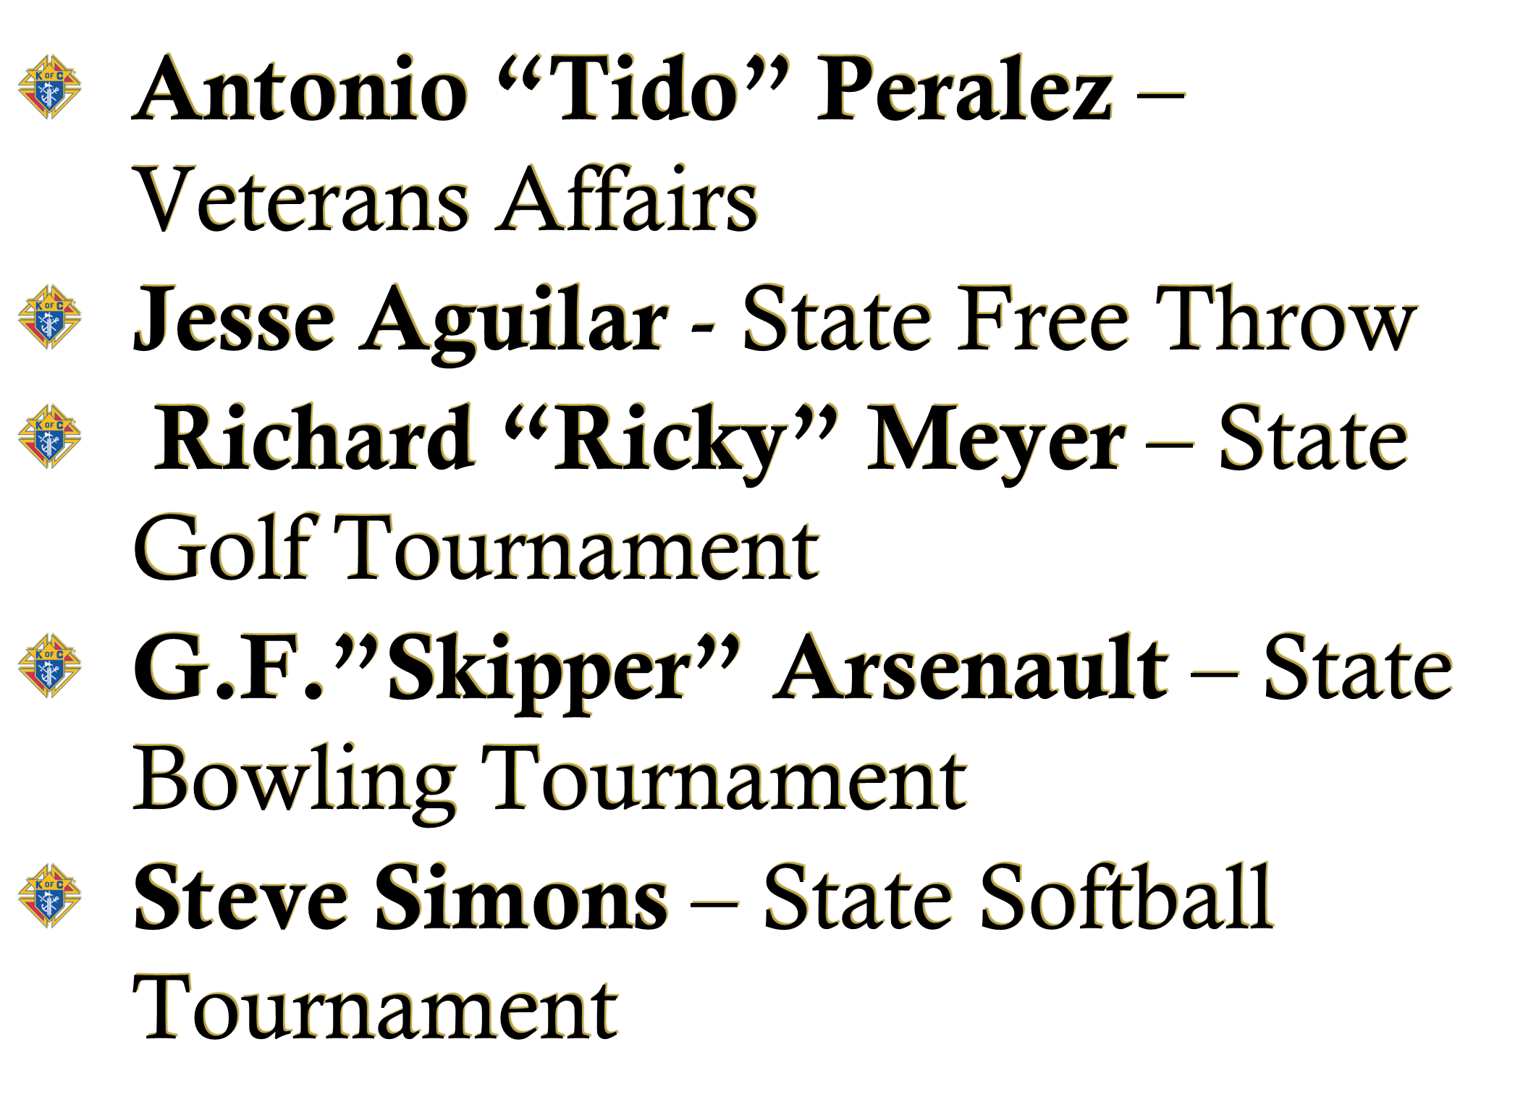
State Programs

Slide 41
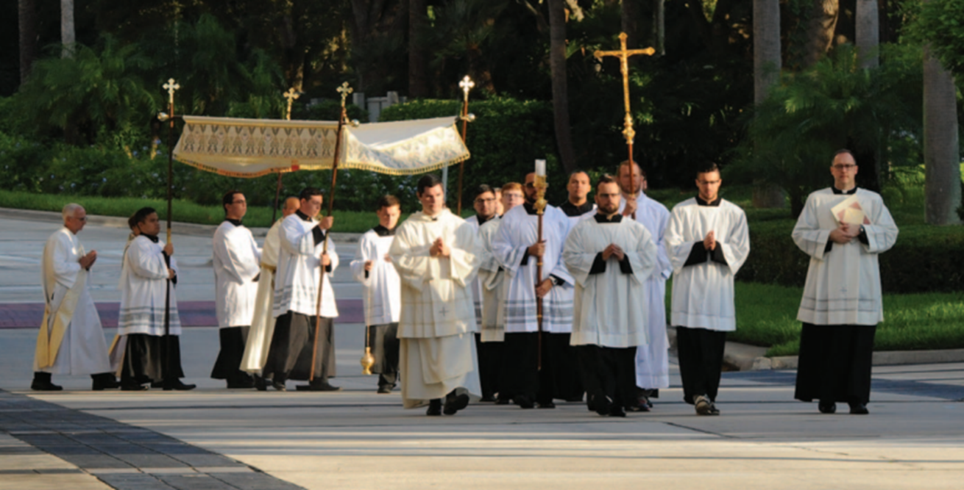
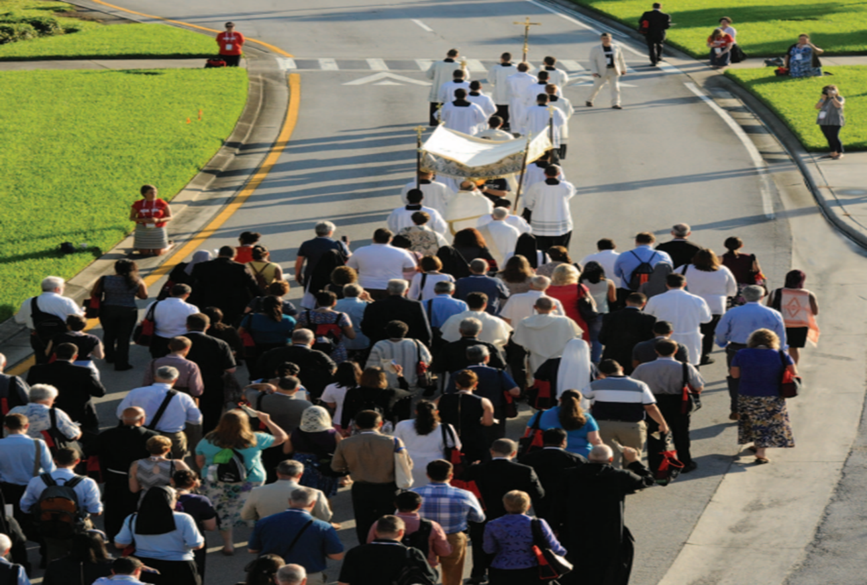
State Programs
Knights assist with processions & adoration
Resources available - kofc.org/eucharist

Slide 42
State Programs - Faith in Action
Program Categories
Faith
Family
Community
Life
Columbian Award requires
Faith – 4 activities
Family – 4 Activities
Community – 4 activities
Life – 4 activities
Featured Programs
Faith | Community
RSVP Into The Breach Spiritual Hour Holy Hour | Coats for Kids Global Wheelchair Mission Habitat for Humanity
Family | Life
Food for Families Family of the Month/Year Family Fully Alive Family Prayer Night | March for Life Special Olympics Ultrasound Initiative Pregnancy Center Support/ASAP(Aid & Support After Pregnancy)
Notes:
When your council conducts a featured program and satisfies the associated requirements, it will receive two credits toward that program category.

Slide 43
State Programs RSVP Vocation Resources
#1942 Vocations Handbook
#2863 RSVP Refund Application
#4688 RSVP Tri-Fold
#10743 Vertical Poster
#2959 “Keep the Faith Alive”
Vocations DVD’s: The vocation to the Priesthood – The Vocation to Marriage – The Vocation to Religious Life for Women

Slide 44
State Programs - RSVP
Vocations support and the RSVP Program consist of more than just giving money.
Section II: Moral Support must have information on how you have engaged with the seminarian, postulant or novice.
Have you invited them to join you for your Silver Rose Service? Meetings? Fish Fry’s? Pilgrim Icon Service?
Engage to build the alliance with the Knights when they are ordained.
WHERE IS MY REBATE??
Must be endorsed by the Seminarian, Postulant or Novi
Front and Back of check must be submitted
Do not make the check out to the Religious Order
Name of Seminary or convent is missing
Check not drawn on Council or Assembly checking account.

Slide 45
State Programs – Silver Rose
Traveling March through Mid-December, Silver Roses are stewarded by councils along routs from Canada to Mexico.
Each stop, the Silver Rose is a rosary-centered occasion for Knights, parishioners and community members to gather and pray.
Respect for life, for the Spiritual Renewal of each nation and for the advancement of the message of Our Lady of Guadalupe.

Slide 46
State Programs Silver Rose Resources
#10625 Guide Sheet
#10720 Schedule-Fillable
#10219 Vertical Poster
#10722 News Release-Fillable
#4841 Service Booklet
#10723 Horizontal Poster
#9754 Our Lady of Guadalupe Pledge Card

Slide 47
State Programs – Silver Rose Routes
Route 5 coming from Louisianna
Beaumont Diocese receives Silver Rose 26 November
Returned to Mid-Year 1 December
Travels to Laredo 9 December for transfer to Mexico
Route 7 coming from New Mexico
El Paso Diocese receives Silver Rose 16 July – 5 August
San Antonio Diocese receives from El Paso 6 August – 2 Sept.
Victoria Diocese receives from San Antonio 3 Sept. – 16 Sept.
Galveston Houston Diocese receives from Victoria Diocese 17 Sept. – 7 October
Beaumont Diocese receives from Galveston Houston Diocese
8 October – 21 October
Galveston Houston receives from Beaumont Diocese
22 October – 11 November
Corpus Christi Diocese receives from Galveston Houston
12 November – 29 November
Returns to Midyear 3 December
Travels to Laredo 9 December for transfer to Mexico
Route 8 Silver Rose
Currently in Ft. Worth Diocese, remains until Supreme Advisement
Special Event Silver Rose
Dallas Diocese 6 June – 29 June
Ft. Worth Diocese 30 June – 16 July
Return to Supreme 17 July
Route 2 coming from Oklahoma
Received by Ft. Worth Diocese 19 Nov – 30 Nov
Returns to Mid-Year 1 December
Travels to Laredo 9 December for transfer to Mexico
Route 3 coming from Arkansas
Tyler Diocese receives Silver Rose 19 Nov
Returned to Mid-Year 1 December
Travels to Laredo 9 December for transfer to Mexico
Notes:
Be sure to report your service with the Fraternal Programs Report Form (#10784) the day of the service. Any Brother can submit this form. This form is also found at the above QR Code in the Faith in Action Overview Tab.
Be sure to include your Financial Secretary with a copy of the submission so he can document on the Columbian Award Application (#SP-7)

Slide 48
State Programs – Pilgrim Icon
Knights of Columbus selects an icon of a saint whose patronage is particularly inspiring to Knights and their communities.
These icons serve as centerpieces for prayer services in parishes throughout the Order.
More than 174,800 council and parish prayer services with some 22 million participants have been held since the first traveling icon of Our Lady of Guadalupe in 1979.

Slide 49
State Programs – Pilgrim Icon
Each Diocese has an Icon at minimum 6 months every year
10 icons in the Texas Jurisdiction.
The St. Joseph Icon projected to remain until August 2024.
Check with your Icon chairman in your Diocese to verify there are enough prayer service booklets (#5050) and St. Joseph Prayer Cards (#11221) available for use well in advance of your service and order through Officers Online if you need more.
Be sure to report your service with the Fraternal Programs Report Form (#10784) the day of the service.
Please include your Financial Secretary on the submission so he can document on the Columbian Award Application (#SP-7)
#10682 Guidesheet
#5050 Prayer Booklet
#11221 St. Joseph Icon Prayer Card
#10738 Horizontal Poster
#10739 Verticle Poster
#11266 News Release
#11265 Schedule

Slide 50
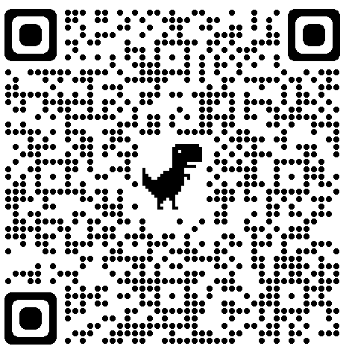
State Programs Faith in Action QR Code for Supreme Resources
Supreme has all you need to make a new member an expert with programs

Slide 51
Texas State Programs - LIFE
1) March for Life – State-Texas Rally for Life– Austin Saturday Jan 27th 2024
https://www.texasallianceforlife.org/events/2024-texas-rally-for-life/
Special Olympics – Working with Special Olympics affiliates, funding, sponsoring or volunteering for these events in home community.
Ultrasound Program – Major Influence for Life, women view their unborn children.
Pregnancy Center Support – Adopt a pregnancy center and provide material, labor and spiritual support throughout the year.

Slide 52
Texas State Programs - LIFE
All Knights are asked to pray 3 Hails Mary’s each day for the unborn
First is for the Unborn
Second is for the moms of those unborn children – that they allow their babies to live and be born
Third is for those in the abortion industry – that they turn away from their evil ways and instead seek the face of God.

Slide 53
Texas State programs - LIFE
It takes a real man, a Brave Knight, to earn and wear the ACE Wings!
Silver ACE Wings – 5 Public Pro-Life Events in 1 Fraternal year – Each event must be different
Special Forces ACE Wings – Once a Knight earns the Silver ACE Wings his Council can elect to present him (and Spouse) the SFAW
Gold – Diocesan Deputy may present 2 Knights from the Diocese the Gold ACE Wings per year.

Slide 54
Texas State Programs - LIFE
Pro-Life ACE Wings 20th Anniversary Pro-Life without Apology, Compromise or Exception
20 Years of ACE Wings.
A commemorative set is now available to those that have earned the Silver ACE Wings in the past or during 2023-2024.
Those that earn Silver ACE Wings in 2023-2024 will still receive the standard Silver ACE Wings. The 20th Anniversary ACE Wings will not automatically be sent out.
Cost is $10 plus shipping (Usually $4 for shipping)

Slide 55
Texas State Programs - LIFE
Pro-Life ACE Wings 20th Anniversary Pro-Life without Apology, Compromise or Exception

Slide 56
Texas State Programs Ultrasound Initiative
Texas currently has placed 105 machines with 4 currently pending waiting for funding approval.
We are doing great work to save lives, but WE know Texas can do even better
The program is designed to help get ultrasound machines placed in Crisis Pregnancy Centers with 50% matching funds from Supreme

Slide 57
Texas State Programs Ultrasound Initiative
Notify the State Ultrasound Chairman of your intention to participate in the Ultrasound Program.
Form 10715 Must first be filled out and approved by the Diocesan Right to Life Office (Bishop’s Office, not the KofC Diocesan Pro-Life Chairman).
Once approved by Supreme, THEN, Fundraising can begin.
Once funds are raised Form 10716 needs to be filled out and signed by the State Deputy.
Supreme Board will vote on the funds and a check will be issued to the PRC – usually takes 6 to 8 weeks once the 10716 is sent in.

Slide 58
Texas State Programs Ultrasound Initiative
There are several steps to the process, but I am here to help make the process as smooth as possible.
If you have any questions about the process or how to get started please reach out to me so I can help!
Andrew Clark
972-814-8975
situs6012@gmail.com

Slide 59
State Programs - ASAP
Aid and Support After Pregnancy (ASAP)
Support pregnant women, mothers and their babies
Financial support and material assistance. Every $500 Council donates, Supreme will match with $100

Slide 60
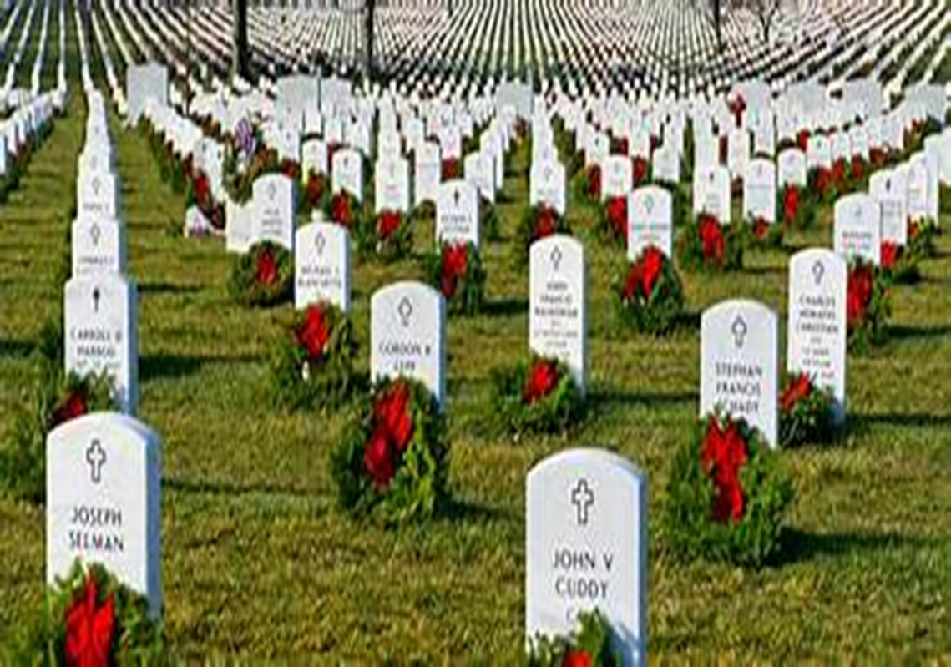
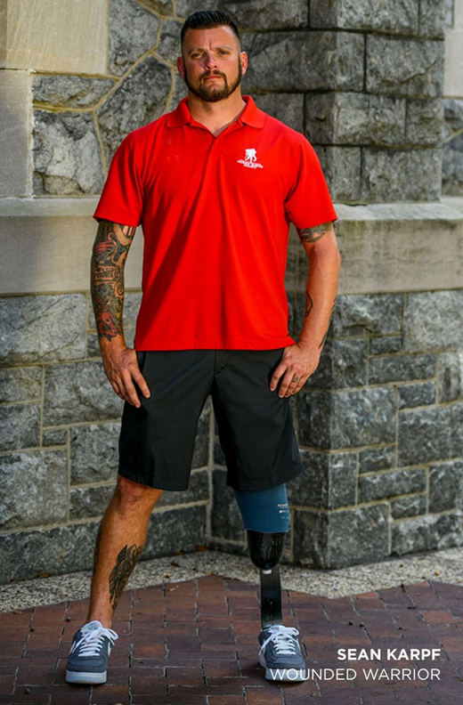
Texas State Programs Veterans Affairs
Veterans Values
Leadership
Management
Teamwork
Accountability
Responsibility
https://www.wreathsacrossamerica.org

Slide 61
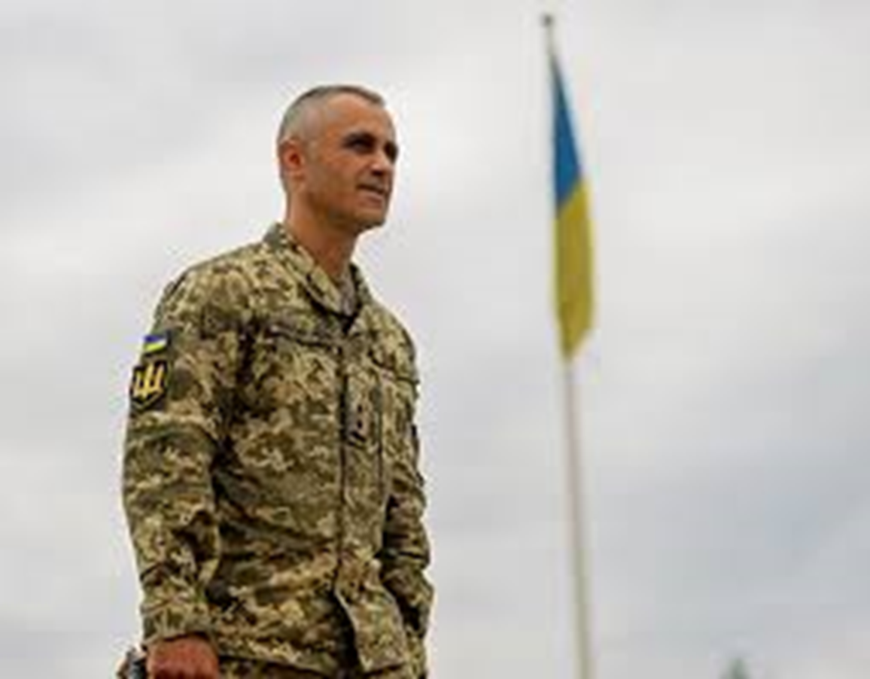
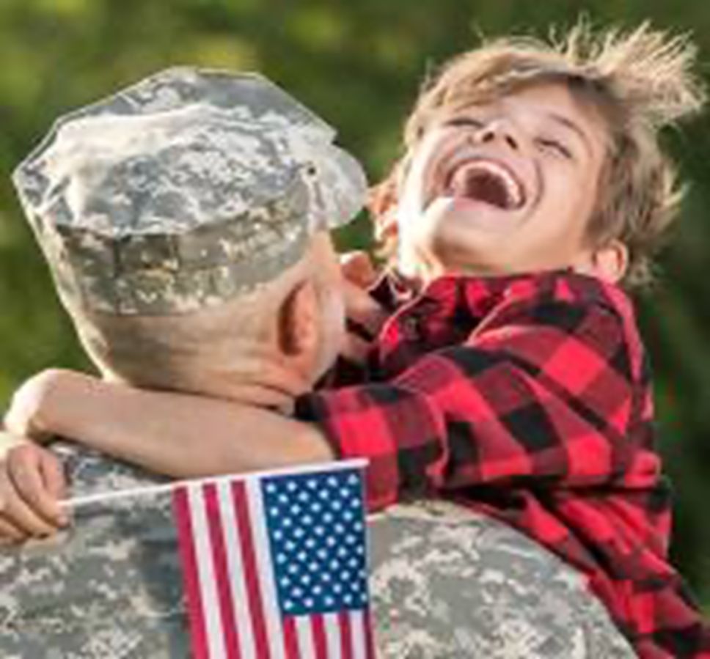
Texas State Programs Veterans Affairs
Veterans Visitations
V.A. Hospitals
Retirement facility
Veterans homes
Bring them to church
Record your Visitation Hours
Form 1728

Slide 62
Texas State Programs Veterans Affairs
Veteran assistance program
REMEMBER
our fallen U.S. veterans.
HONOR
those who serve.
TEACH
your children the value of freedom.
https://www.help.vamedclaims.com/va-claims

Slide 63
Texas State Programs Shield a Badge Program
Pray for your local Law Enforcement Officer for Their Safety, Good Judgement, and Safe Return Home.

Slide 64
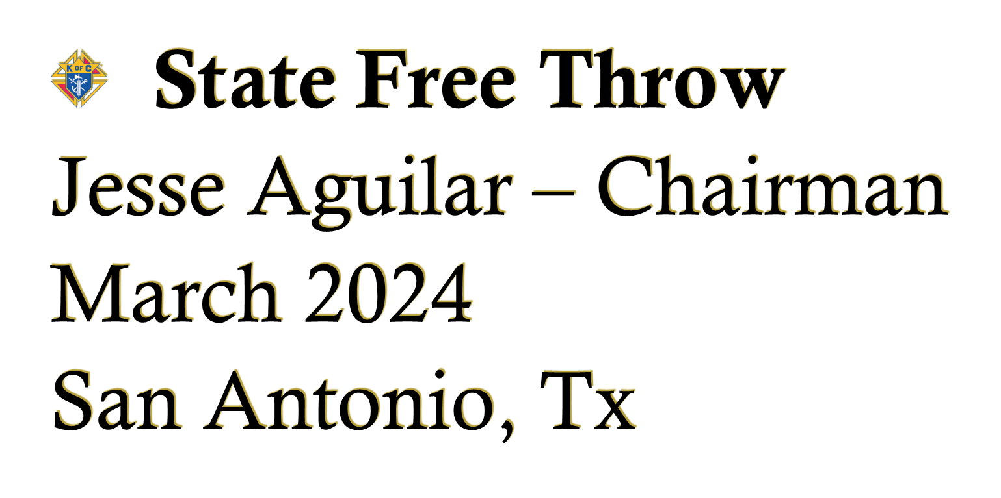
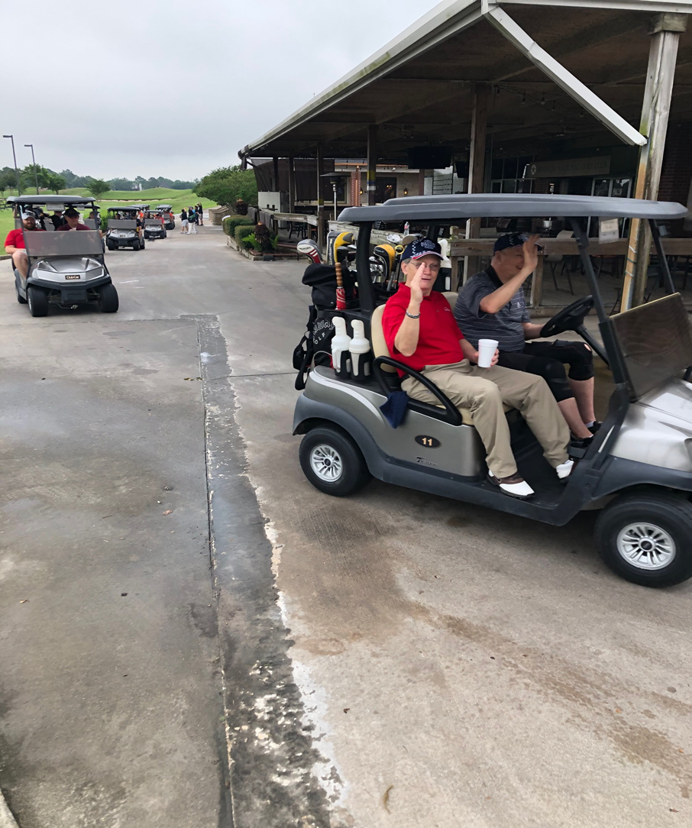
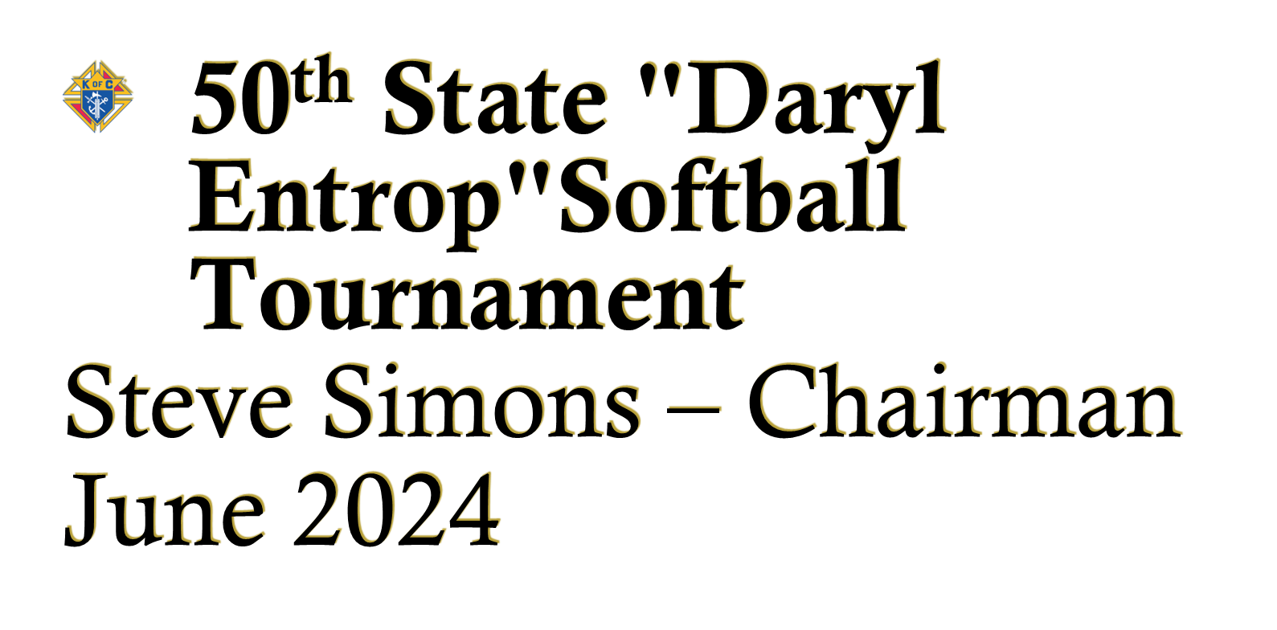
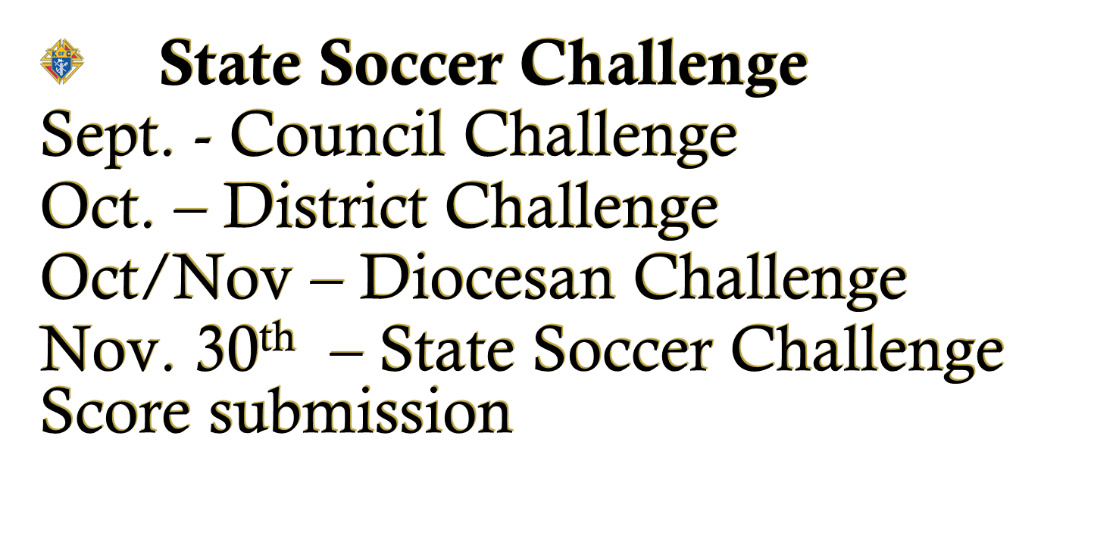
Texas State Programs - Athletics
49th State "Johnny Lopez" Golf Tournament
Ricky Meyer – Chairman
Larry Solanski – Co-Chairman
Sept. 15-16-17, 2023
Squaw Valley Golf Course
2439 E. US-67
Glen Rose, TX 76043
DEADLINE TO ENTER – AUG 15, 2023

Slide 65
State Programs – Youth
Catholic Essay Contest – TOPIC -
How can the Church Evangelize in the Digital Age?
Order Council Kits July/early August
Submit Essays to State Program Director by January 12, 2024.
Keep Christ in Christmas Contest
Order Council Kits September
Submit Posters to State Program Director by Feb. 9, 2024

Slide 66
The Circle of Success

Slide 67
Evangelization & Faith Formation
“zeal for the proclamation of the Gospel and generous concern for the needs of his brothers and sisters made him an outstanding witness of Christian solidarity and fraternal assistance”
-Pope Francis, Apostolic Letter proclaimed at Bl. McGivney’s Beatification Oct 31, 2020

Slide 68
Evangelization & Faith Formation
Help all men grow in their relationship with Jesus Christ
To provide opportunities for men to serve Christ in His Church including being a missionary disciple
To provide opportunities for men to serve those most in need in their communities and around the world IN THE NAME OF CHRIST JESUS
Promise to provide protection and aid to widows and orphans through our insurance arm

Slide 69
Evangelization & Faith Formation
Faith in Jesus Christ,
Evangelization and Discipleship
MUST permeate ALL aspects of
council life and membership engagement

Slide 70
COR
The Cor exists to form and strengthen Catholic men in faith and virtue as missionary disciples by drawing them into a deeper relationship with Jesus Christ through prayer, formation, and fraternity.
The goal of each Cor is to provide the opportunity for men to encounter Christ (to be evangelized), to strengthen our bonds of brotherhood, and to prepare for the courageous mission of evangelization.

Slide 71
COR
Additional gathering for the council focusing on men’s formation
Optional
Open to all men of the parish
Held monthly (at minimum)
Three key and required elements:
Prayer
Formation
Fraternity

Slide 72
COR
Prayer
Formation
Fraternity
Through prayer we strengthen our relationship with God as disciples (followers) of Jesus Christ and grow in our knowledge of Him.
\
(Examples: Rosary, Holy Hour, Chaplet of Divine Mercy, Lectio Divina)
The aim of Catholic formation is to be like Christ, taking on his character and virtue, life of prayer, and his mission.
(Examples: Into the Breach Video Series, Supreme Chaplain’s Monthly Challenge, small group discussion or Bible Study, Faith-inspired talks by clergy or others, reading a spiritual reflection)
The Cor Meeting brings men together as a band of brothers to strengthen each other in friendship and fraternity.
(Examples: Social events, BBQ, bonfire, intentional conversation, and shared meals i.e. donuts and coffee or pizza and beverages.)

Slide 73
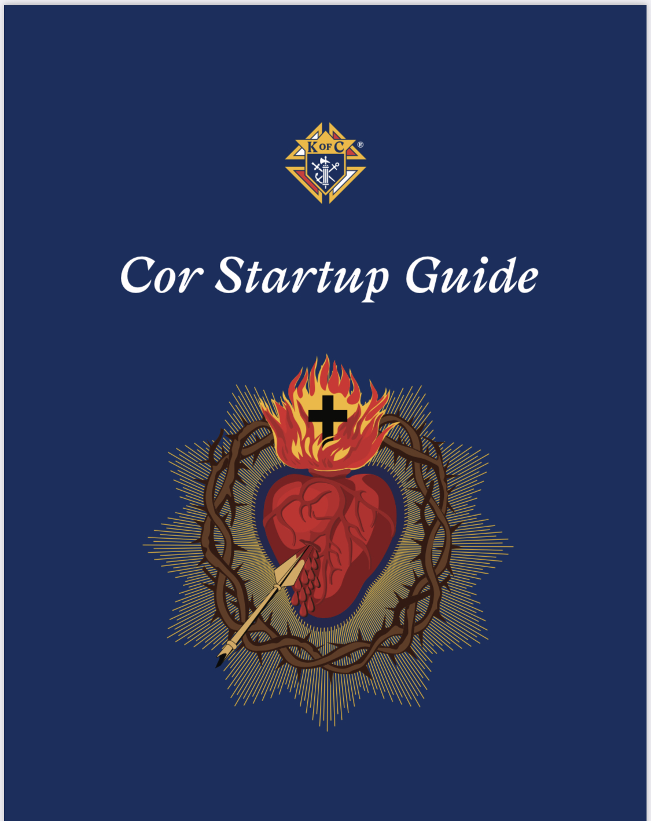
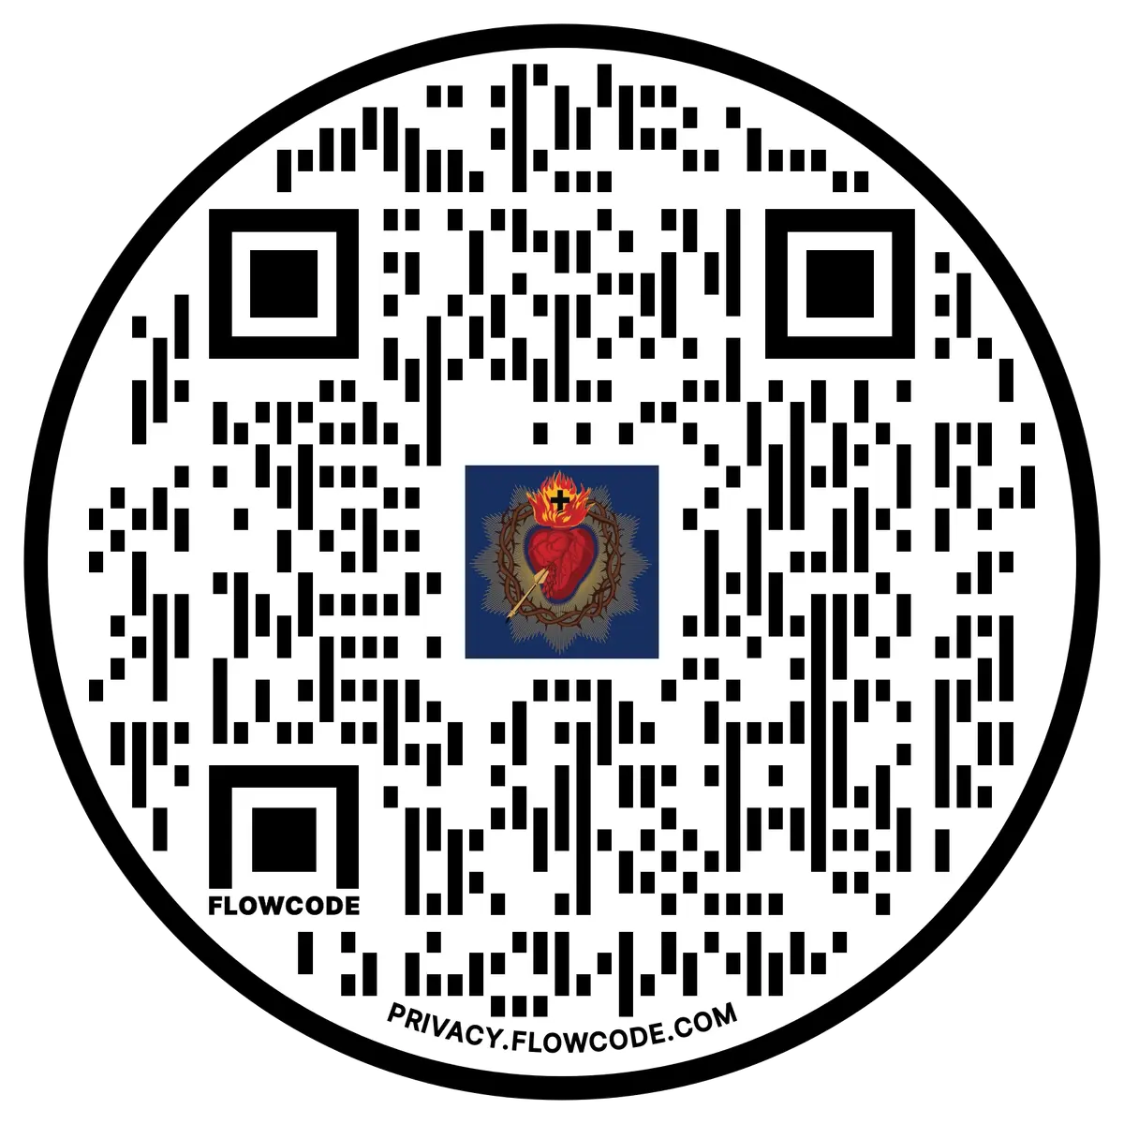
Evangelization & Faith Formation
New startup guide
Pairs down the
COR guidebook
for ease of implementation

Slide 74
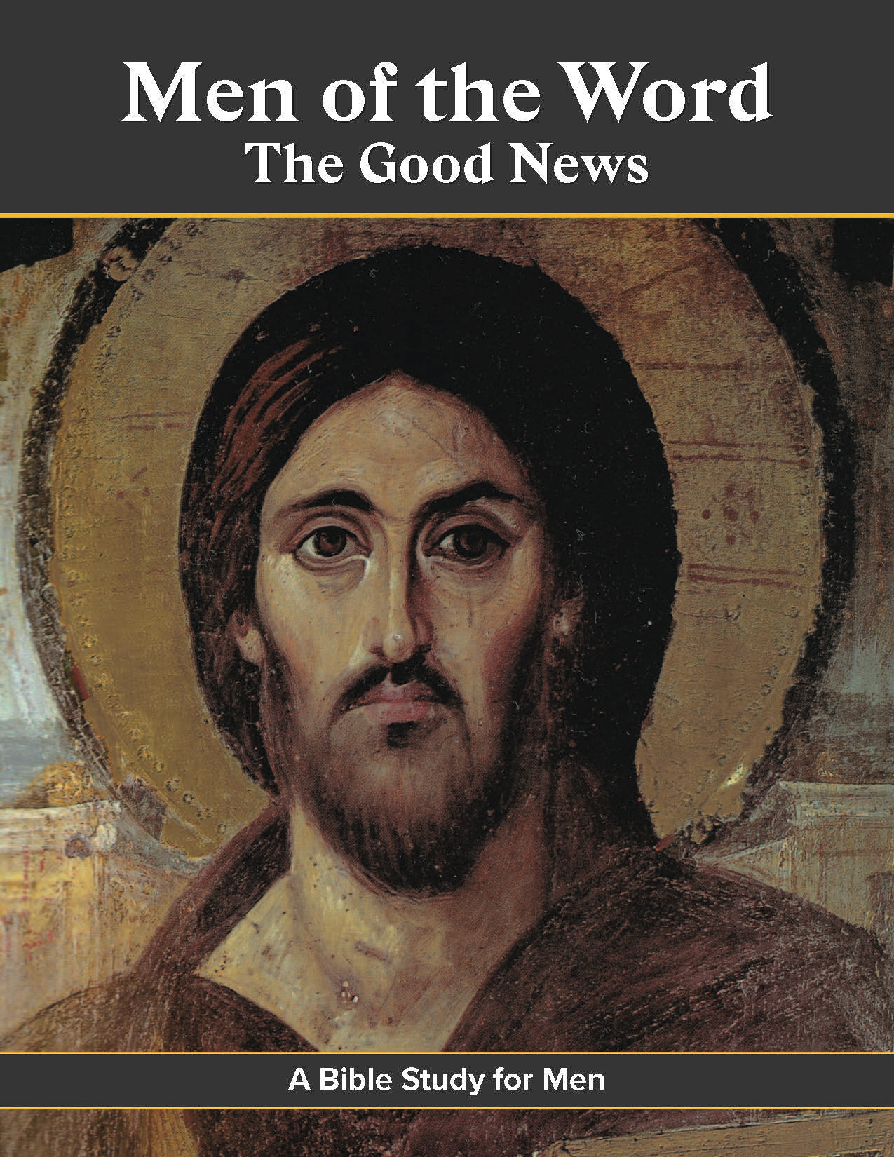
Evangelization & Faith Formation
Men of the Word
The Good News
Bible Study
Available this Fall
kofc.org/cis

Slide 75
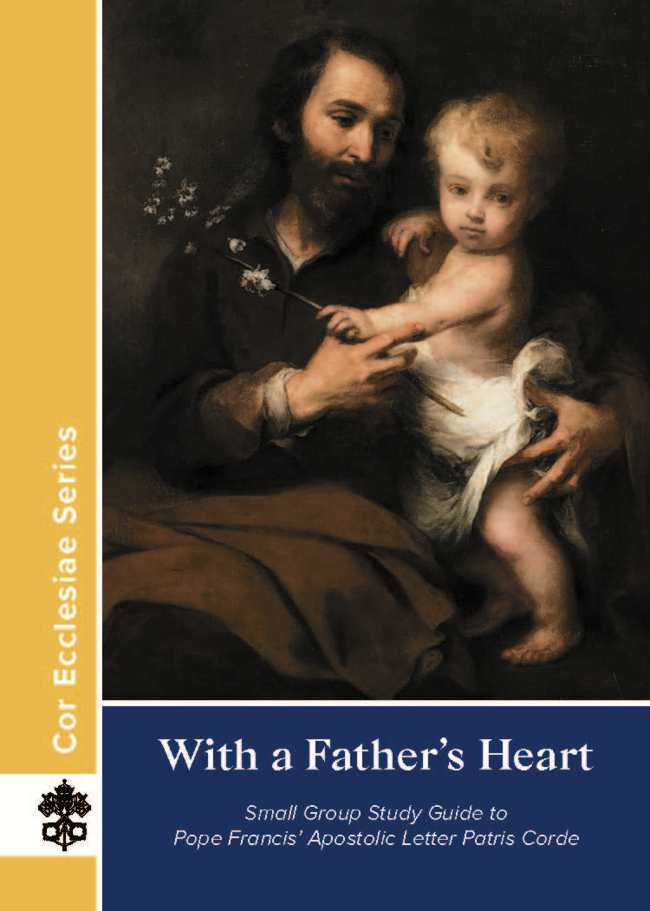
Evangelization & Faith Formation
With a Father's Heart
Study on St Joseph
Available at
kofc.org/cis

Slide 76
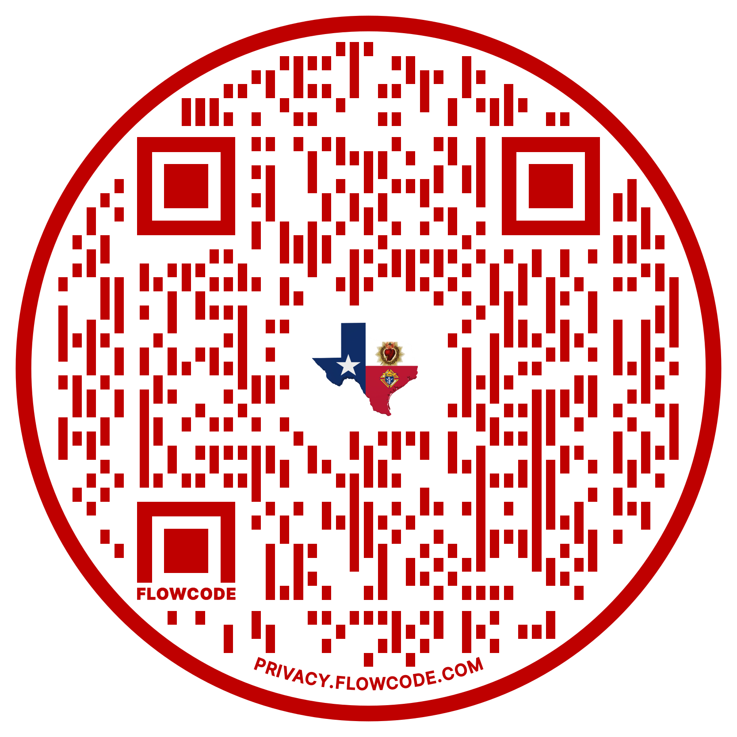
Evangelization & Faith Formation
Supreme COR Resources
for Councils

Slide 77
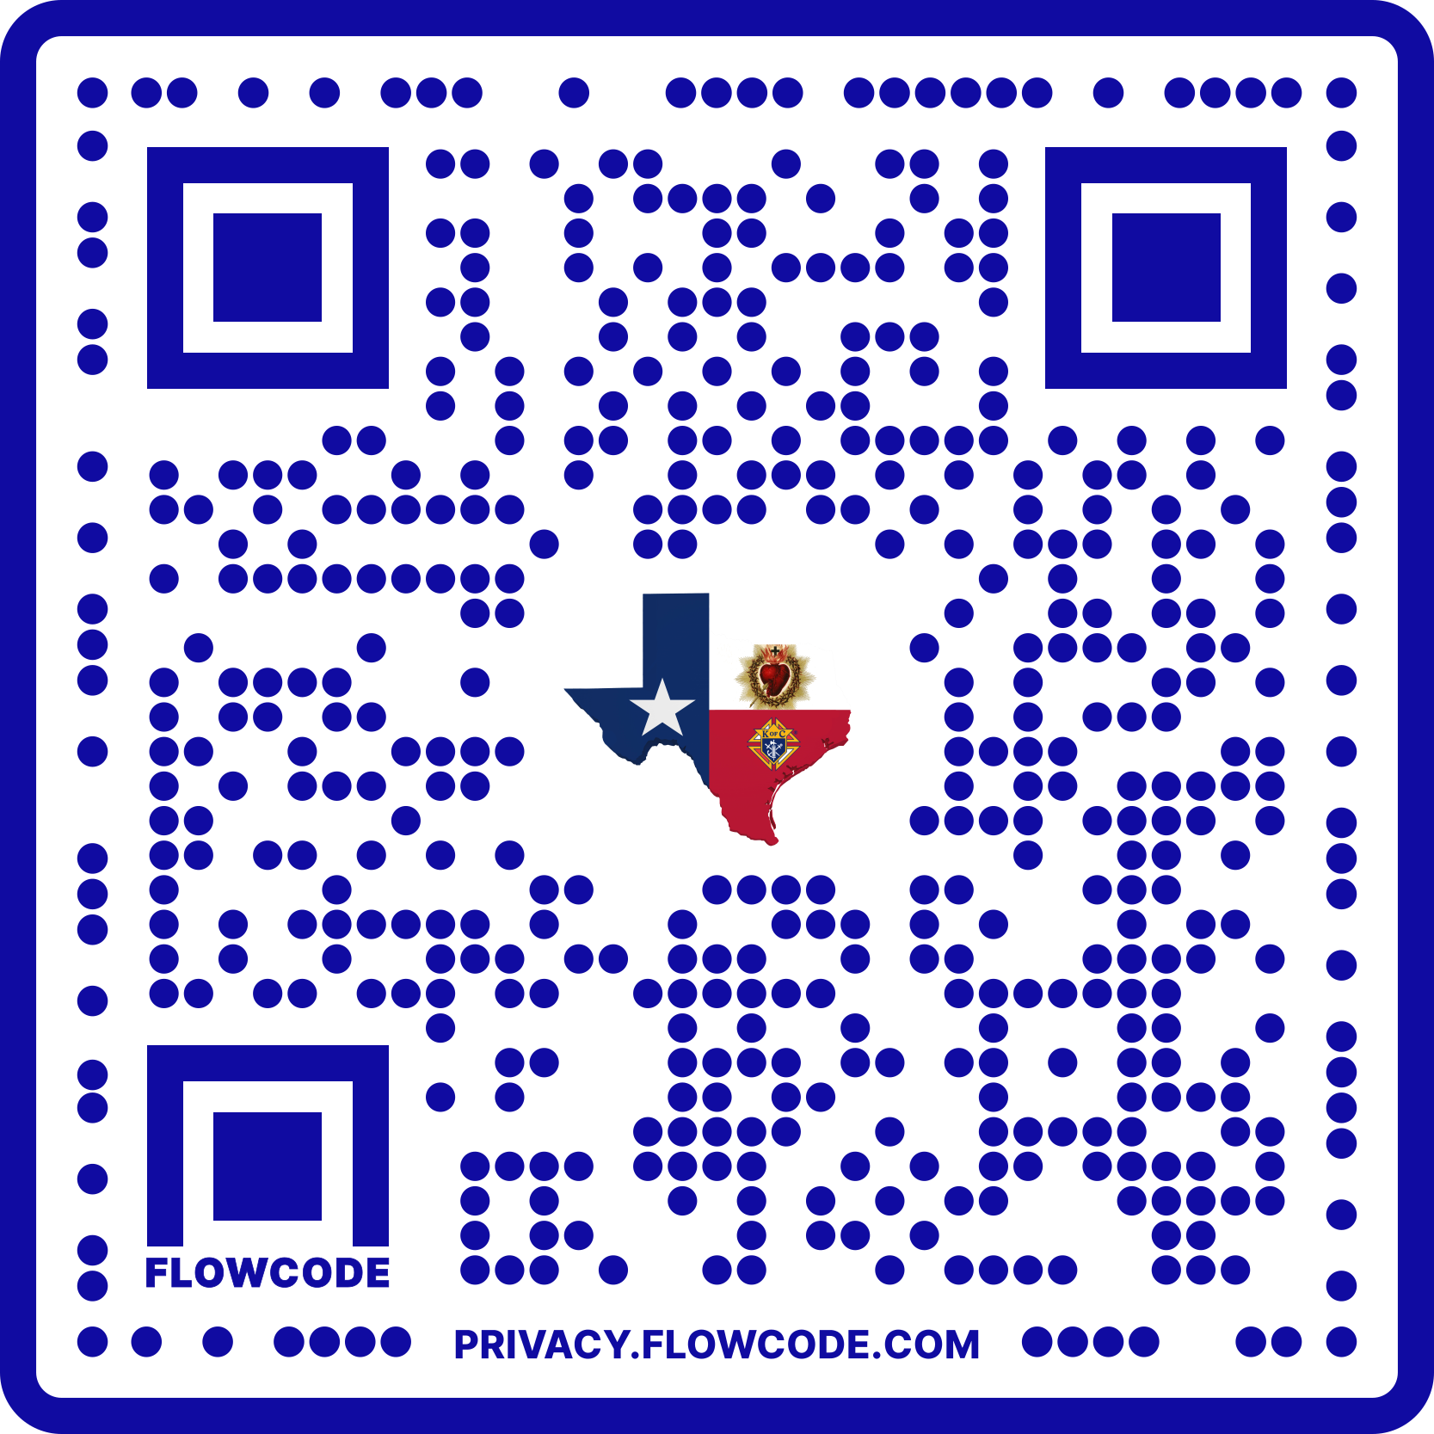
Evangelization & Faith Formation
COR Survey to be completed by council COR Director at the conclusion of each
COR gathering

Slide 79
State Charities
Reed A Fontenot, III
State Council Charities, Director

Slide 80
The first and foremost principle upon which our Order is founded.
CHARITY

Slide 81
State Charities
2022-23 – How did we do?
YOUR councils raised well over $968,000 or >119% of our State goal!
A RECORD NINE (of 15) Dioceses exceeded 100%
A RECORD 501 Quick Start councils!
The State Leadership and your Bishops THANK YOU!

Slide 82
Charity fundraising goals:
2023-2024 TSC Charity Goal = $840,000
Increase Charitable Volunteer Hours Documentation
(reported on Form 1728 due January 31, 2024)
TSC Charity PIN displayed by every Texas fraternal leader
- Diocesan Deputies please pick up your pins at our table
- just $20 for individual contributions!

Slide 83
Charity fundraising goals:
100% Council Participation
- last year all councils made goal in Dallas, Laredo, Tyler!
Increase number of councils earning Quick Start – pay 100% and pay State per Capita by 12/31/23
The rest of our councils earning Honor Roll – pay 100% and pay State per Capita by 6/30/24

Slide 84
State Charities
Each member of a council (less inactive insurance members) is assessed $10 for State Charities on July 1, 2023
Statements for State Charities and State per Capita to go to councils end of July, 2023
70% of these funds come back to your Bishop for his charity of choice
Once you reach 100% of your charity goal, 100% of any additional funds collected go to the Bishop
Please urge your councils to BUDGET for State Charities now! Just 3 cents per day per member!

Slide 85
State Charities American Wheelchair Mission
The 1st Lady’s Project!
Goal is to exceed $1,000,000 in contributions this year
Increase council and individual member contributions
Each wheelchair costs $150 – all councils should budget for at least one chair
Increase Wheelchair Sunday Drives

Slide 86
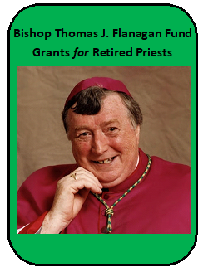
State Charities Bishop Thomas J. Flanagan Fund Goals
Fund established to provide Grants to our Retired Priests
Increase participation with TX DMV License Plate opportunity
- just $30 more per year for a “K of C” license plate!
Double the number of Texas K of C license plates issued
- currently ~1,000. We should easily get to over 2,000 this year!
This will increase Retired Priest fund distributions to each of the Diocese

Slide 87
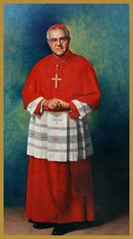
State Charities Cardinal Medeiros Fellows
Who should you consider as a potential recipient of a $1,000 fellowship?
All new Bishops in Texas
Districts - Retiring District Deputy, Retiring Diocesan Deputy
Councils - Council Chaplains, Retiring Parish Priests
Assemblies - Former Masters, Faithful Friars

Slide 88
State Charities Catholic Educational Grants
The interest from the Cardinal Medeiros Program funds all these grants! This trust began in 1993.
- 21 school grants
- 23 education grants
Increase program awareness to increase number of submissions received – due March 1, 2024

Slide 89
State Charities Special Olympics
Continue strong partnership with Special Olympics Texas.
Increase council and individual membership participation in events
Increase submission of Partnership Profile Report (Form 10784) – by paying State Charities you should report 2.5% of your contribution. Funds come back to Texas! An average of $9,000 but we could use more!

Slide 90
State Charities Emergency Response
The mission of our emergency response program is to provide GUIDANCE and ASSISTANCE to our brothers and councils before and after disasters.
Utilizing our state-wide network of Emergency Response Coordinators (ERC), we provide GUIDANCE to councils and Knights, thus allowing a concerted effort for all involved.
Our relief ASSISTANCE comes through charitable giving from our brothers and councils.

Slide 91
State Charities Emergency Response
Harry Storey – State Chairman
(214) 557-2923 or hss@storeycorp.net
Regional Emergency Response Coordinators:
Larry Pellerito – Central - Austin, Galveston/Houston, Victoria
(281) 224-3728 or kcpellerito@gmail.com
Ronnie Kwiat – Northeast – Beaumont, Dallas, Fort Worth, Tyler
(619) 368-5996 or rpkwiat48@gmail.com
Michael Samp – West – Amarillo, Lubbock, El Paso, San Angelo
(432) 352-4259 or thelungpro@gmail.com
OPEN – South – San Antonio, Laredo, Corpus Christi, Brownsville

Slide 92
State Charities Emergency Response
What Every Council Should Do To Prepare
Know who is your Diocesan ERC and save his contact information. He is the first person to call when disaster strikes.
Select a Council Emergency Response Coordinator & arrange training with the Diocesan ERC.
Read information at www.KofC.org/Prepare
Budget $500 for disaster relief & make your State Charities contribution.

Slide 93
CHARITY
The first and foremost principle upon which our Order is founded.
Support your Bishop by supporting State Charities!

Slide 94
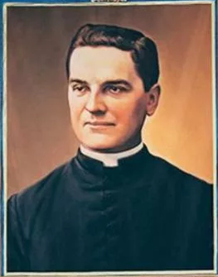
Council Growth
Blessed Father McGivney’s vision was to create a group of laymen to help his parish to care for the widows & orphans to keep the family unit together, and strengthen the men’s faith. This notion spread quickly and Councils began to spring up across this great land.
Supreme Knight Patrick Kelly has challenged us to make a Council or Knight’s presence in every Parish or Mission

Slide 95
Council Growth
How do we make the Vision come true?
New Councils – in all languages
Reactivations of any Suspended or Dormant Council
Roundtables
College Councils
Council Retention

Slide 96
Council Growth
The Team:
Director – David Zeigler – (903) 926-0776; zigsr@att.net
New Council Development (NCD) - Rick Guzman, Chairman - skrickguzman6021@gmail.com
Round Tables - Dan Aguilar, Chairman - daguilar1@satx.rr.com
Reactivations and Mergers - Greg Dutchover, Chairman- gdutchover@musiccitymall.net
Council Retention - Michael Barnett, Chairman - mbarnett360@yahoo.com
Hispanic Council Development –
Miguel Torres, North Chairman - mike.torres1681@icloud.com
Carlos Rene Ramirez, South Chairman - carlosrenermz@gmail.com
College Council Development - Archie Wright II, Chairman - allw1989@yahoo.com

Slide 97
Council Growth
Council Retention
Supreme Per Capita
total $6.50/member
($4.50 per capita & Catholic Advertisement &
$2.00 Culture of Life)
Assessed ½ twice a year: ($3.25/member each)
July 1 Roster – Due by October 10
January 1 Roster – Due by April 10
Council Statements will only be available on Officers online, Go To:
www.kofc.org> sign in>Click on Reports tab>Click on Financial Statement
Councils that do not pay by dates above will be suspended & not eligible for any Supreme Award (until paid in full)

Slide 98
Council Growth
Council Retention
Texas State Council Per Capita
$10.00/member
As approved at the 119th State Convention
Assessed once a year in July (sent with State Charities Statement)
One is a blue statement & one is yellow
Due by March 1 or earlier for certain State Awards
Councils that do not pay by date above will be suspended & not eligible for any State Activity or Award
Includes Diocesan Deputy, District Deputy, or Individual Awards
if home council is not paid

Slide 99
Council Growth
Hispanic Council Development
Goal:
To promote ethnic membership growth, growing the number of Spanish speaking councils and reactivating suspended Spanish speaking councils. Additionally, establishing a firm foundation of training to assure sustainability of all the Spanish speaking councils.
Fastest growing population in the State.
We owe it to every eligible Catholic man 18 years & older, the opportunity to be an active Knight in an active Council, regardless of language. Contact one of our chairman for help.

Slide 100
Council Growth
Roundtables
Purpose:
“To actively engage Knights of Columbus members to aid the parish and sustain visible Catholic action through works of charity in every parish and mission throughout the Order, and in sustainable parishes to form the roundtable into a fully functioning council.” (Supreme website)

Slide 101
Council Growth
Roundtables
Roundtables help both the parish & supporting Council
Should have regular meeting prior to the Council meeting
The Coordinator is to be a member of the adjacent Parish/Mission & of the supporting Council & attend both the Roundtable meeting & Council Meetings to report back & forth the needs of the Parish/Mission & Council
Parish Round Table Coordinator (Form #2629) DUE: June 30
(by December 31 for State Incentive – see Star Guide) https://www.kofc.org/un/en/forms/council/roundtable_coordinators2629_p.pdf
Grand Knight must sign back of form!
Submit to Supreme, State Roundtable Chairman, Diocesan Deputy, & District Deputy

Slide 102
Council Growth

Slide 103
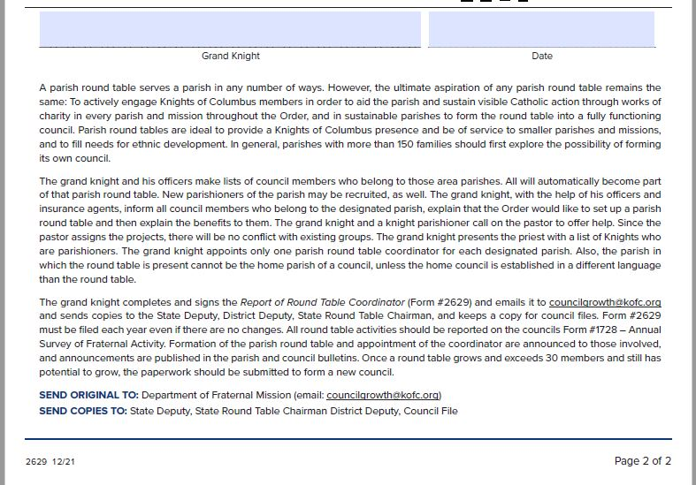
Council Growth

Slide 104
Council Growth
College Councils
Future Leaders of the Order & of our society
Keeps young men invested in their Faith
Our Goals:
To promote active growth in established College Councils
Reactivate the non-active College Councils
Establish a College Council Roundtable with close campus or Council
Conduct a State Wide College Council Conference –
November 10-12, 2023 – Hosted by UTSA
registration information coming soon

Slide 105
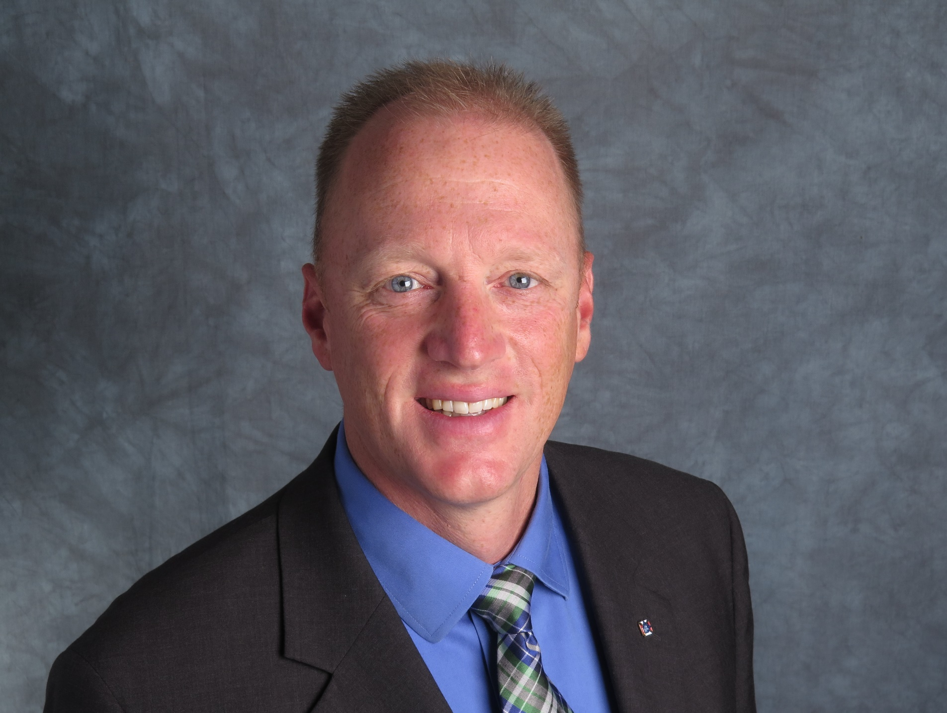
Education/Training/Communication
Ed Tydings, ETC Director
Edwardtydings@gmail.com
512-565-9749

Slide 106
Education/Training/Communication
ETC Team
Ed Tydings – ETC Director
Presentations – Anson Geisel
Social Media – Josh Jones
Webmaster & Photographer – Mark Johnson
Scorekeeper – Greg Wilson

Slide 107
Education/Training/Communication
The Financial Secretary Training Team
Chairman and El Paso / San Angelo – David Solis
Austin / San Antonio – Pete Donahoe
Dallas / Ft. Worth / Tyler – Victor Garza
Galveston-Houston / Beaumont / Victoria – JL Giegerich
Corpus Christi / Brownsville / Laredo – Michael Murphy
Amarillo / Lubbock – Steven Webb

Slide 108
Education/Training/Communication
Who are we?
We are the leadership for the Texas Knights of Columbus
We are all volunteers, but we also volunteered to be leaders
We have a responsibility to prepare ourselves for our various roles

Slide 109
Education/Training/Communication
What are we?
We are the team that will help provide education and training to our fraternal leaders
We are the team that will help communicate our goals and our accomplishments

Slide 110
Education/Training/Communication
What else do we do?
Diocesan and District Deputy of the Year
The Finish Line
The Texas Knight and the Website
Constant Contact
The Star Guide

Slide 111
Education/Training/Communication
Where?
The Supreme website www.kofc.org
District Deputies request login help at 1-800-380-9995

Slide 112
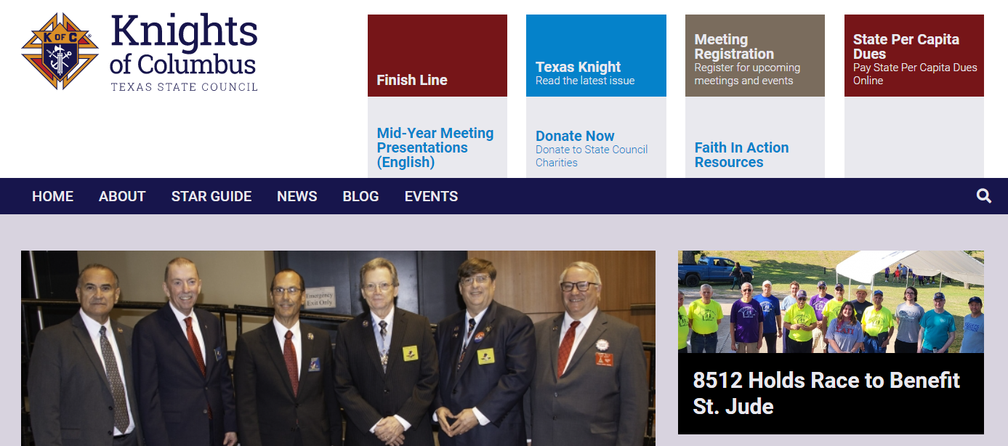
Education/Training/Communication
Where?
The Texas state council website www.tkofc.org

Slide 113
Education/Training/Communication
Where can we share it?
Texas State Council Website – www.tkofc.org
Texas State Council Facebook page – facebook.com/txkofc
Texas State Council Twitter page – twitter.com/txkofc
Texas State Council Instagram page – instagram.com/txkofc
Texas State Council YouTube youtube.com/@TexasKnights

Slide 114
Education/Training/Communication
Why do we do it?
Catholic marriages are down
Children are not receiving the sacraments
Families are leaving the church
Children whose fathers attend Mass are more likely to remain in the faith

Slide 115
Education/Training/Communication
When do we promote ourselves?
Every day on social media
Every quarter in the Texas Knight, articles due August 1, November 1, February 1, and May 1
As often as you can on www.tkofc.org
Leading up to membership drives
Leading up to major events (fish fries, family picnics)

Slide 116
Education/Training/Communication
Texas Knight Reporter Award
For outstanding reporting of local Knights of Columbus Events
to the Texas Knight.
Applications and links should be sent to the communications team at communications@tkofc.org or it can be snail mailed.
Due by March 1.
1st Place award to be a 10” Wi-Fi tablet with front & rear Camera and case. 2nd & 3rd Place awards to receive a TSC Shirt with name &
“Texas Knight Reporter” as a title.

Slide 117
Education/Training/Communication
Council Communication Award
For those Councils for excellence in digital media communications
Post all activity on the on the Texas State Council Facebook page. The Council should use the hashtag #TX(your Council #). An Example is #TX1422.
A Council Social Media Coordinator must be appointed for the Council to qualify for this award.
Applications and links should be emailed to the communications team at communications@tkofc.org .
Due by March 1.
1st Place award to be a 10” Wi-Fi tablet with front & rear Camera and case
2nd & 3rd Place awards to receive a TSC Shirt with name &
“TSC Council Communicator” as a title.

Slide 118
Education/Training/Communication
Financial Secretary Training
Schedule at least 2 training sessions per diocese each year
Both live and virtual training options

Slide 119
Education/Training/Communication
Form Submissions
Submit all forms electronically
Copy all Supreme forms to forms@tkofc.org
For forms requiring State Deputy signature, sdsignature@tkofc.org

