Slide 1

Dallas Diocese Chapter

Slide 2
THANK YOU BROTHERS!!

Slide 3
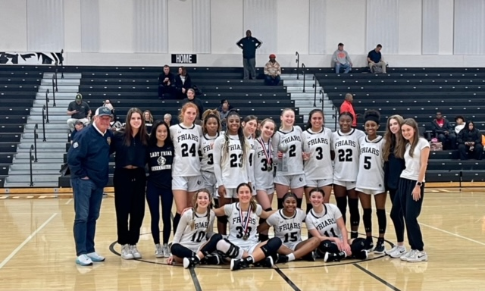
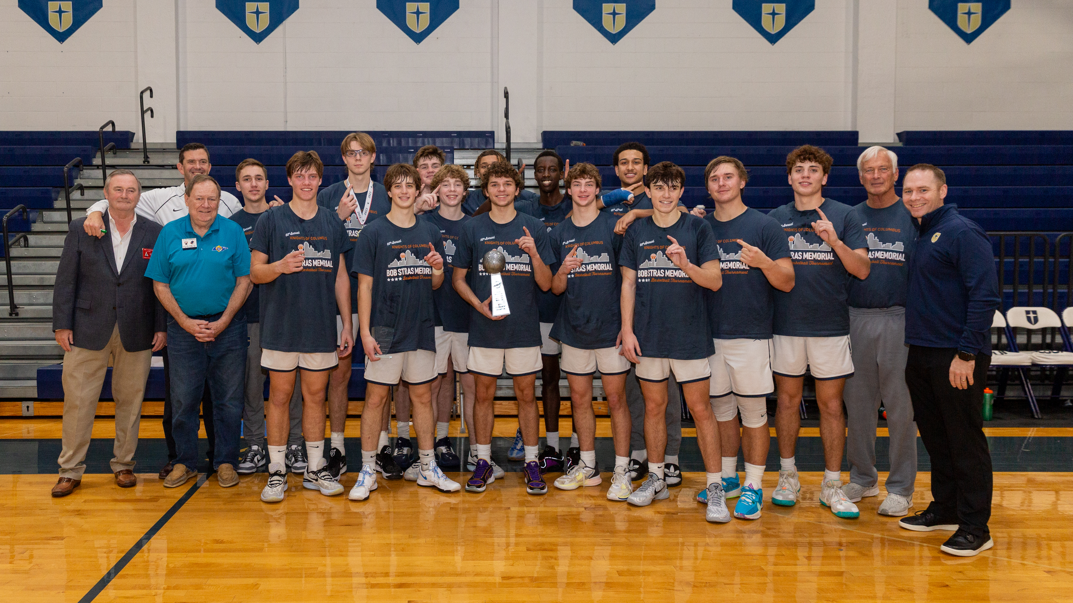
The 60th Annual Knights of Columbus Bob Stras Memorial High School Basketball Tournament
Eight Girls Teams at Bishop Lynch
Eight Boys Teams at Jesuit Dallas

Slide 4
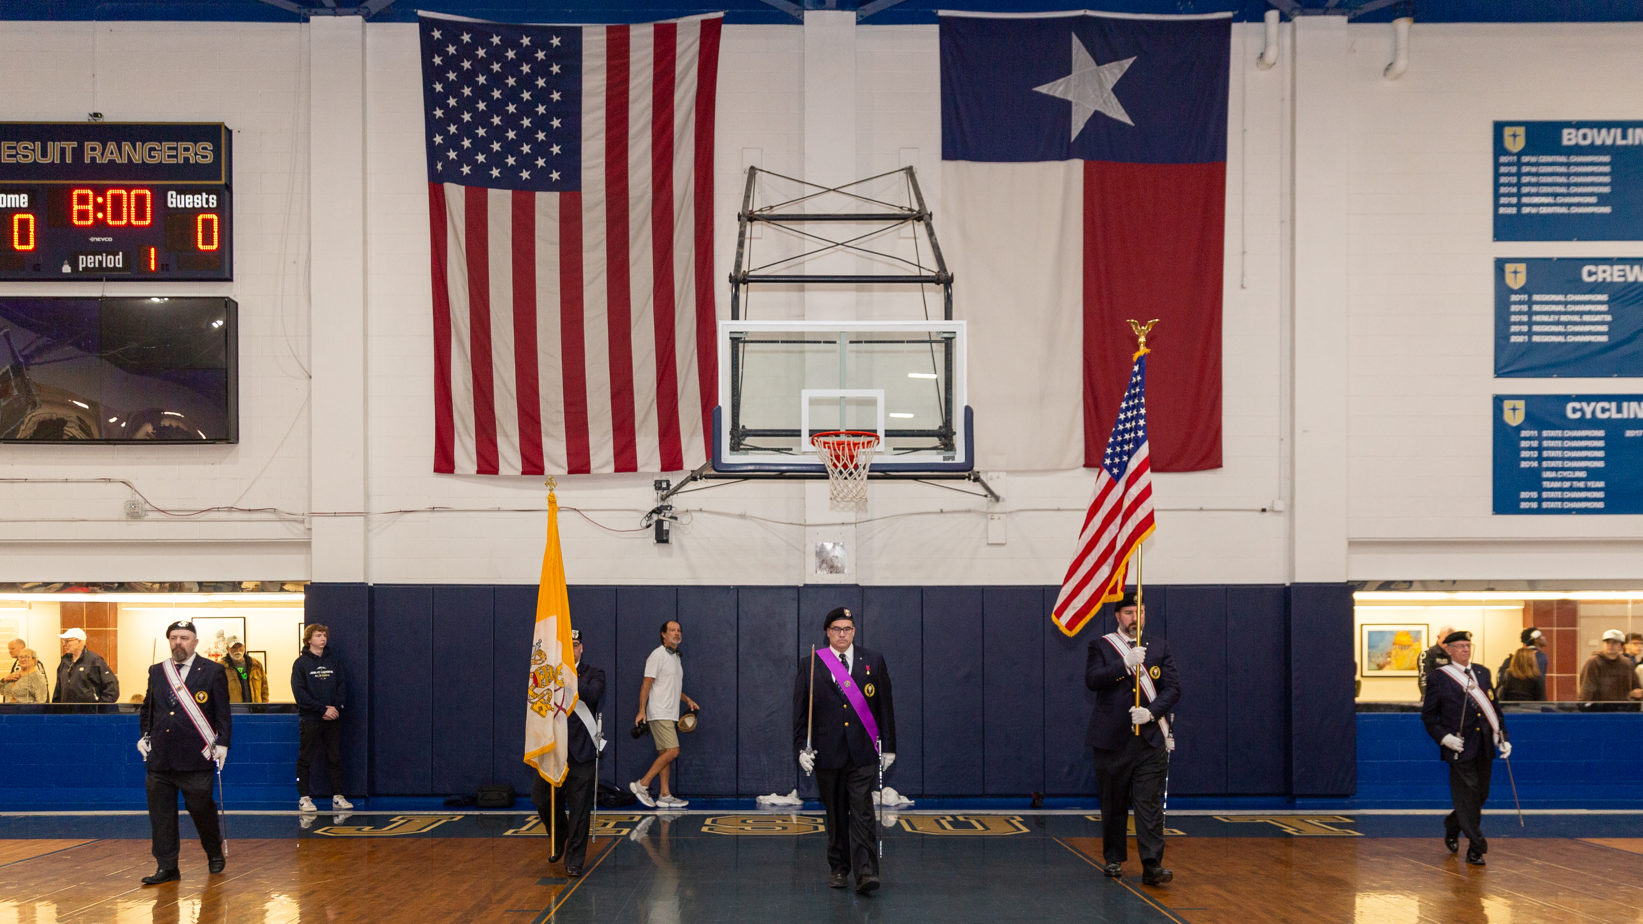
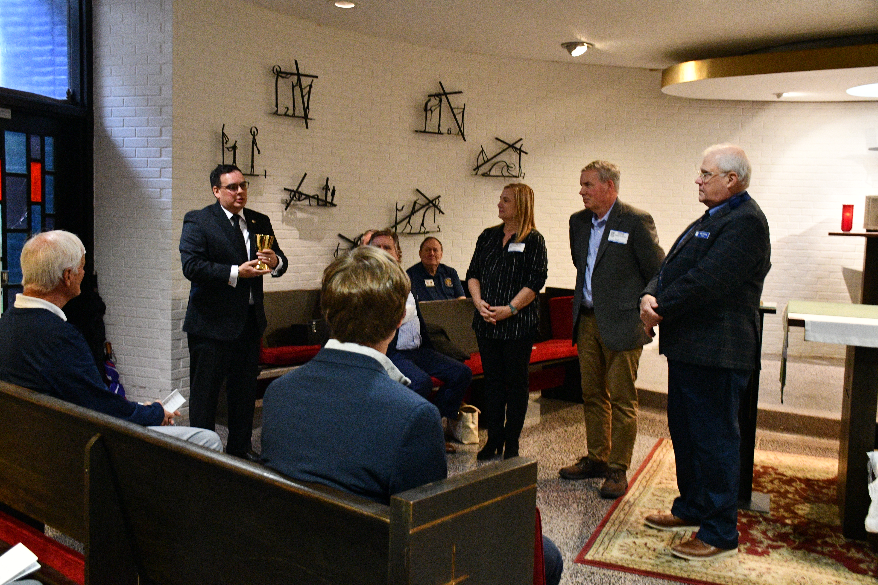
The 60th Annual Knights of Columbus Bob Stras Memorial High School Basketball Tournament
Color Corps At Both Sites
4th Degree Chalice Presentation

Slide 5
Record Results For 2023!
Elements | 2022 Results
Program | 48 Pages With Twice the Number of Color Pages
School Stipends | $5,000 For Each Host School – 25% Increase!
Tee Shirts, Luggage Tags and Trophies | All Provided By The Knights
Post Game Food | 5 Out Of 6 Days (3 Per Campus) Provided and/or Served By Brother Knights
Commemorative Coach’s Gifts | Specially Inscribed Power Pack
Color Corp | Color Corp Present To Present The Colors At Both The Boys And Girls Championship Games
Tournament Results | Jesuit won the Championship on the Boys Side and Bishop Lynch Finished 2nd on the Girls side.

Slide 6
Thanks To Our Sponsors & Partners ....
Councils and Assemblies – 19 Councils and Assemblies Advertised This Year. Special Thanks to Council 5052 & Assembly 2144
Individual Knight Sponsors – 55 Individual Sponsors (4 Full Page, 1 Half Page, 37 Platinum and 13 Gold Sponsorships)
Affiliated Organizations – K of C Insurance, Dallas Diocese Chapter, Third Texas District, The Dallas Degree Corps
The Stras Family – Chalice Presentation
Commercial & Foundation Sponsors
Volunteers – 21 Brother Knights from 799, 5052, 5656, 6065 and 11293
Host Schools – Bishop Lynch High School & Jesuit Dallas
Color Corp Members

Slide 7
Thanks To The 2023 Tournament Committee
Jake Fleischer, 2023 Co-Chair (Council 6065)
Roy Rabenaldt, 2023 Co-Chair (Council 5052)
Mike Murray (Council 6065)
Roger Scott (Council 13520)
Patrick Vlk (Council 799)
New Committee Members Wanted!

Slide 8
Additional DDC Topics.......
Clergy Appreciation Banquet
-- Event Sold Out – Thank You!
-- Need Table Guest List ASAP
Next DDC Meeting – Saturday 4/13
-- Seeking a Council to Host
-- Same Format as the October Meeting
State Convention (April 26 to 28th)
-- Plan on Attending
-- Seeking a Council to Host the Hospitality Suite
Website Updates Needed

