Slide 2
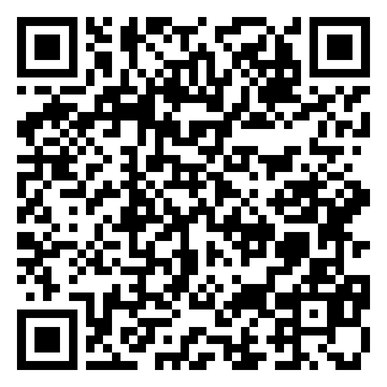
Scan to Download

Slide 3
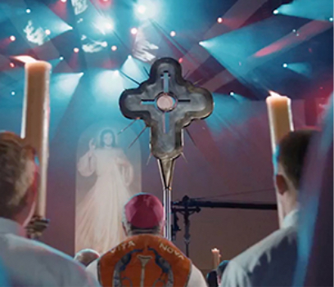
Membership Derek W. Rabey, Director
2023 – 2024
CIRCLE OF HONOR
Goal – 4,473
@ 57.99%
Intake – 2,594
Need – 1,879
Online – 1,767
January Goal - 361
Notes:
Intake = COH new member intake since December 29, 2023
Need = new member intake needed to achieve COH goal
Online = number of new members brought into the Order using the Online Membership portal

Slide 4
Membership
January 2024 Intake: 31 vs. Goal – 36
As of January 26, 2024: 289 vs 572
50.5% of year intake goal
Two (2) Districts inactive
Rest of year goals:
February – 50 March – 50 April – 48
May – 56 June - 67
Notes:
Districts 104, 116

Slide 5
MEMBERSHIP
RECRUITMENT – Success from the Prospect’s Point of View
Reach out to ME
Engage ME as a friend
Communicate with ME early and often
Relate to MY perspective
Understand MY availability and offer ME choices
Include MY family and yours
Thank ME regularly and ask ME to invite a friend

Slide 6
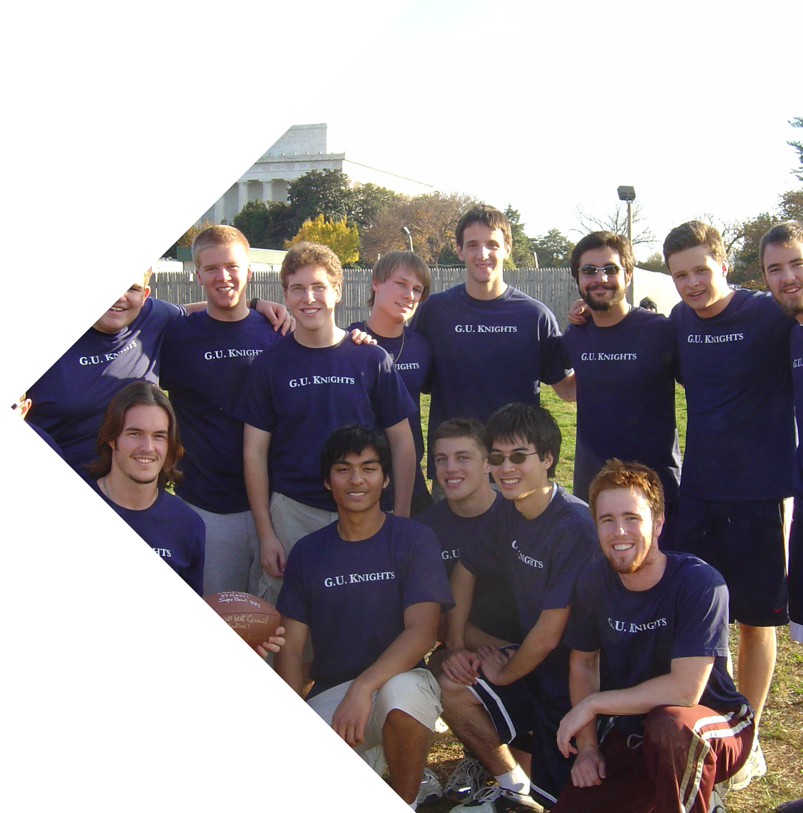
Membership
It’s not about us!
It’s about them!
Welcoming
Invite prospects, new members, and existing members to Council, as well as community, activities and events
Assign mentors to new members
Notes:
Remain member focused!
Include family members if they are in the local area
Activities – prayer group, fellowship opportunities, Mass, Adoration, Cor, Into the Breach, Men of the Word, etc.
Events – board games, social gatherings, sporting events, school sponsored events, etc.

Slide 7
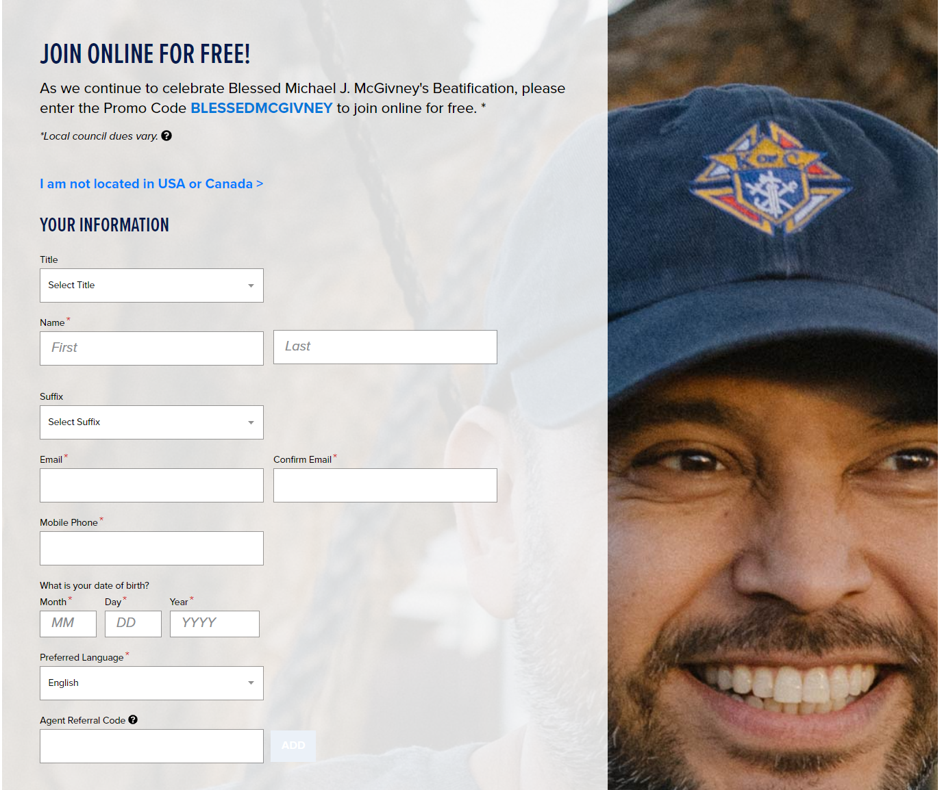
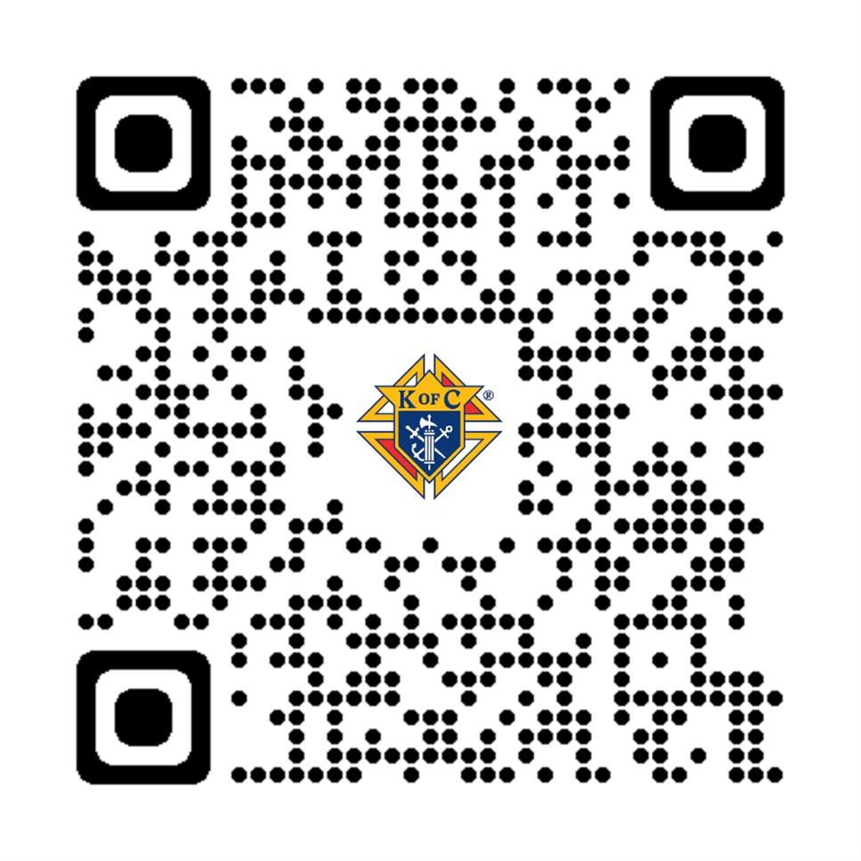
Membership
eMembership – Online Membership
Conversions (912 – 52%)
Promo Code – BlessedMcGivney
Good until further notice
Notes:
- Men are initially emailed 3 times to confirm membership
-- Instantly, 24 hours, 48 hours
-- Simply click button: “CONFIRM MEMBERSHIP”
- Unconfirmed men remain prospects and are emailed weekly
A member right away – access to benefits and resources
Learn more about the KofC firsthand through online activity

Slide 8
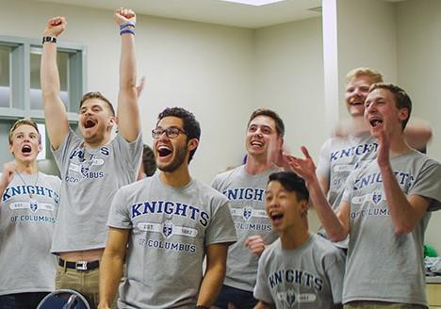
Membership
Succeeding
Active Membership Director
Monitor Prospect Tab
Get candidates to an Exemplification
Spring Drive scheduled
Inviting men to join at events
One on one invitations
Notes:
Answer to the question of Why?
Purpose
Help all men grow in their relationship with Jesus Christ
To provide opportunities for men to serve Christ in His Church including being a missionary disciple
To provide opportunities for men to serve those in most need in their communities and around the world in the name of Christ Jesus
Promise to provide protection and aid to widows and orphans through our insurance arm
Organized recruitment opportunities

Slide 9
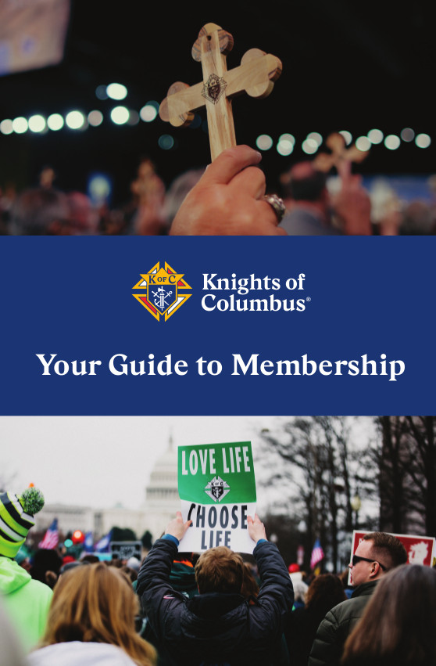
Membership
Resources
Trainings
Prospect/Candidate Tab
Exemplifications
Church Drives
Council Growth
How To Videos
Online Join Process
Open Houses
Recruiting Resources

Slide 10
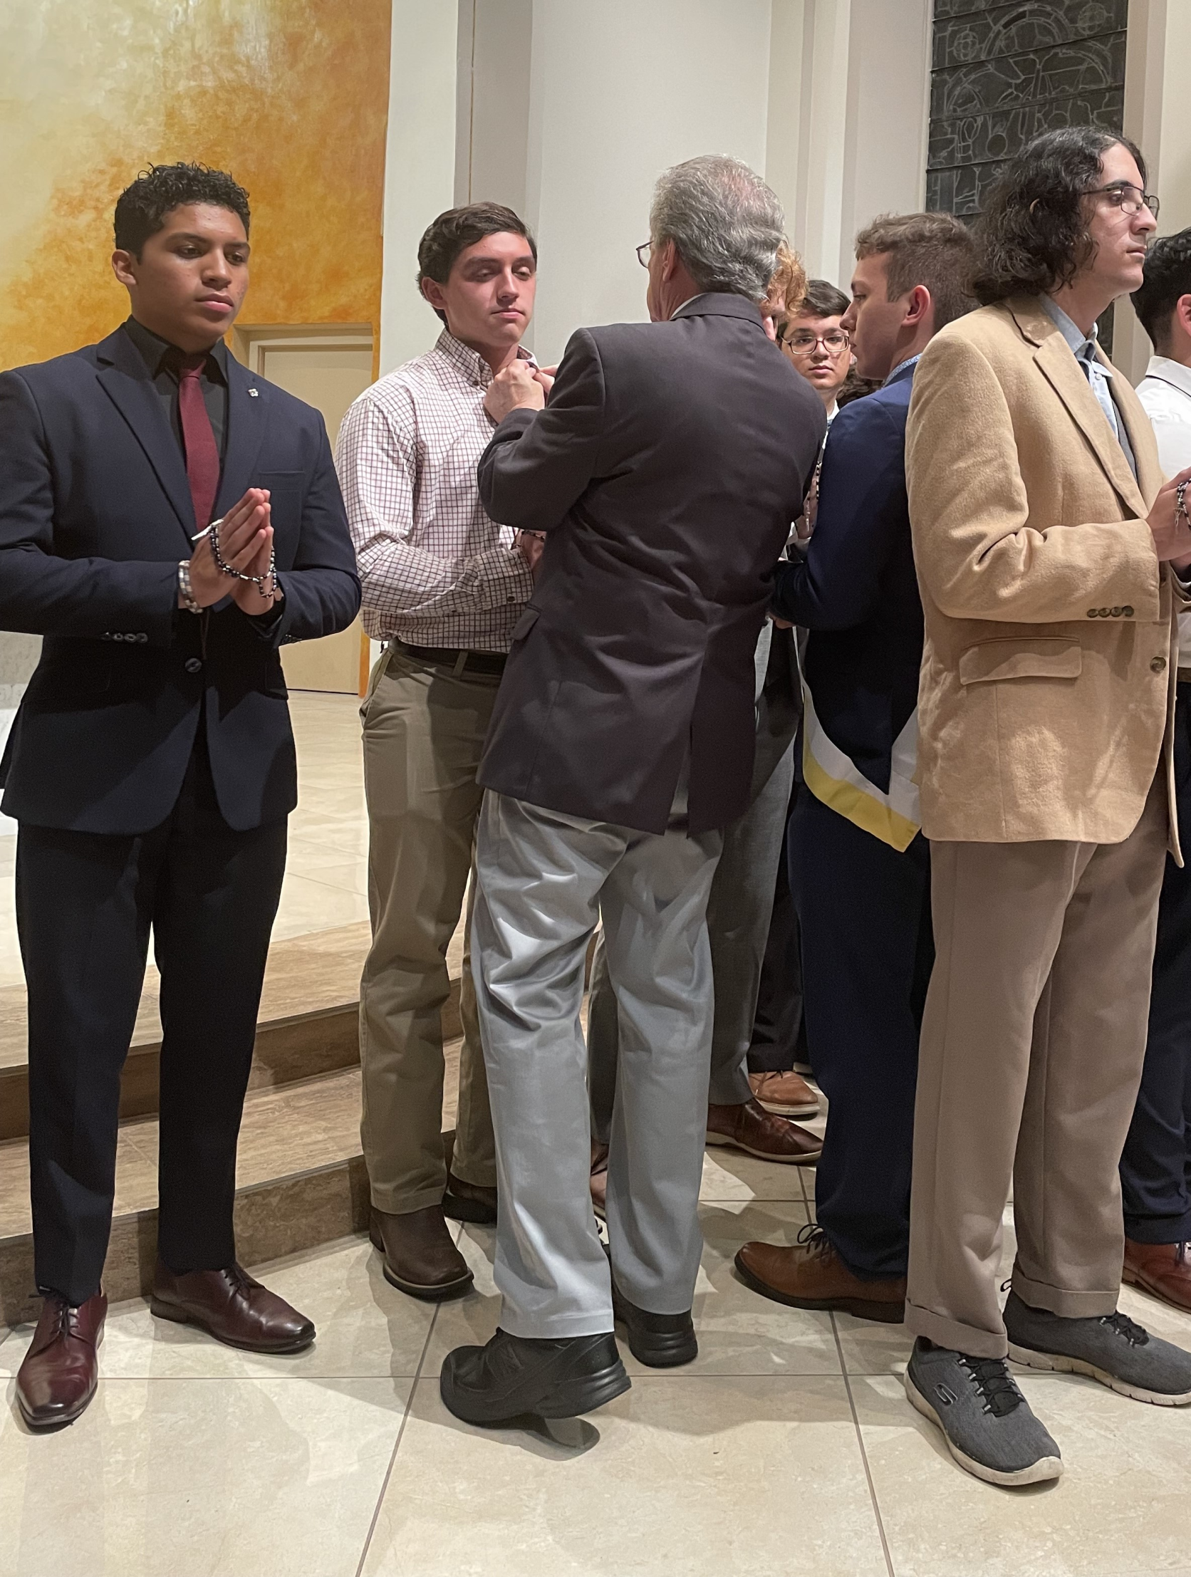
Membership
Ceremonials – Exemplifications
Schedule – Schedule – Schedule
Live Ceremonials
Online Ceremonials
On-Demand Ceremonials
Notes:
Councils need to know where to take their candidates
Share the details throughout your District, Diocese and with the State
- send scheduled CUF information to Brother Charlie Perez

Slide 11
Membership
Next Time We Get Together
TSC Convention April 26-28, 2024
Recruitment Goals
January - 361
February - 413
March - 440
April - 435
Goals = 1,649 New Members
Notes:
Continue sharing the Light of Christ with all those you come into contact with.

Slide 12
Membership
Circle of Honor
Finish Strong
May – 481
June - 528

Slide 13
State Charities Reed Fontenot, State Director
Fundraising
Reports and Historical Data
American Wheelchair Mission
Bishop Thomas J. Flanagan Fund - Grants for Retired Priests
Cardinal Medeiros Fellow which funds:
Educational Grants
Special Olympics
Emergency Response

Slide 14
Charity fundraising goals:
2023-2024 TSC Charity Goal = ~$840,000
Increase Charitable Volunteer Hours Documentation
(reported on Form 1728 due January 31, 2024)
TSC Charity PIN displayed by every Texas fraternal leader
- just $20 for individual contributions!

Slide 15
State Charities Expenses for the 30% of Charity Funds retained by the State
Educational Grants and Catholic School grants.
Special Olympics
Disaster Relief state expenses
Catholic Archives - Texas.
Awards for State Charities
Charity Board meetings (3 times per year)
Charity pins
Fundraising committee expenses
Miscellaneous requests for donations (i.e. College Catholic Centers – usually matching funds, etc.)
State Office Administration (ONLY 3% of the expenditures)
Online fees for Texas state website donations
Swipe card fees for Square device at State Meetings

Slide 16
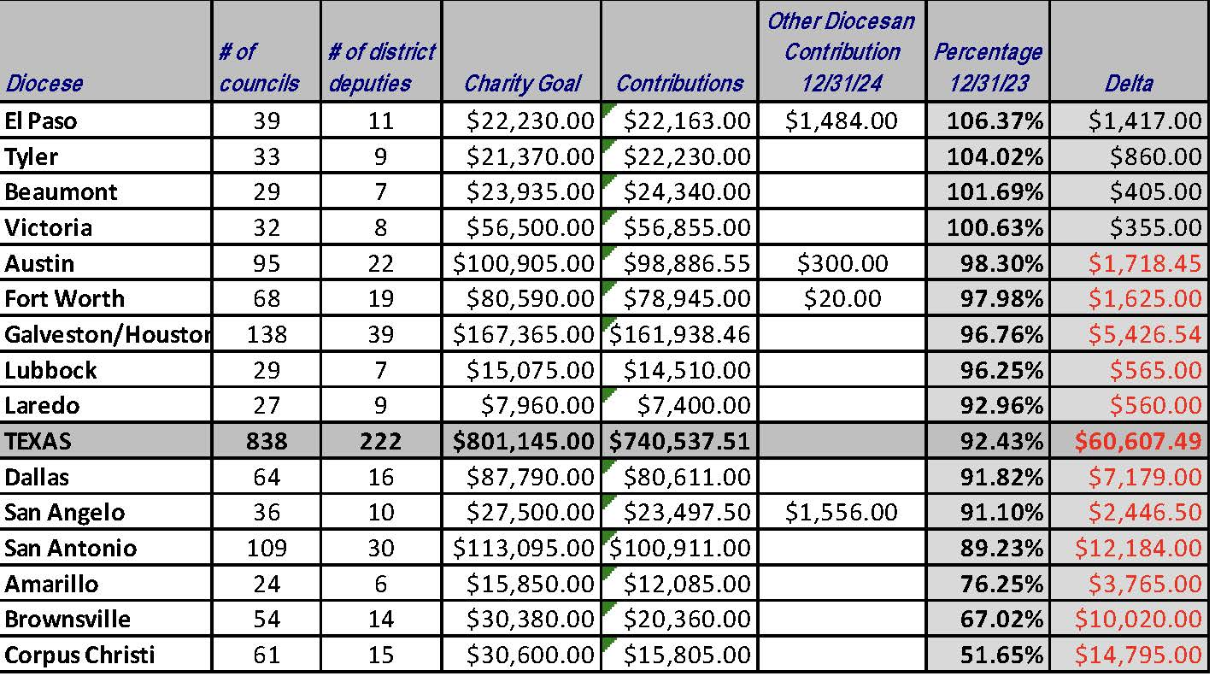
State Charities (12/31/23)

Slide 17
State Charities American Wheelchair Mission
The 1st Lady’s Project!
Goal is to exceed $1,000,000 in contributions this year
The goal for District Deputies is to have all their Councils participate in the Wheelchair Program by donating at least $150 for one wheelchair and have at least one of their Councils hold a Wheelchair Sunday.
Increase Wheelchair Sunday Drives

Slide 18
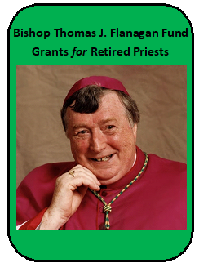
State Charities Bishop Thomas J. Flanagan Fund Goals
Fund established to provide Grants to our Retired Priests
Increase participation with TX DMV License Plate opportunity
- just $30 more per year for a “K of C” license plate!
($22 per plate goes to fund)
Double the number of Texas K of C license plates issued
- currently ~1,100. We should easily get to over 2,000 this year!
This will increase Retired Priest fund distributions to each of the Diocese

Slide 19
State Charities Special Olympics
Continue strong partnership with Special Olympics Texas.
Increase council and individual membership participation in events
Increase submission of Partnership Profile Report (Form 10784) – by paying State Charities you should report 2.5% of your contribution. Funds come back to Texas! An average of $9,000 but we could use more!

Slide 20
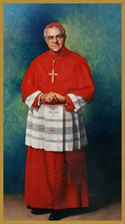
State Charities Cardinal Medeiros Fellows
Who should you consider as a potential recipient of a $1,000 fellowship?
Districts - Retiring District Deputy, Retiring Diocesan Deputy
Councils - Council Chaplains, Retiring Parish Priests
Assemblies - Former Masters, Faithful Friars

Slide 21
State Charities Catholic Educational Grants
Interest from the Cardinal Medeiros Program funds all these grants! This trust began in 1993.
Increase program awareness to increase number of submissions received –
due March 1, 2024
https://www.tkofc.org/assets/uploads/docs/Fillable-A-Educational-Grant-Form-2024-revised-jul2-23.pdf

Slide 22
State Charities Emergency Response
The mission of our emergency response program is to provide GUIDANCE and ASSISTANCE to our brothers and councils before and after disasters.
Utilizing our state-wide network of Emergency Response Coordinators (ERC), we provide GUIDANCE to councils and Knights, thus allowing a concerted effort for all involved.
Our relief ASSISTANCE comes through charitable giving from our brothers and councils.

Slide 23
Star Council Bill Tillotson, State Director
Earn the Father McGivney Award for membership growth by June 30, 2024. Membership goals are set at 6% growth with a minimum of 5 and maximum of 15.
Earn the Founders’ Award for insurance growth by June 30, 2024 by hosting at least two Fraternal Benefits events with either 10 or 14 participants total.
Earn the Columbian Award for Faith in Action programs by June 30, 2024 by conducting four programs in each of the four Faith in Action categories of Faith, Family, Community, and Life.

Slide 24
Star Council – Requirements (Cont.)
Complete and send required forms (365, 1728, SP-7) to Supreme and the Texas State Office.
Be in good standing with Supreme (i.e., current on Per Caps).
Safe Environment – The Grand Knight and Program, Community and Family Directors must be Safe Environment compliant.

Slide 25
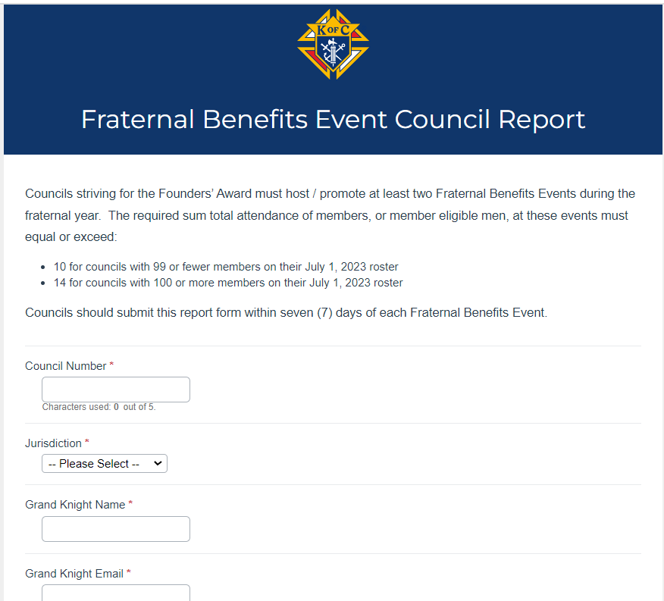
Star Council – Requirements - FBE
Form 11077 is submitted by GK after the FBE.
Can only be submitted online
Find at kofc.org -> search for “council forms”

Slide 26
Star Council – SE Training
The following positions must be current in the Safe Environment Training through Praesidium: Grand Knight, Community, Family and Program Directors (and Squires Counselors, if applicable).
The following must also consent to a background check: Family and Community Directors (and Squires Counselors, if applicable).
E-mails are sent (one for training, another for background check, if required) after submittal of Forms 185 and 365.
If there are issues, contact the Office of Youth Protection.

Slide 27
Star Council – Lone Star Award for Excellence
Meet the Star Council Award criteria
Submit Form 185 by July 1, 2023
Pay State Per Capita by March 1, 2024
Meet State Charity Goal by June 30, 2024
Seat at least one delegate at the State Convention in Houston in April 2024
Submit Form 1295 Semi-Annual Audit by August 15, 2023 & February 15, 2024

Slide 28
Star Council – Lone Star Award for Excellence w/ Distinction
Meet the Star Council Award criteria
Submit Form 185 by July 1, 2023
Pay State Per Capita by December 31, 2023
Meet State Charity Goal by December 31, 2023
Seat at least two delegates at the State Convention in Houston April 26-28, 2024
Submit Form 1295 Semi-Annual Audit by August 15, 2023 & February 15, 2024
File Special Olympics Activities using Form 10784 by January 31, 2024
Submit at least one entry for a State Service Program Award or Family of the Year or Chap. of the Year or Educational Grant by March 1, 2024

Slide 29
Star Council – Where Should We Be Today
Membership Growth Active (≥50%)
At least one Fraternal Benefit Event held
Forms 185, 365 and 1295-1 submitted
All Safe Environment Training complete
Have held at least two programs in each of the four program areas
Supreme Per Caps, State Per Caps and State Charities paid

Slide 30
Star Council – Where are we going?
Membership Growth Active
At least one more Fraternal Benefit Event (if needed)
Submit Form 10784 for Special Olympics (Jan. 30)
Submit Survey of Fraternal Activity Form 1728 (Jan. 30)
Should be working now; submit interim if needed
Submit Columbian Award Form SP-7 (starting March 1)
Must be four activities in the four Faith In Action areas
Will be rejected for incompleteness
Cannot be late – make it due to you, the DD, June 1

Slide 31
Star Council – Where are we going?
Remain Stay Safe Environment compliant
Supreme Per Caps (April 10), State Per Caps and State Charities (if not yet paid by March 1)
Submit entries to State Program Awards, Family of Year, Chaplain of Year or Educational Grant by March 1
Seat delegates at State Convention (and BE AT CAUCUS)

Slide 32
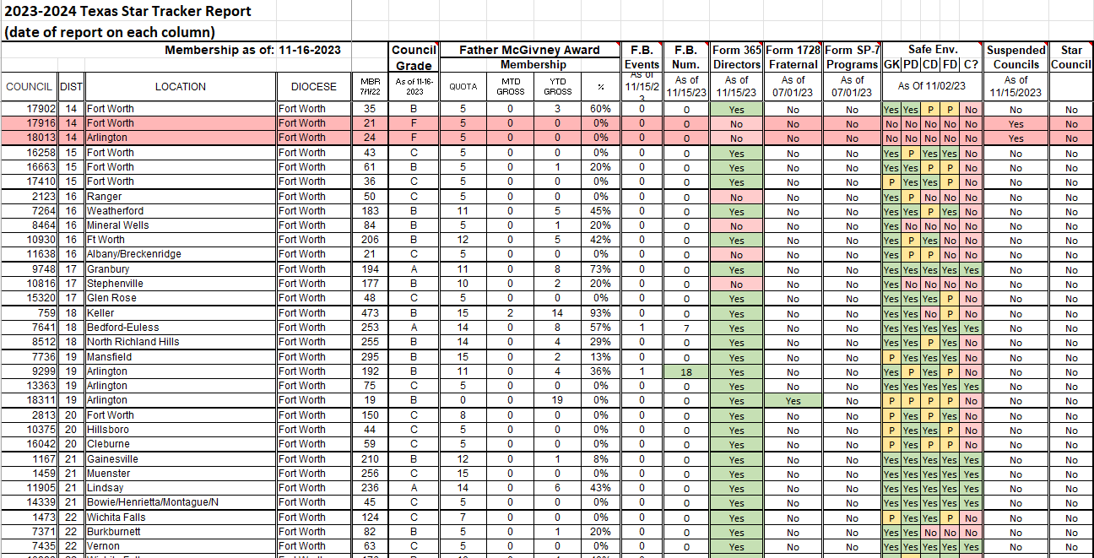
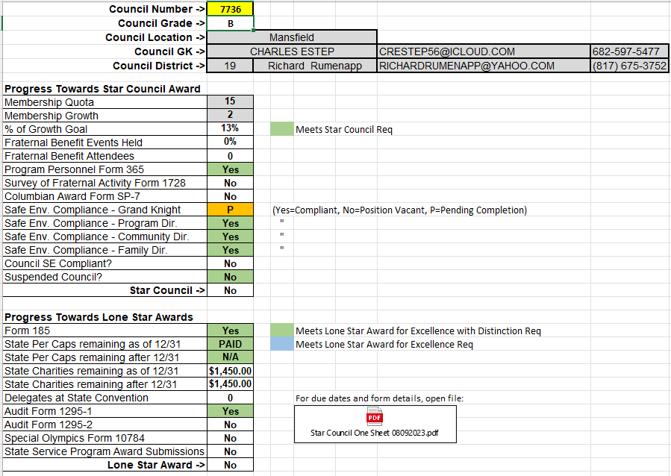
Star Council – Star Tracker
Tracker is sent 1st and 15th of every month
Get green all the way across

Slide 33
Star Council – Motivation
Every council can strive for Star Council
Use the Star Tracker to follow up your council’s progress
The District Deputy should be helping the councils
Use your Star Council Committeeman as required

Slide 34
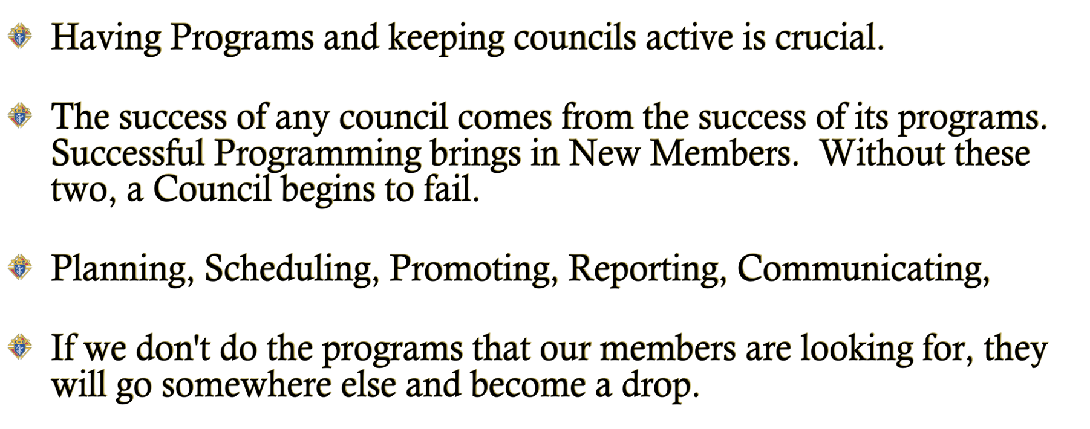
PROGRAMS Pat Henz, Director
It's Halftime – Are Your Councils Surviving?

Slide 35
Texas State Programs
(New) State Program Director Pat Henz pghenz@yahoo.com
Faith In Action Includes the Following
Faith
Family
Community
Life
Columbian Award Requires (SP-7)
Faith – 4 activities
Family – 4 Activities
Community – 4 activities
Life – 4 activities
Remember: Featured Programs count for two credits if all requirements are met and proper forms submitted.
Don’t forget to Submit 10784 Reports (or the appropriate form) following each program

Slide 36
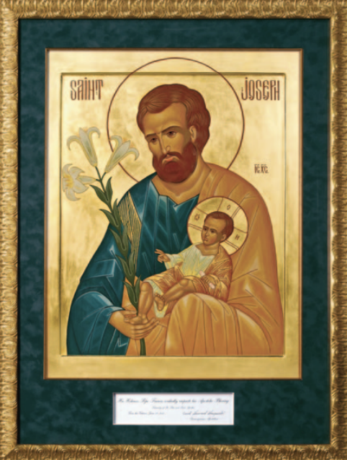
Vocations /Pilgrim Icon Programs
Vocations / RSVP
Councils are encouraged to promote Vocations whenever possible.
Several councils also support seminarians outside their dioceses including the Military Diocese.
RSVP Refund Application #2863 is due by JUNE 30 – or anytime before.
St. Joseph Icon
Are we utilizing this program? Numbers are low.
Order extra booklets through Supreme.
Make sure councils submit the #10784 Report for their Icon Program.
Councils are encouraged to conduct this simple Faith program for their parish.

Slide 37
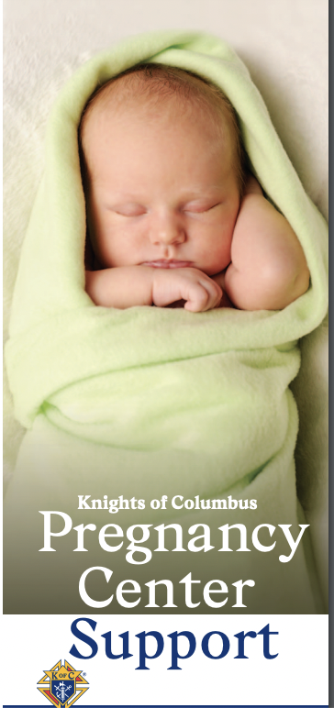
Life Programs
ACE Wings
The “Precious Feet” are the size and shape of a baby’s feet at 10 weeks old after conception.
The “Heart” is also the size as a baby’s heart at 10 weeks old.
UltraSound
If any council is wanting to raise funds for an Ultrasound machine, they need to get with State Ultrasound Chairman Andrew Clark to go over all the necessary paperwork.
Chairman Tom Clark
20th Anniversary of the ACE Wings.
Councils are encouraged to do a Pro Life event in January – and every month.
ASAP Program
Aid and Support After Pregnancy
Councils supporting Pregnancy Centers at $500

Slide 38
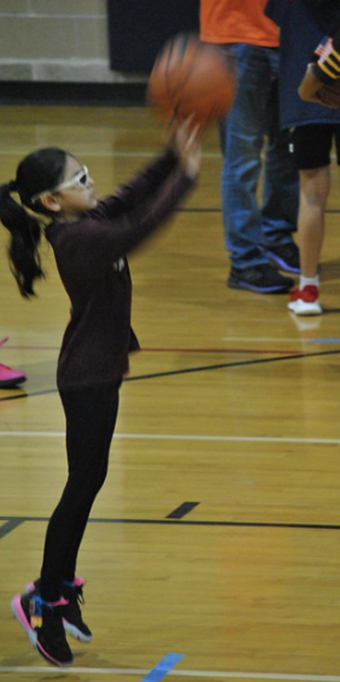
State Athletics Programs
State Bowling Tournament
Chairman Skipper Arsenault -
Two weekends: April 13/14 & 20/21
Port Arthur
Forms will be sent out in January.
State Free Throw
Chairman Jessie Aguilar
Saturday, March 2, 2024
Ed White Middle School in San Antonio
Make sure Council's per capita are paid!
Order the Free Throw kits now.
Ages 9 – 14 years old
State "Daryl Entrop" Softball Tournament
Chairman Steve Simons
Will be in June -
Date / Location: Possibly in Arlington
Celebrating the 50th anniversary of this tournament.

Slide 39
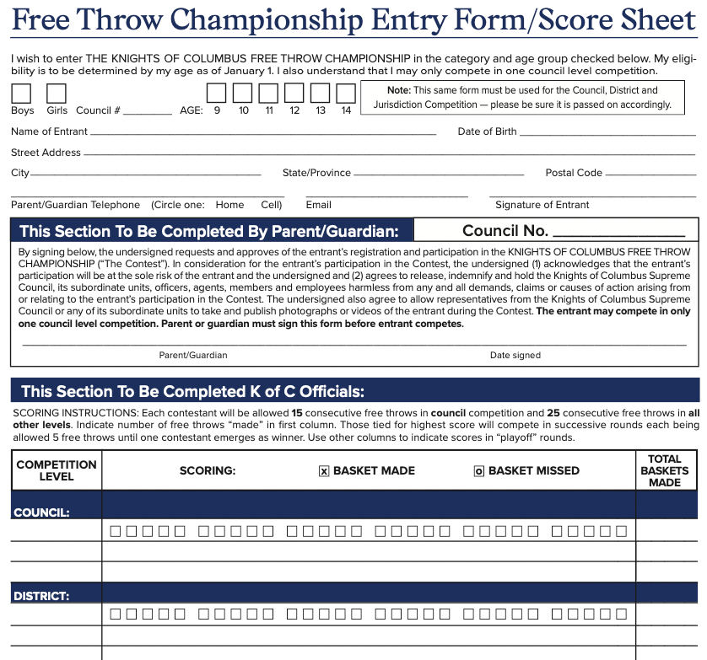
Key Points
** KIDS MUST BE PRESENT AND COMPETE TOGETHER
USE THE CURRENT ENTRY / SCORE SHEET FORM…
Boys & Girls ages 9-11 use a woman’s regulation size BB.
Girls ages 12-14 use a woman’s BB.
Boys ages 12-14 use a men’s regulation size BB.
International Scores are the totals from each level.

Slide 40
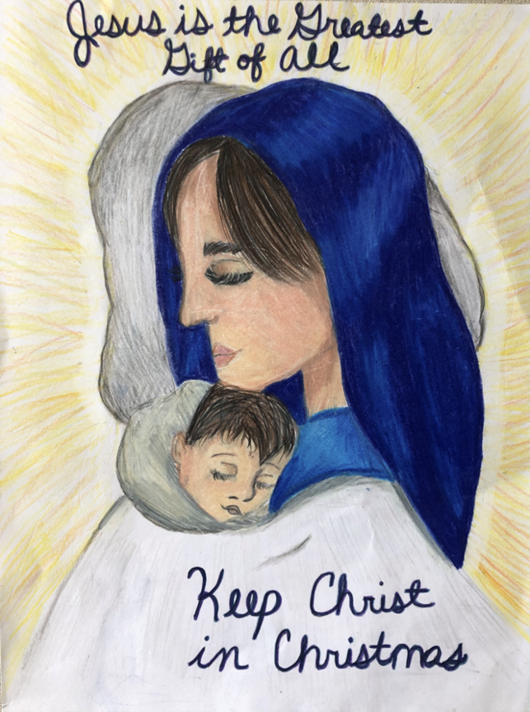
Time Sensitive Programs
Keep Christ in Christmas
November / December / January – Judging done at District / Diocesan level.
Submit Diocesan winners to State Program Director by February 9, 2024
We have had several international winners in the past few years!!
Story Mendez – Age 8-10
Council 1202 Corpus Christi
Submit all Diocesan 1st Place Winners to Pat Henz – pghenz@yahoo.com

Slide 41
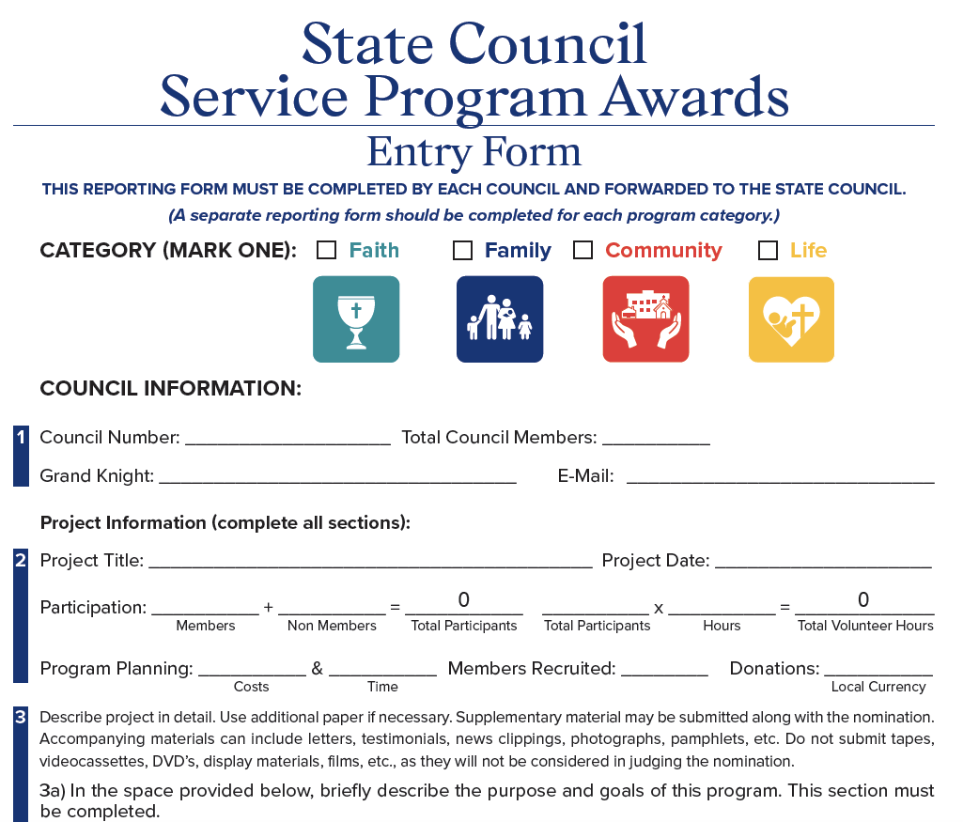
Time Sensitive Programs
State Service Program Awarads
Form "STSP" is found under FORMS on Supreme website
Submit one form for each category.
DO NOT Submit to Supreme
Include photos, articles, and extra pages if necessary.
Due to the State Program Director by
MARCH 1, 2024
Submit to Pat Henz – pghenz@yahoo.com

Slide 42
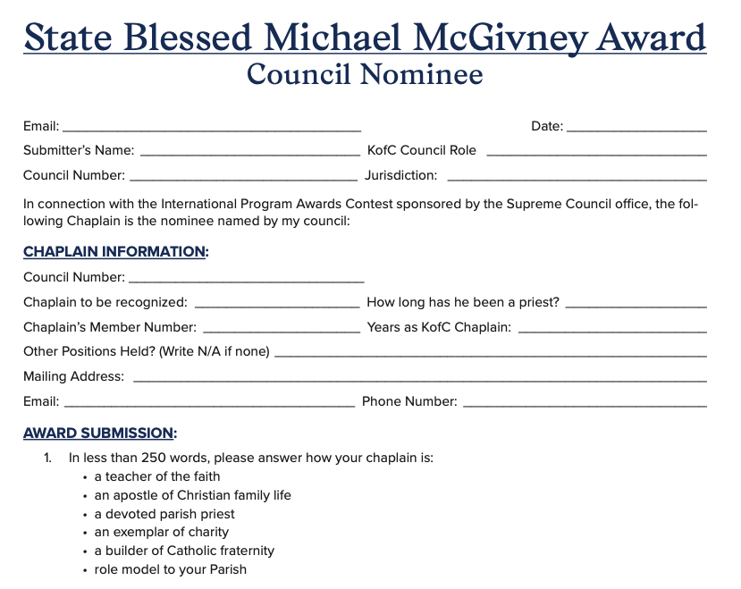
Time Sensitive Programs
Chaplain of the Year
This form is found on Supreme website.
Due to the State Program Director by March 1, 2024
Submit to Pat Henz – pghenz@yahoo.com

Slide 43
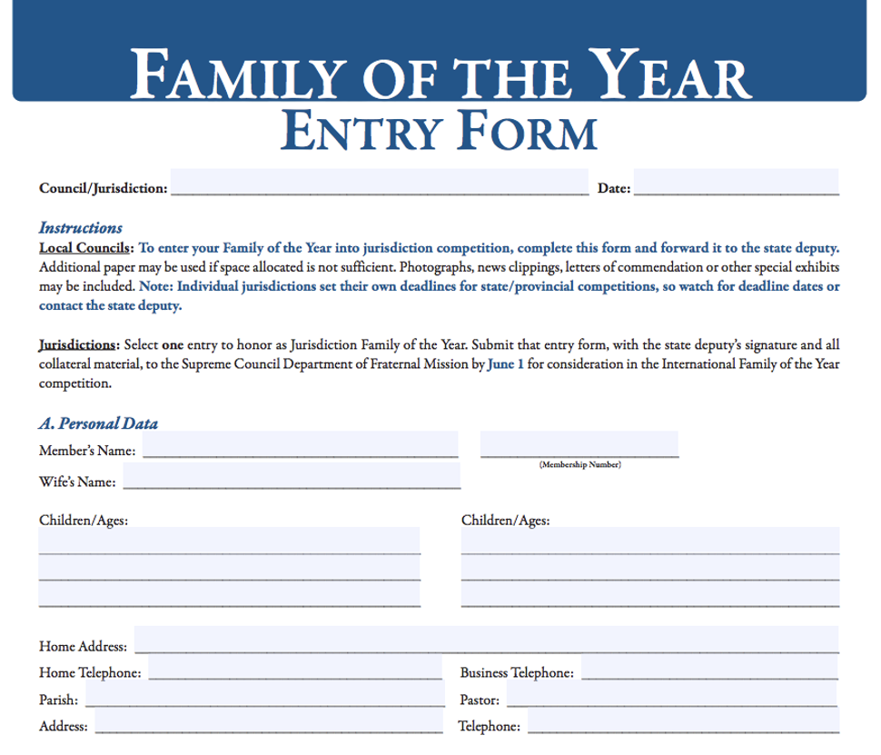
Time Sensitive Programs
Family of the Year
This form is found on Supreme website.
Due to the State Program Director by March 1, 2024
Submit to Pat Henz – pghenz@yahoo.com

Slide 44
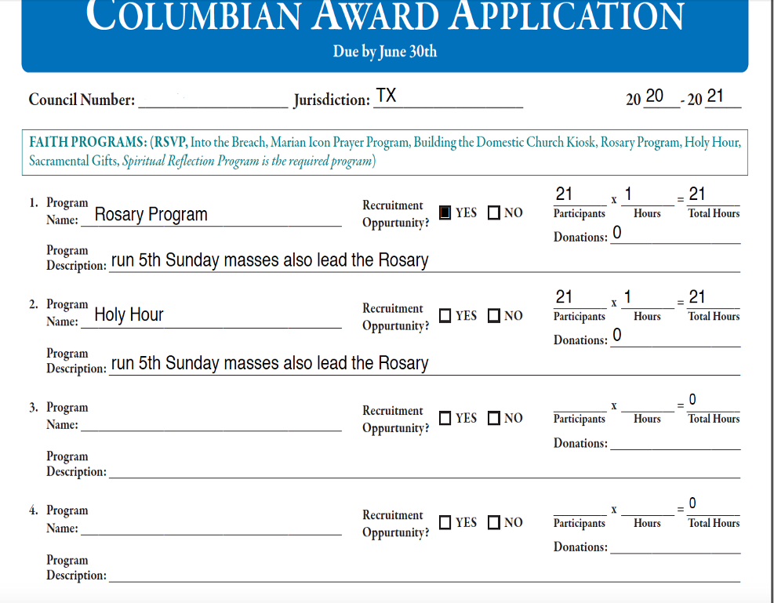
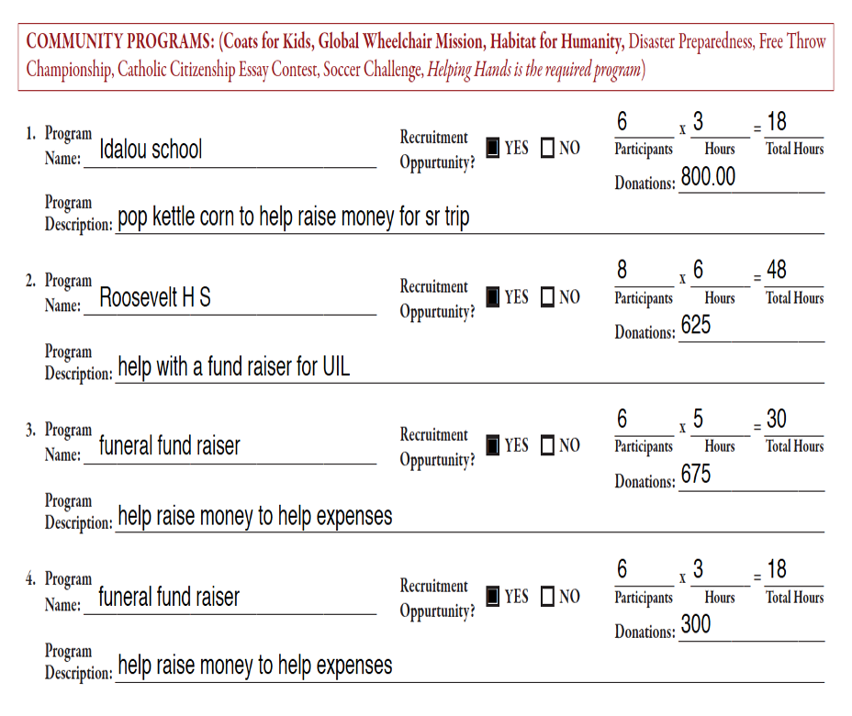

Slide 45
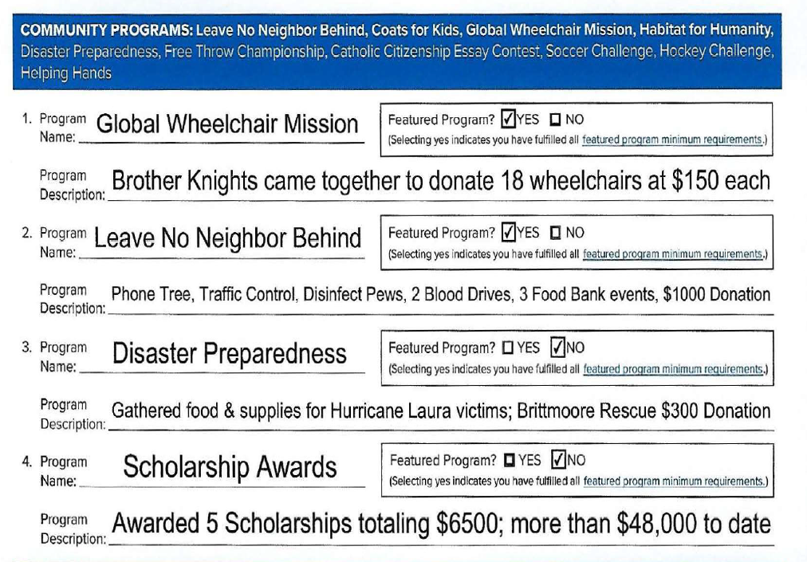
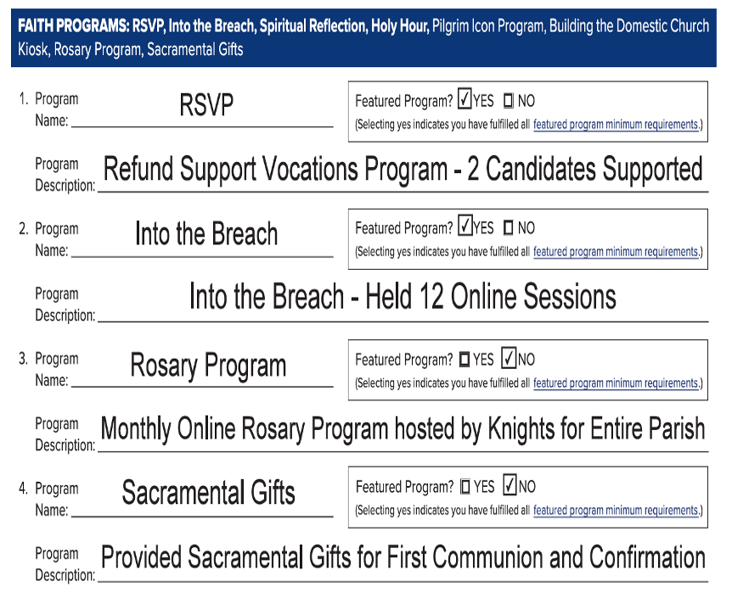

Slide 46
Council Growth
Supreme Knight Patrick Kelly has challenged us to make a Council or Knight’s presence in every Parish or Mission
How do we make the Vision come true?
New Councils
Council Retention
Roundtables

Slide 47
Council Growth
New Council
Council #18262
Holy Trinity, Dallas, TX
Dallas Diocese
DD 108 Jack Ayres
Mike Courtney – Diocesan Deputy

Slide 48
Council Growth
Council Retention
Supreme Per Capita
total $6.50/member
($4.50 per capita & Catholic Advertisement &
$2.00 Culture of Life)
Assessed ½ twice a year: ($3.25/member each)
July 1 Roster – Due by October 10
January 1 Roster – Due by April 10
Council Statements will only be available on Officers online, Go To:
www.kofc.org> sign in>Click on Reports tab>Click on Financial Statement
Councils that do not pay by dates above will be suspended & not eligible for any Supreme Award (until paid in full)

Slide 49
Council Growth
Council Retention
Texas State Council Per Capita
$10.00/member
Assessed once a year in July (sent with State Charities Statement)
One is a blue statement & one is yellow
Due by March 1 or earlier for certain State Awards
Councils that do not pay by date above will be suspended & not eligible for any State Activity or Award
Includes Diocesan Deputy, District Deputy, or Individual Awards
if home council is not paid

Slide 50
Council Growth
Roundtables
Roundtables help both the parish & supporting Council
Should have a regular meeting prior to the Council meeting
The Coordinator is to be a member of the adjacent Parish/Mission & of the supporting Council & attend both the Roundtable meeting & Council Meetings to report back & forth the needs of the Parish/Mission & Council
One Coordinator per Roundatble.
Parish Round Table Coordinator (Form #2629) DUE: June 30
(by December 31 for State Incentive – see Star Guide) https://www.kofc.org/un/en/forms/council/roundtable_coordinators2629_p.pdf
Grand Knight must sign back of form!
Submit to State Roundtable Chairman, Diocesan Deputy, & District Deputy

Slide 51
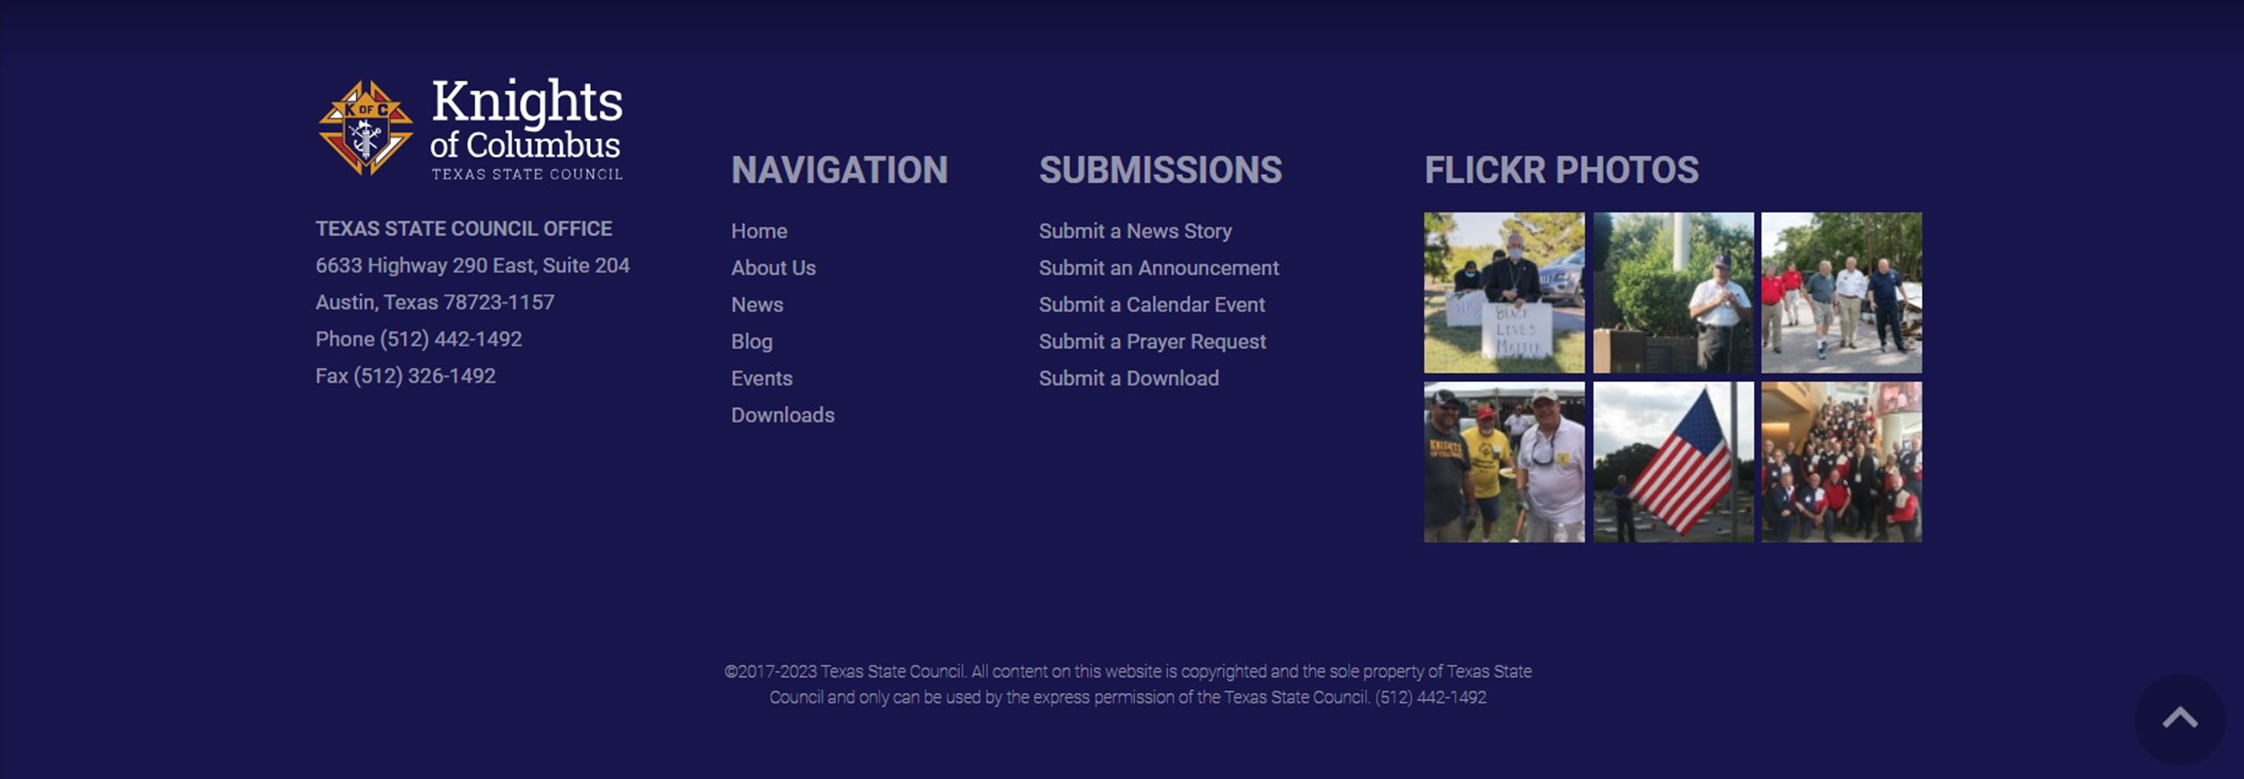
Education, Training, & Communications (ETC) Ed Tydings, Director
For those looking for the State Directory, it can be found at the bottom of tkofc.org

Slide 52
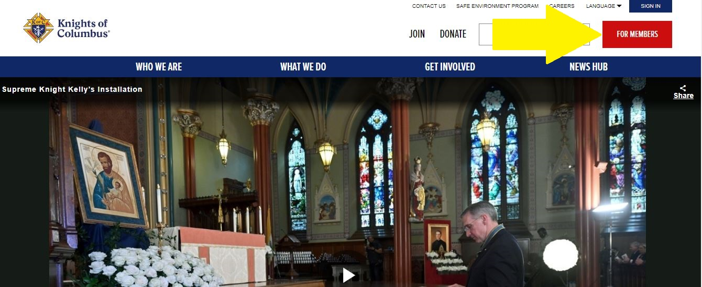
ETC – DD 102
Supreme has made several training improvements to its offerings. They can be found in the “For Members” tab on the home screen.

Slide 53
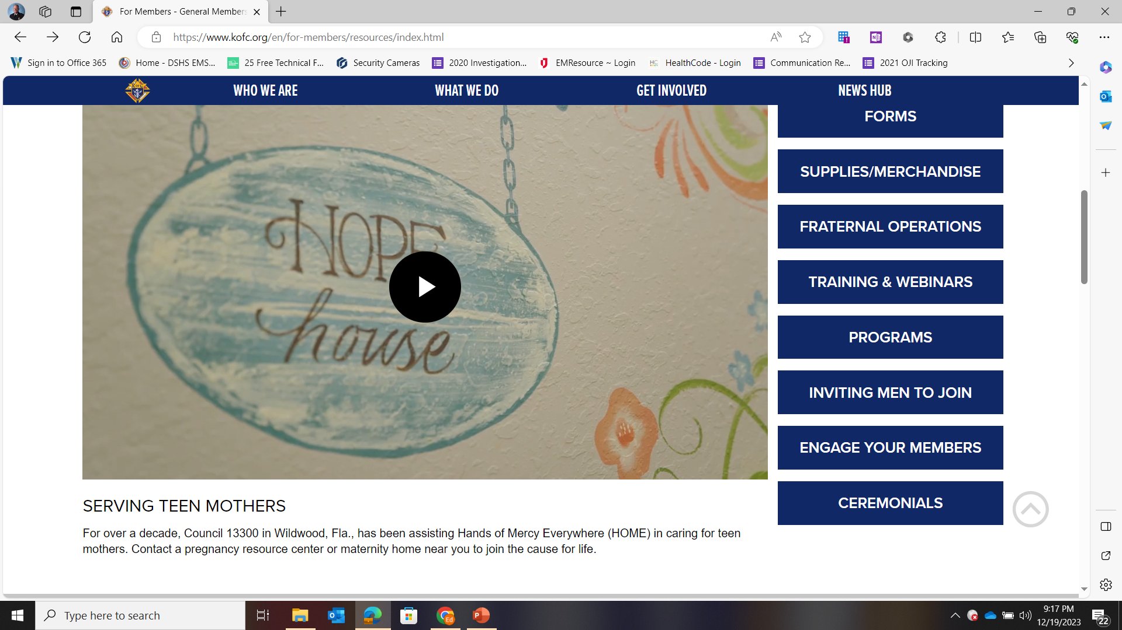
ETC – DD 102
Notes:
After clicking on the “For Members” tab on the home screen, there are myriad training sites and webinars for leaders of all levels.

Slide 54
ETC – DD 102
Schedule FS training session any time you need it
Audit
New billing cycle
Before a membership drive
Dallas Diocese FS Trainer:
Victor Garza – vgarza48@att.net

Slide 55
ETC – DD 102
www.tkofc.org
Social media is your friend
Texas Knights of Columbus – YouTube
Texas Knights of Columbus - YouTube
Does your council, district, or diocese have a social media presence? Are you tapped into it?
Notes:
Please emphasize the various ways the State of Texas has to stay connected.

Slide 56
Evangelization and Faith Formation Greg Brown, Director
Dallas Diocese - Coordiator | Dr. James Kauffmann

Slide 57
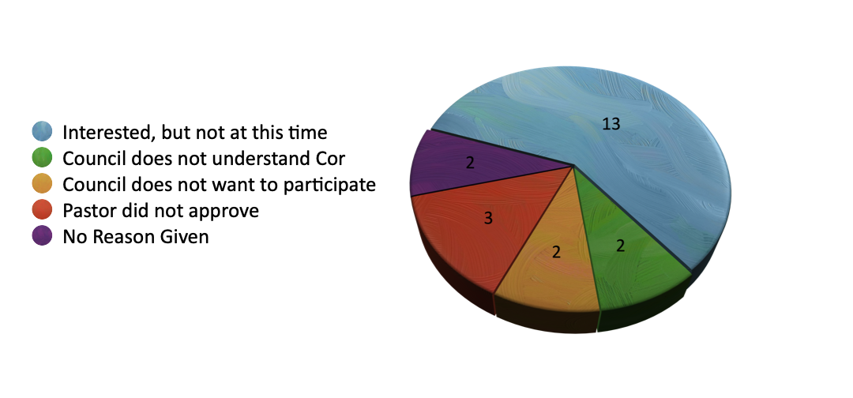
944 "Will not be implementing Cor this Fraternal Year"

Slide 58
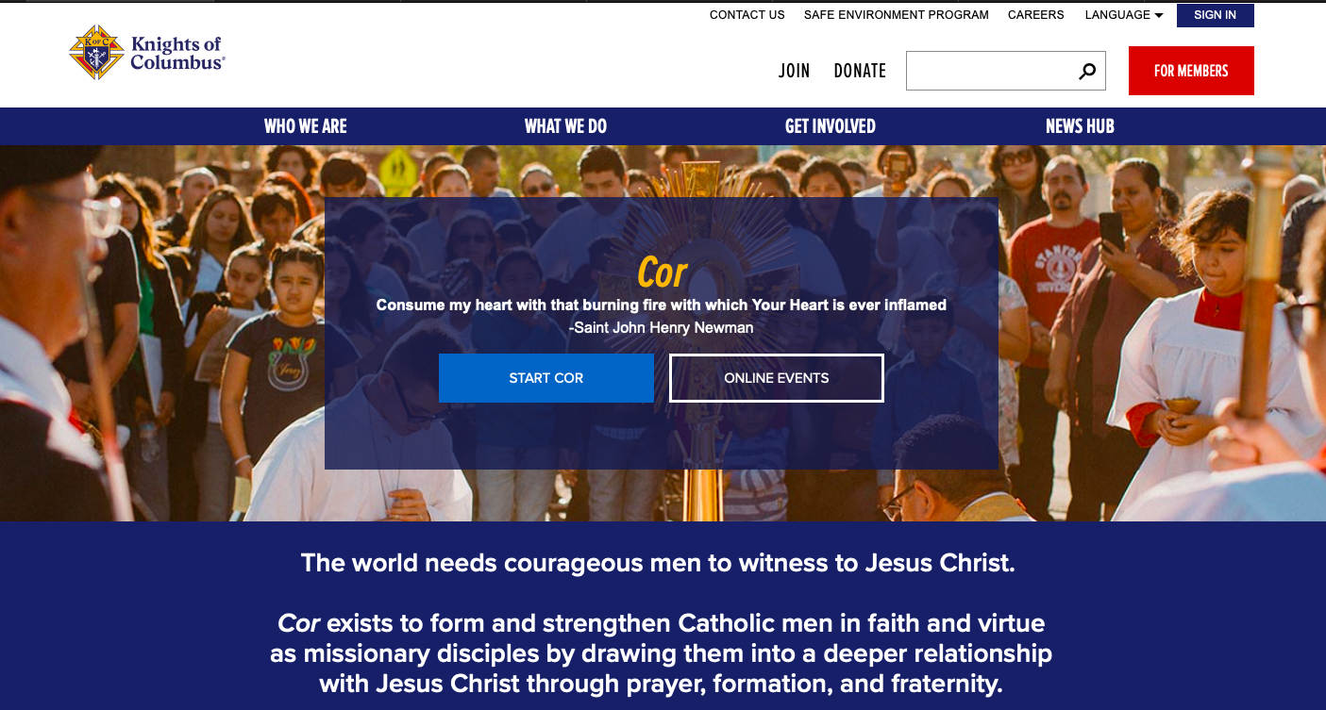
www.kofc.org/cor

Slide 59
Available as a download on kofc.org/cor or order from supplies online 11500

Slide 60
www.kofc.org/cor

Slide 61
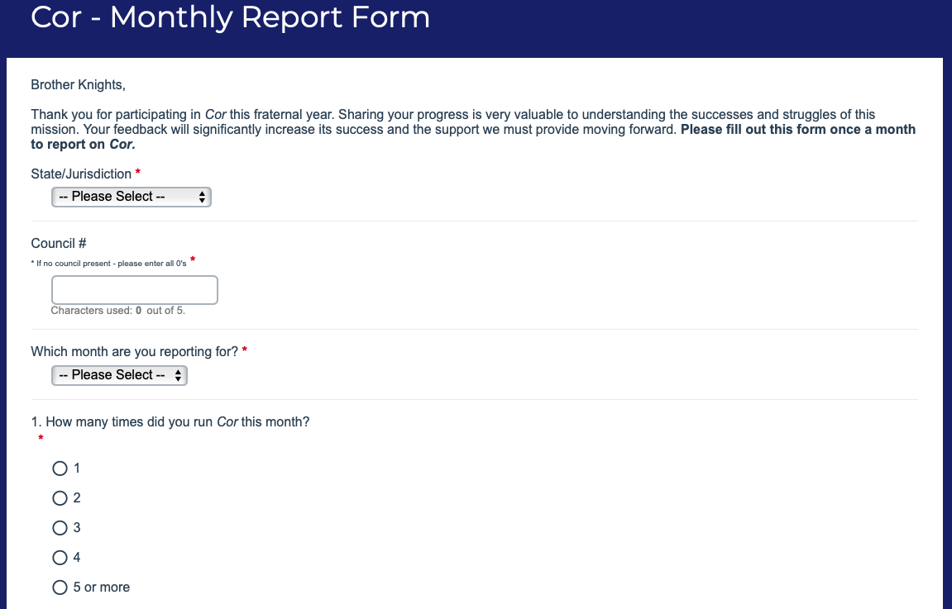
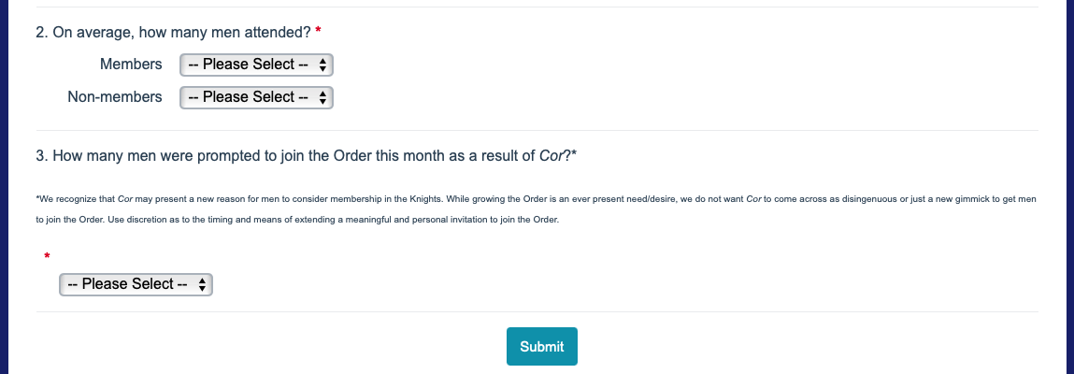
COR Monthly Report Form

Slide 62
www.kofc.org/cor

Slide 63
Legal
David Pels – State Advocate
(817) 988-3484; pelsd66@gmail.com
Fort Worth
Mikell West – Legal Affairs Committeeman
(361) 215-8487; mikellwest@gmail.com
Corpus Christi
Webster Veade – Legal Affairs Committeeman
(512) 905-5900; veade@cs.com
Austin

Slide 64
RESOURCES FOR DISTRICT DEPUTIES AND COUNCIL OFFICERS
Officers Online on Supreme Council Website www.kofc.org
Officers Desk Reference (ODR)
Home Corporation Handbook
Your Diocesan Deputy
Training sessions
Chapter Meetings and Conferences

Slide 65
SAFE ENVIRONMENT – SUPREME OFFICE OF YOUTH PROTECTION
Supreme website OYP
Report violations or incidents of abuse per the training to law enforcement, your Diocesan Safe Environment Coordinator, and Supreme OYP
Removal from membership is mandatory for felons and convicted sex offenders
Notify the State Advocate immediately with information regarding arrest or conviction of a sex offense

Slide 66
SAFE ENVIRONMENT TRAINING
K of C safe environment (Praesidium) v Diocesan safe environment
NOT the same: one does not substitute for the other
GK, Program Director, Family Director, and Community Director
Diocesan: follow your Bishop’s guidelines as to which Knights should take it

Slide 67
UPDATING COUNCIL BYLAWS
Template bylaws on the Supreme website
Same template for new Councils or existing ones
Fill in the blank
No other variations
Uniformity of provisions
Approval by Supreme

Slide 68
COUNCIL IRS ISSUES NATURE OF A COUNCIL AS AN ENTITY
Councils are 501(c)(8) entities
Make sales without having to pay sales tax
Councils are not 501(c)(3) entities per agreement between Supreme and the IRS

Slide 69
EIN (Employer Identification Number)
Each Council should have its own EIN
No EIN means Council must pay taxes on sales
ODR has a step by step guide for getting a new EIN
Council’s EIN should be provided to Supreme

Slide 70
IRS FORM 990 (INFORMATON TAX RETURN)
Each Council must file the 990 every year
Failure to file for 3 years means loss of EIN and tax exempt status
Step by step guide in ODR to the 990 filing
Less than $50,000, then 990n e-postcard
Most Councils qualify for the 990n

Slide 71
MONEY ISSUES
$500 Rule
Budgets
Semi-annual audits
Require 2 signatures on checks
Financial Secretary (FS) v. Treasurer duties

Slide 72
HOME CORPORATIONS OR HALLS
Are entities separate and apart from the Order
Tax status and entity creation comes from Supreme & IRS agreement
Either 501(c)(2) or 501(c)(7)
501(c)(2): return all monies over expenses to the associated Council
501(c)(7): fraternal lodge, social club

Slide 73
HOME CORPORATIONS OR HALLS (cont’d)
Are separate and apart from Councils
Councils cannot own real property
Charitable Distribution Agreement
Terms of Use Agreement
Notify State Advocate well in advance of Hall property sale

Slide 74
Legal
David Pels – State Advocate
(817) 988-3484; pelsd66@gmail.com
Fort Worth
Mikell West – Legal Affairs Committeeman
(361) 215-8487; mikellwest@gmail.com
Corpus Christi
Webster Veade – Legal Affairs Committeeman
(512) 905-5900; veade@cs.com
Austin

Slide 75
Scan to Download

