Slide 1
63rd Annual Knights of Columbus Bob Stras Memorial HS Basketball Tournament
Presented By
The Knights of Columbus
Of
The Dallas Diocese

Slide 2
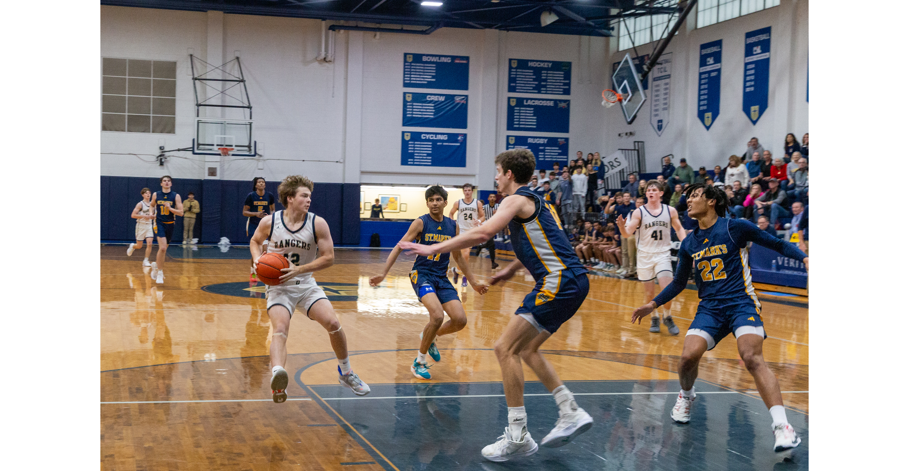
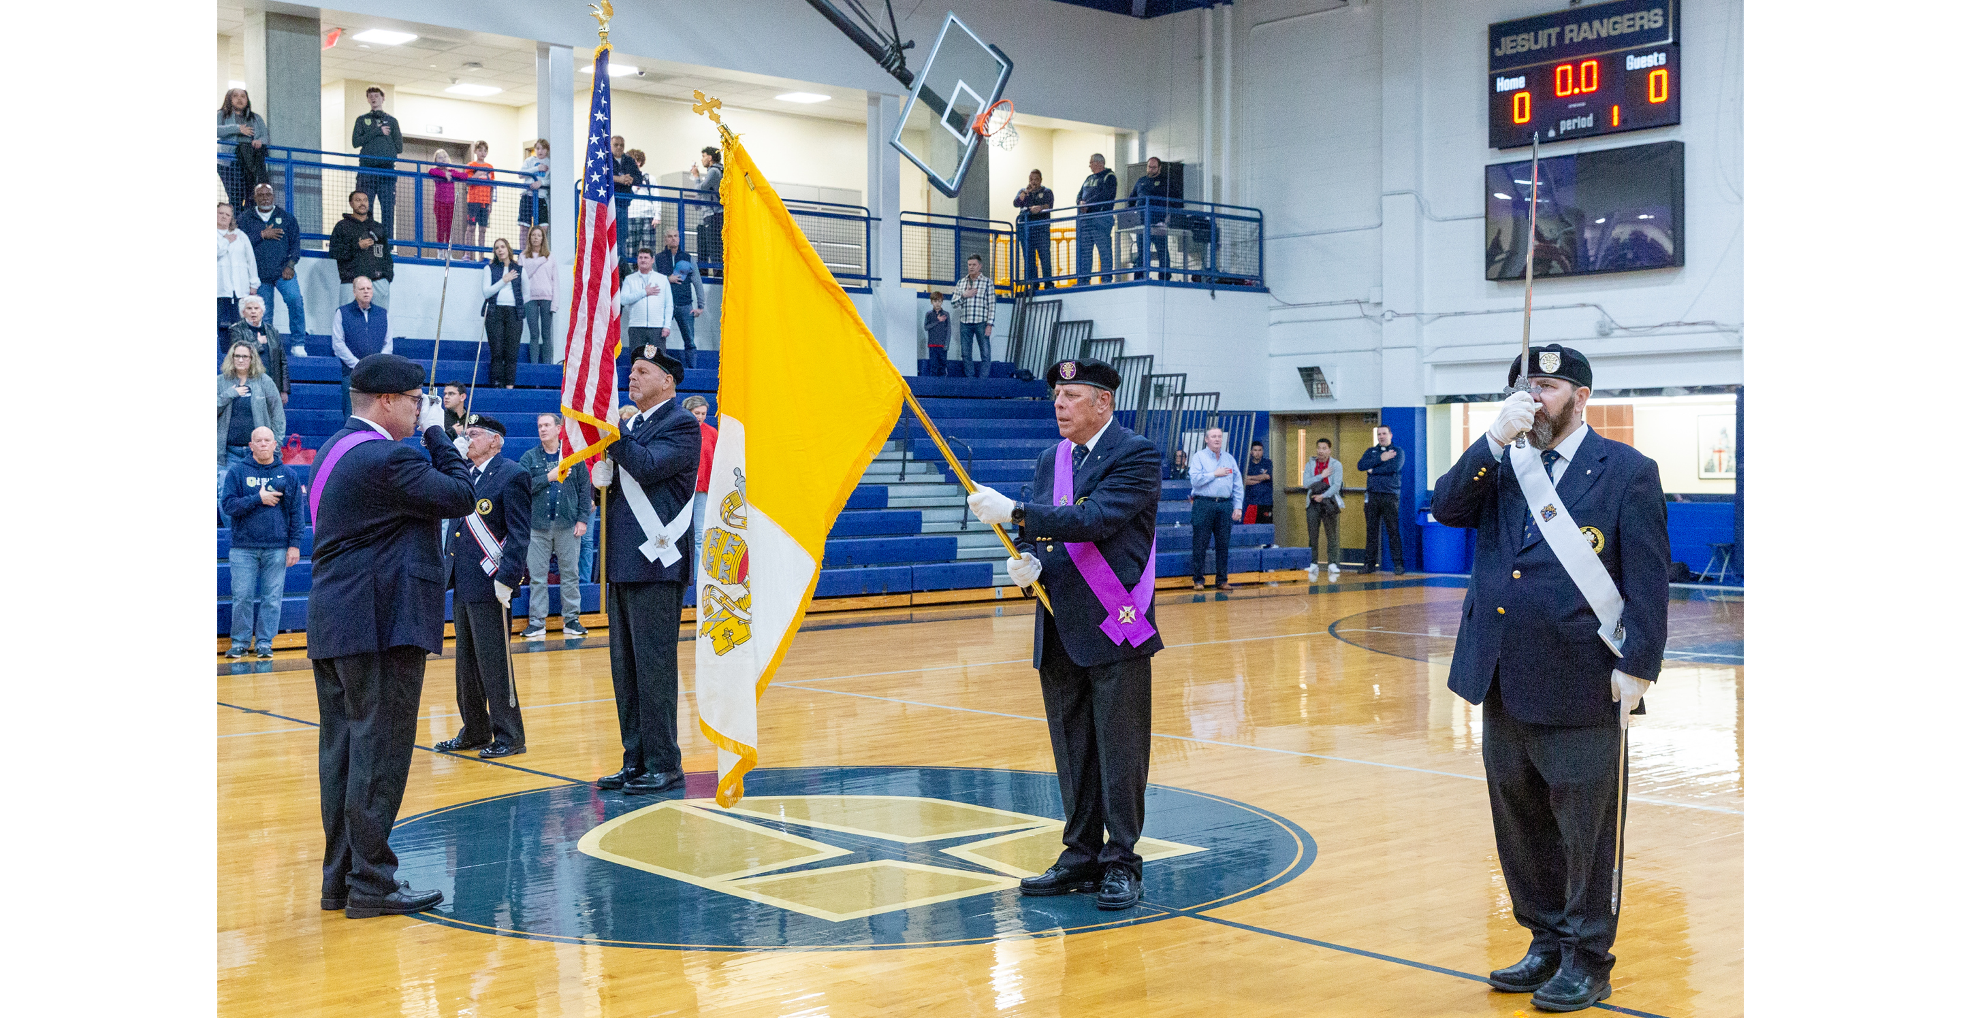
Why Have The Knights of Columbus of the Dallas Diocese Done This For 63 Years?
1) To Connect The Knights With The Youth of Our Diocese
2) To Publicize The Mission And
Purpose of The Knights
3) To Support Two of Our Largest Catholic High Schools
4) To Honor The Legacy of Our Departed Brother – SK Bob Stras

Slide 3
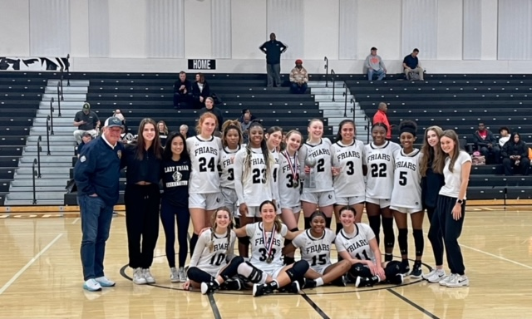
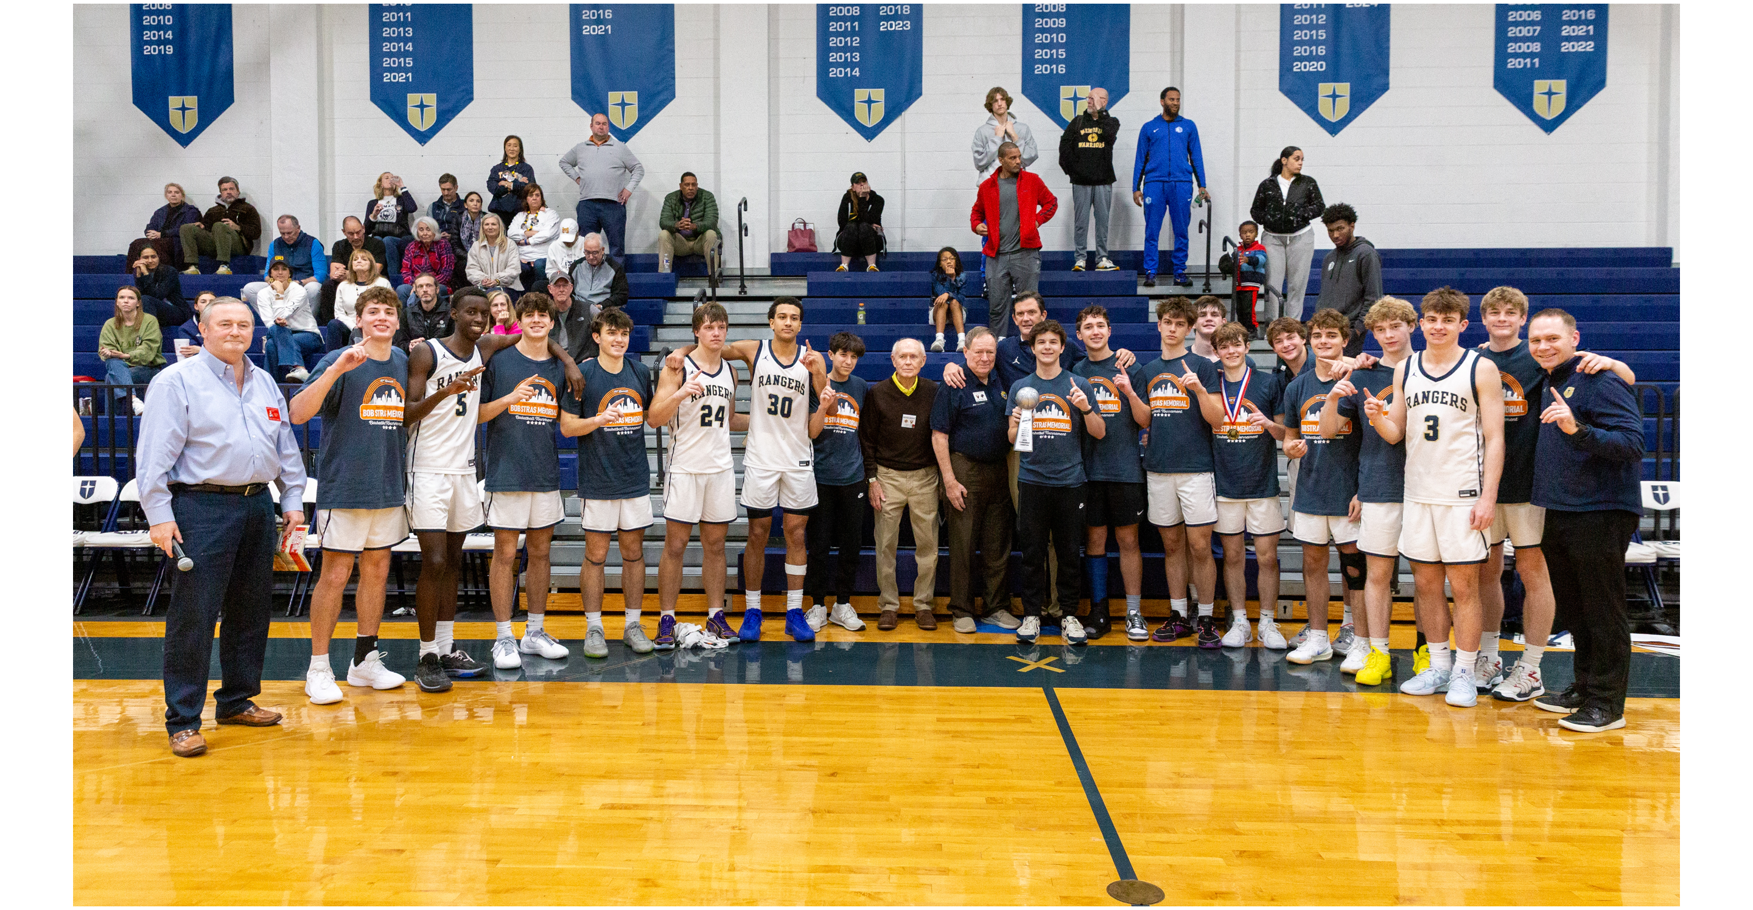
On December 3rd, 4th & 5th Eight Boys Teams Will Compete At Jesuit Dallas And Eight Girls Teams Will Compete At Bishop Lynch!
Eight Girls Teams at Bishop Lynch
Eight Boys Teams at Jesuit Dallas

Slide 4
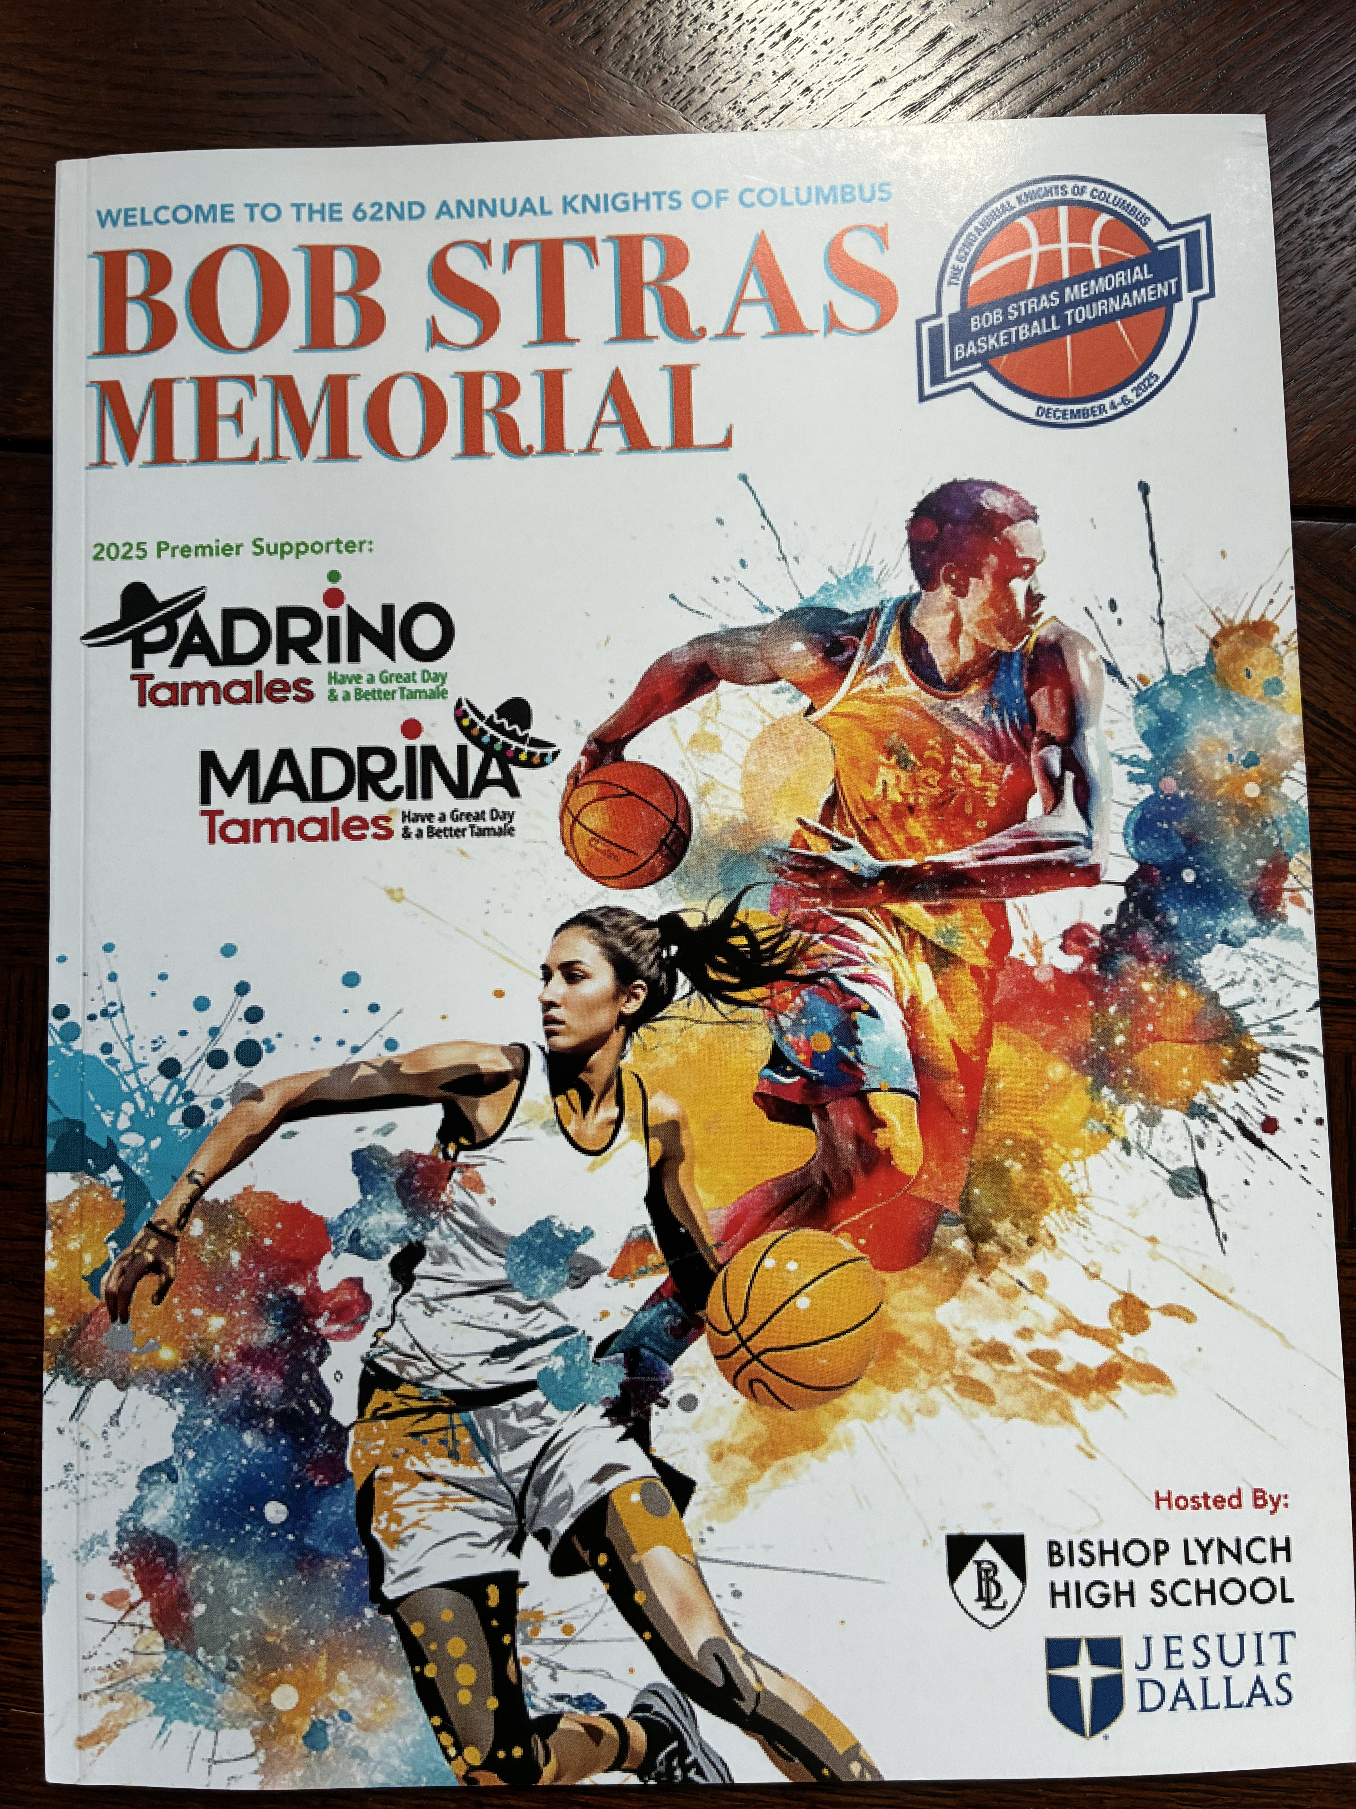
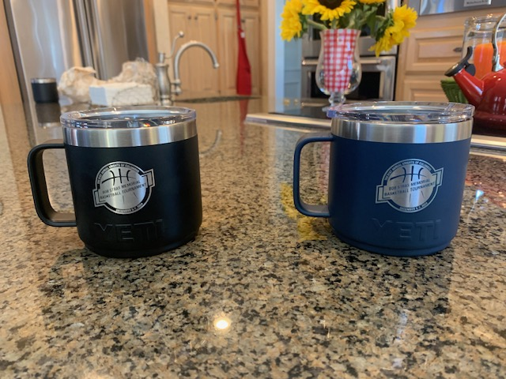
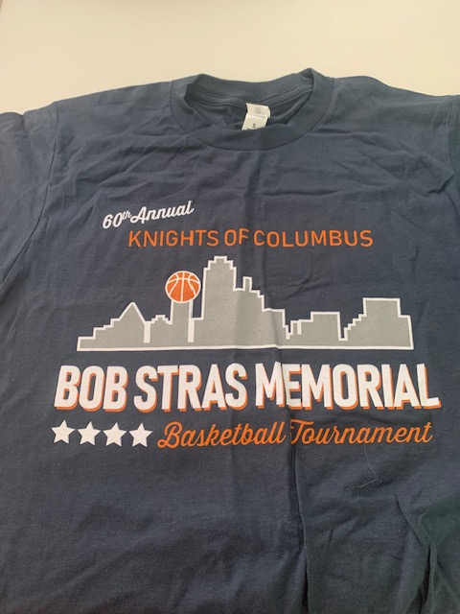
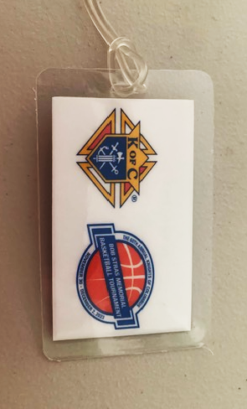
What Do The Knights Contribute
All Trophies And Awards
Tee Shirts For All Participants
Personalized Bag Tags
Food For Teams After Games
Commemorative Coach’s Gift
Stipend For Each Host School For Referees, Security, Operations, Etc.
50 Page Color Program
Volunteers At The Tournament
Color Corp At Both Sites

Slide 5
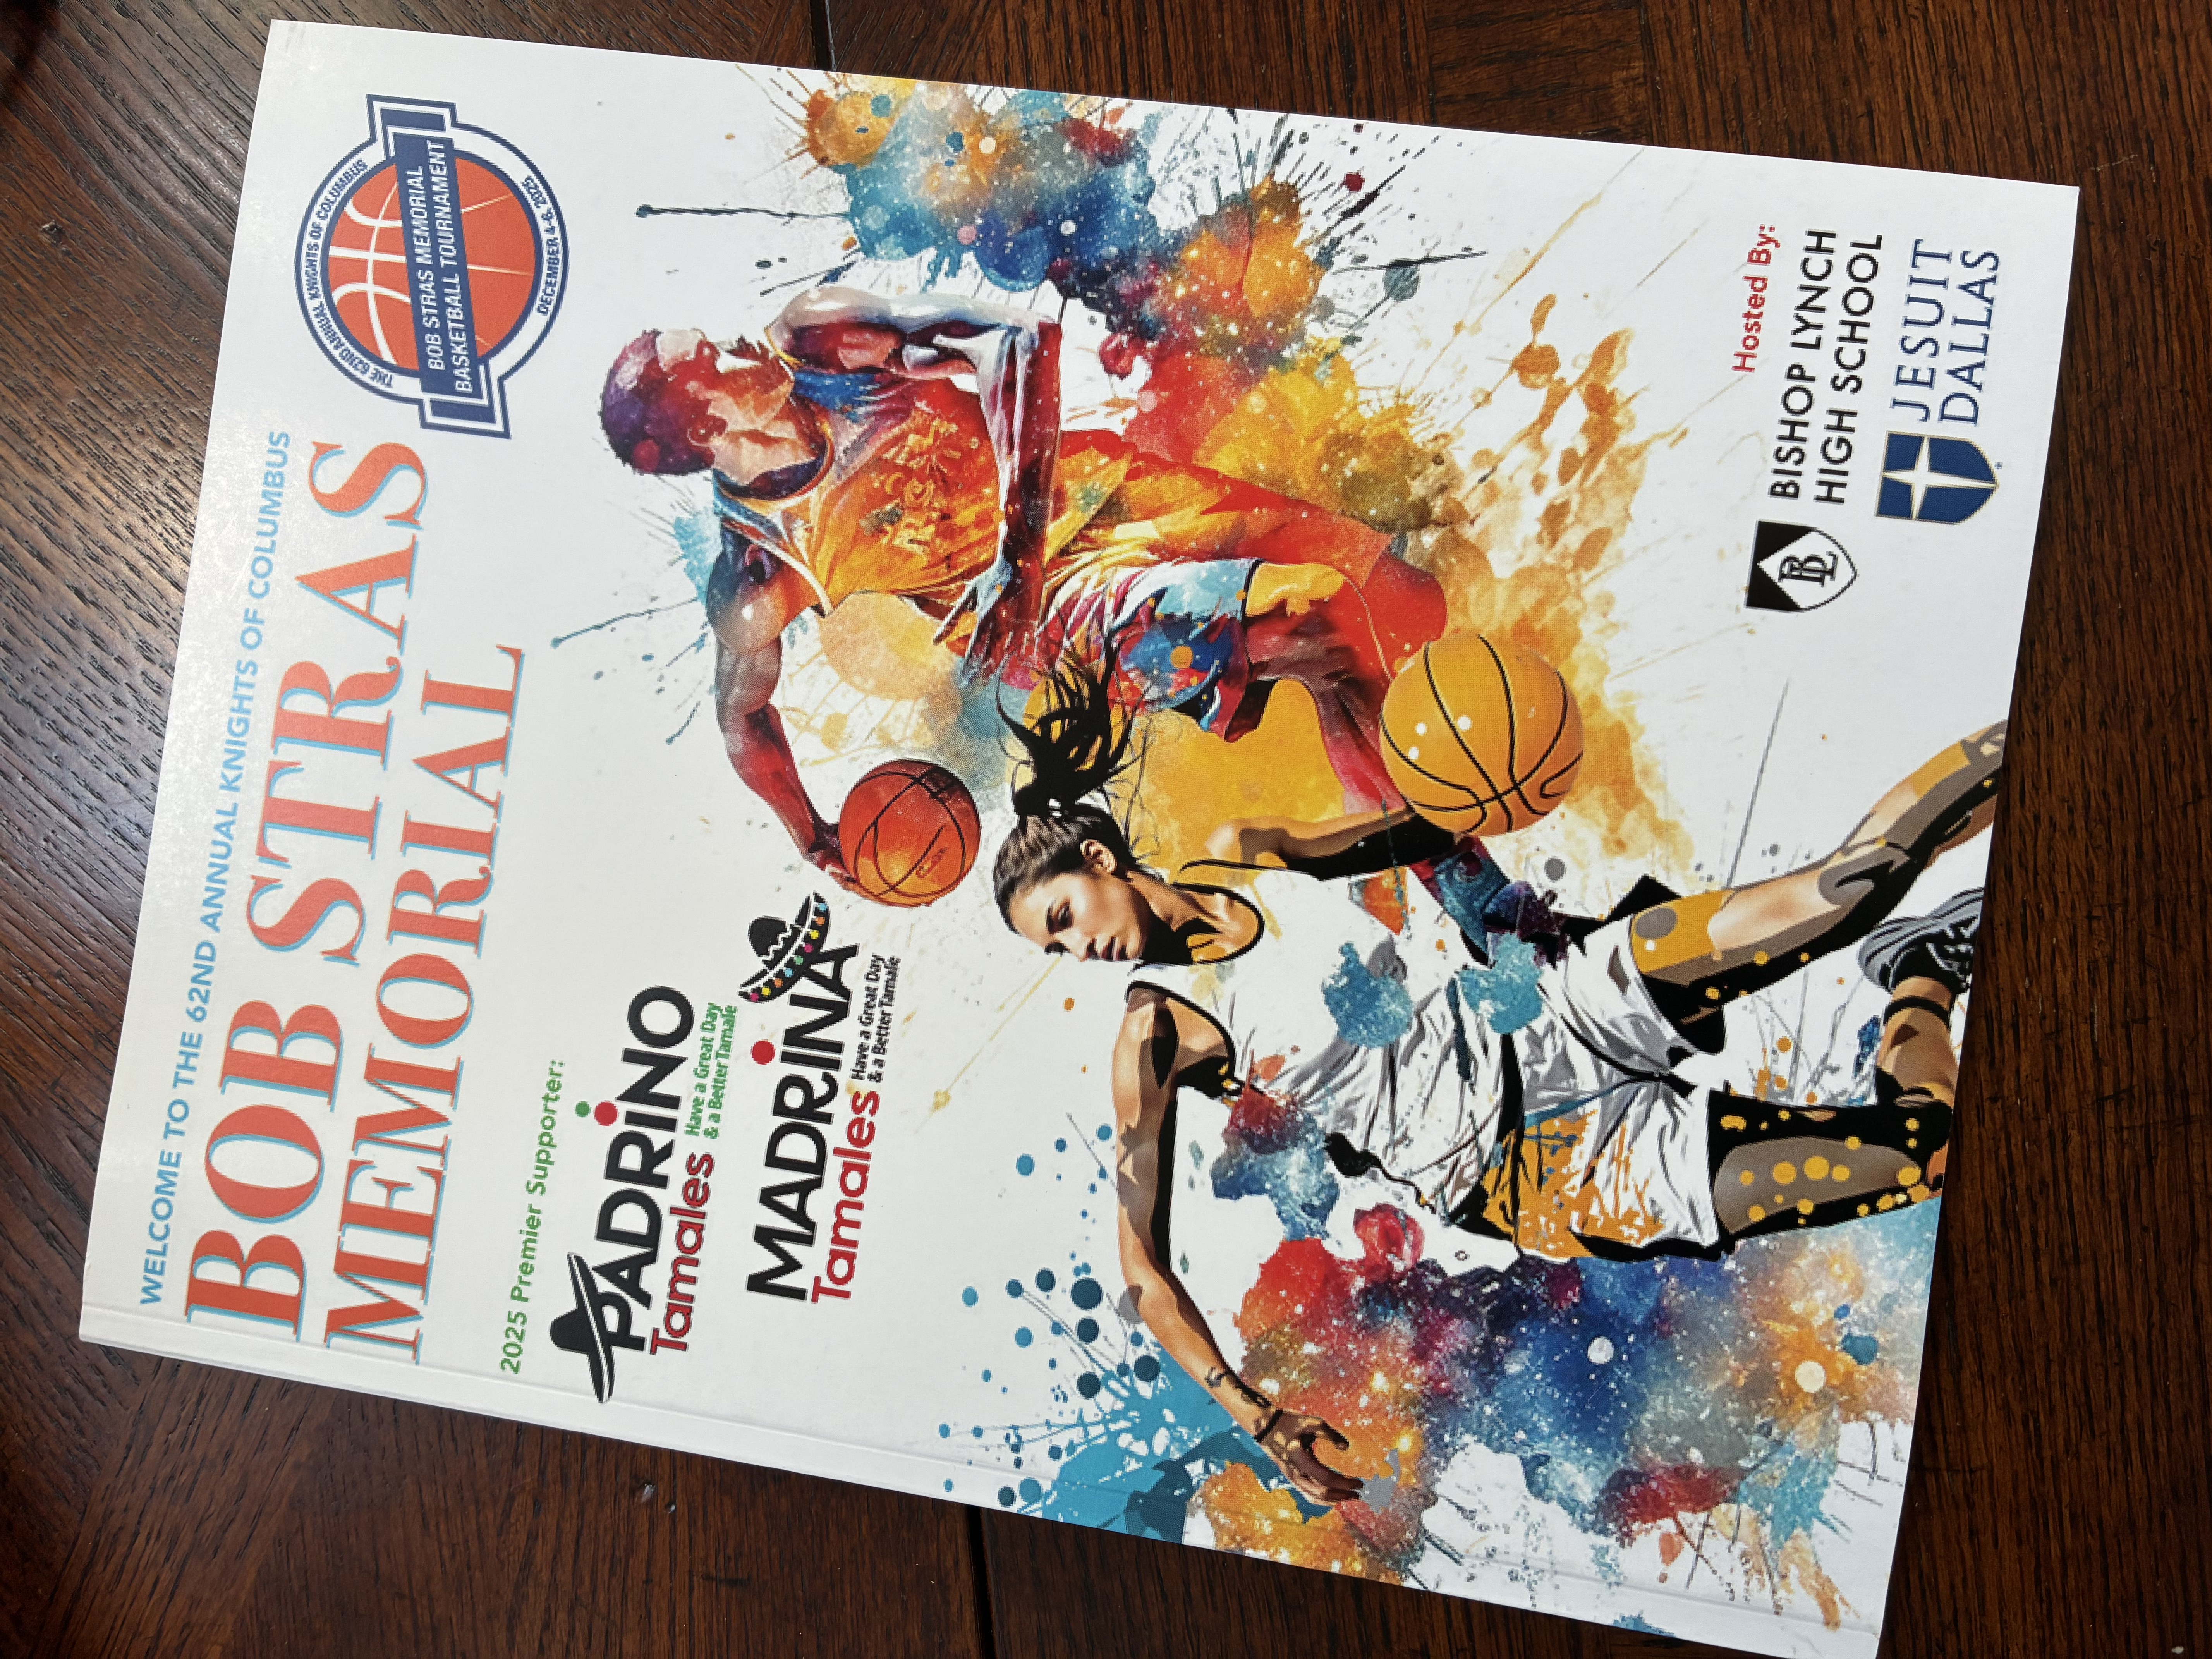
The Tournament Program
50 High Gloss Color Pages
Includes All Team Rosters & Brackets for the Tournament
Sales Of Advertising & Sponsorships In This Program Fund The Entire Tournament
Combination of Sources For Advertising & Sponsorships
Creative Contributions From Many Knights

Slide 7
So, What Can I Do To Support The 2026 Tournament?
To Support An Advertisement For Your Council Or A Platinum or Gold Sponsorship:
​
Complete The Form Distributed Today
OR
​
2) Visit The “Store” Section on www.kofcdallas.org
​
Have My Council Commit To An Ad In The 2026 Tournament Program!
Encourage All Brothers In My Council To At Least Consider A Platinum or Gold Sponsorship!
Approach A Local Business To Support The Tournament!

Slide 8
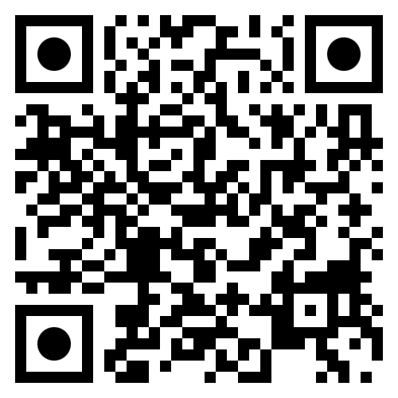
QR Code To Commit To An Ad
Kofcdallas.org/store

Slide 9
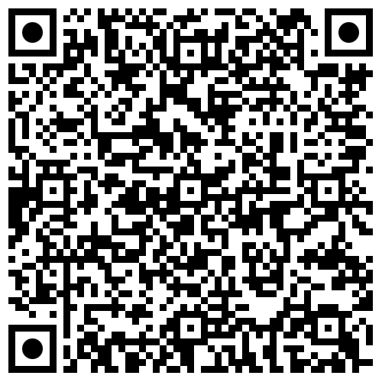
QR Code For A Platinum Or Gold Sponsorship
Kofcdallas.org/store

Slide 10
Questions?
Contact
Jake Fleischer
johnfleischer7@gmail.com
Or
Roy Rabenalt
royrab@sbcglobal.net

