Slide 1


Dallas Intro & Membership
SK Reed Fontenot
Dallas Diocesan Deputy

Slide 2
Dallas Organizational Meeting - 7/11/2026

Slide 3
2026-27 Dallas District Deputies
Congratulations to Kevin Quinn (DD108) and Michael Kells-Murphy (DD111) for being appointed as Assistant Diocesan Deputies

Slide 4
Membership

Slide 5
2025-26 Dallas Membership

Slide 6
2025-26 Dallas Membership
14 of 15 District Deputies made goal!

Slide 7
2025-26 Dallas Membership
36 of 59 Councils made goal! +4 over last year!

Slide 8
2025-26 Dallas Membership
36 of 59 Councils made goal! +4 over last year!

Slide 9
2026-27
Dallas Membership
Off to a slow start

Slide 10
2026-27 Dallas Membership
Please schedule your CUF ceremonials now to ensure we start the new year strong!
Strive for at least ONE CUF each month in each District starting in July!
Ensure all are scheduled on the State and Dallas Diocesan website
Let’s ensure all eligible Catholic men are offered the gift of membership in Dallas!

Slide 11
Weekend Membership Drives
This guide outlines the three phases of a weekend membership drive

Slide 12
Phase 1: The Pre-Recruitment Weekend
Meet with your Pastor
Present your recruitment plan, including the pulpit talk and after-Mass appeal.
Explain the purpose of the drive: “We want to build the Kingdom of God through our Faith in Action programs.” Provide him with a copy of the statement.
Agree on a weekend for the drive.
Select a CUF date within two weeks of the drive and share it with him.
Provide your setup plan, including exit-door coverage and inclement-weather options
Explain the e-Membership application process.
Keep the meeting brief and limit attendance to one or two Knights.

Slide 13
Identify and set goals
Determine the demographic profile of each Mass.
Determine how many new members you need. As a baseline, aim for 120% of your annual quota to earn LSAFE w/D.
Analyze your goals, determine how you will recruit new members and encourage them to become active
Preparation
Essential: Communicate and Publicize the recruitment plan
District Deputy
Field Agent
Degree Team Captain
Key council members
Sunday church bulletin
Weekly parish email newsletter
Parish website
Please post the CUF on the state website and the chapter website

Slide 14
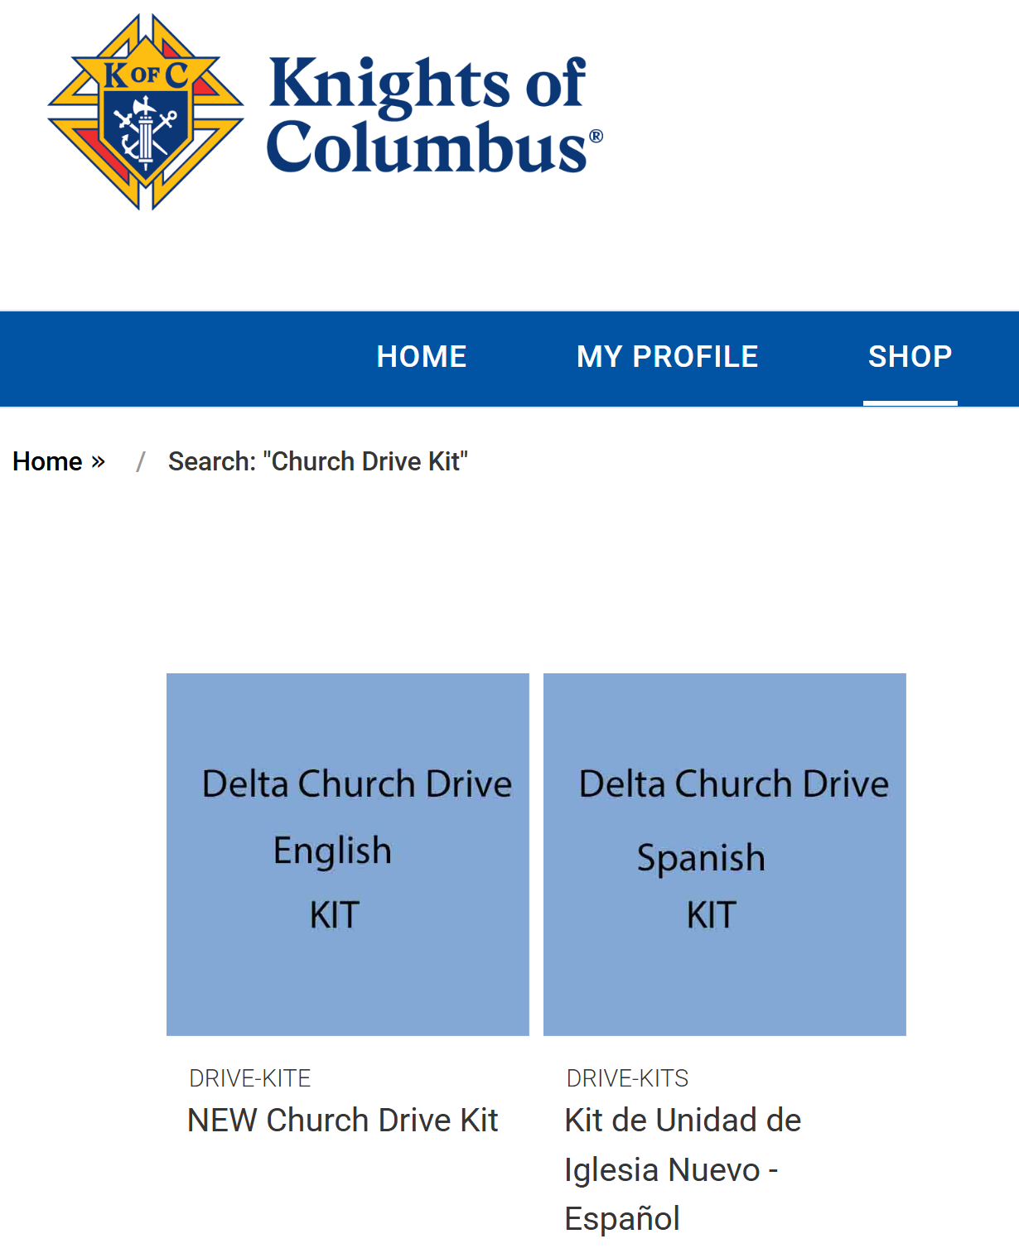




Acquire all materials early
Order Delta Church Drive Kits (DRIVE-KIT-E). They are available in English and Spanish and include enough materials for 800 parishioners.
Order Membership Enrollment Forms 11881.
Order Faith in Action Guidebooks 10907.
Order a variety of prayer cards.
Obtain clipboards, pens, and pencils.
Provide one long table per exit with a KC blue table cover.
Obtain KC blue pop-up canopies, especially for inclement weather.
Provide chairs, but not for use while recruiting is in progress.
Get individually packaged snacks for children. Use kid-friendly packaging, when possible, such as cookies, chips, breakfast bars, or fun-size candies.
Provide food and drinks for your recruiters so they can
Stay all day and cover all Masses.
In Supplies Online, search “Church Drive Kits” and this page will pop up.

Slide 15

Practice Presentations
Choose the best speaker for each Mass. The pulpit announcement should be 45 seconds to 1 minute 45 and seconds long.
Do not read from a script. Deliver the message from memory and with sincerity.
Sit near the location
where you will give
the talk.

Slide 16
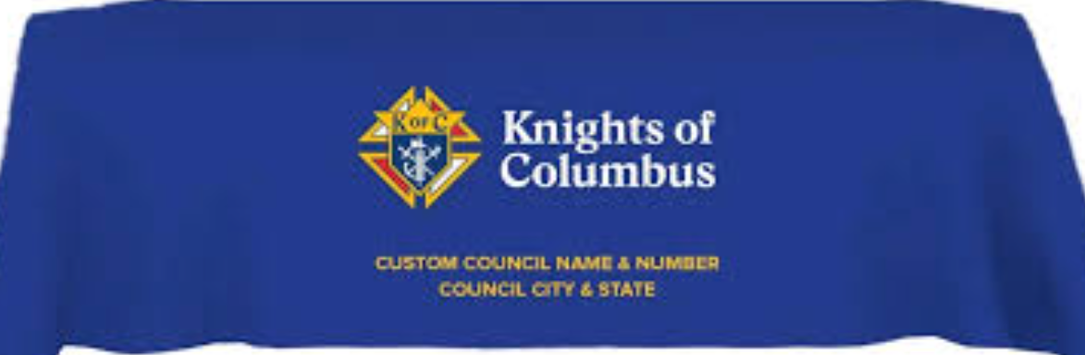

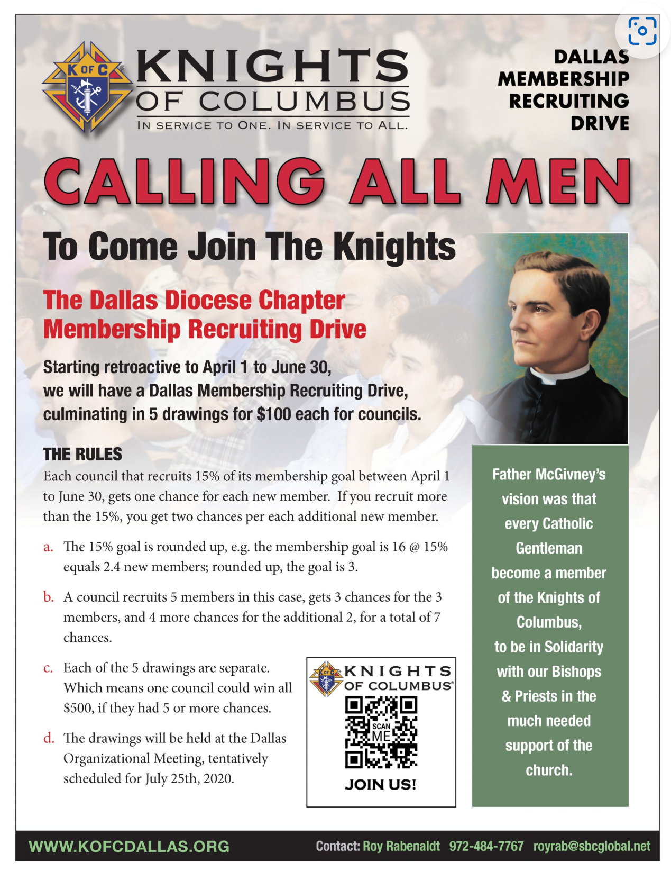


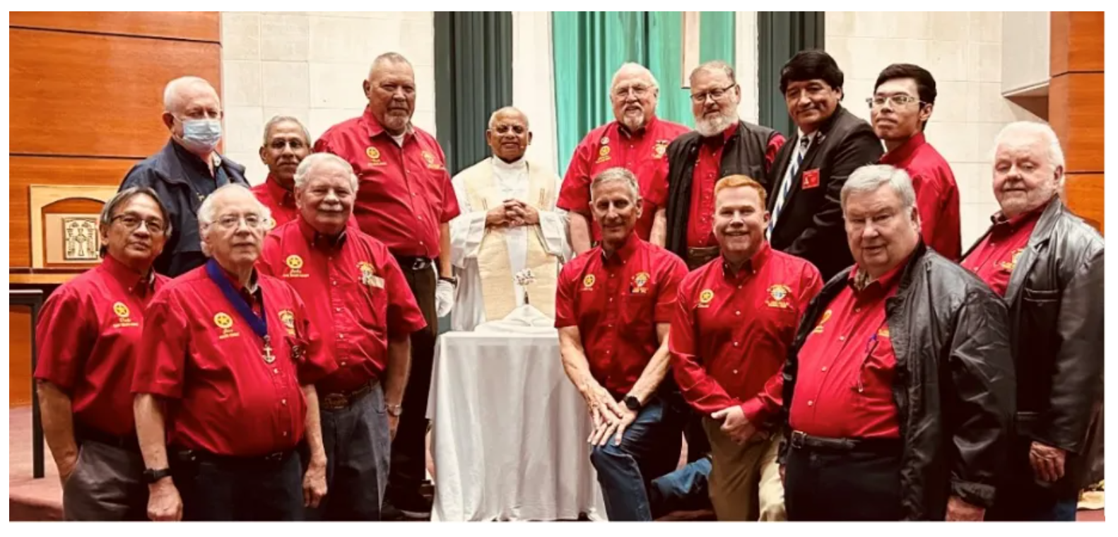
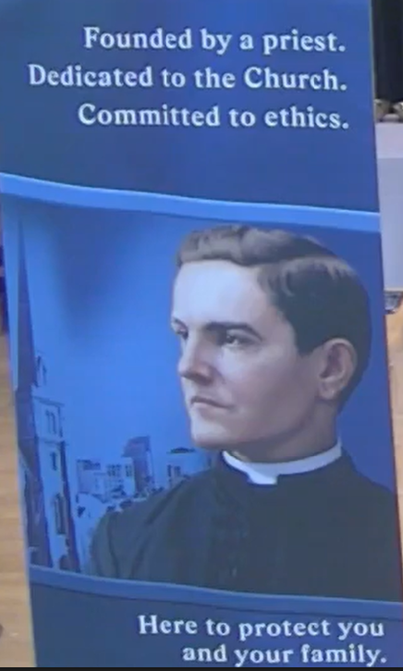

Phase 2: The Recruitment Weekend
Church Arrival and Set-up
Arrive at least 1 hour before the first Mass.
Set up tables, banners, canopies, recruiting materials, balloons, and children’s treats.
Make sure arriving parishioners see enthusiasm and unity.
Greet each parishioner as they arrive.
Wear your council shirt and name badge.

Slide 17

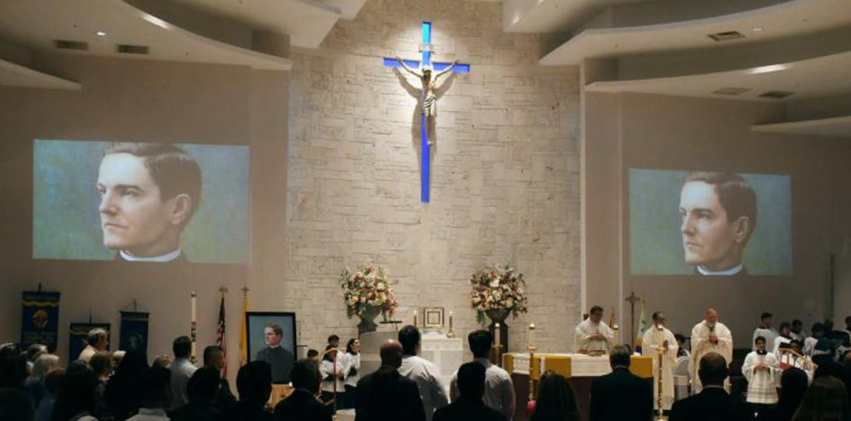
Keep your presentation concise and focused.
Conclude with: “We are seeking men from our parish to join us in serving Father and our parish community in both spiritual and corporal works. Please stop by as you leave and say ‘Hello.’ We are simply asking for your contact information so you can join us in serving our parish. Thank you, and may God bless you all.”
Genuflect appropriately
when approaching and
departing the altar area.

Slide 18
Mass dismissal and implementation of strategy
Recruitment Positions
At the end of Mass, assign at least two Knights to each exit.
Position recruiters in front of the tables, not behind them.
Use the tables for children’s snacks and recruiting materials. Encourage the children to help themselves.
Help families feel welcome and comfortable approaching the tables.
Greet the prospect, then ask: “May I get your name and contact information so you can join us in helping Father ________ and our parish?”
Use Membership Enrollment Card 11881. Proofread it immediately to ensure it is legible. Use his cell phone to complete the online e-Membership application.
Provide
Materials
Give him a copy of the Faith in Action guidebook and ask him and his wife to read it at home.
Give the wife prayer cards.
Give him a “Save the Date” card with the welcome
event date and location.

Slide 19
Phase 3: The Post-Recruitment Weekend
Have your best recruiters call prospects within 24 hours of the recruitment weekend
Remind each prospect about the 30-minute welcome ceremony and let them know family and friends are welcome. A reception will follow.
Review Membership Enrollment Card 11881 and confirm the information is accurate.
If an e-Membership application has not been submitted, explain how to complete it.
Track who will attend the CUF, who has a conflict that night, and who submits an e-Membership application.
Have the Grand Knight or Financial Secretary add members without email addresses to the Candidate Tab.
Have a backup plan for those who cannot make it to your CUF.

Slide 20

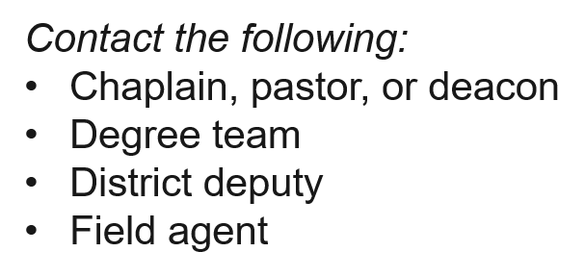
Vetting
The Grand Knight may complete vetting at a time and location of his choosing. Admissions Committees are no longer required.
The candidate may attend a CUF before or after the council votes for his admittance.
.
Confirm the location:
Have the Financial Secretary manage the registration table.
Ensure you have enough Candidate Kits 531E.
Plan and prepare the reception.

Slide 21

Assess your goals after 30 days
Measure the number of new members. A reasonable goal is for at least 25% of recruits to become members.
Discuss strengths and weaknesses with yourrecruiting team to improve future drives.
Monitor
Assign new members as mentees to experienced members.
Continue to check on pending e-Members, Candidate Tab entries, and any other prospects

Slide 22
Online Membership Application
A properly filled out e-application will get your recruit to your councils Prospect tab correctly. This is the best way to avoid other problems down the line like having 3 new recruits with the same name or your recruit assigned to a council some where in Jersey.
It’s the fastest, easiest way to become a Knight while he receives a free pass for the 1st year of membership.

Slide 23
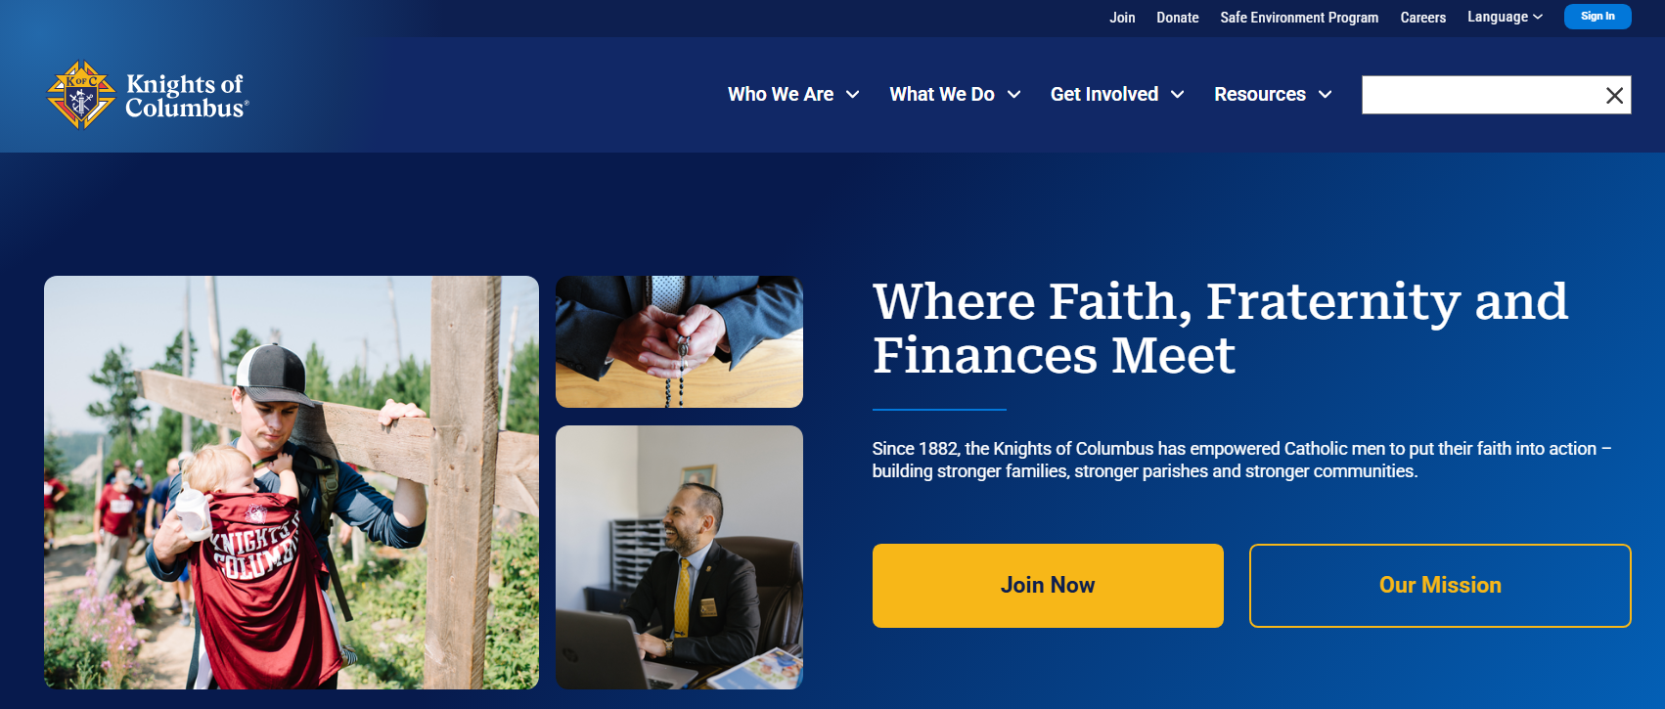
The application is found at the home page of the Supreme website
This page can also be found at www.KofC.org/join
Idea
Set up a QR code for quick access
Click the “join now” tab

Slide 24
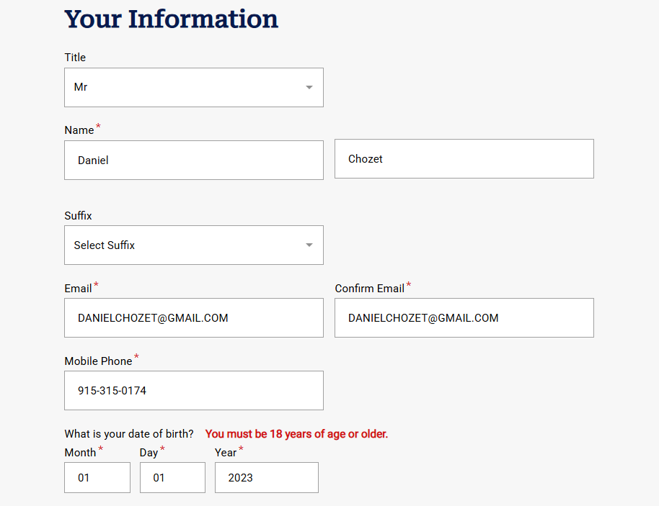










Fill in the blanks COMPLETLEY

Slide 25
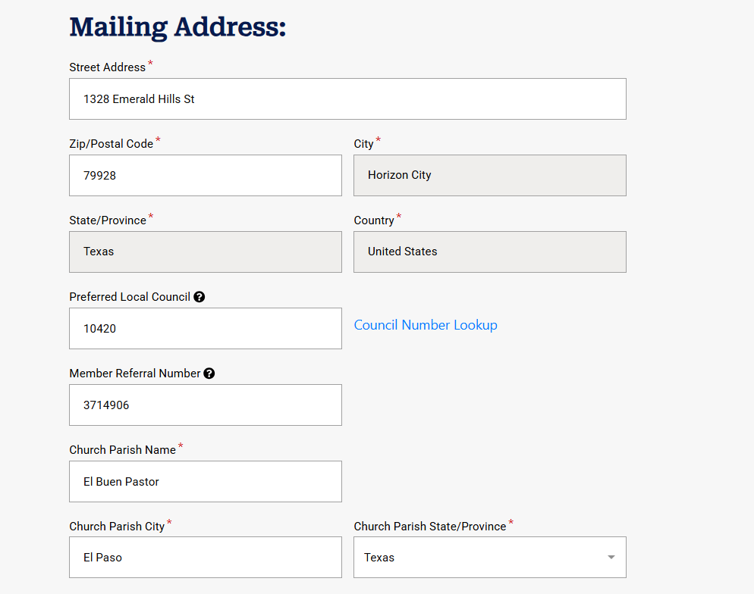










The very best method is to give your council number to the candidate instead of him looking up the council number.
Mistakes easily happen with this option.
The member referral number is your membership number
(the proposer number)
Remember to
Fill in the blanks COMPLETLEY

Slide 26
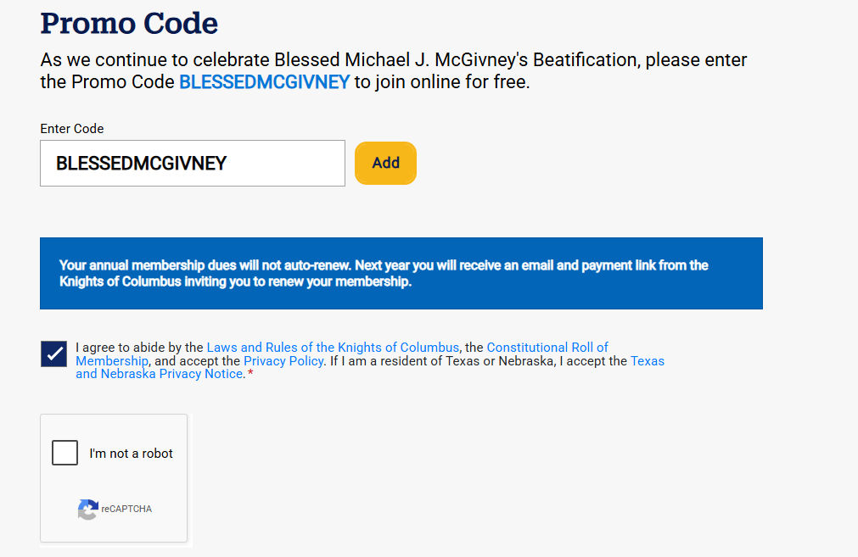


Here is where the special code is entered.
Remember,
No Spaces
Click the join button
✓
JOIN

Slide 27
Congratulations !
A congratulation note will appear. You qualified for a special promotion for the first year of your membership to the Knights of Columbus
The recruit must click the box “I agree”
I agree to abide the laws and rules of the order, the constitutional roll of membership, and the Texas State Privacy Policy.
Notes:
A man becomes part of a 2-million-member worldwide fraternity.
Ideal for men who don’t have a local council, tight schedule, want to explore the Order first.

Slide 28
E-Member Responsibilities
After submitting information, the eMember will receive a confirmation email. The eMember must respond to this email to finalize his membership within 24hrs ! This will happen 3 times. If the candidate does not respond his application will be assigned to the State council.
Respond to contact made by the local council.
Attend the Exemplification of Charity, Unity and Fraternity (CUF).
Become active in parish-based fraternal life.
Notes:
Attend meetings, volunteer for programs, participate in faith formation and charitable works, build fraternity with other Catholic men.

Slide 29
Special Note:
Copies of the un-answered applications will sent to the State Council where they will be followed up on. However, these applications will not be placed on the council's prospect tab.
Councils need to realize this and take immediate actions if the candidate does not show up. Councils will have to contact the recruit so he can be converted into an e-member. Many of the recruits do not have e-mail addresses so follow up is important and communication is critical.
Save all of the recruits contact info! Don’t be left in the dark !

Slide 30

Prospect Tab
Online members “assigned” as prospects to councils will appear in the council’s Prospect Tab in Officers Online.
This tab is only seen by the GK and FS.
Allows for the acceptance or rejection of the eMember.
Use this tab to “transfer” the eMember into the council after the CUF or to “reject” the eMember.

Slide 31
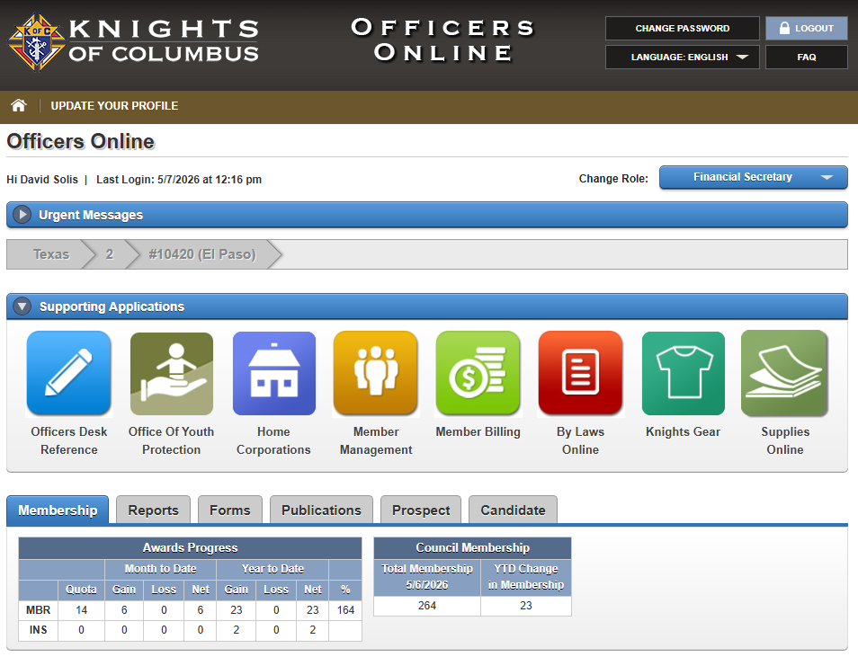
Officers Online
Prospect Tab
Step 3:
Click Prospect

Slide 32
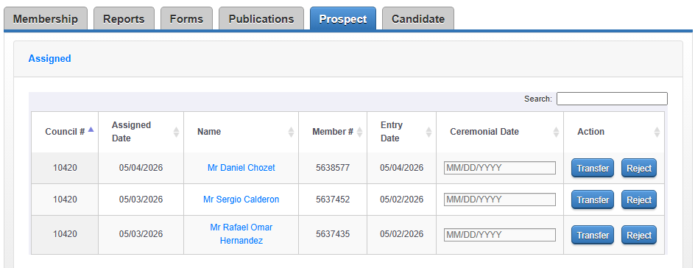
Officers Online
Prospect Tab
Step 4:
Find the eMember
Click on the name

Slide 33
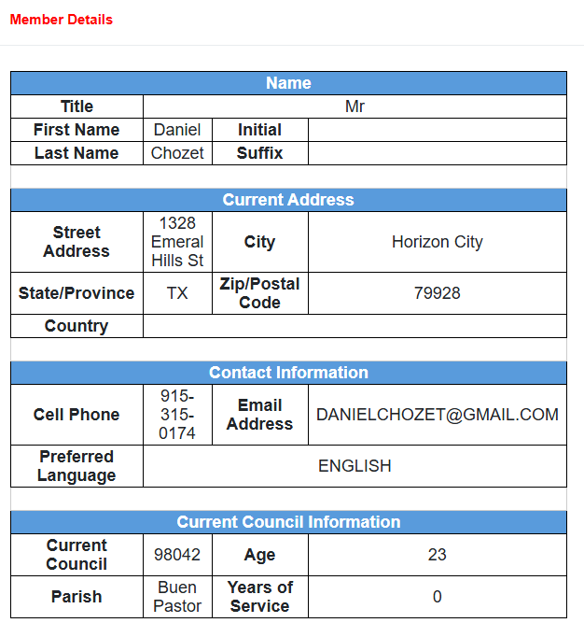
Officers Online
Prospect Tab
Step 5:
Review eMember
details
Contact e-Member
Schedule for CUF

Slide 34
Officers Online
Prospect Tab
Step 6:
Enter the Ceremonial Date
Click on “Transfer”
Prospect gets added to roster in 1 – 2 days.

Slide 35

Candidate Tab
Allows the GK and FS to provide the membership information for new, reactivated, & transferring members directly to the Supreme Council online.
Online Form 100 (NO PAPER FORM #100).
Use to “Process” the candidate into the council after the CUF or to “Delete” the candidate.
Use to “transfer” a member into the council.
Processing time is 1 – 2 days.
Notes:
A man becomes part of a 2-million-member worldwide fraternity.
Ideal for men who don’t have a local council, tight schedule, want to explore the Order first.

Slide 36
Officers Online
Candidate Tab
Step 3:
Click on “Candidate”

Slide 37
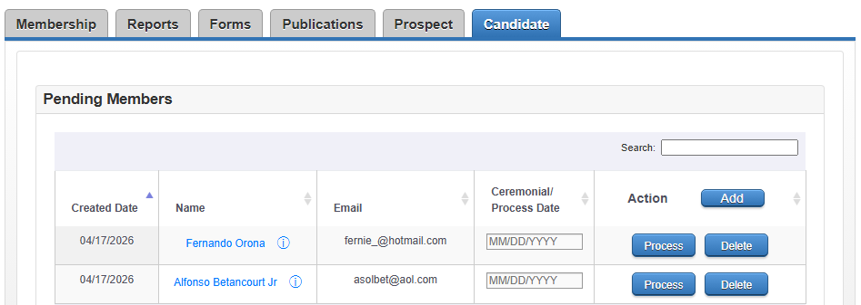
Officers Online
Candidate Tab
Step 4:
Click on “Add”

Slide 38
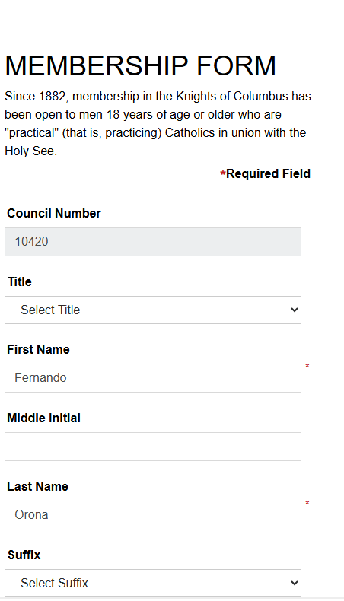
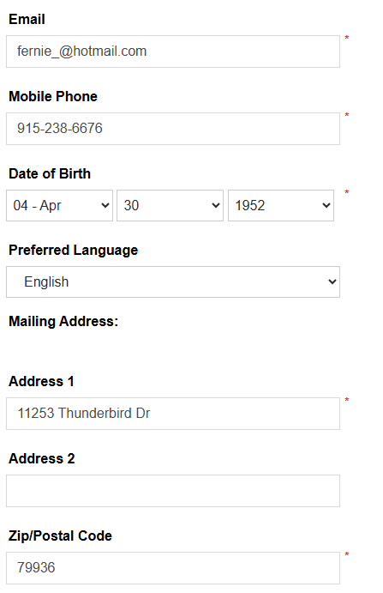
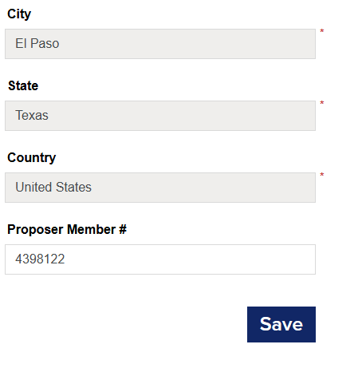





Slide 39
Officers Online
Candidate Tab
Step 6:
Candidate’s names will appear as Pending Members
Enter a Process Date
Click on “Process”
Candidate gets added to roster
Delete candidate if
necessary

Slide 40
Summary
Prospect Tab is your pipeline for online members. It’s fast, paperless and assignment driven.
Candidate Tab is your pipeline for traditional applicants. It’s structured, Form 100 based and council managed.
Together, they ensure every potential Knight is tracked, contacted, and guided into full council membership.
Notes:
A man becomes part of a 2-million-member worldwide fraternity.
Ideal for men who don’t have a local council, tight schedule, want to explore the Order first.

