Slide 1
Dallas Organizational Meeting - 7/11/2026

Slide 2
Knights of Columbus Programs
Successful Programs Lead To Success In Recruitment!!!

Slide 3

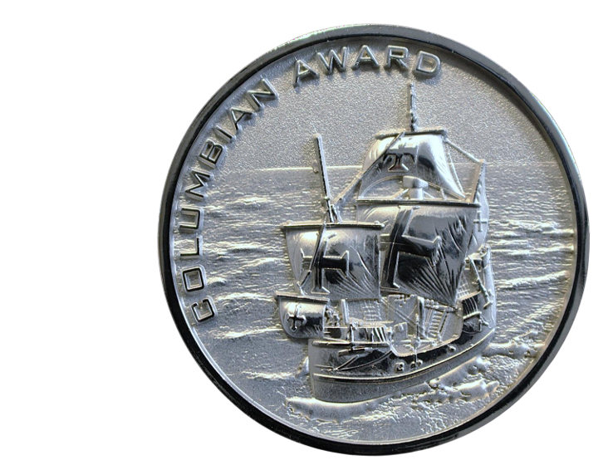
The Columbian Award
2026-2027

Slide 4
Satisfy all three requirements
1. Donate $500 to; Aid and Support After Pregnancy, Food for Families, Refund Support Vocations Program, or Coats for Kids
2.Conduct four Faith in Action Programs
3.Conduct three activities, one each, focused on;
Christ/Fraternity/Community or Monthly Cor

Slide 5



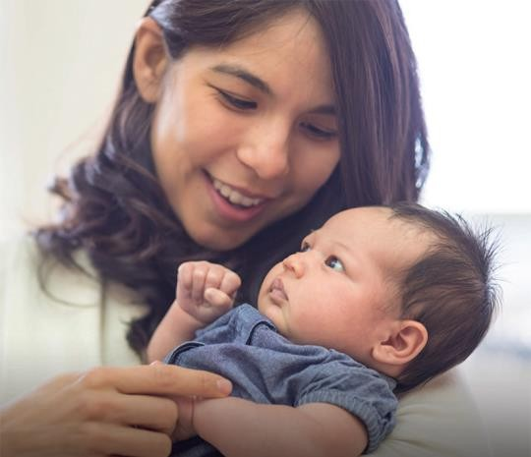
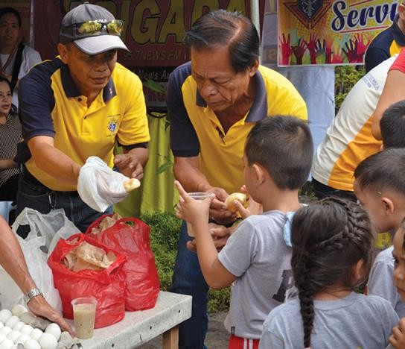
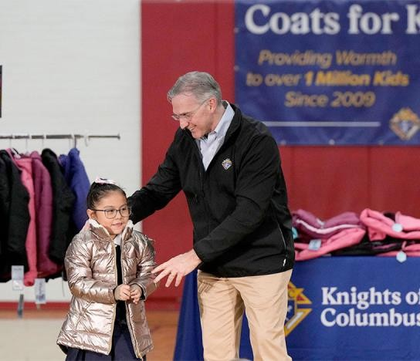
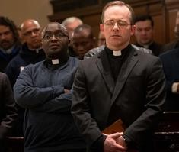


Requirement #1
Donate $500 toward any of the following:
ASAP
(cash or item value)
Food for Families
(cash or 1,000 lbs.)
Coats for Kids
RSVP

Slide 6
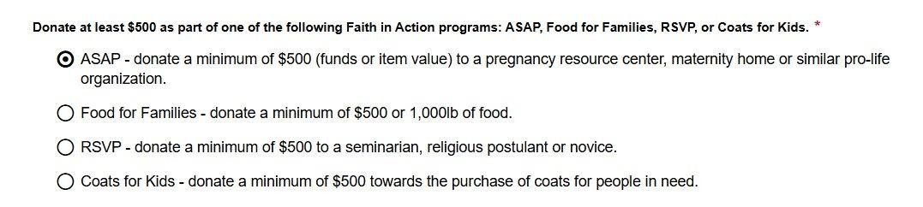

Slide 7




Requirement #2
Faith
Family
Community
Life
Conduct 1 Program in each of the 4 FIA Categories. The Program selected here can not have been used in Requirement #1.

Slide 8
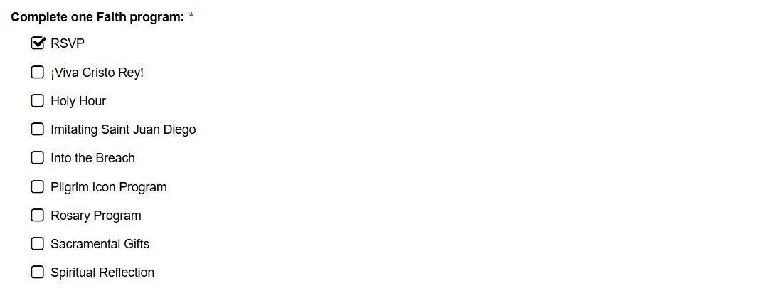

Slide 9

Requirement #3
3 Unique Programs/Activities
Build fraternity Bring men closer to Christ
Serve Parish or Community
Conduct Cor monthly
Include name and email of EFF Director

Slide 10
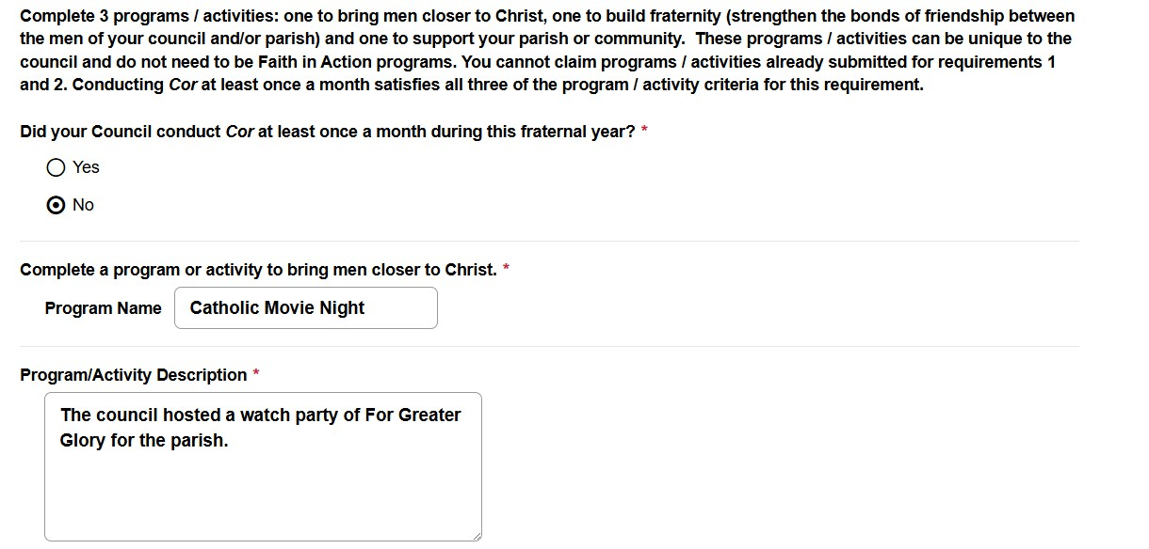

Slide 11

Removed
Family Week
Good Friday Family Promotion Habitat for Humanity
Combined
Family Fully Alive 🡪 Family Prayer Night Novena for Life 🡪 Gospel of Life Pregnancy Center Support 🡪 ASAP

Slide 12


Added
Family
Build-a-Bed Quinceañera Support
Remembering Our Faithful Departed
Life
Gospel of Life
Holy Hour for Life with Our Lady of Guadalupe
Community
Bright Futures Celebrating Our Catholic Heritage
Faith
Imitating Saint Juan Diego
¡Viva Cristo Rey!
Other
Moving Building the Domestic Church Kiosk to Family category

Slide 13

Star Council 2026 – 2027
Earn the McGivney, Founders’, & Columbian Awards; and satisfy all administrative requirements
2026-2027 Administrative Requirements:
Be in good standing with Supreme Council (pay assessments)
Safe Environment compliant
Submit forms
#185 (Report of Officers), #365 (Report of Directors),
#1728 (Annual Survey)
NEW:
Submit form #1295 (Annual Audit)

Slide 14

Main Goal This Year: Have Fun!!!!

Slide 15
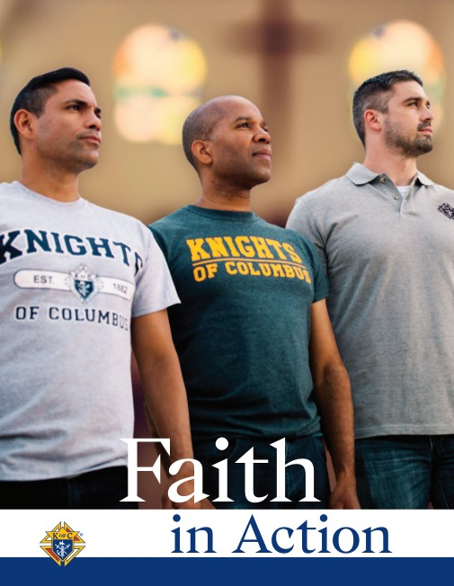
Faith In Action

Slide 16
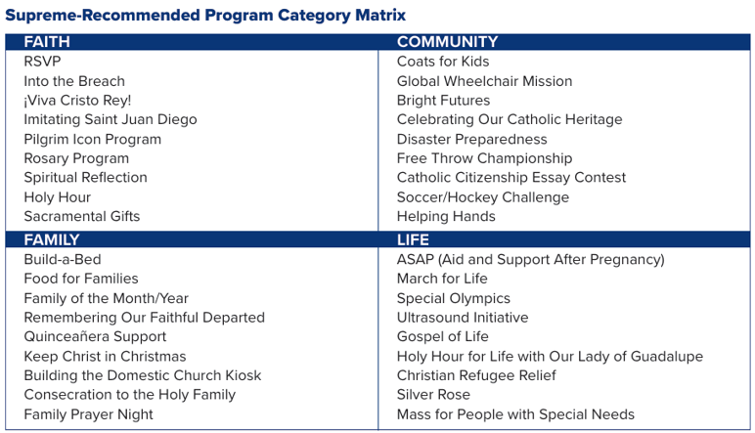
Faith In Action

Slide 17
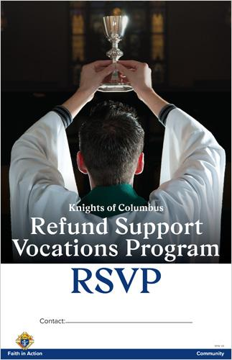
Faith

Slide 18
Faith
Chairman: Ricky Solice
bmusic2411.rs@gmail.com
Goal is to have every Seminarian in the state of Texas sponsored!
$500 Donation also fulfills Requirement #1 For Columbian Award

Slide 19
Faith
What We Need:
Every Diocesan Deputy needs to reach out to their Vocations Director & provide a list of seminarians to Ricky by August 1st.
Mark those who already are sponsored.

Slide 20
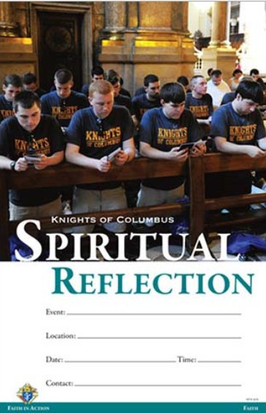
Faith

Slide 21
Faith
The definition of a “reflection” is broad but should be a day-long event at minimum and could possibly encompass an entire weekend.
Councils can attend religious retreats and days of reflection organized by other groups. However, if they are attending a reflection and not planning it themselves, council attendance should be significant with at least 10 percent of the council or a minimum of 10 members participating.

Slide 22
Faith
Be creative! Pilgrimages to nearby basilicas, monasteries or convents can qualify for a Spiritual Reflection.
Councils are strongly encouraged to include Mass within their Spiritual Reflection, celebrating the liturgy with your chaplain or pastor. Also, incorporate opportunities for other sacramental and liturgical activities such as confession, Eucharistic adoration, a rosary or all of these.

Slide 23
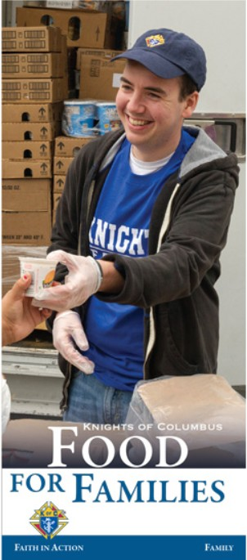
Family

Slide 24
Family
Collect a minimum of $500 or 1,000 pounds of food for a parish or community food pantry and contribute a minimum of 100 total man-hours in preparation, distribution & service of meals. Report activity and apply for the refund using the Food for Families Refund Application (#10057).
Immediately after your program is finished, complete the Food for Families Refund Application (#10057) and the Fraternal Programs Report Form (#10784)

Slide 25
Family
Remember to provide proper documentation with form #10057, such as a donation receipt or letter from a food assistance organization detailing your donation. Applications will not be accepted and/or processed without supporting documentation. Submit completed application along with supporting documentation to fraternalmission@kofc.org
The $500 Donation also fulfills Requirement #1 for the Columbian Award

Slide 26
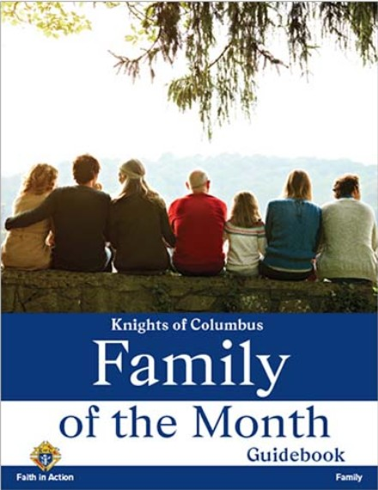
Family

Slide 27
Family
Recognize twelve families throughout the fraternal year (one each month) and submit a Family of the Year to the State.
Report activity using the Fraternal Programs Report Form (#10784) each month and a Family of the Year Entry Form (#10680) by March 1st.

Slide 28
Family
Family of the Month Criteria
Is the family tight-knit? Does the family spend quality time together?
Does the family attend weekly Mass together?
Does the family pray together outside of Mass?
Has the family made significant contributions to the parish and church community?
Does the family serve as a model of Catholic family values?
Does not have to be a Council member!

Slide 29
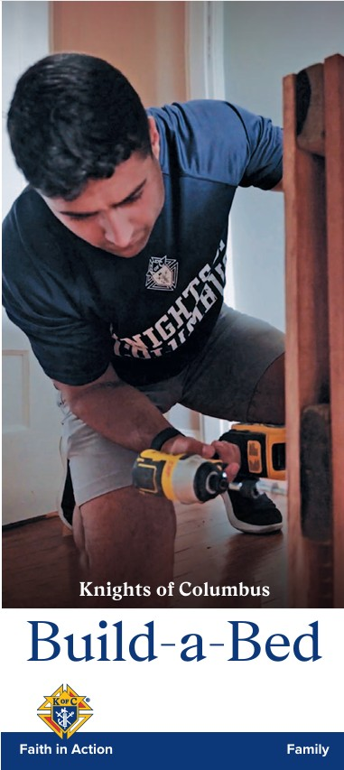
Family
Build-a-Bed will be added as a new Family program for the 2026-27 fraternal year!
Through the program, councils partner with Sleep in Heavenly Peace to build and deliver beds for kids in need. The program resources will be available online at kofc.org/build-a-bed at the start of the upcoming fraternal year (as will the guide sheet which is pending).

Slide 30

Family

Slide 31
Family
Deadlines
Septemeber 1st: Order Kits from Supplies Online
September 1st: Order Paper (11 x 17 White Card Stock)
October: Create Posters
November 15th: Council Judging
Early December – District & Diocesan Judging
January 15th – Winning Posters to State
February 25th – State Winners To Supreme

Slide 32
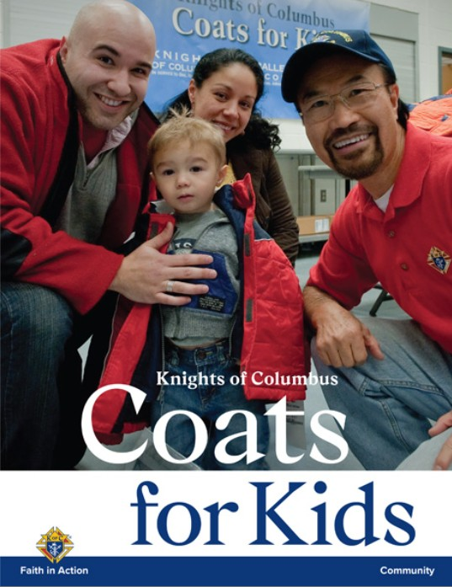
Community

Slide 33
Coats For Kids
Chairmen
Leo Saenz
(512) 831-8516
leosaenz@gmail.com
Tom Krueger
(210) 889-3993
tomk3276@gmail.com

Slide 34
Coats For Kids
Hugely Successful In San Antonio Last Year
We need Commitments From Diocese By July 17th - YES
As of This Weekend, We will have 10 Distribution Points Across The State
Distribution of Coats Will Be on Black Friday, November 27th
We will need a Coordinator From Each Diocese
Supreme Offers a Buy One Get One (BOGO) Opportunity
Currently will Match 50 Cases (600 Coats)
Working to Get That Increased to 100 Cases

Slide 35
Coats For Kids
Since 2009 Knights Have Supplied More Than 1.6M Coats
Funds For Coats Need to At State Office By August 15th
Heavy Coats (12 per case) & Lightweight (24 per case) are Options
Suggested Partners Include Catholic Charities & Catholic 501(c)3s
Can’t Stress Enough: Need A Diocesan Coordinator
Texas State Council Will Submit Proposal For BOGO By Sept. 1st
Councils Can Participate at another time But Won’t Qualify For BOGO

Slide 36
Coats For Kids
Diocesan Distribution
Dallas
Ft. Worth
Galveston/Houston
Austin
San Antonio
Amarillo/Lubbock
El Paso/San Angelo
Brownsville/Laredo
Corpus Christi/Victoria
Beaumont/Tyler

Slide 37
Community
A $500 donation fulfills Requirement #1 for the Columbian Award

Slide 38

Community
Our First Lady’s Project For the next 2 years

Slide 39

Community

Slide 40
Community
The 2026-27 fraternal year essay topic is:
“The rights of man come not from the generosity of the state but from the hand of God.”
In 500-750 words, explain what this quote from former U.S. President and Knights of Columbus member John F. Kennedy’s 1961 Inaugural address means and its importance for the flourishing of a nation.

Slide 41
Community
Deadlines
July 1st – Order Kits From Supplies Online
September – Write Essays
October – Council Judging
November – District Judging
Early December – Diocesan Judging
January 15th – Winning Essays to State
February 15th – State Winners To Supreme

Slide 42

Life
State March For Life
State Capitol
Austin, Texas
Saturday, January 23, 2027
Councils are encouraged to hold marches in their own Diocese!

Slide 43
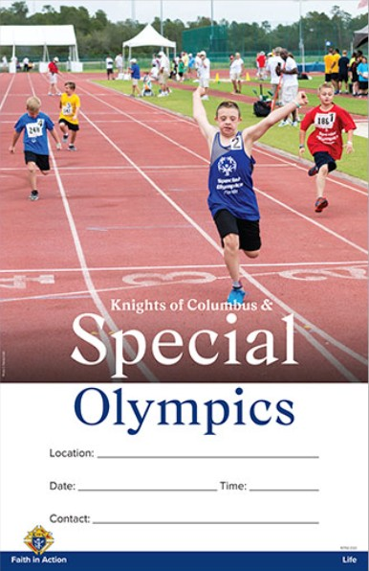
Life
Every Council Can Participate
Remember that 2.5% of your State Charity contribution can be counted as a donation to Special Olympics.
Just remember to report it on your Form #10784 by January 31st.

Slide 44
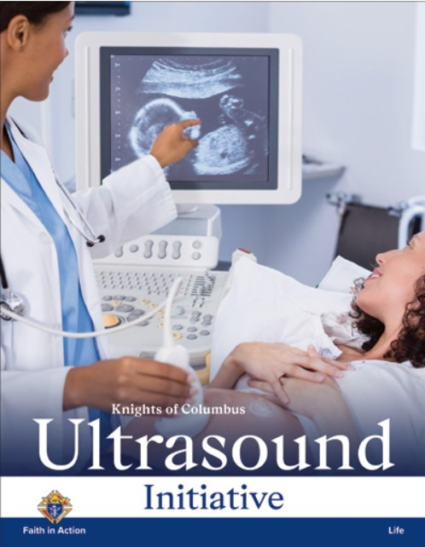
Life
Chairman
Dr. George Brooks
drgabrooks@comcast.net
(832) 814-2718
Also: Culture Of Life Director

Slide 45
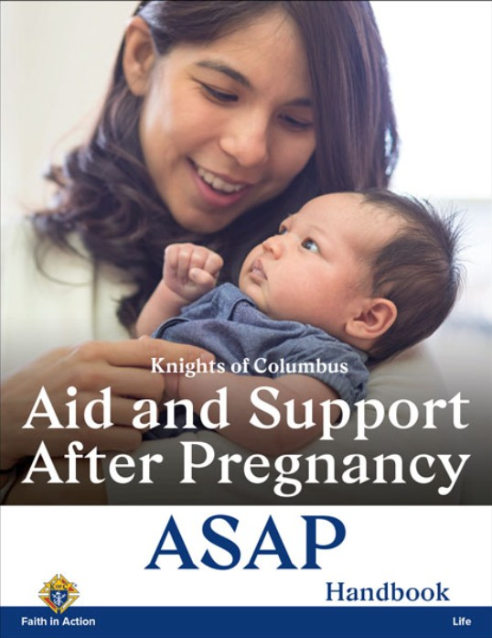
Life
Chairman
Gregory Dutchover
gdutchover@musiccitymall.net
(432) 770-1780
Merged with Pregnancy Center Support

Slide 46
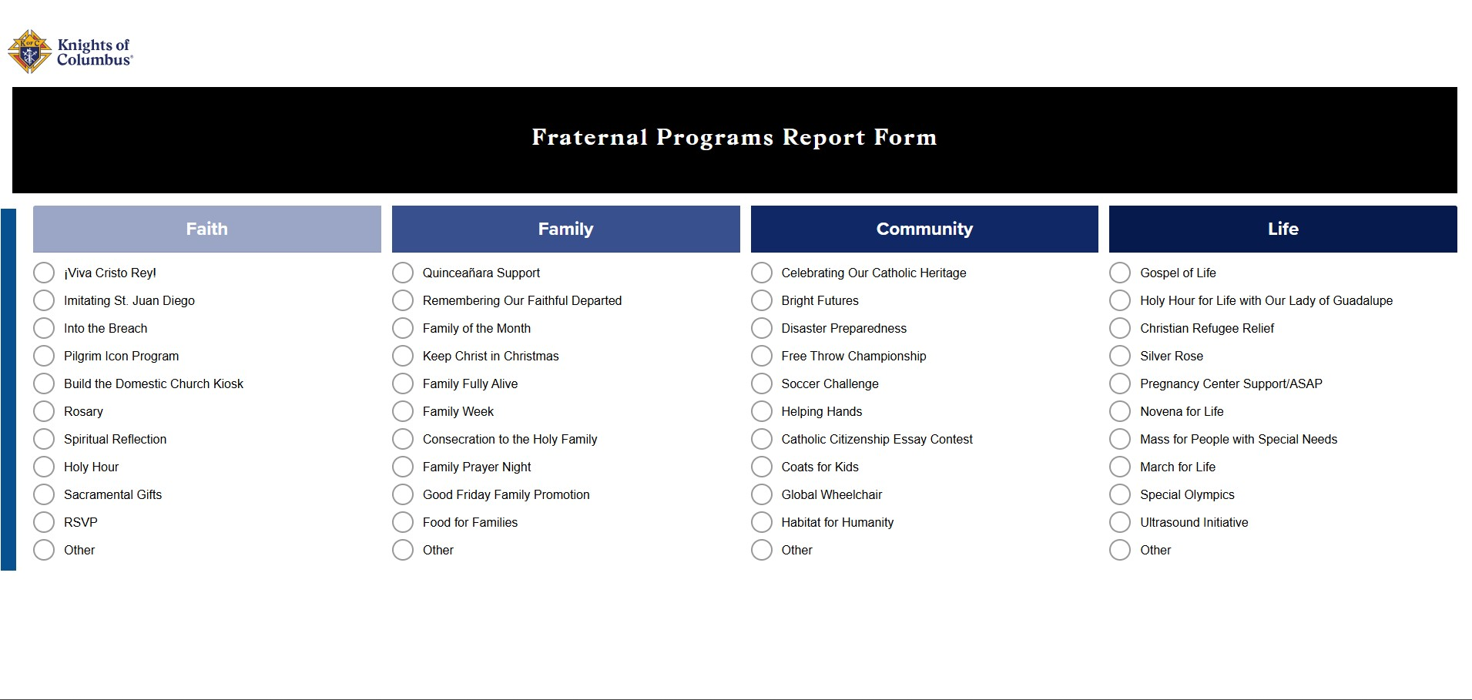
Make Sure You Fill Out A #10784

Slide 47
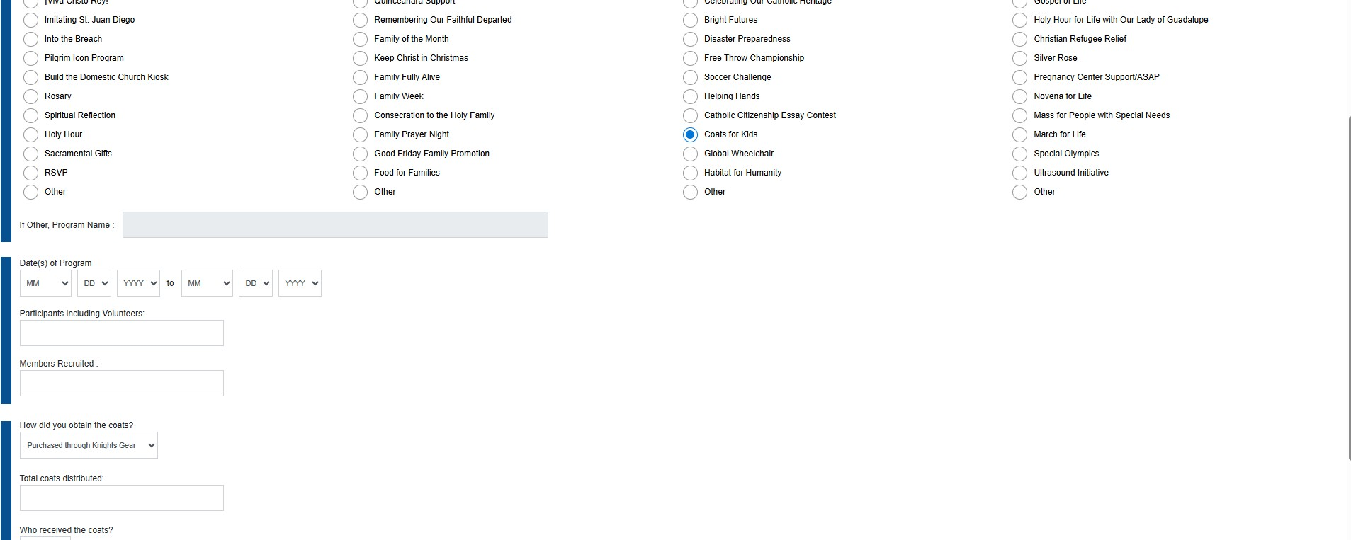
Make Sure You Fill Out A #10784

Slide 48
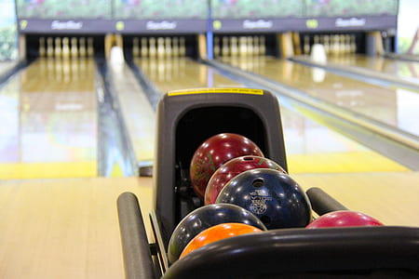

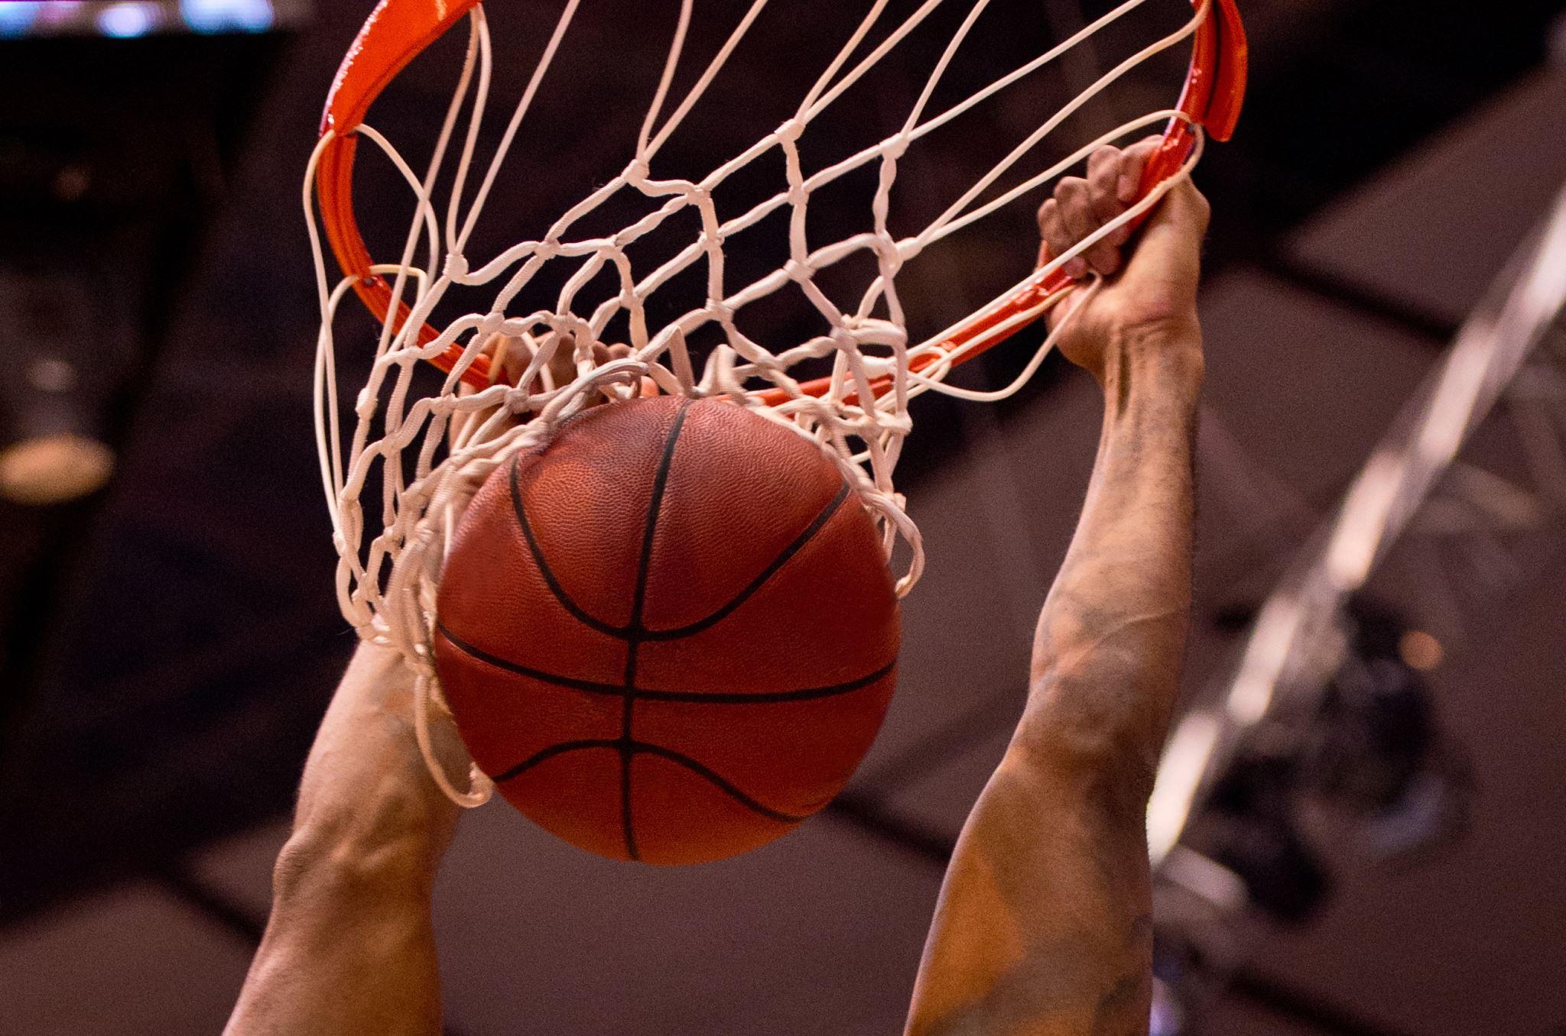
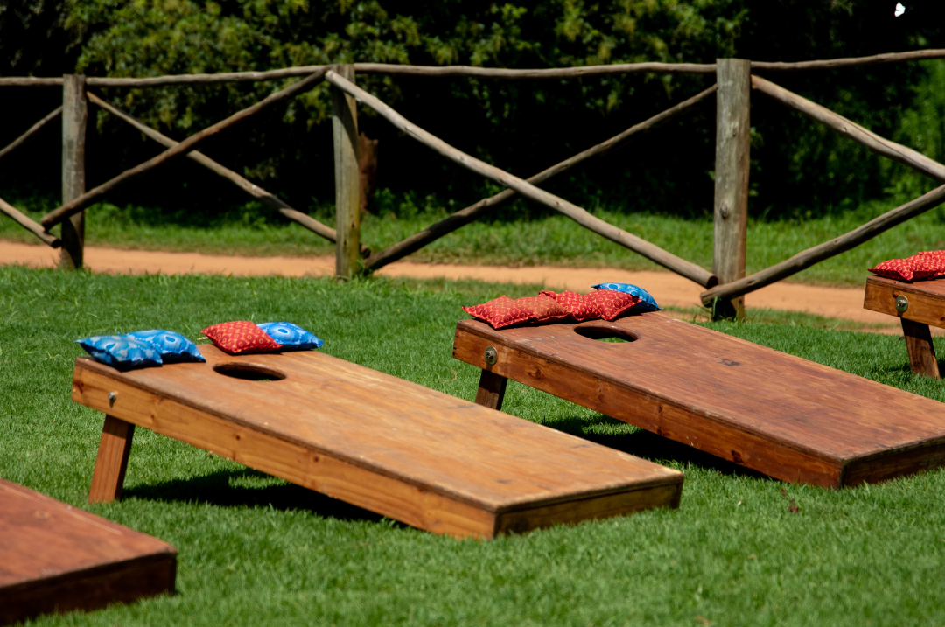
Athletics

Slide 49

When: Sept. 11-13, 2026
Where: Glen Rose, TX
Registration Deadline:
August 15, 2026
Chairman: Ricky Meyer

Slide 50

Soccer Challenge
Deadlines
July 1st – Order Kits From Supplies Online
August 1st – Order District Medals
September – Hold Council Contest
October – Hold District & Diocesan Contest
November 5th or 12th – State Contest Austin
Novemeber 27th – Winning Scoresheets to State
December 19th – Winners Submitted to Supreme
Chairman: Juan Carlos (Primo) Sanchez

Slide 51
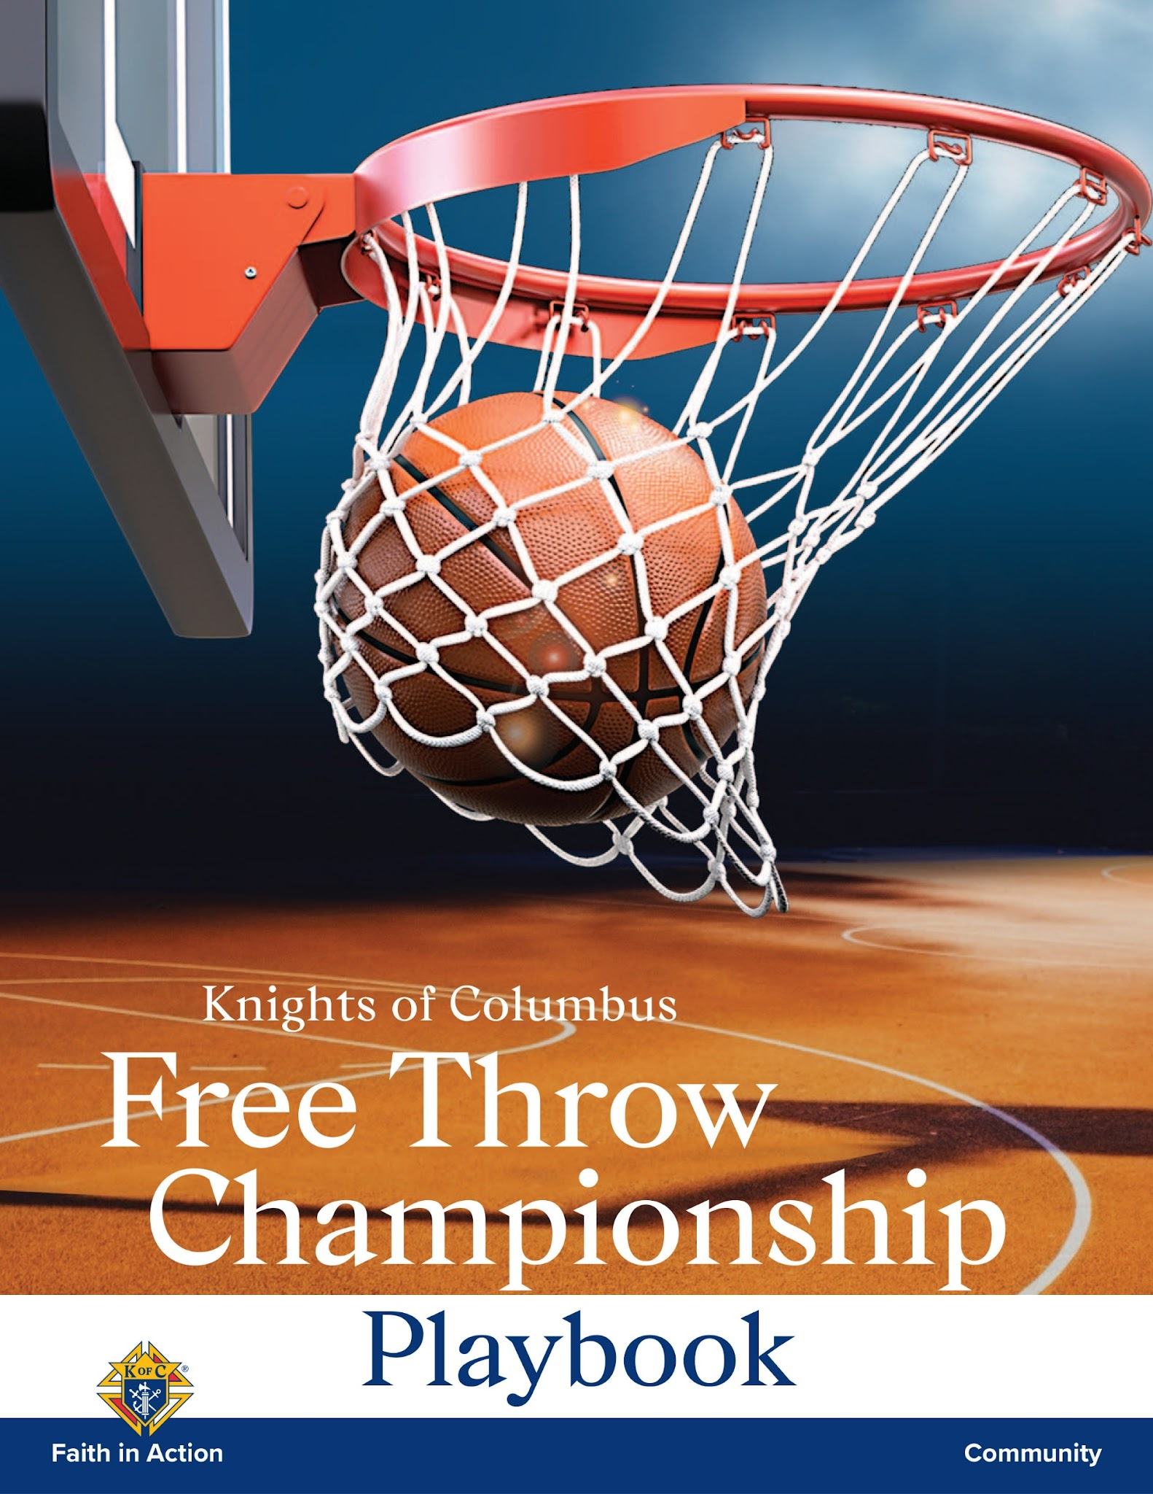
State Free Throw Contest
Deadlines
November 1st – Order Kits from Supplies Online
December 1st – Order District Medals
January – Council Contest
Early February – District Contest
Mid February – Diocesan Contest
March 6th – State Contest San Antonio
April 15th – State Winners To Supreme

Slide 52

State Bowling Tournament
When: April 10 & 17, 2027
Where: Lucky Strike, Georgetown
More Information
to come!
Chairman: Michael Cook

Slide 53
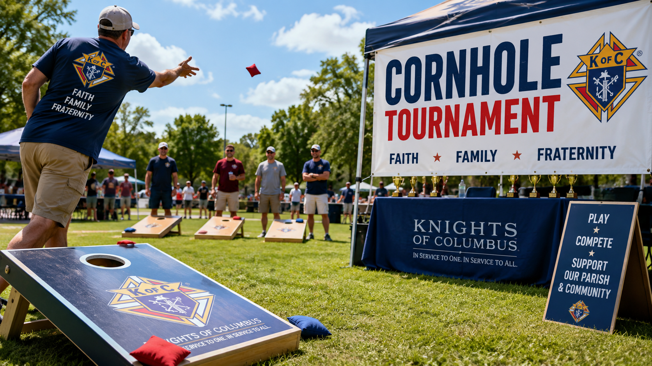
July 1st - March Councils Hold Tournaments
State Tounament- TBA
Chairman: James Halfmann

Slide 54
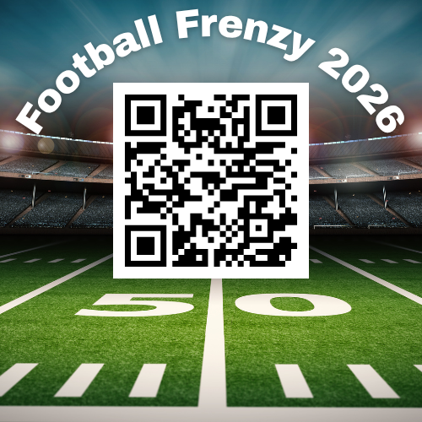
Football Frenzy
District 1- AGH, Victoria, Beaumont
Tony Butera
District 2- Austin, El Paso, Lubbock
Jimmy Hernandez
District 3- FTW, San Angelo, Amarillo
Fredrick Garcia
District 4- Dallas, Corpus Christi, Tyler
Willie Balerio
Distict 5- ASA, Brownsville, Laredo
Ray Mendoza
Chairman – Willie Balerio

Slide 55
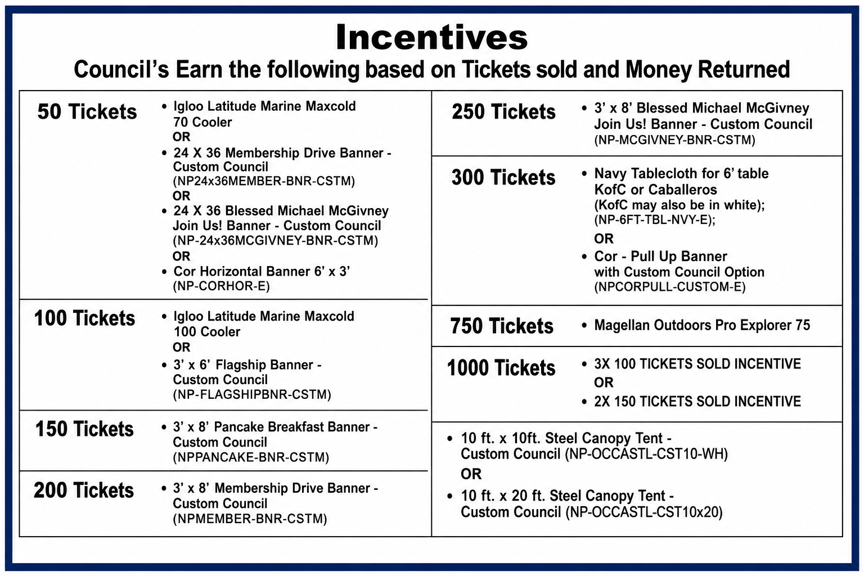
Football Frenzy

Slide 56
Programs
How to access Program Information via
Supreme Website

Slide 57
Programs
www.kofc.org
Then Scroll To Bottom of Page

Slide 58
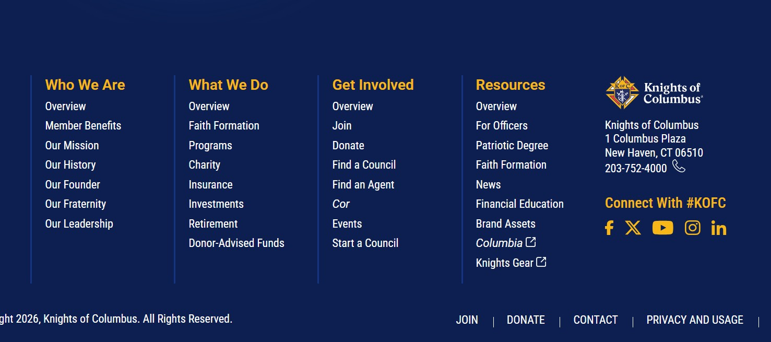
Programs

Slide 59
Programs
Accessing Officers Online

Slide 60
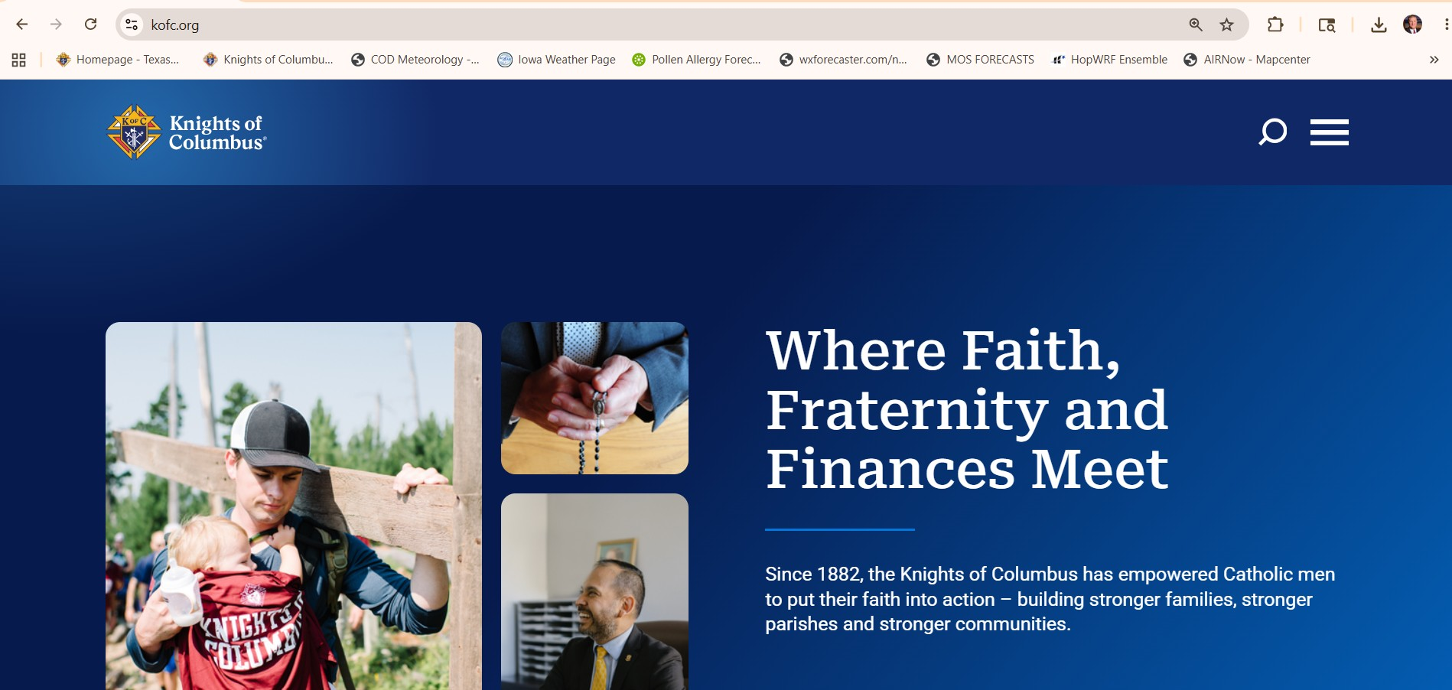
Programs

Slide 61
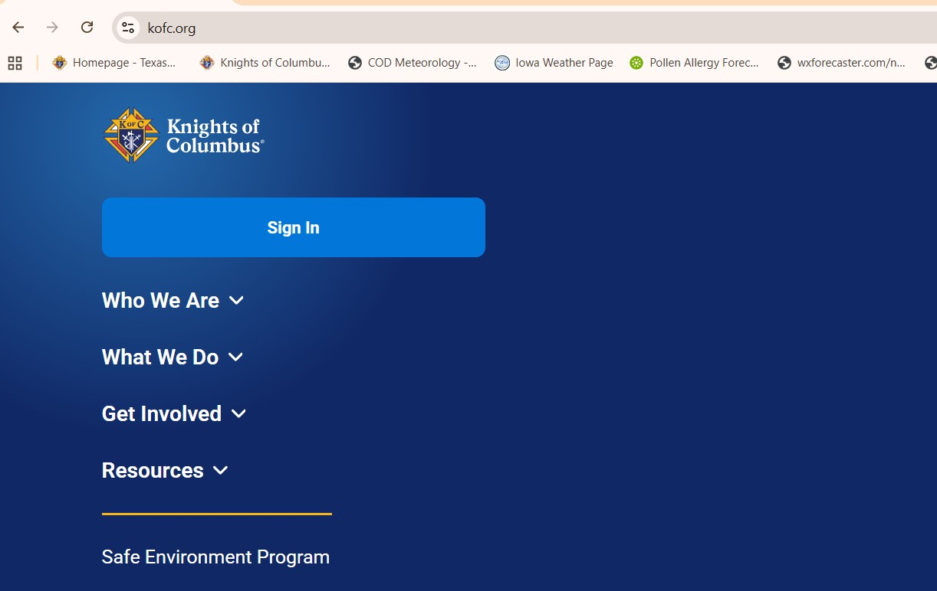
Programs

Slide 62
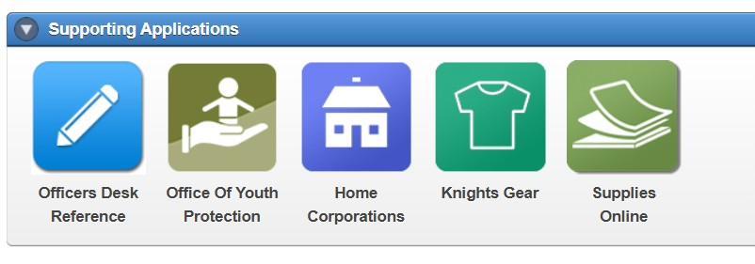
Programs

Slide 63
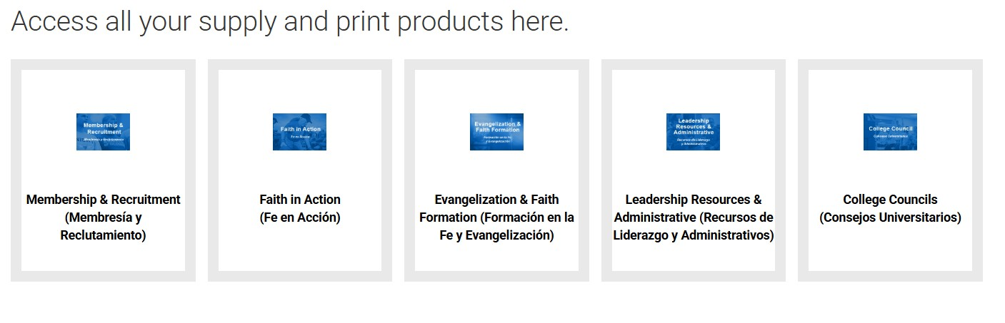
Programs

Slide 64
Main Goal This Year: Have Fun!!!!

