Slide 1
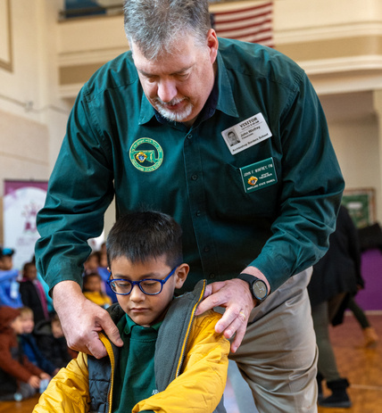
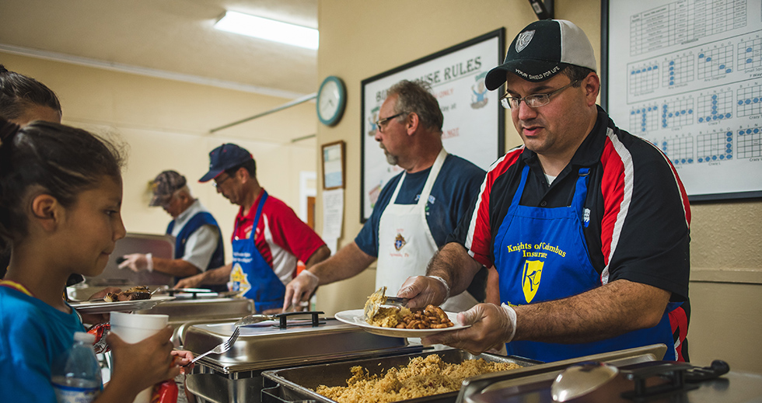
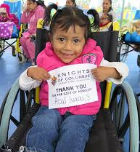
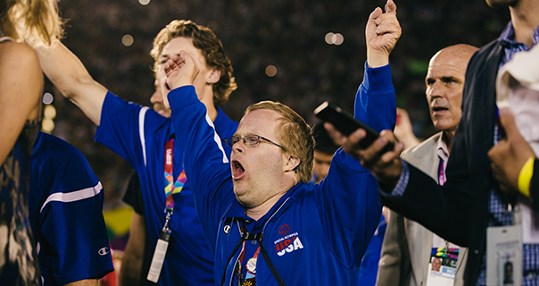
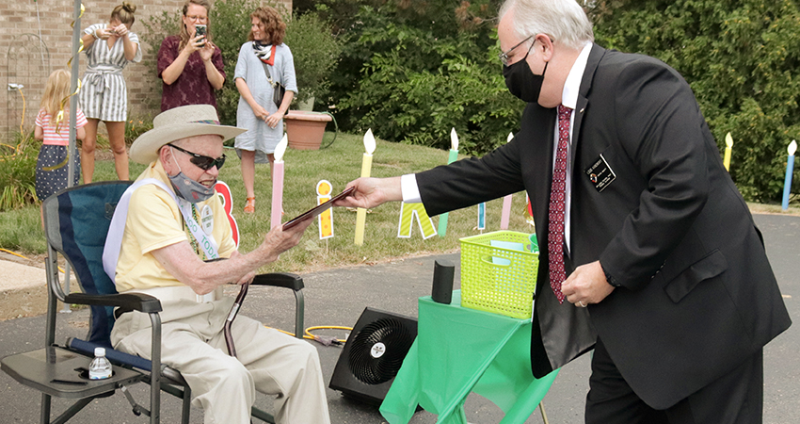
DDC Safe Environment Program (SEP)
July 2026 Update

Slide 2
Safe Environment Program (SEP) Requirements
All Knights participating in Service Programs at Diocesan/Parish Property must be Cleared in DDC records
Dallas Diocesan Chapter (DDC)
AND
The Order
Catholic Diocese of Dallas
SEP / NPBO Policies
Policies
DDC SEP
Compliance Program
K of C Supreme SEP
Office of Youth Protection (OYP)
Audits
Reports
Monitors Employees and Volunteers in Parish or Diocesan Ministry
(and sometimes K of C)
Enrollment through Parish Coordinator
Accutrak Criminal Background Check (Diocesan account)
Diocesan Online/Parish Training
(Virtusonline.org)
Knight cleared by Diocese provides proof of clearance to the GK/Council SEP Director
for a waiver of duplicate training/background
Policies at dallascatholic.org
DDC monitors compliance of all Knights in Dallas through KnightConnect.org (Jorge Ruiz)
Council GK/SEP Director responsible for initial enrollment, enforcing policies and updating member compliance
Accutrak Criminal Background
Check (DDC account)
DDC Webinar Training
(Chuck Johnson)
Active Knights (not waived) must maintain training and background through DDC
Policies and guides at kofcdallas.org
Order-wide, not diocesan
Enrollment of
GK, Program, Family &
Community Director
Criminal Background Check (Supreme)
Praesidium Training (Supreme)
Safe Environment Quick Reference Guides for event compliance
Policies and Guides at kofc.org
(OYP and Officers Desk Reference)
OR

Slide 3
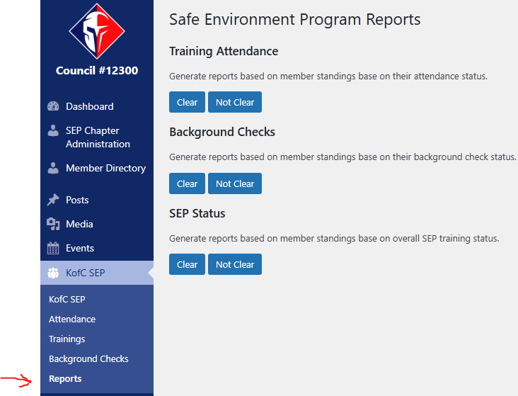
Running Reports to Determine Active + Not Clear
GK/SEP Director must enforce that all in service events must be cleared

Slide 4
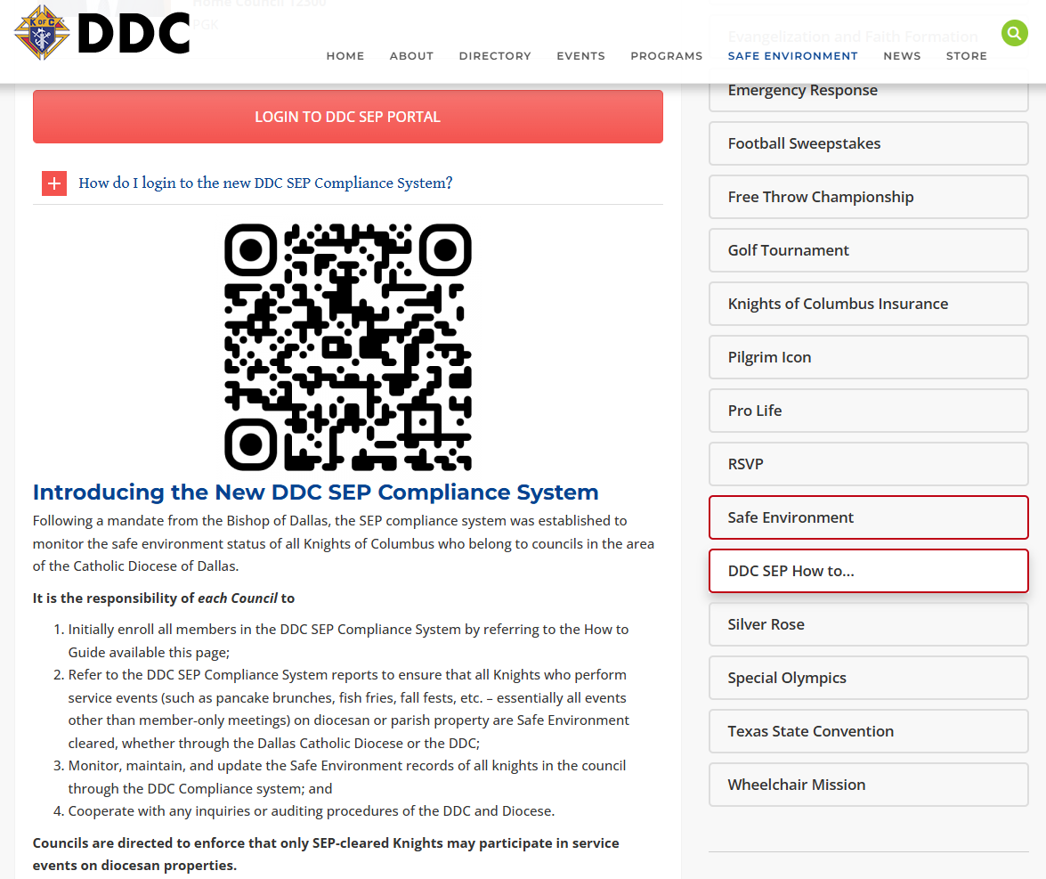
KofcDallas.org Safe Environment tab

Slide 5
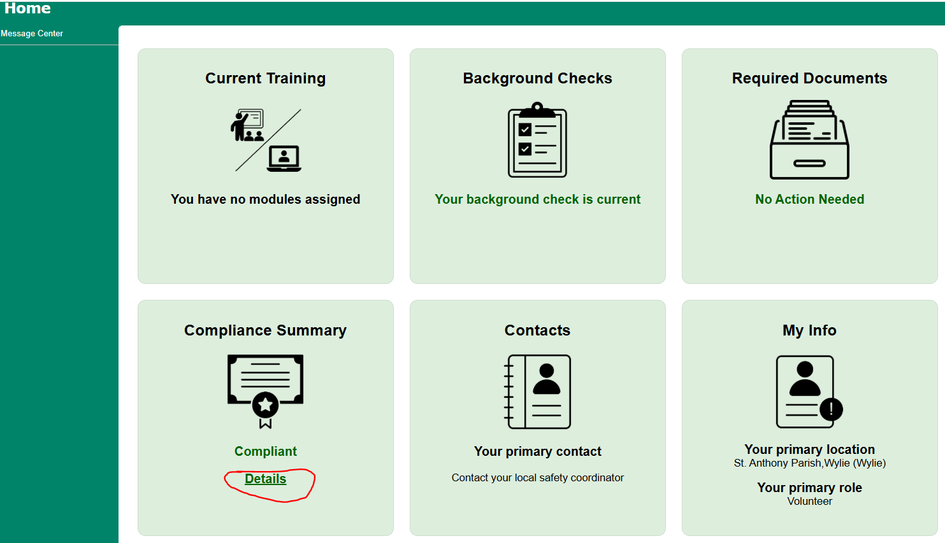
Exemption: Find your Diocesan Compliance Summary

Slide 6
Overall Compliance with Safe Environment Clearance and Insurance
“Catholic Diocese of Dallas and its entities” should be additional insured
Send renewed Certificates of Insurance to Rita Gracia (Diocese and Bryan Finley)

Slide 7
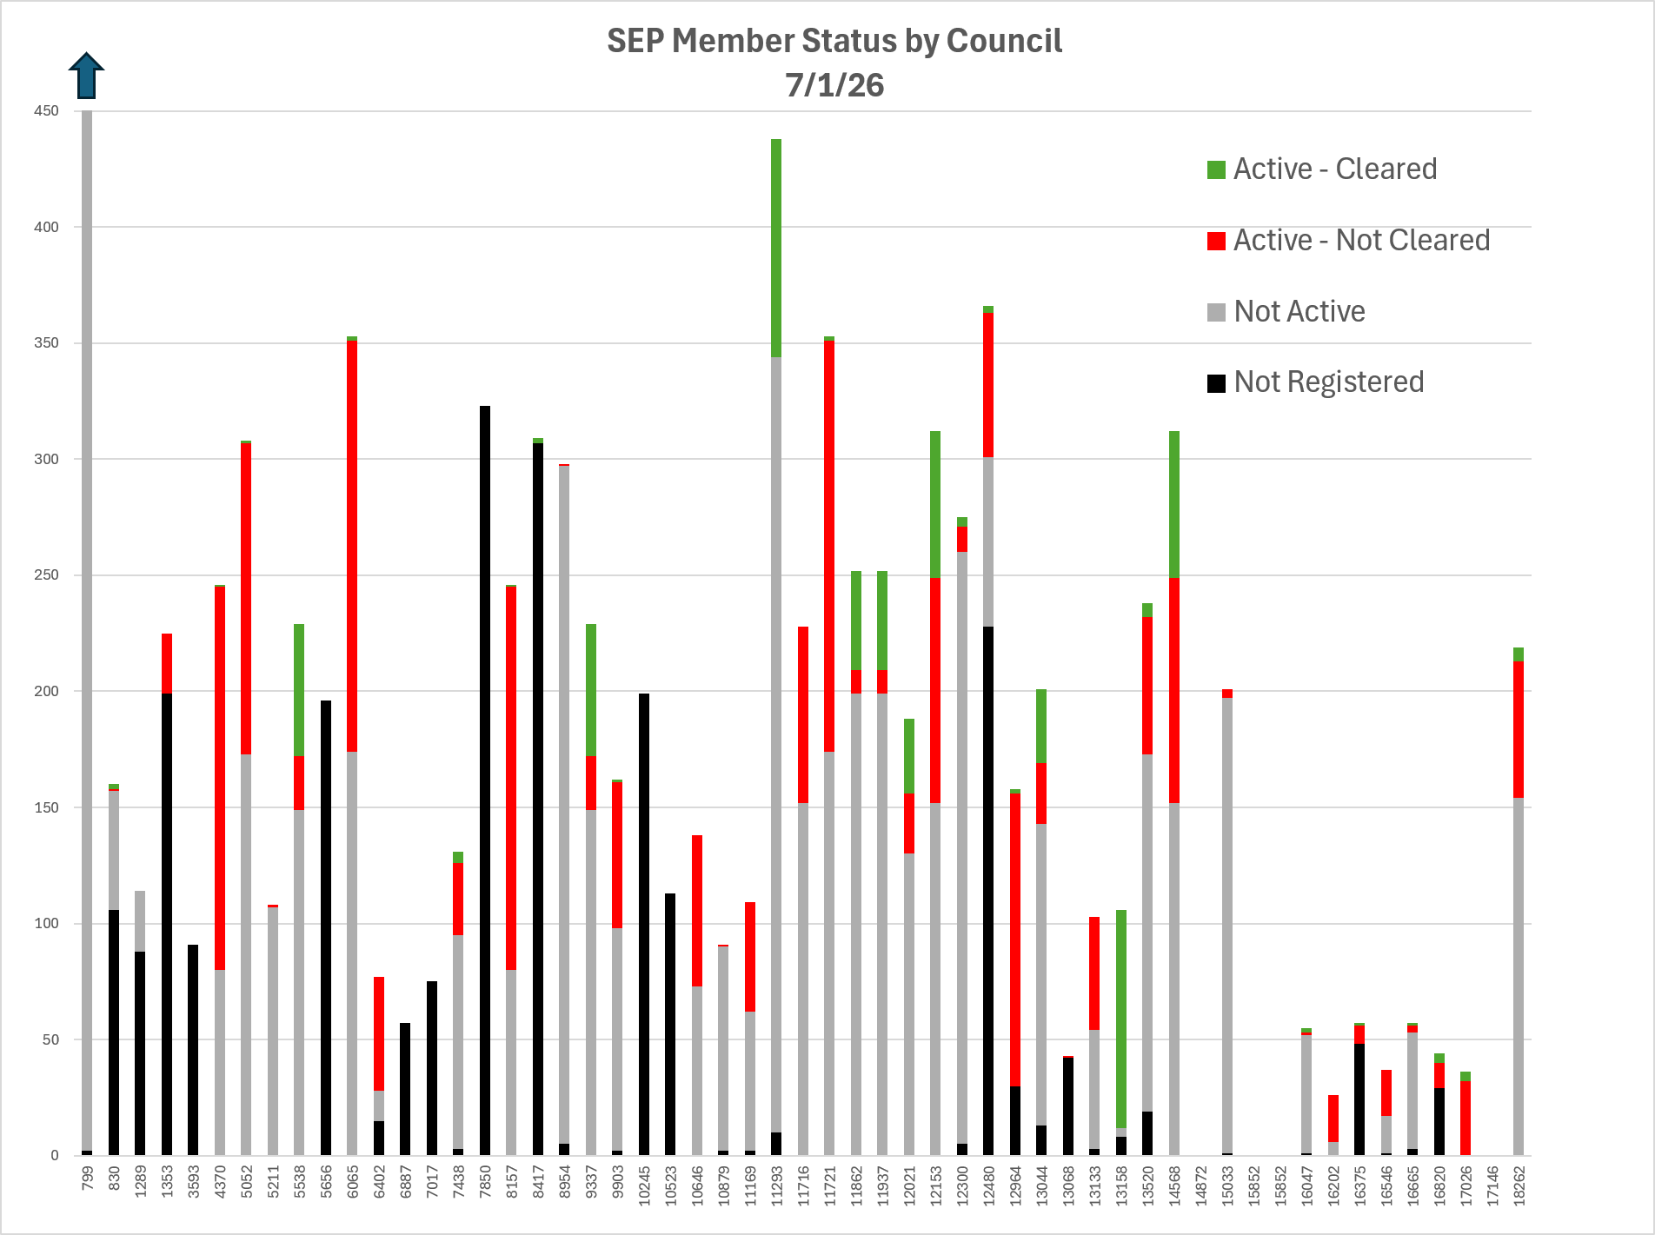

Slide 8
DDC SEP Training
Fourth Thursday: Safe Environment Training Webinar for Knights needing SEP training (DDC Clearance)
  Date: July 23 at 7:00pm
GKs / SEP Directors Training on use of KnightConnect.org
  Monitor and enforce compliance
  Update system from Virtus Online Records
  Add/change/delete members
  Date: Monday, July 27 at 7:00 p.m.

Slide 9
DDC SEP Team
Bryan A. Finley, DDC SEP Director
Jorge Ruiz, DDC SEP Compliance System
Chuck Johnson, Training /Communication
Rich Frasco Tim Lucius

