Slide 1
July 11, 2026

Slide 2
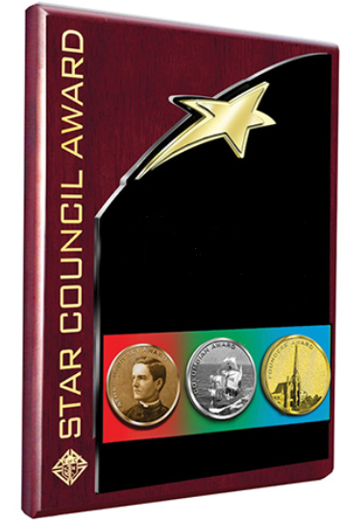
Star Council Award
Congratulations Dallas!
Outstanding Work In 2025-2026!
Now - Let’s do it again!

Slide 3
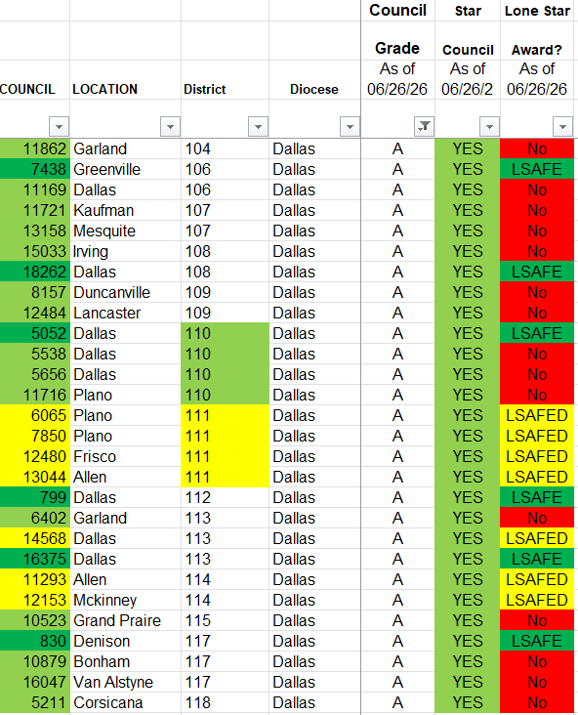
Star Councils – Dallas
As of 6/26:

Slide 4
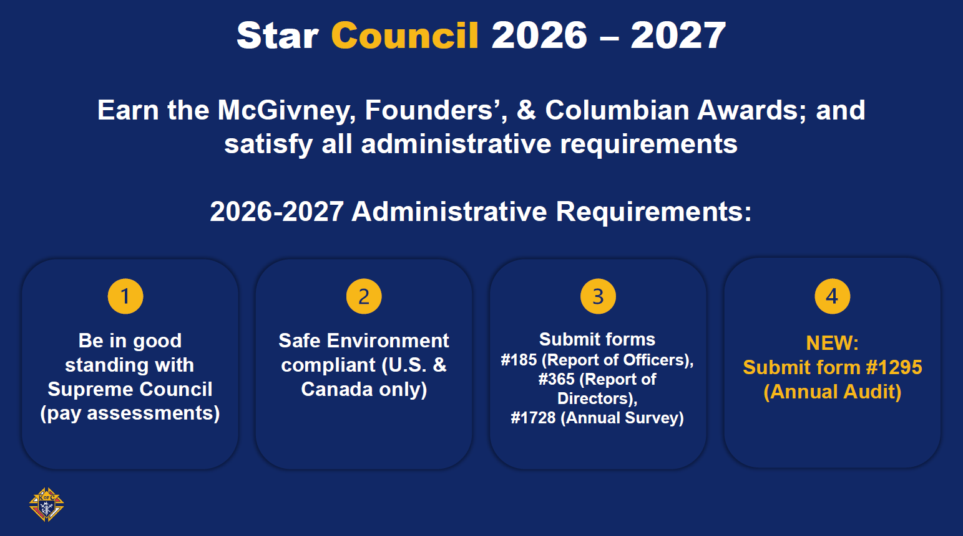

Slide 5
Star Council Award
Requirements for the Award:
Report of Officers Chosen for the Term (#185), by 6/30
Service Program Personnel Report (#365), by 6/30
Annual Audit (#1295), by 8/15
Annual Survey of Fraternal Activity (#1728), by 1/31
Online (Preferred Method)

Slide 6
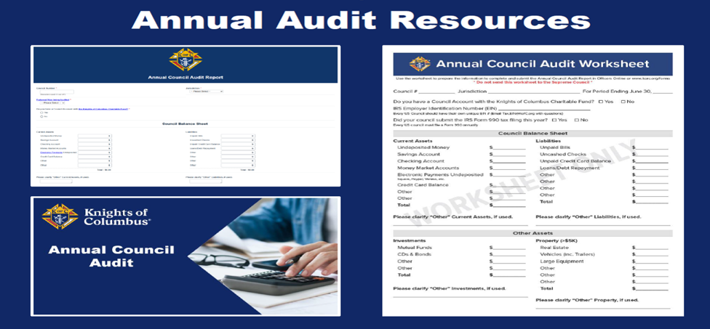
Star Council Award
New Audit - 1295 Training, Worksheet, Submit Online by 8/15
kofc.org - Resources - For Officers - Fraternal Training - Operations Training
Finances

Slide 7
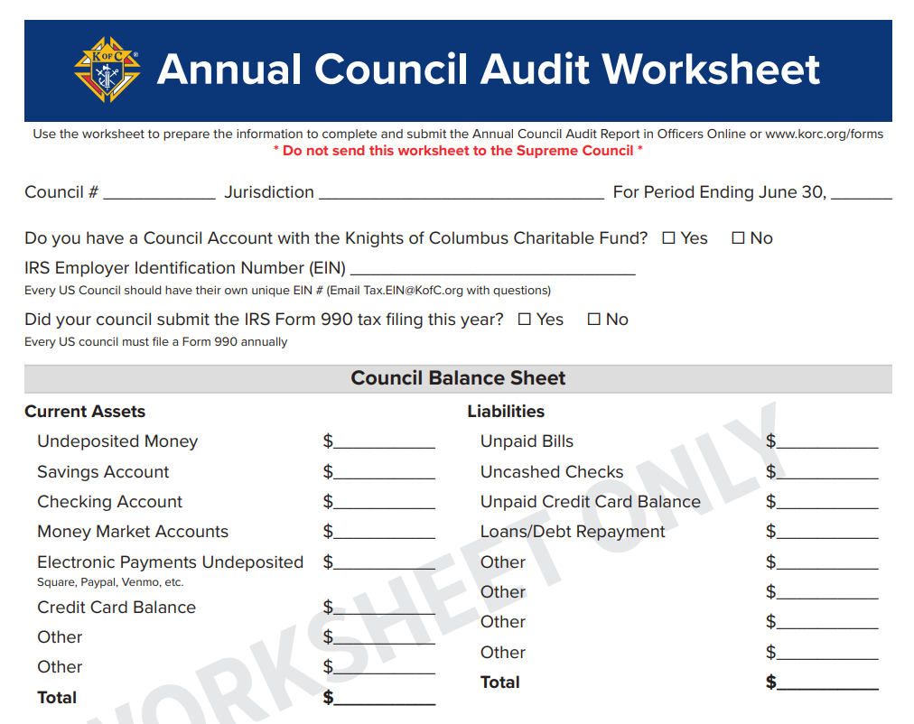
Star Council Award

Slide 8
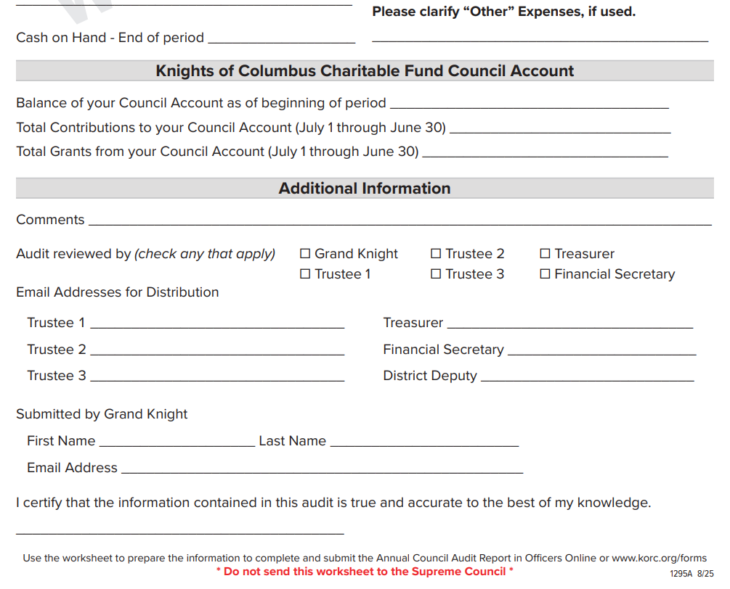
Star Council Award
kofc.org - Resources - For Officers – Forms – See Worksheet 1295A PDF
See 1295 – Online (Preferred Method) to Submit

Slide 9
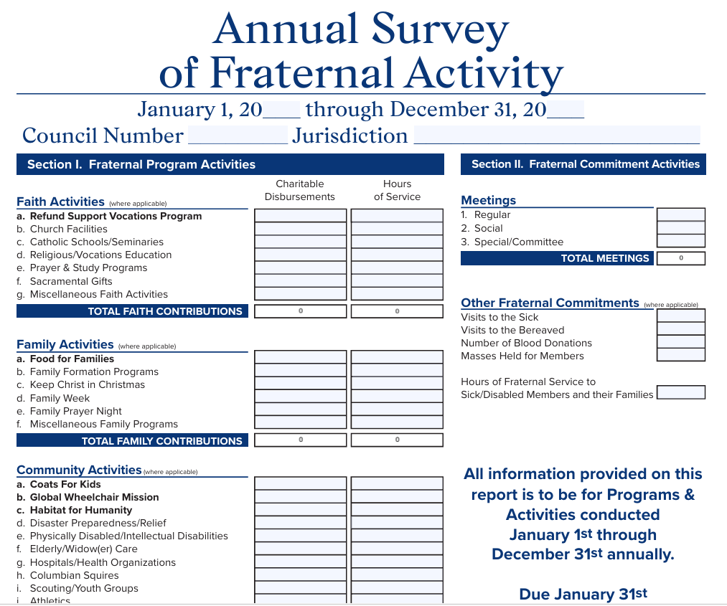

Slide 10
Star Council Award
Requirements for the Award:
Father McGivney Award – No Changes
This award recognizes excellence in your council’s membership growth. To earn this award your council must meet or exceed its yearly membership quota.
The quota is 6% increase in the council’s membership as of July 1 (intake only, minimum of five and maximum of fifteen).

Slide 11
Star Council Award
Requirements for the Award:
Father McGivney Award
Your specific council quota can be found in Officers Online. There is no application for the Father McGivney Award.
Eligibility is automatically determined by the Supreme Council.

Slide 12
Star Council Award
Requirements for the Award:
Father McGivney Award
Councils that attain Star Council status and achieve 200 percent of their gain goal will receive the Double Star Council Award.
Councils that achieve 300 percent of their gain goal will receive the Triple Star Council Award.
All membership transactions must be received, processed, recorded, and released at the Supreme Council office by June 30.

Slide 13
Star Council Award
New Requirements for the Columbian Award – Online, 3 Steps
Requirement 1: Donate at least $500 as part of one of the following Faith in Action programs: ASAP, Food for Families, RSVP, or Coats for Kids.
Requirement 2: Complete 4 Faith in Action programs, one in each of the following categories: Faith, Family, Community, & Life. You cannot claim programs / activities already submitted for requirement 1.
Requirement 3: Conduct Cor monthly or 3 unique programs / activities: one to bring men closer to Christ, one to build fraternity (strengthen the bonds of friendship between the men of your council and/or parish) and one to support your parish or community.

Slide 14
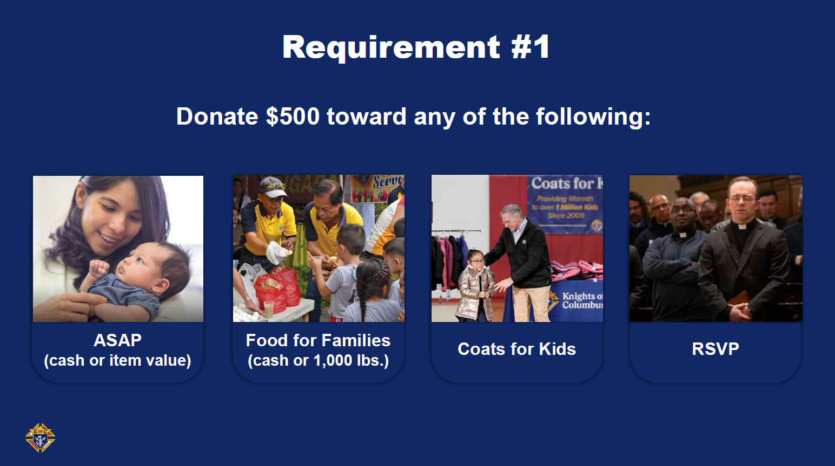

Slide 15
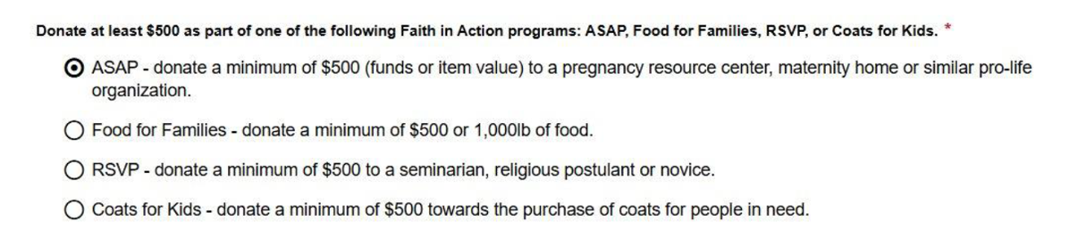
Star Council Award
New Requirements for the Columbian Award – Requirement #1:

Slide 16
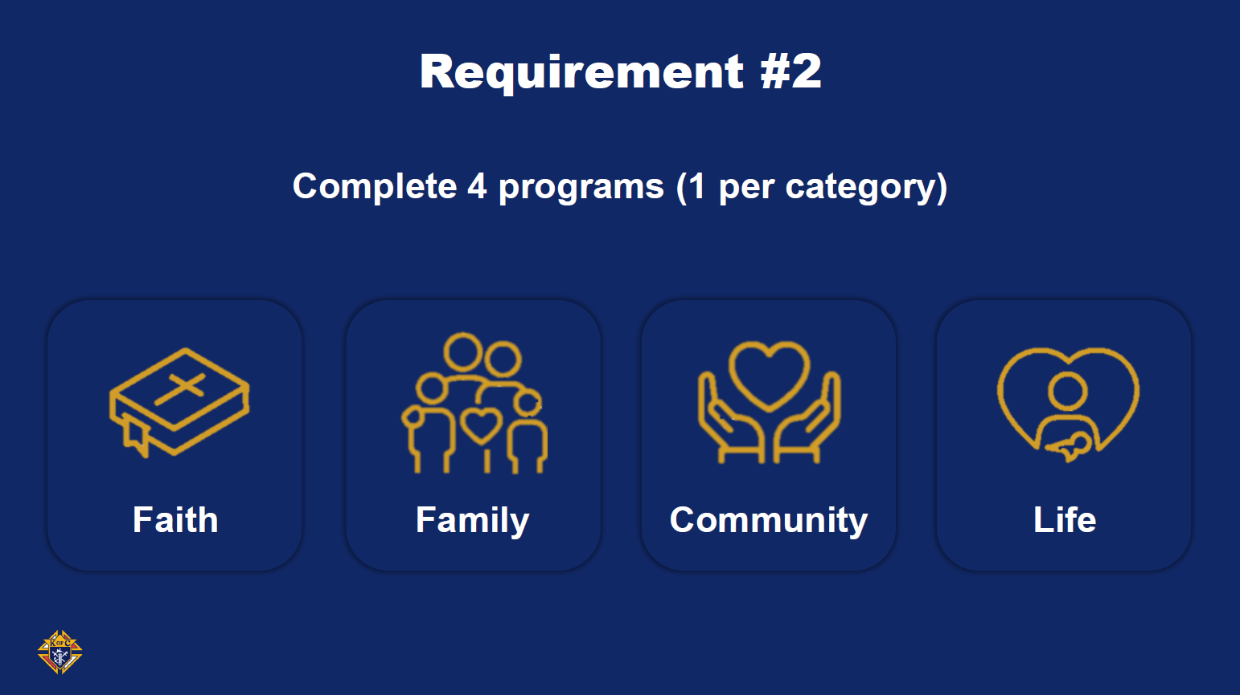

Slide 17
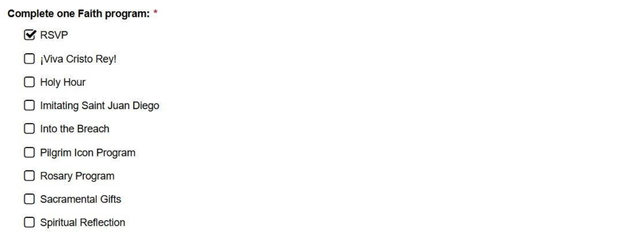
Star Council Award
New Requirements for the Columbian Award – Requirement #2:

Slide 18
Star Council Award
New Requirements for the Columbian Award:
To qualify as Faith in Action programs, the council must run programs similar to those described in the Faith in Action Program Guidebook

Slide 19
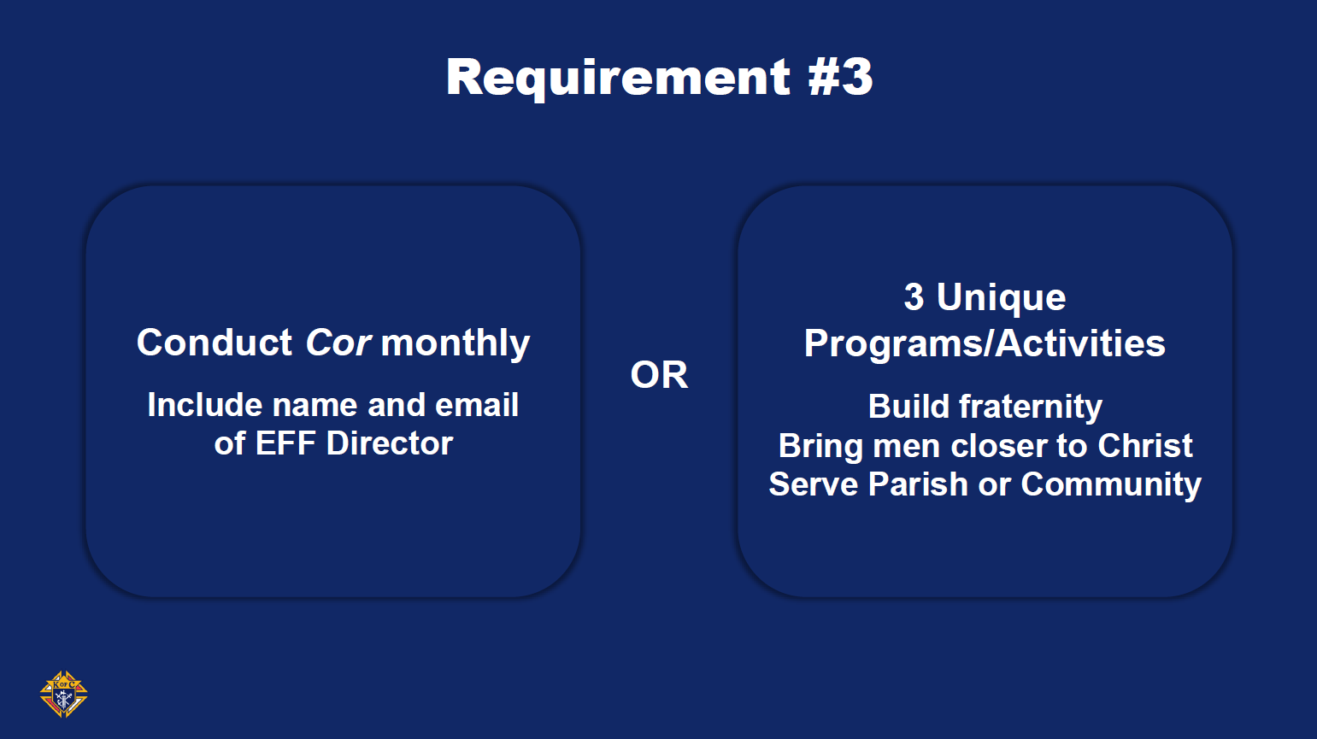

Slide 20
Star Council Award
New Requirements for the Columbian Award – Requirement #3
These programs / activities can be unique to the council and do not need to be Faith in Action programs. You cannot claim programs / activities already submitted for requirements 1 and 2.

Slide 21
Star Council Award
New Requirements for the Columbian Award:
Conducting Cor satisfies all three of the program/activity criteria for requirement 3. Councils must implement and sustain Cor gatherings that feature prayer, formation, and fraternity at least once per month.
To qualify, Cor must be implemented starting on or before April 1st with plans for long-term sustainability.
.

Slide 22
Star Council Award
New Requirements for the Columbian Award:
Cor may be held in conjunction with an additional men’s ministry and pull from non-KofC content.
For additional information on Cor and its structure, visit kofc.org/corleaders ,view the Cor Startup Videos and Cor Leader Guide Cor Leader Guide, and contact your State EFF Director.
If you choose this option, you must include the name and email address of your council Evangelization and Faith Formation (EFF) Director.

Slide 23
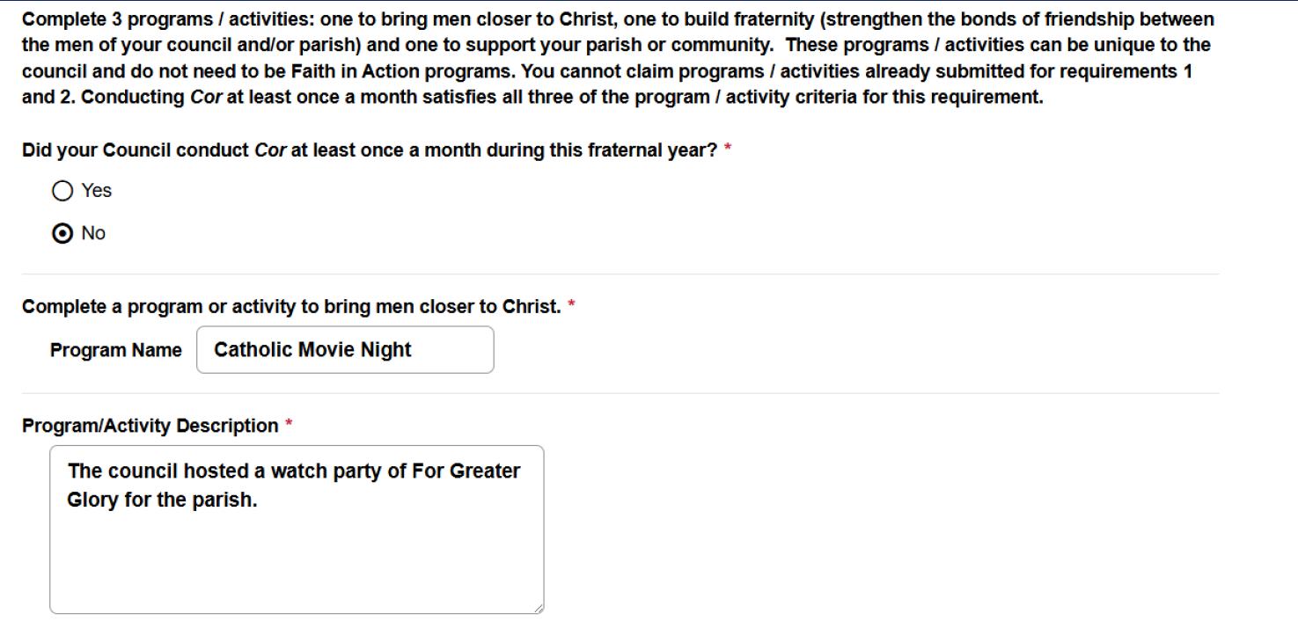
Star Council Award

Slide 24
Star Council Award
New Requirements for the Columbian Award:
The online application can be found at kofc.org/forms or by clicking on this link Online Columbian Award Application (#SP-7)
A completed (#SP-7) must be received by the Supreme Council office by June 30 in order to earn this award.
United States and Canada Requirements

Slide 25
Star Council Award
New Requirements for the Founders Award:
The Founders’ Award recognizes excellence the promotion of our insurance and fraternal benefits.
All councils must have 10 percent of their Associate Members,
(Min 5 / Max 15), meet with a Field Agent or a General Agent and have a Financial Review, either in person or via a virtual meeting.
Insured Member Vs. Associate Member?
Exemplified Member of the Order & Council - regardless of degree level - not holding a KofC financial or insurance product.

Slide 26
Star Council Award
New Requirements for the Founders Award:
A council with 74 Associate Members would have a quota of 8.
Coordinate with the Field Agent to track financial reviews completed.
WGK will still be required to submit form #11077.
Member/Agent Meeting Report (26-27). Only available online.
New Founder’s Award Explained: New FBE Training

Slide 27
Star District / All Star District
STAR DISTRICT AWARD (Silver Medal)
District Deputies are also recognized for excellence by Supreme. Criterion for this award is:
Meet 70% of the District Membership goal.
50% of the Councils achieve the Founder’s Award.
Submit District Deputy Report Form 944 for each of his councils prior to September 15.
Have at least two councils in the district earn Star Council.

Slide 28
Star District / All Star District
ALL STAR DISTRICT AWARD (Gold Medal)
District Deputies are also recognized for excellence by Supreme.
Criterion for this award is:
Earn Star District.
All councils in your District must earn Star Council.

Slide 29
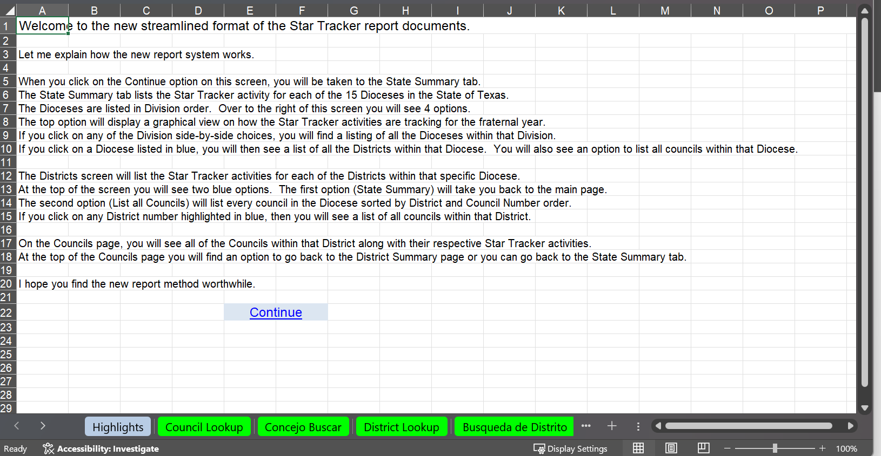

Slide 30
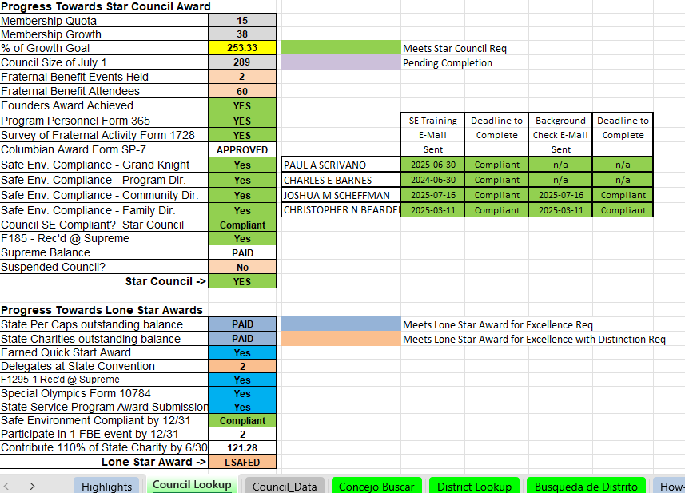
Star Tracker – Council Lookup
Council # 12153

Slide 31
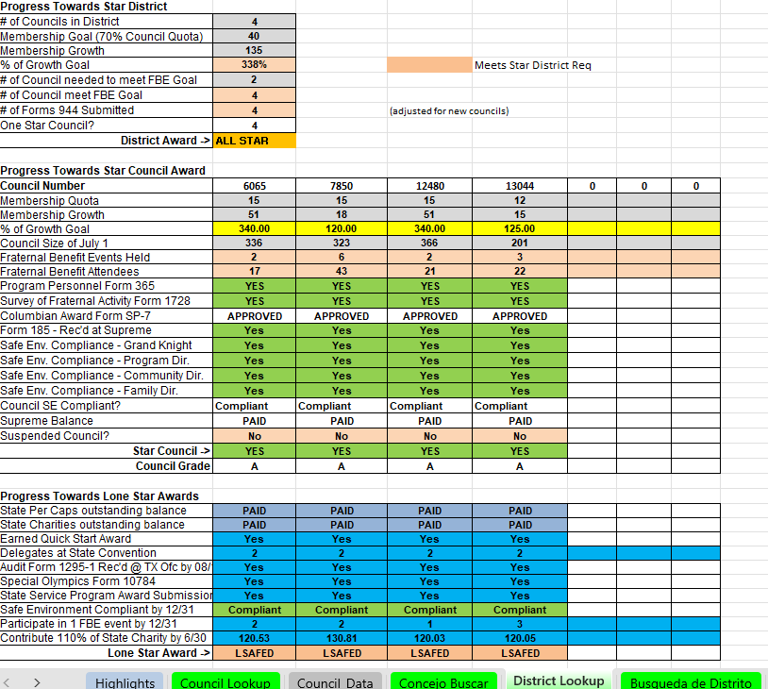
Star Tracker – District Lookup
District # 111

Slide 35
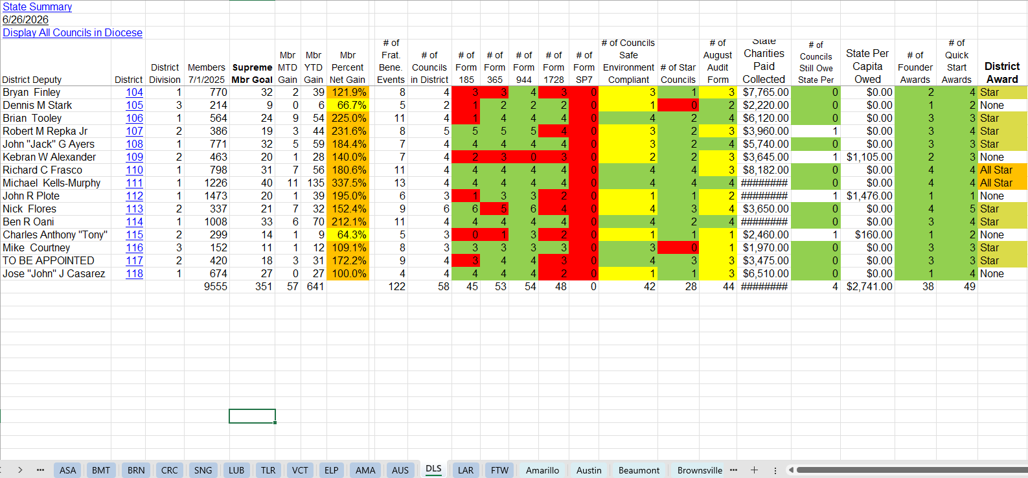

Slide 36
Star Council Award
Additional Resources for Success:
Fraternal Planner & the Fraternal Excellence Guide
Protocol, Meetings, Ceremonials Guide
Faith in Action Guidebook
Officers Online Infographic
Suggested Training by Office
Fishers of Men Guide
Cor Leader & Formation Content Guides
Working with Men’s Ministries
Supreme Fraternal Leader Advisory, FLA Webinars
State Deputy – Finish Line, State Director Reports, Diocesan Deputy & Program Chair Updates
kofc.org, tkofc.org, kofcdallas.org

Slide 37
Division 1
Austin
Dallas
Fort Worth
Galv/Houston
San Antonio
Division 2
Brownsville
Corpus Christi
San Angelo
Victoria
El Paso

Slide 38
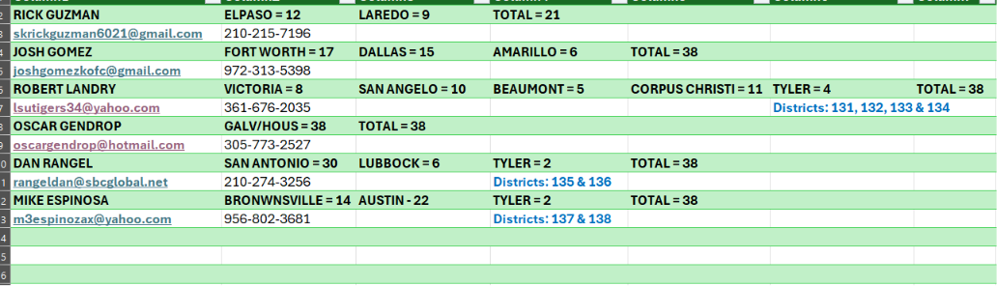
Star Council Team Assigned Districts

