Slide 1
KC State Charities– July 11, 2026

Slide 2
Charity is the foundation of the Knights of Columbus, inspiring members to serve God by serving others and responding to needs within their communities. The primary mission of the Texas State Charity Program is to provide meaningful assistance to dioceses, parishes, and charitable causes throughout Texas.

Slide 3
Funds collected are distributed in two main ways:
70% returned to local dioceses: These funds are allocated to each bishop, who designates specific charitable causes within their diocese.
30% used statewide: Supports broader charitable efforts, administrative needs, and additional programs across Texas.

Slide 4
Key Charitable Initiatives
The Texas State Charity Program supports a wide range of causes, including:
Bishop Thomas J. Flanagan Fund - Grants for Retired Priests
Cardinal Medeiros Fellow
Educational Grants
Emergency Response
Special Olympics

Slide 5
2026-27 Charity Team Goals
2026-2027 TSC Charity Goal > $1,00,000.00
100% Council Participation
Increase Charitable Volunteer Hours Documentation (reported on Form 1728)
TSC Charity PIN displayed by every TX fraternal leader
Two Cardinal Medeiros Fellows per Diocese
Special Olympics: Form 10784
All Councils REPORT 2.5% of State Charity Payment

Slide 6
State Council Charities – 26/27 Team
Position | Name | Phone # | Email Address
Director | Mike Courtney | (214) 914-0666 | kcmikecourtney0666@gmail.com
Charity Reports Historical Data | Nick Flores | (214) 926-9509 | nickfloresjr@verizon.net
Special Olympics | Archie Wright | (832) 748-0071 | allw1989@yahoo.com
Cardinal Medieros Chairman | Jake Fleischer | (214) 232-1084 | johnfleischer7@gmail.com
Bishop Flanagan Fund Chairman | Dan Stoffel | (469) 682-1046 | danstoffel@yahoo.com
Fundraising Chairman | David Keating | (281) 650-5503 | jdkeating73@att.net
Emergency Response Chairman | Larry Pellerito | (281) 224-3728 | kcpellerito@gmail.com
Educational Grants Chairman | Ben Oani | (214) 843-8935 | ben.r.oani@gmail.com

Slide 7

Special Olympics …
Increase awareness of program activities and publicize
Increase individual membership participation in events
Increase council participation in events
Increase submission of Partnership Profile Report (Form 10784)
Establish Council representative
Notes:
Special Olympics Chairman – Chris Hoefer
Point #1 – what is taking place in your Diocese? Who is publicizing/communicating this in your council?
Point #2 – Make this the year you personally get involved in Special Olympic activities!
Point #3 – Make this the year your council get involved in Special Olympic activities!
Point #4 – All council should be completing and submitting this form no later than January 31, 2022
these forms translate to dollars for Special Olympics
this can be as much as $9,000
Point #5 – Ensure your Council has a primary point of contact for Special Olympics
Chic O’Conner Award submissions – due no later than January 31, 2022

Slide 8
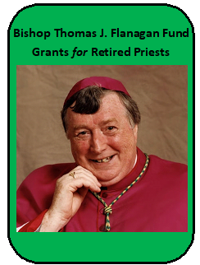
Bishop Thomas J. Flanagan Fund
Donations can be made at TKOFC.ORG. Or purchase a State Charity Council
Magnet for $20. Or acquire and display a Texas Knights of Columbus license plate on your vehicle.
The easiest way to order a Knights of Columbus Texas License Plate is to go to MYPLATES.COM.
The prices are $30 for a state issued plate and $70 for a personalized or vanity plate.
$22 from each new and renewed license plate goes from the Texas Department of Motor Vehicles to the Knights of Columbus Bishop Thomas J. Flanagan Fund to support retired priests.

Slide 9
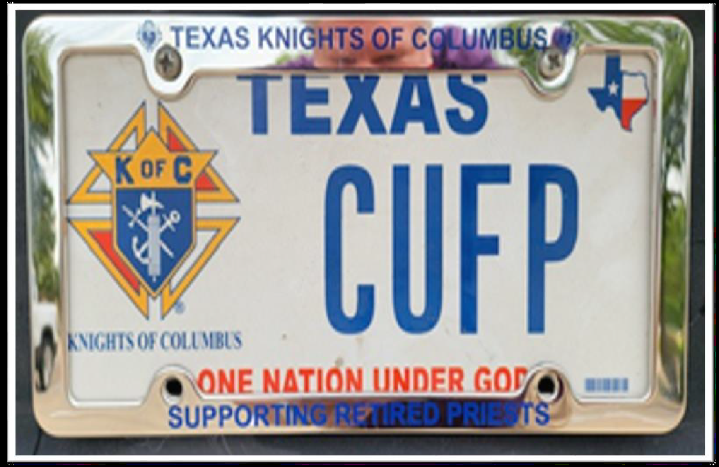
Who can you consider to receive the gift on behalf of the fund?
Diocese - Diocesan Team Leads, District Deputies
Districts - Past Grand Knights, District Wardens
Councils - Council Chaplains, Grand Knights

Slide 10
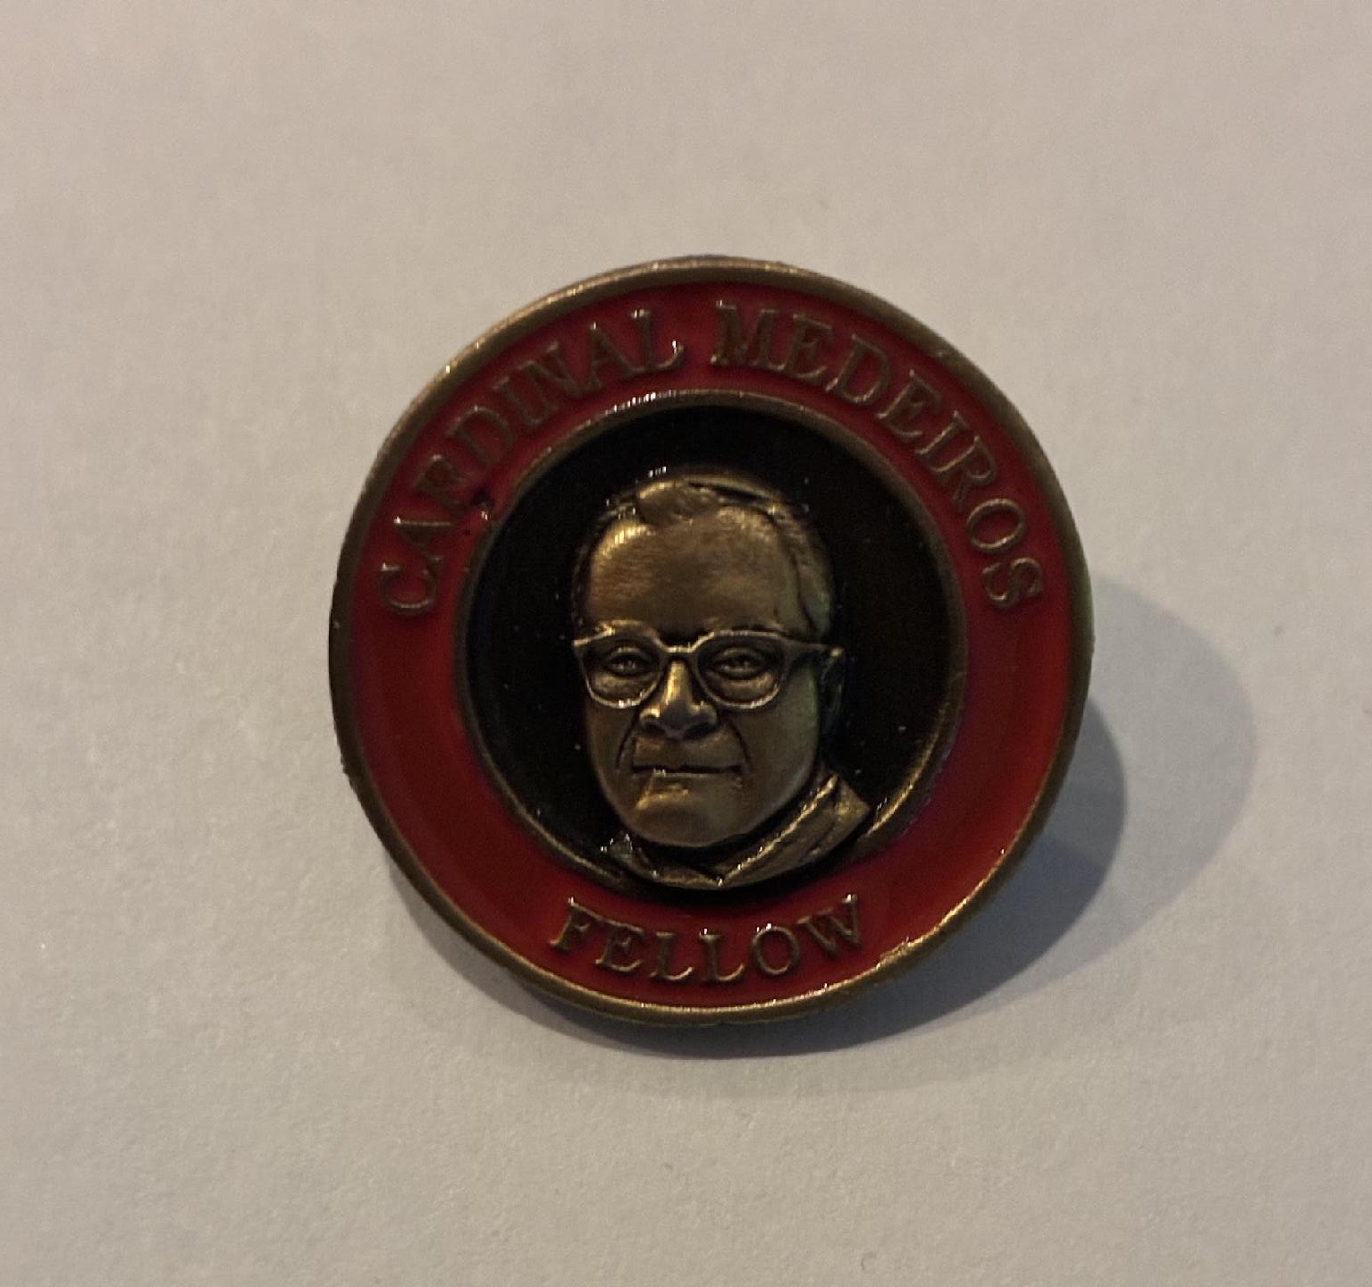
The Cardinal Medeiros Fellow Program
“Recognizing Greatness Among Us …. Investing In Those That Follow”

Slide 11
The Cardinal Medeiros Fellow Program
THE CARDINAL MEDEIROS FELLOW PROGRAM WAS CREATED IN 1998 FOR TWO PURPOSES:
TO HONOR EXEMPLERY KNIGHTS OR THEIR WIVES
TO HELP FUND THE TEXAS STATE COUNCIL CHARITIES EDUCATIONAL GRANTS PROGRAM. ___________________________________________________
KNIGHTS AND/OR THEIR SPOUSES, LIVING OR DECEASED, CAN BE NOMINATED FOR A FELLOWSHIP FOR ANY NUMBER OF REASONS BUT PRIMARILY TO RECOGNIZE SPECIFIC OUTSTANDING ACHIEVEMENTS OR MILESTONES.

Slide 12
REQUIREMENTS
IDENTIFY A WORTHY KNIGHT OR HIS SPOUSE TO RECEIVE THE FELLOWSHIP OR SELF-NOMINATE.
COMPLETE THE APPLICATION FORM AND SUBMIT TO THE STATE OFFICE.
SUBMIT $1,000 CONTRIBUTION ALONG WITH THE APPLICATION. THIS MONEY IS DEPOSITED IN THE CARDINAL MEDEIROS TRUST FUND AND THE INTEREST FUNDS OUR STATE EDUCATION GRANTS.
ALLOW 2 TO 6 WEEKS FOR THE PERSONALIZED PLAQUE AND LAPEL PIN TO ARRIVE FOR PRESENTATION TO THE FELLOW.
NOTE:
ELECTRONIC OR MANUAL
APPLICATION FORM CAN BE FOUND ON:
TKOFC.ORG

Slide 13
THE PROCESS FOR NOMINATING A KNIGHT OR HIS SPOUSE
ENSURE UNDERSTANDING OF THE CARDINAL MEDEIROS FELLOW PROGRAM AMONG DISTRICT DEPUTIES, CHAPTERS AND COUNCILS, AS WELL AS INDIVIDUAL KNIGHTS.
HAVE COUNCILS OR CHAPTERS BUDGET FOR A $1000 CONTRIBUTION TO FUND A CARDINAL MEDEIROS FELLOW IN THE 2026/27 YEAR.
COMPLETE THE “ CARDINAL MEDEIROS FELLOW APPLICATION” FOUND ON THE TEXAS STATE COUNCIL WEBSITE AT https://tkofc.org/Donate-Now/Cardinal-Medeiros-Fund

Slide 14
THE PROCESS FOR NOMINATING A KNIGHT OR HIS SPOUSE
SUBMIT THE APPLICATION EITHER ELECTRONICALLY USING THE “DONATE NOW” BUTTON ON THE WEBSITE OR BY PRINTING THE APPLICATION AND MAILING IT TO THE STATE OFFICE. IN EITHER CASE, THE APPLICATION MUST BE ACCOMPANIED BY A $1000 CONTRIBUTION VIA CHECK OR CREDIT CARD.
PLAN A FORMAL AWARD EVENT OR CEREMONY TO CONFER THE FELLOWSHIP.

Slide 15
OUR GOAL FOR THE 2026/27 FRATERNAL YEAR IS TO HAVE AT LEAST TWO CARDINAL MEDEIROS FELLOWS NOMINATED BY EACH DIOCESE !

Slide 16
And when you thought we were through!
Introducing the Newly Founded
Cardinal DiNardo Fellow
and
Cardinal Farrell Fellow

Slide 17
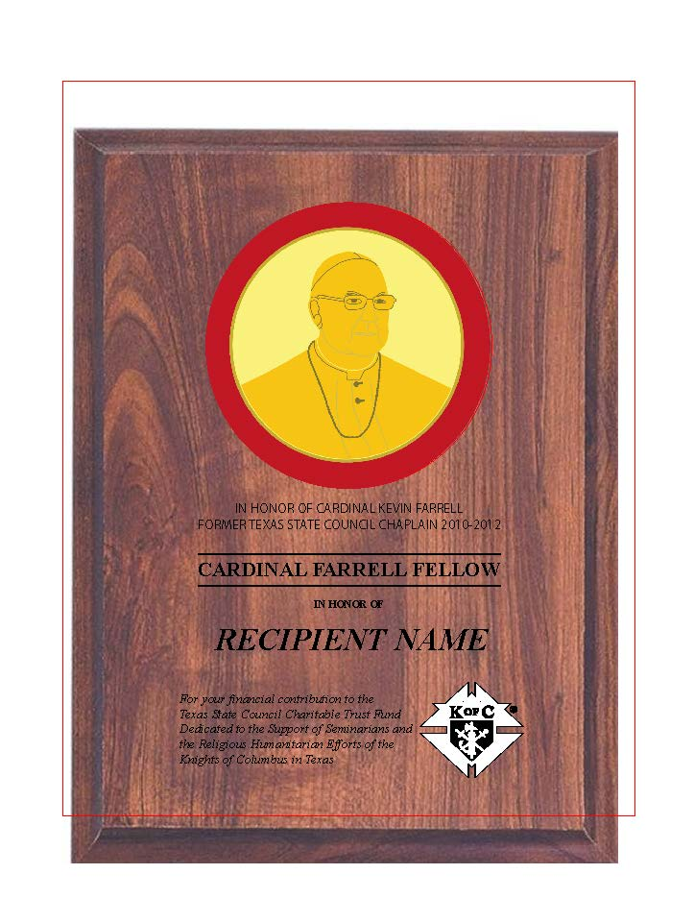
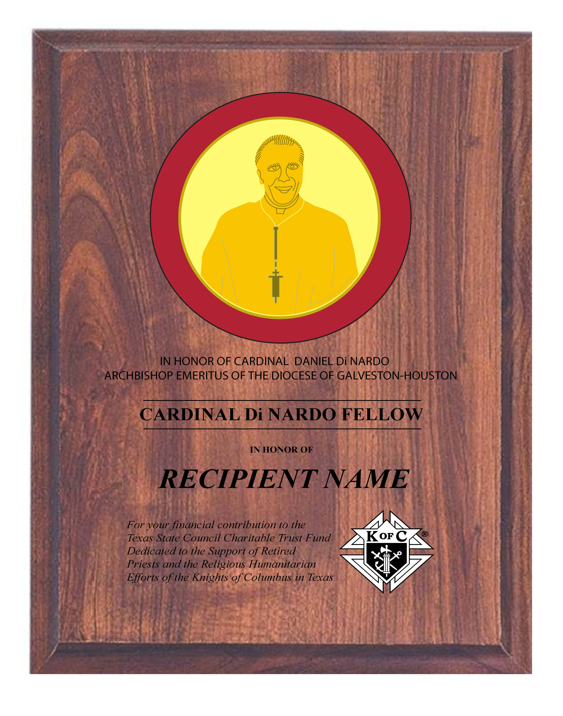


Slide 18
Cardinal Daniel DiNardo
In Honor of Cardinal Daniel DiNardo
Archbishop Emeritus of the Diocese of Galveston-Houston
Cardinal DiNardo Fellow
Presented To (Name)
For your financial contribution to the Texas State Council Charitable Trust Fund Dedicated to the Support of Retired Priests and Religious and the Humanitarian Efforts of the Knights of Columbus in Texas.

Slide 19
Cardinal Kevin Farrell
In Honor of Cardinal Kevin Farrell
Former Texas State Council Chaplain 2010-2012
Cardinal Farrell Fellow
Presented to (Name)
For your financial contribution to the Texas State Council Charitable Trust Fund Dedicated to the Support of Seminarians and the Humanitarian Efforts of the Knights of Columbus in Texas.

Slide 20
Educational Grants …
Increase program awareness
Increase program publicity
Increase the number of submissions received
Notes:
Educational Grant Committee Chairman – Giacomo Leone; Committeemen – Mike Crivello, Leo Saenz, David Zwingman
Point #1 – providing funds to our future – our students of higher learning
Point #2 – share this opportunity with your members and their families
Point #3 – make it a priority to get grant applications ahead of the March 31, 2022, deadline

Slide 21
Texas State Council Emergency Response Program
The mission of our emergency response program is to provide GUIDANCE and ASSISTANCE to our brothers and councils before and after disasters.
Utilizing our state-wide network of Emergency Response Coordinators (ERC), we provide GUIDANCE to councils and Knights, thus allowing a concerted effort for all involved.
Our relief ASSISTANCE comes through charitable giving from our brothers and councils.

Slide 22
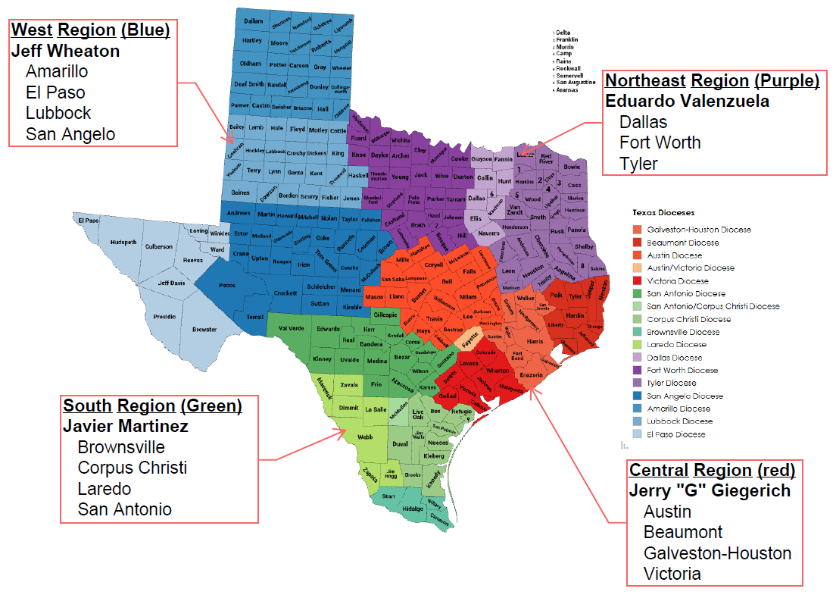
Texas Emergency Response Team By Region

Slide 23
Texas Emergency Response
DDs are a vital link between councils & the Diocesan ERC
DDs should make sure their council’s leadership is functioning and confirm they are checking on their members to determine who needs assistance and working to assist those in need.
DDs should collect and pass on information to the Diocesan ERC and Diocesan Deputy on the extent of the disaster, the needs of the community, Knights needing assistance, and council activities.
DDs should work closely with the Diocesan Deputy and Diocesan ERC to provide guidance to local councils (make sure Flocknote information gets to all the members).

Slide 24
Contact your Diocesan or
Regional Emergency Response Coordinator
or
State Emergency Response Chairman – Larry Pellerito
Cell phone: 281-224-3728
Email: kcpellerito@gmail.com
Texas State Emergency Response E-Mail: EmergencyResponse@TKofC.org

Slide 25
Thank you for ALL you do and will do!
Questions?

Slide 26
First Lady Project Wheelchair Mission – July 11, 2026

Slide 27
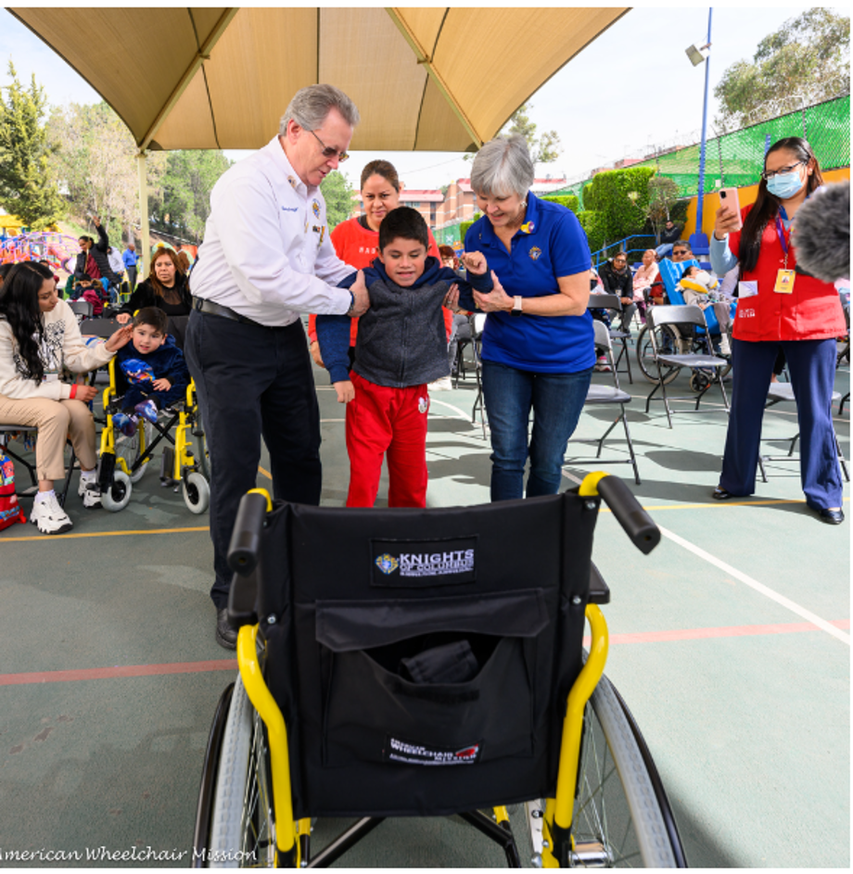
American Wheelchair Mission
Perfect opportunity for councils to exemplify Charity, Unity and Fraternity.

Slide 28
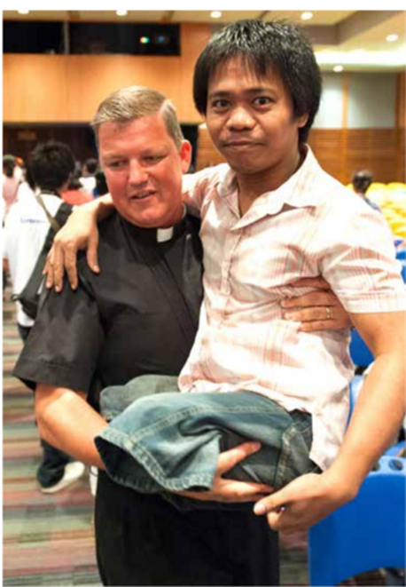
Wheelchair Users
Wheelchair Users in Texas
  Adults
  700,000
  Children
  50,000

Slide 29
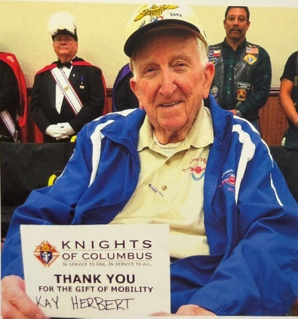
Wheelchair Users
  Veterans WC users in Texas
  Veterans
  25,000

Slide 30

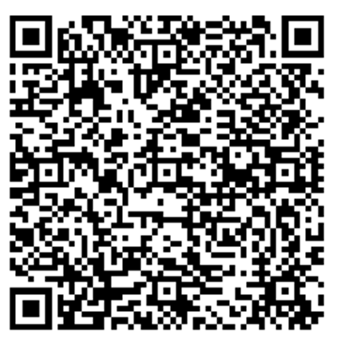
Donor Form

Slide 31
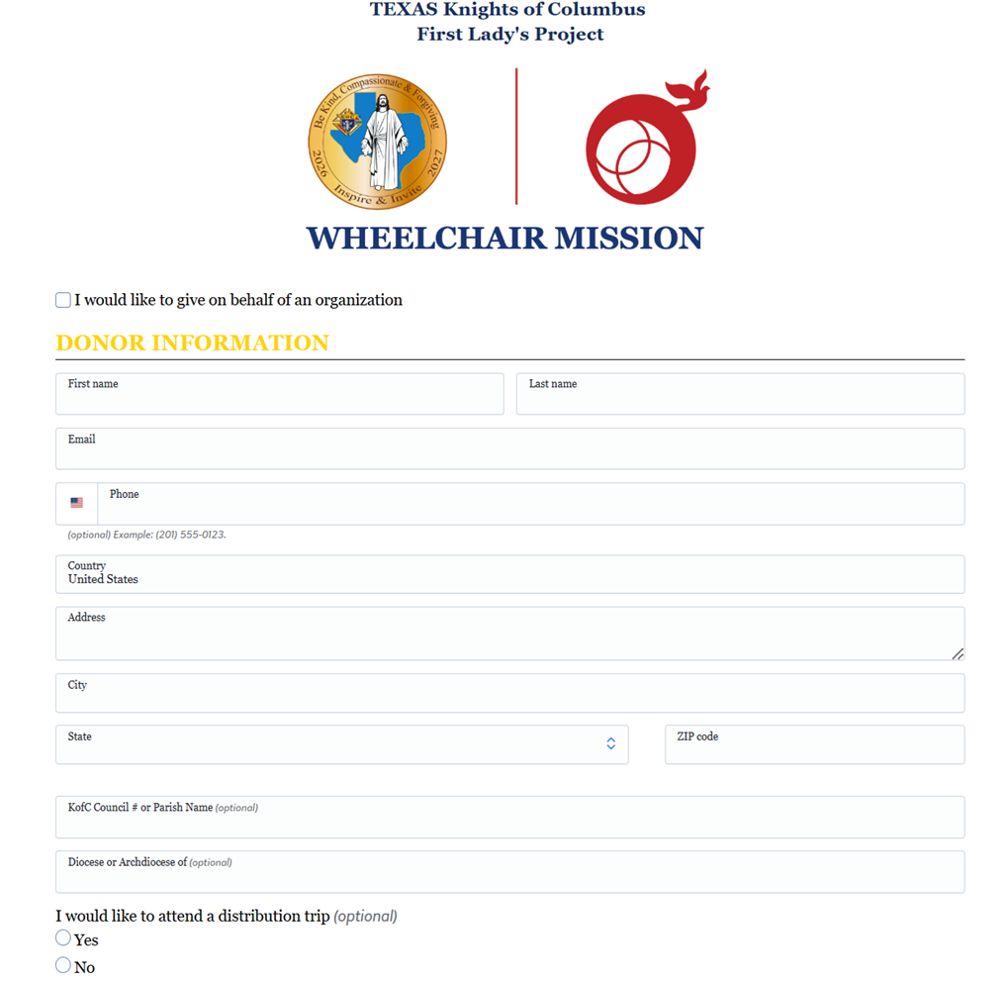
First Lady’s Project Donor Form
Donor Information
Fillable Online Form
  Name
  Email
  Phone Number
  Address
  K of C Council Number
  Diocese
  Distribution Trip
  Individual or Organization

Slide 32
Wheelchair Sunday Goals
The First Lady’s Project’s Goal
The goal is to sponsor 15,000 wheelchairs in the State of Texas.
Wheelchairs will stay within the local diocese.
Wheelchairs may still be distributed beyond the diocese at the discretion of individual councils.

Slide 33
Wheelchair Sunday Goals
Diocese | 2026-2027 Goal | Wheelchairs
AMARILLO | $41,700 | 278
AUSTIN | $137,400 | 916
BEAUMONT | $65,525 | 437
BROWNSVILLE | $77,300 | 515
CORPUS CHRISTI | $83,050 | 554
DALLAS | $884,125 | 5,894
EL PASO | $113,250 | 755
FT. WORTH | $128,250 | 857
GAL-HOU | $170,250 | 1,135
LAREDO | $58,500 | 390
LUBBOCK | $41,775 | 279
SAN ANGELO | $78,400 | 523
SAN ANTONIO | $269,075 | 1,794
TYLER | $57,200 | 381
VICTORIA | $44,100 | 294
GRAND TOTAL | $2,250,000.00 | 15,000

Slide 34
What We Need from You
GK & Councils
Set the foundation Get pastor approval and establish clear goals with the council Plan and coordinate Schedule the date, share details, and connect with the WCS Chairman for resources Organize support Recruit volunteers and engage other groups (e.g., CDA) Promote and give Run announcements and a 6-week campaign, including online donation options
District & Diocesan Deputies
Plan and expand reach: Confirm pastor approval, plan with councils, and identify opportunities at parishes without councils Align and engage Set goals, coordinate resources, and encourage council participation and collaboration with other groups Promote and support giving Encourage pulpit announcements and highlight online donation options Track and ensure compliance Require form submissions (SP-7, Form 10784) and aim for at least 3 Wheelchair Sundays per district

Slide 35
