Slide 1

Texas State Council
State Per-Captia and Charities Payments
Meeting Type – Location – Date

Slide 2

SPECIAL NOTE:
Starting this new fraternal year (July 1st) the State Per Capita and Charity statements will not be mailed as in the past. A report from the State website showing amount owed will need to be pulled by each council.
State Per Capita statements/report can be found on tkofc.org, no login/password needed
Methods of payment are listed on tkofc.org Due Dates of all will not change

Slide 3
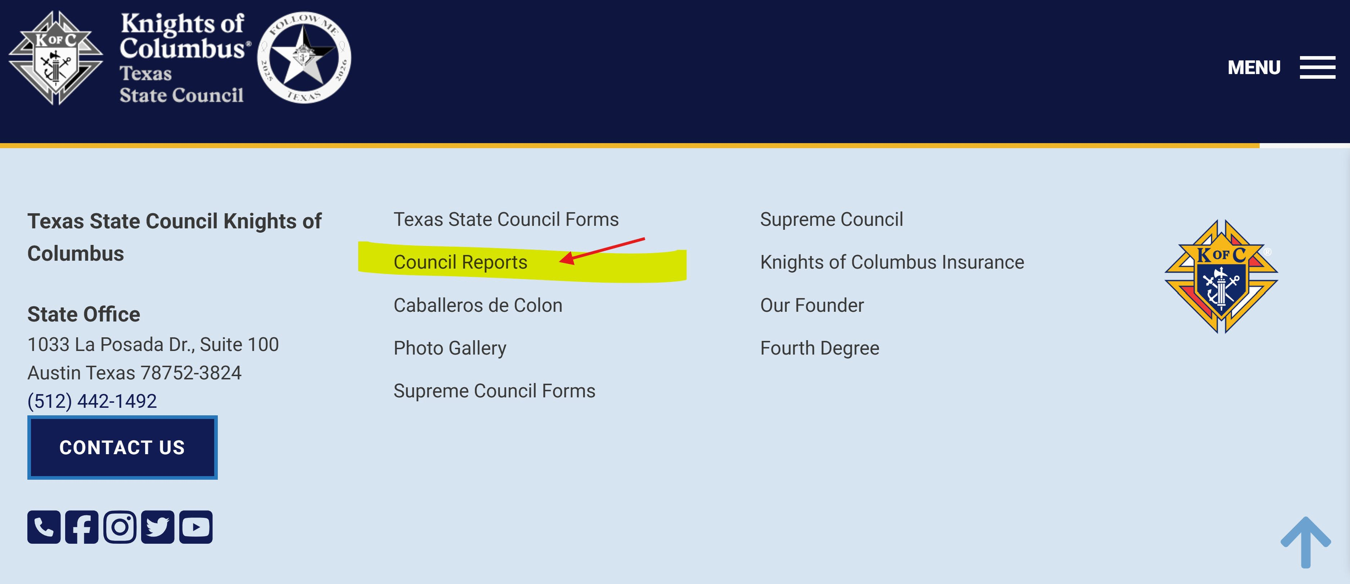
At the State website (www.TKofC.org) proceed to the blue ribbon at the bottom of the home page. Click Council Reports

Slide 4
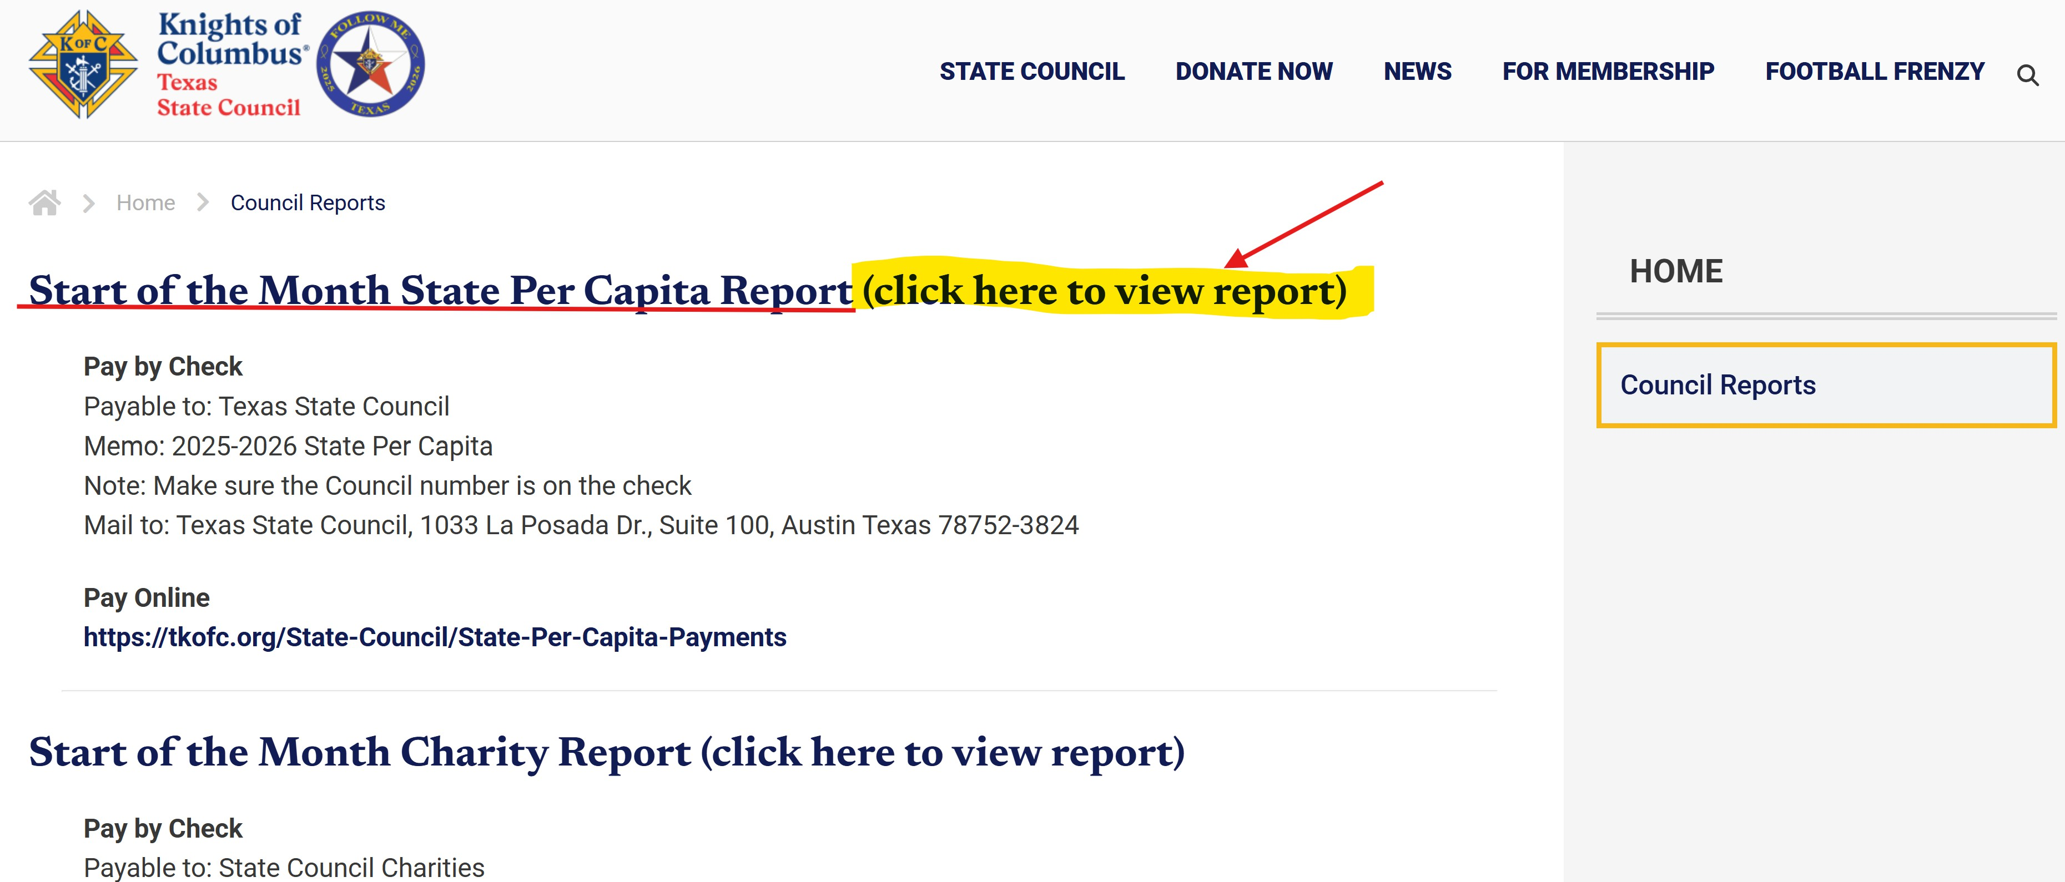
On this page click the “view report” tab

Slide 5
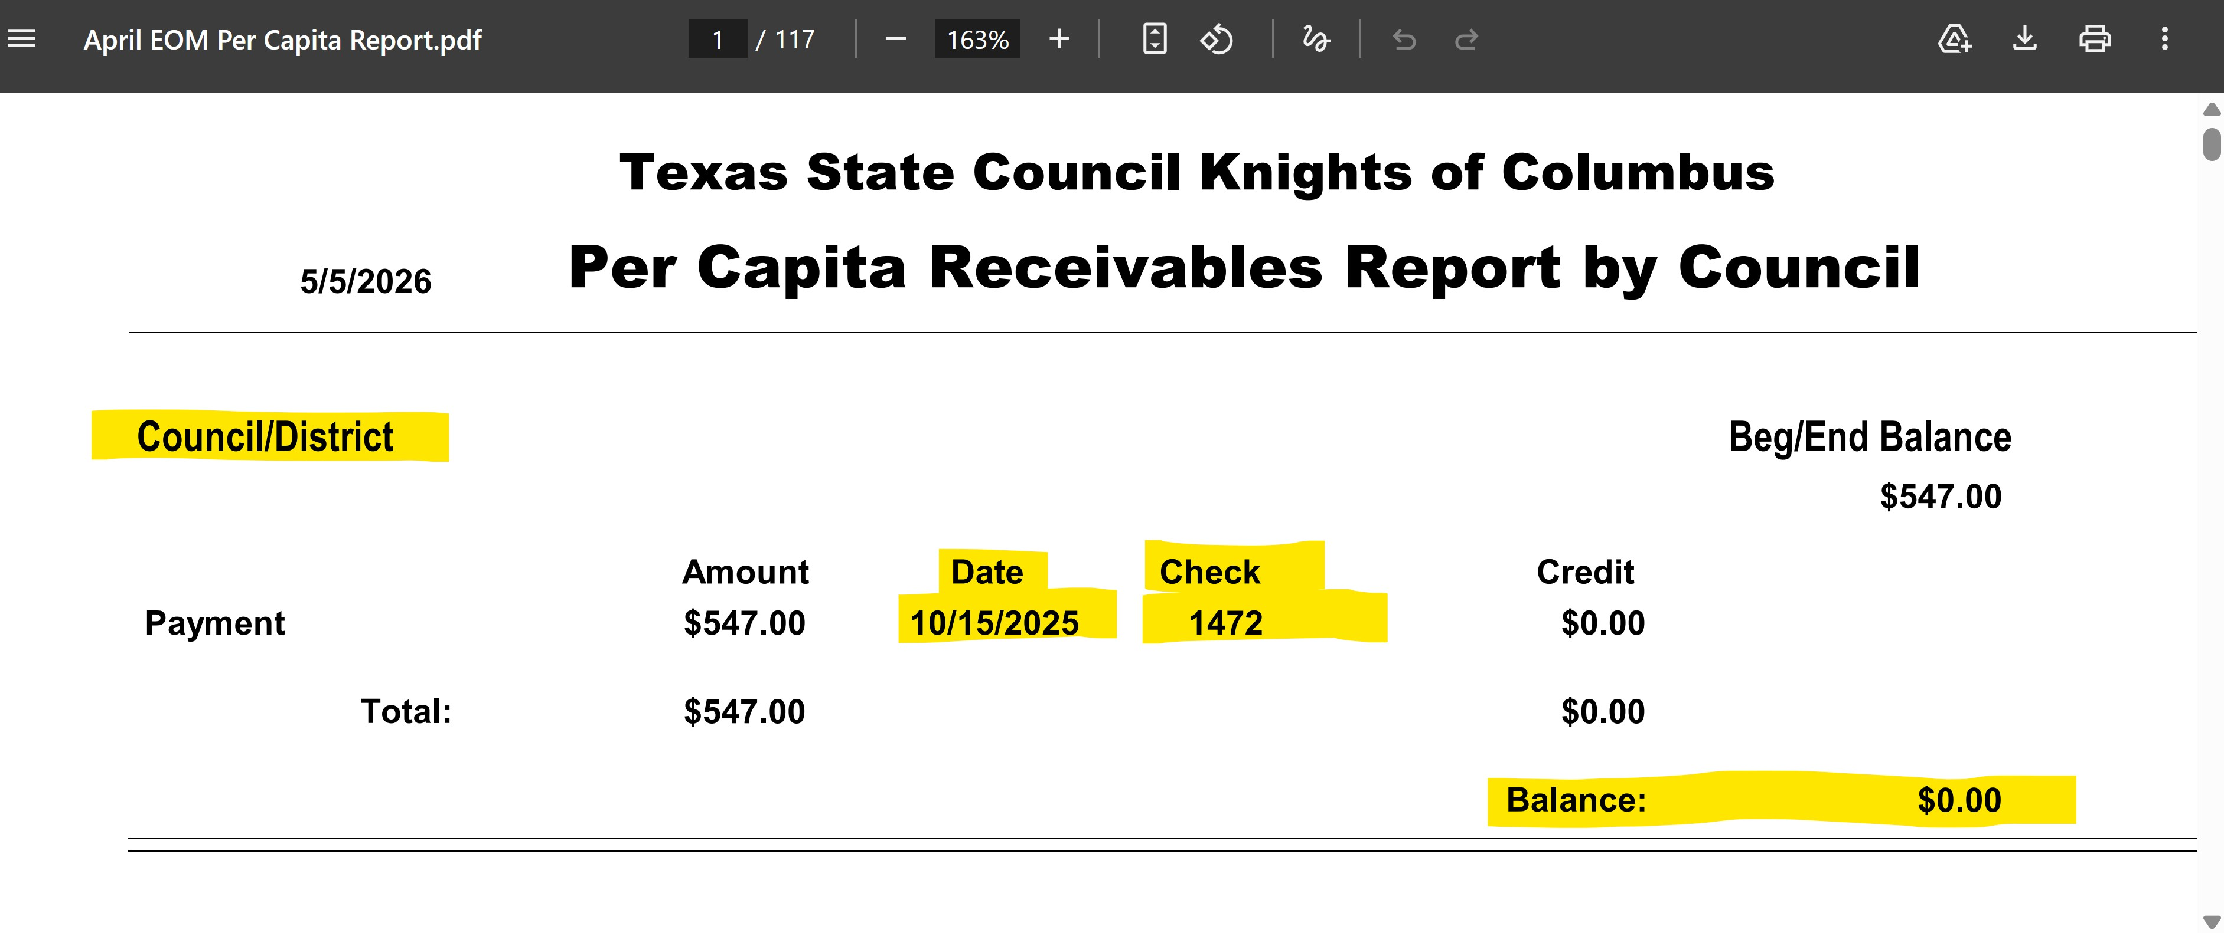
In the report scroll down to the correct council to obtain amount owed. If a payment has been made the report will show the check number and date

Slide 6
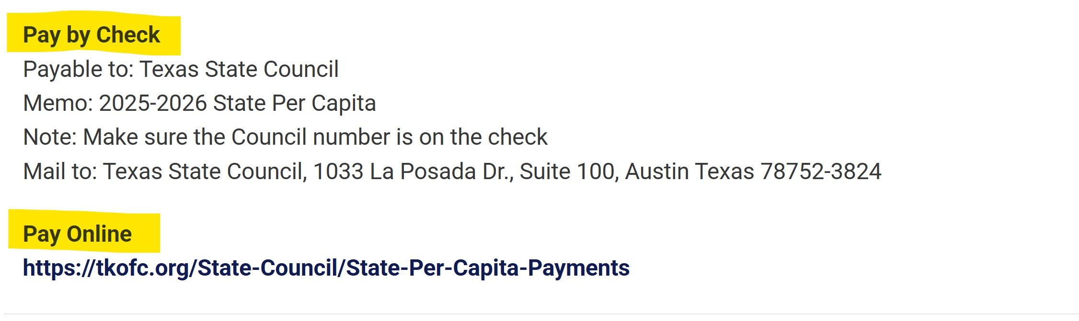
Payment Methods

Slide 7
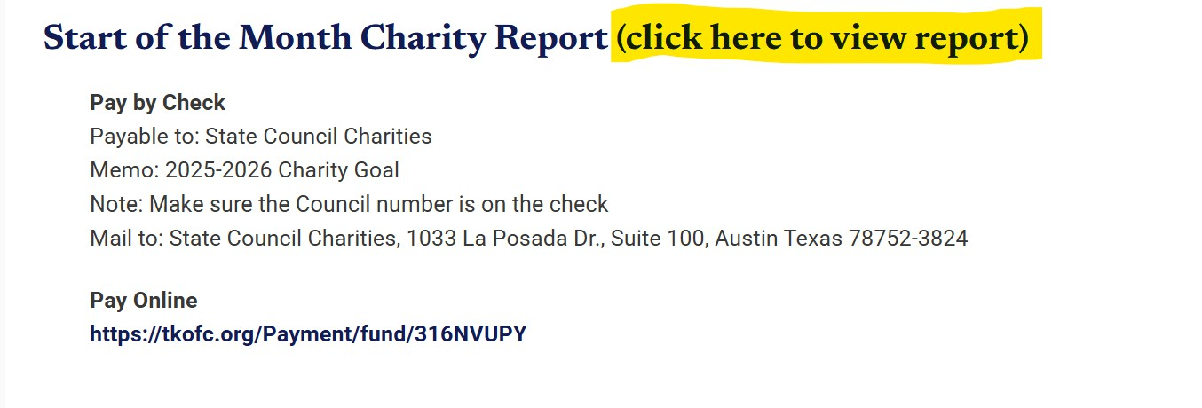

Proceed back to the second page of the website and under the per capita link there is the State Charities link and info. Click on the charity link.

Slide 8
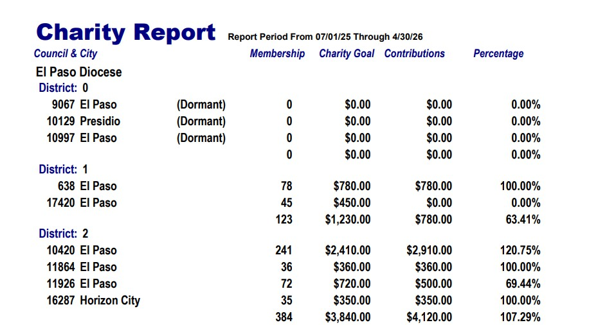
In the report scroll down to find your council and the amount that is owed
…and mail in the payments.

Slide 9
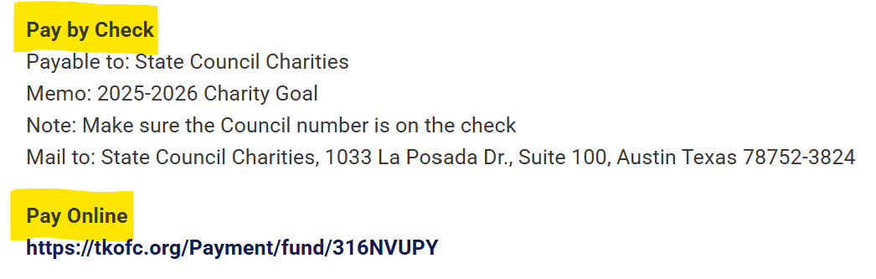
NOTE:
This payment method is different than the Per Captia. Two checks needed !

Slide 10

Pls pass this info on. We are asking every DD to over communicate this new method of obtaining state billing documents.
Councils are responsible for their on-time payments.

Slide 11
Texas State Council
Safe Environment

Slide 12
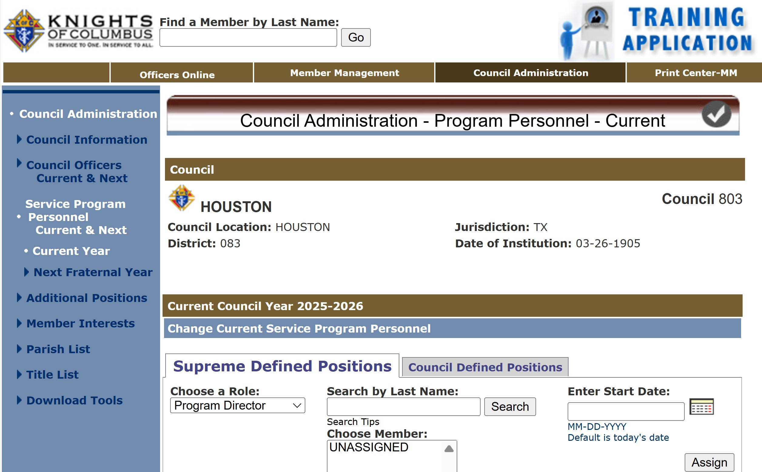

The very 1st step of this program is….
Councils Must Fill and Submit Forms 185 and 365 correctly and on time !
Enter all appointments online via member management
There must be a Grand Knight assigned via Form 185
There must be three different members assigned to the Program, Community, and Family Director roles assigned via Form 365
Watch this video to learn how to submit both forms online:
https://players.brightcove.net/802593642001/y6FLiIa0f_default/index.html?videoId=6191938577001

Slide 13
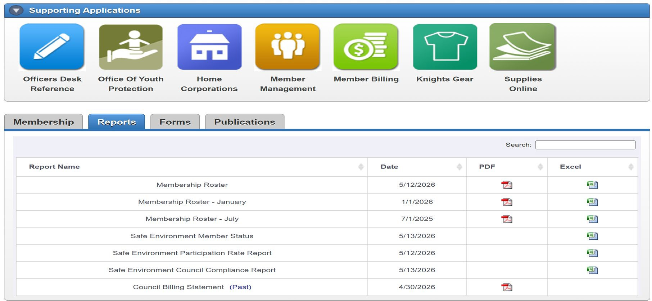
Key Leaders on Required Roles
Grand Knight
Program Director
Family Director
Community Director
All roles above must complete the Safe Environment training. The Community Director and the Family Director must also provide consent for a background screening (criminal and motor vehicle records).
All members who have access to Officers Online may view the safe environment status of their council or jurisdiction each week on the Reports tab.

Slide 14
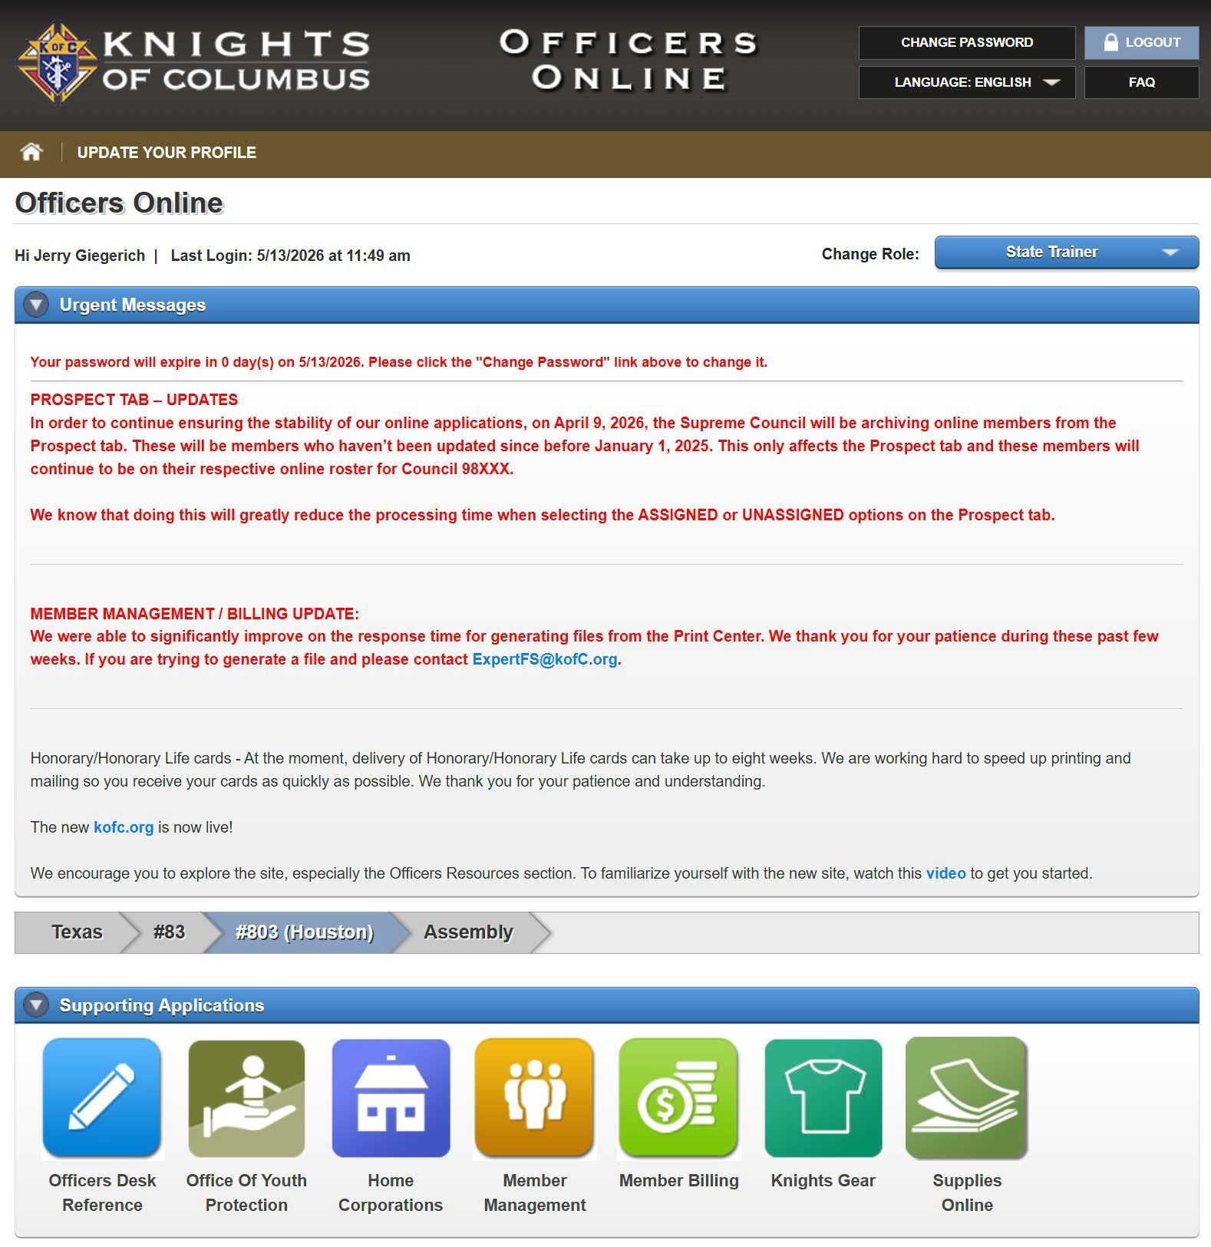

Get Started with Training
From the main page in Officers Online click the
“Office of Youth Protection”
tab

Slide 15


At this screen click on the
“Required Training” tab

Slide 16
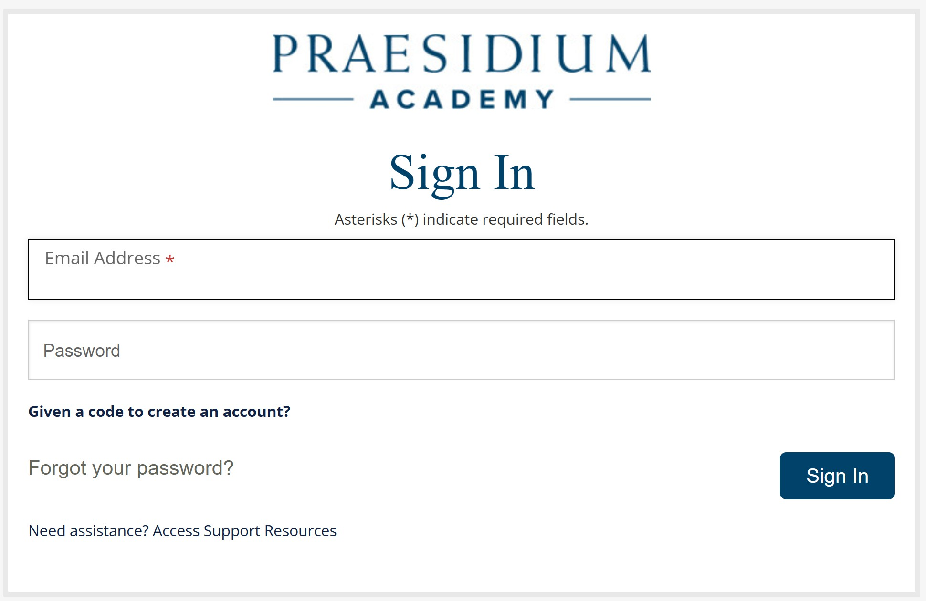
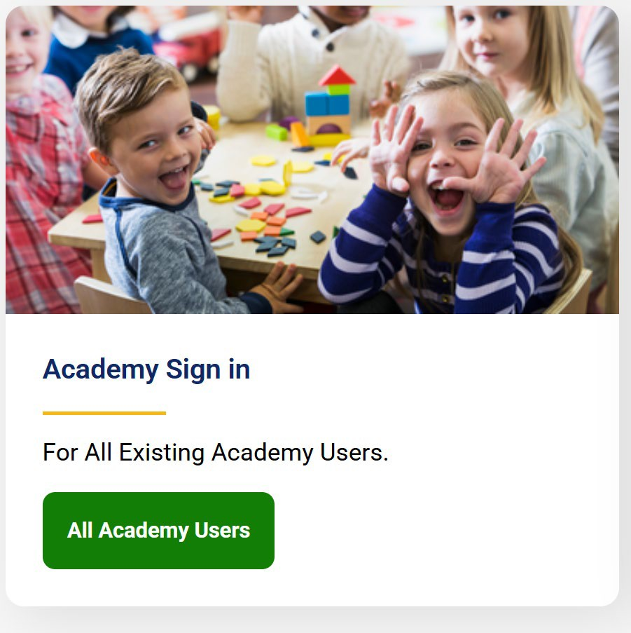
On the next page, the below tab will be one of your choices.
Click this tab to proceed.
On the following screen will be the sign in page for the academy.
This is where officers use the special login & password that was emailed to them from Supreme.
This would have been generated if the 365 is filled out correctly and on time.

Slide 17
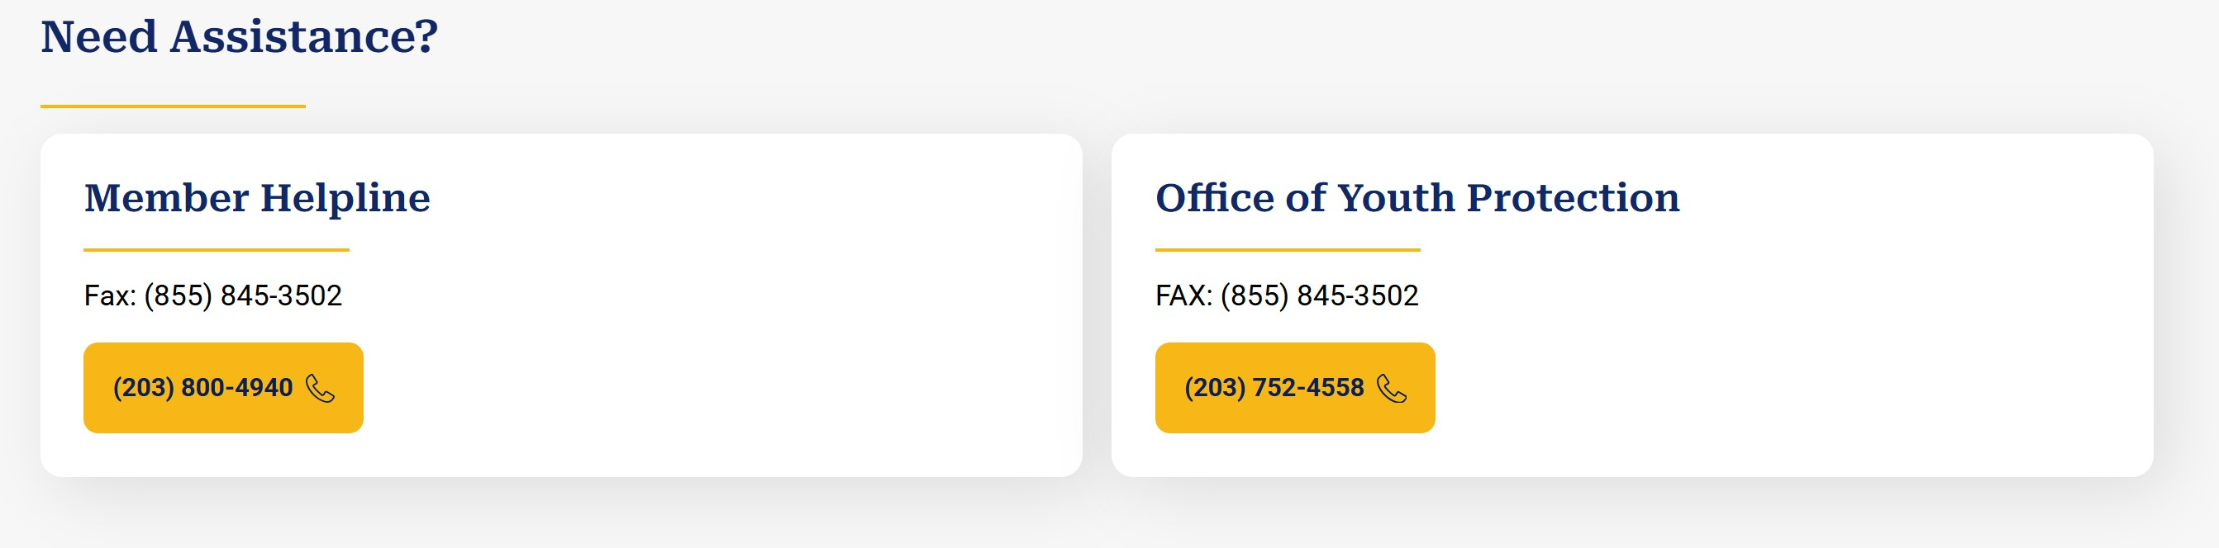
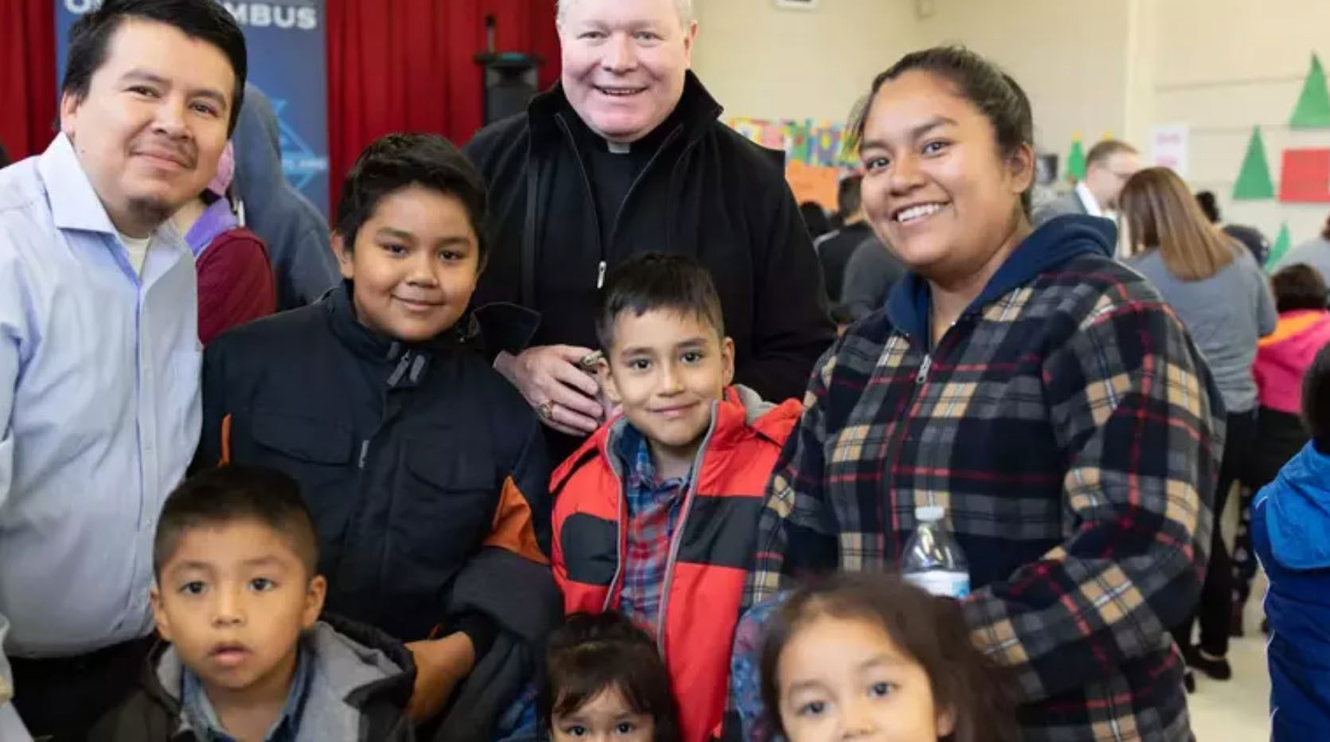

Slide 18

Texas State Council
Reporting CUF Ceremonials

Slide 19
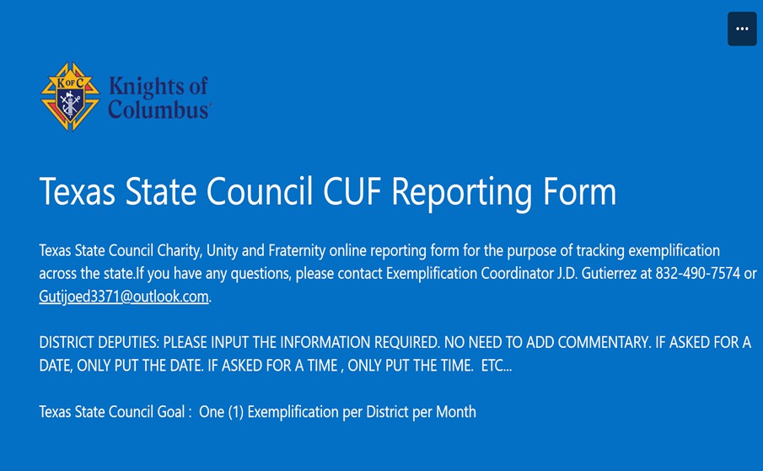


Texas State Council Charity, Unity and Fraternity online reporting form
Please contact new Exemplification Coordinator Tony Scarpa 832-457-5150
scarpaap@yahoo.com
Dallas Diocesan Chapter needs to know as well. Send to admin@kofcdallas.org

Slide 20
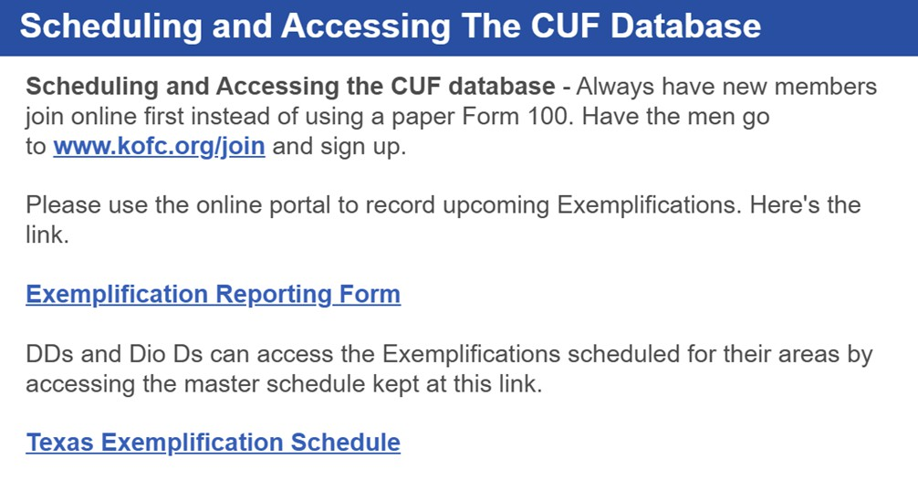
For your needs a link to the reporting form will be posted to the membership department weekly newsletter

Slide 21
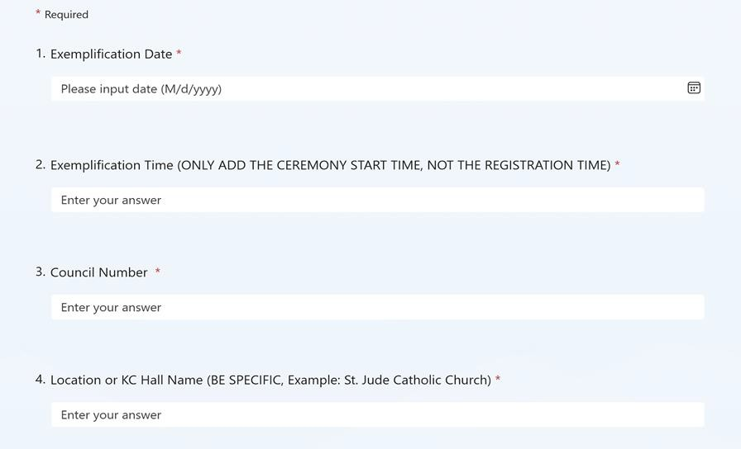
The purpose of the TSC exemplification reporting schedule is to track all exemplifications across Texas. Additionally, each district needs to reach the goal of one exemplification per month
Please fill out the form completely

Slide 22
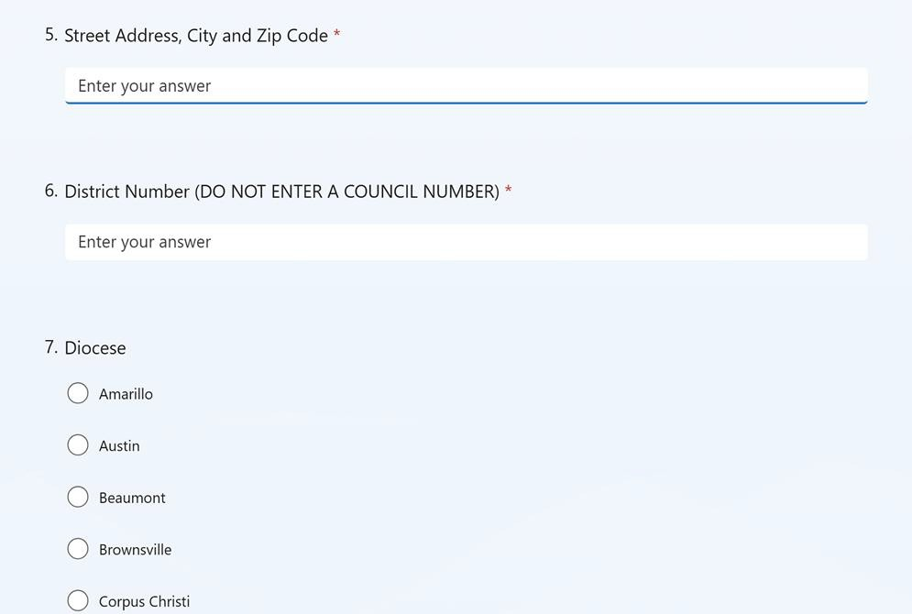

A Diocese must be selected
A complete Diocesan listing
is posted to the live form…

Slide 23
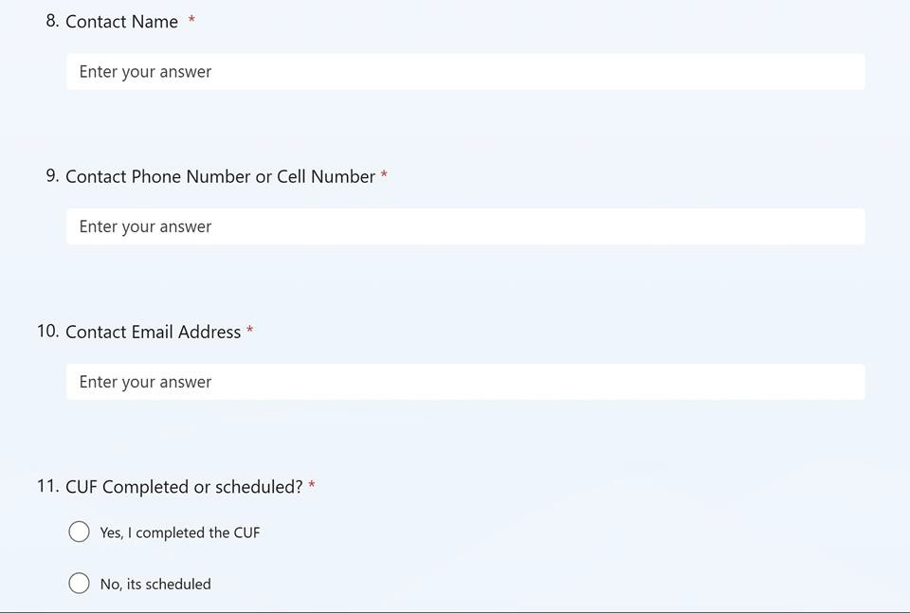

Slide 24
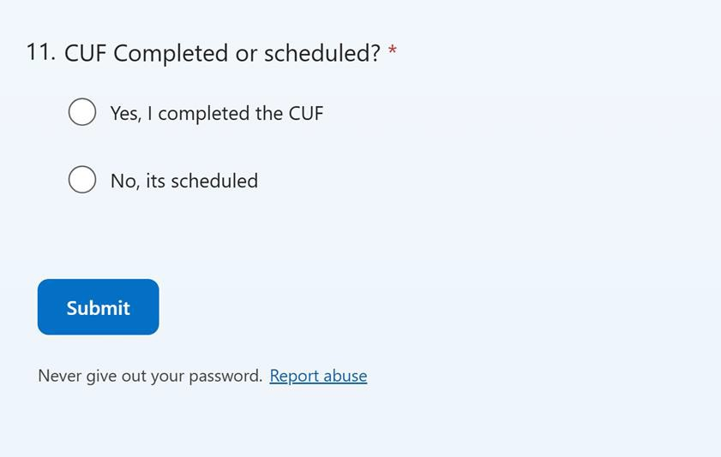
Your completed form is sent to the Exemplification Coordinator
Tony will then review and post your form to the exemplification schedule
Before clicking the submit button
check all your work for accuracy
These schedules can be viewed by all at state website www.TKofC.org

Slide 25
Special Notes
If you are unsure or have problems like a mistake in the form
Or part of the entry changed
Or your CUF was postponed
Or your CUF was cancelled
Or any other problems not described
Send an email to Tony Scarpa at scarpaap@yahoo.com
Subject line should read “Change request – exemplification”

Slide 26
2025-26 Dallas Diocese
Short term Priorities
Complete the annual council audit by 8/15/2026
Pay State Charities and State per Capita by 8/30/2026
DD - District Deputies submit Form 944 by 8/30/2026
K of C Safe Environment completion by 9/28/2026
DD - Schedule ONE CUF per district starting in July 2026

